Slide 1
Exploring Open Badges in HE.
A 2-year journey at the University of Sussex.
Dr Anne Hole, FHEA, CMALT
Technology Enhanced Learning
University of Sussex
@AnneHole
@SussexTEL

Slide 2

Notes:
new TEL team at Sussex January 2014
looking around the sector - badges gaining attention
Suzanne Scott at Borders College
wanted to try for ourselves
what are they?
how do they work? (processes)
are they useful in HE?

Slide 3

Open Education Week 2014
Notes:
experiment - proof of concept
Open Education Week March 2014
try out design, creation, claim and issue processes
Credly
Google form
manual issue
awarded for participating in at least one of the events during the week
internal and external participants
good proportion claimed badges

Slide 4


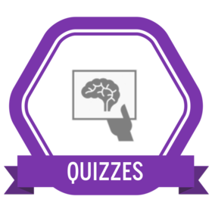

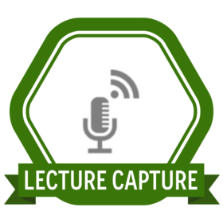

TEL badges for teaching staff
Notes:
TEL open badges project
raise awareness of open badge concept
explore practicalities of badging
recognise CPD in open format
motivate to attend more workshops
the TEL badges
a family of badges
linked to TEL workshops
clear criteria and evidence embedded - mapped to session learning outcomes

Slide 5



Badging 10 Days of Twitter
10DOTTEL was adapted from Ten Days of Twitter for Learning Developers by Helen Webster @scholastic_rat which is licensed under a Creative Commons Attribution-NonCommercial-ShareAlike 3.0 Unported License.
Notes:
Helen Webster’s online course for learning to use Twitter - CC-licensed
we ran it tailored for teaching staff June 2014
we added badges
3 stages
criteria and evidence linked to activities in course
Hatched: set up profile and send at least 5 tweets.

Slide 6


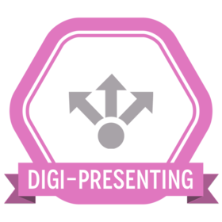

More TEL badges for 2014/15
Notes:
as more workshops developed
more badges created

Slide 7



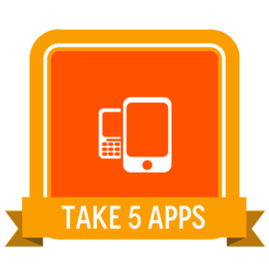
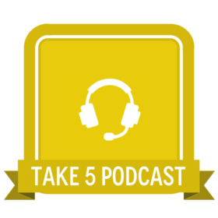
Take 5 bitesize online courses - June/July 2015
Notes:
new format for US - based on Take 5 created at University of Dundee 2011 http://www.dundee.ac.uk/learning/take5/blogs/attribution.htm
badge for each
criteria: complete Day 4 activity (which creates evidence) and score 80% or more in final short quiz
evidence example: Take 5:Open - remix OERs you have found

Slide 8

Notes:
too many badges and issuers dilute value?
started thinking about mapping to established CPD frameworks
Phil Vincent, YSJ presented at SEDA 2014 about mapping badges to UKPSF, Vitae RDF, SEDA PDF
UKPSF ‘The use and value of appropriate learning technologies’ hard to map to individual topics/badges

Slide 9
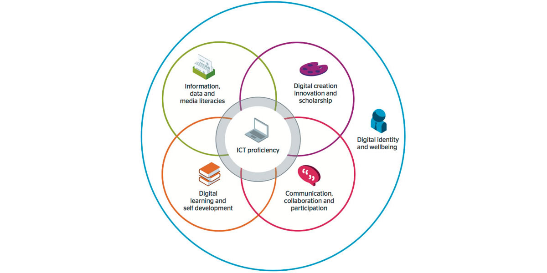
Digital Capabilities
Jisc Digital Capabilities
Digital capabilities: the six elements
©Jisc
CC BY-NC-ND
Notes:
Jisc Building Digital Capabilities project (Helen Beetham and others)
teacher, learner and researcher profiles
matches granularity of open badges

Slide 10
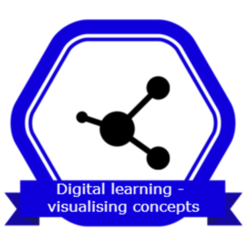
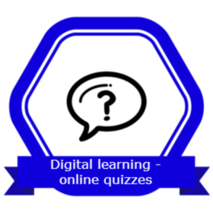
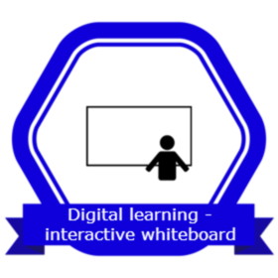
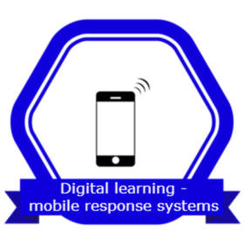


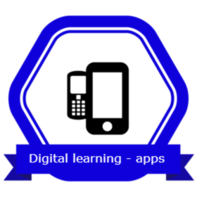
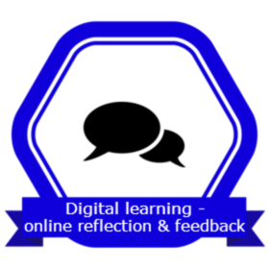
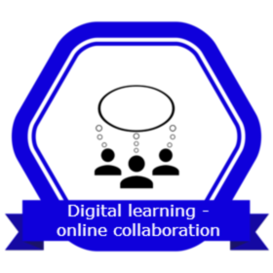

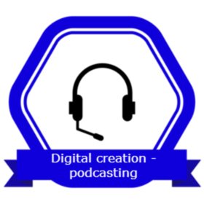




TEL badges mapped to Jisc Digital Capabilities
Notes:
current TEL badges
http://digitalcapability.jiscinvolve.org/wp/files/2015/11/Digital_capabilities_teacher_profile.pdf

Slide 11
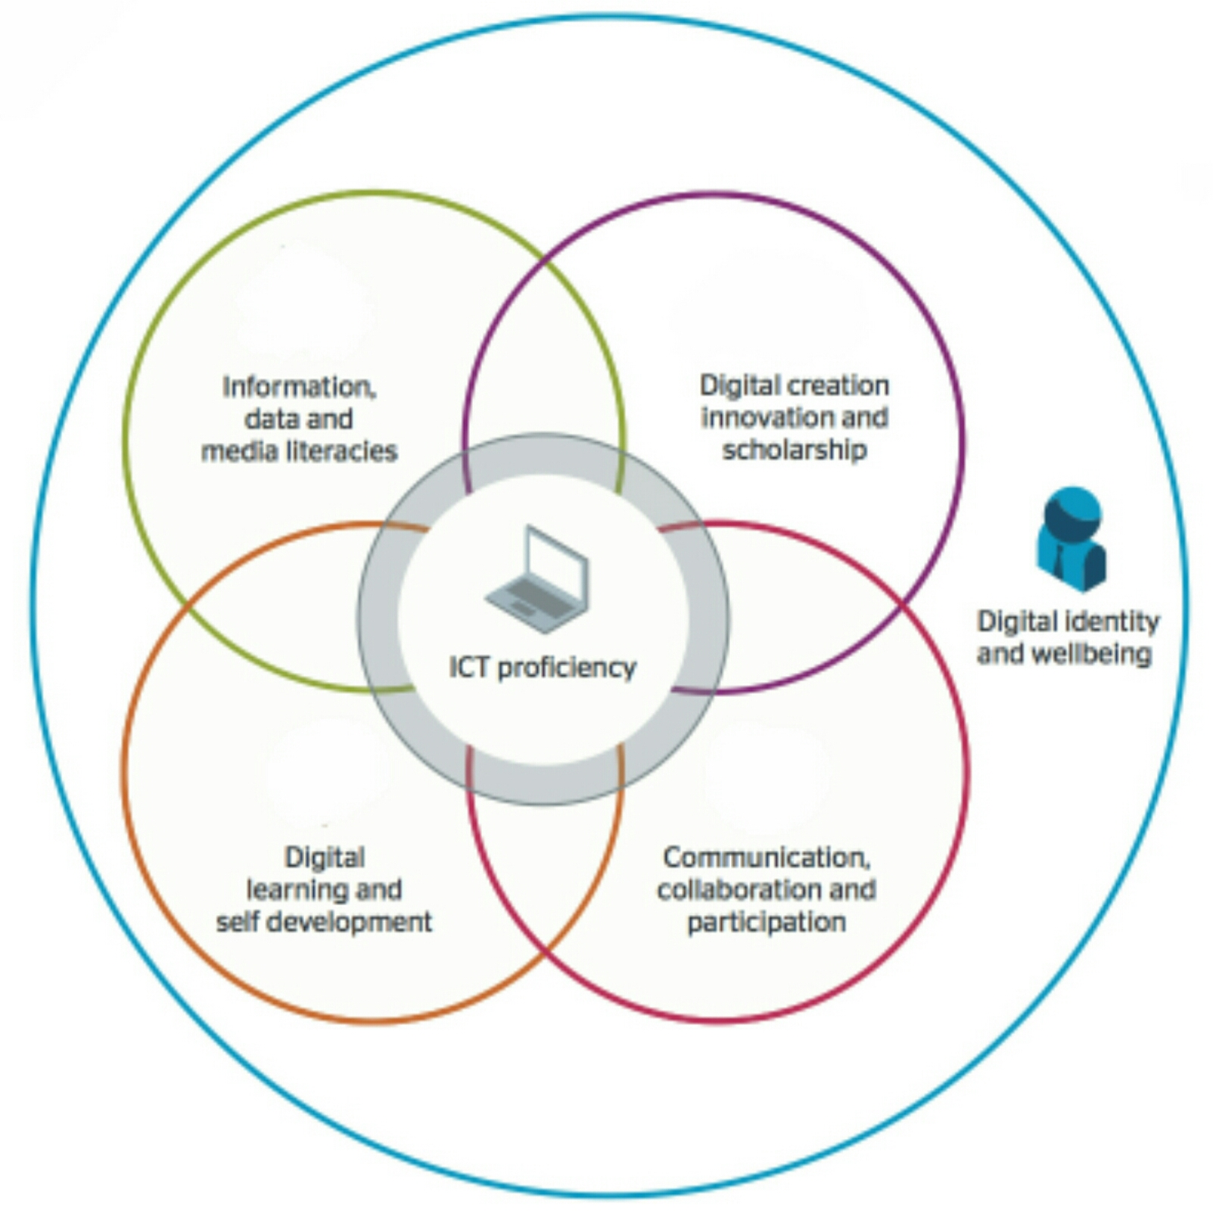
Notes:
badges now linked to digital capabilities rather than workshops
face-to-face workshops and online courses awarding same badge

Slide 12


Student Representatives
online training
recognised by
an open badge

Slide 13
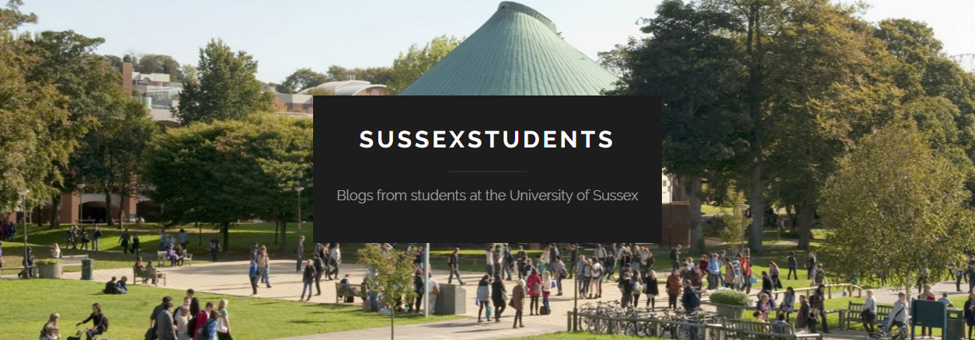
Badges for student bloggers
Student bloggers https://sussexstudents.wordpress.com/

Slide 14

Did we get where we wanted to be?
flickr photo by markbult https://flickr.com/photos/espd/1274207078 shared under a Creative Commons (BY-NC-ND) license
Notes:
explored practicalities of badging
gained expertise to help others in uni
raise awareness of open badge concept
over 100 individuals on Take 5s alone
interest from
Staff Development,
Careers,
Doctoral School (RDF),
Widening Participation,
try badges for open CPD recognition
could work,
would be best if all Staff Development used them
not sure how highly academics value this type of CPD.
motivate to attend more workshops
worked for a few

Slide 15

Where next?
flickr photo by theglobalpanorama https://flickr.com/photos/121483302@N02/16333918448 shared under a Creative Commons (BY-SA) license
Notes:
Student Rep online training being extended - with more badges.
continuing conversations with other professional services
consulting
exploring more options, platforms and tools as they develop.

