Slide 1
Using WordPress as a badge platform
Open Badges in HE
8th March 2016
Martin Hawksey
@mhawksey
Chief Innovation, Technology and Community Officer
This work is licensed under a Creative Commons Attribution 4.0 License. CC-BY mhawksey

Slide 2
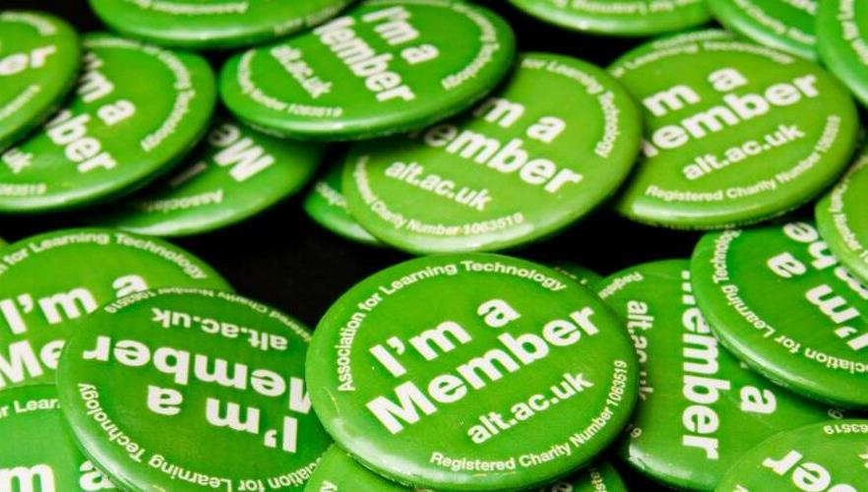
go.alt.ac.uk/join-ALT

Slide 3
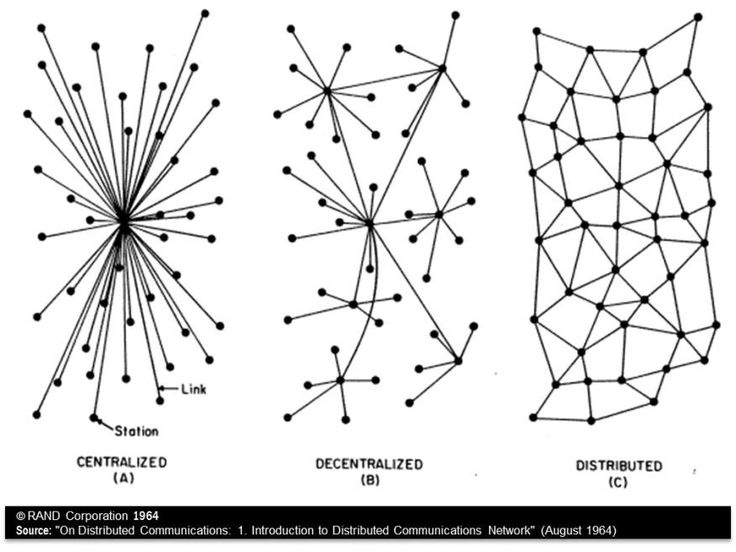
Notes:
“The pioneering research of Paul Baran in the 1960s, who envisioned a communications network that would survive a major enemy attacked. The sketch shows three different network topologies described in his RAND Memorandum, "On Distributed Communications: 1. Introduction to Distributed Communications Network" (August 1964). The distributed network structure offered the best survivability.”

Slide 4
Education today is…
Notes:
“The pioneering research of Paul Baran in the 1960s, who envisioned a communications network that would survive a major enemy attacked. The sketch shows three different network topologies described in his RAND Memorandum, "On Distributed Communications: 1. Introduction to Distributed Communications Network" (August 1964). The distributed network structure offered the best survivability.”

Slide 5
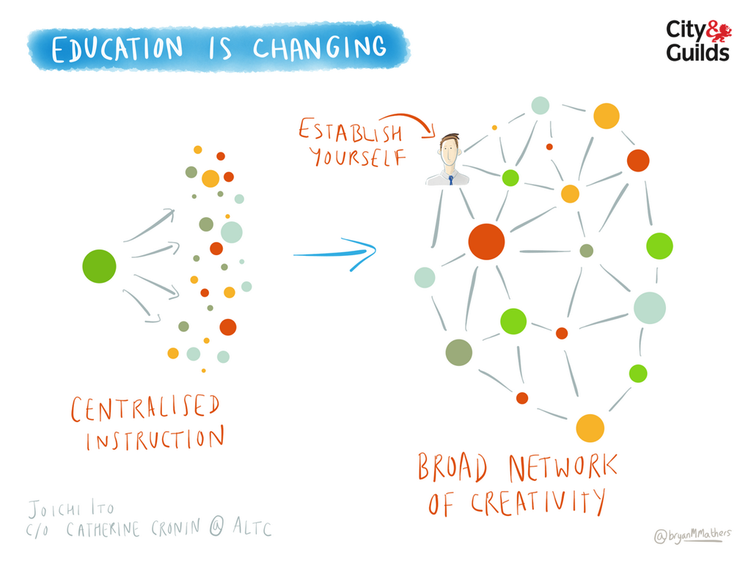

©Bryan Mathers
https://flic.kr/p/p2UJ5d

Slide 6
Accreditation today is…
Notes:
“The pioneering research of Paul Baran in the 1960s, who envisioned a communications network that would survive a major enemy attacked. The sketch shows three different network topologies described in his RAND Memorandum, "On Distributed Communications: 1. Introduction to Distributed Communications Network" (August 1964). The distributed network structure offered the best survivability.”

Slide 7

Open Badges Anatomy
Kyle Bowen
http://classhack.com/post/45364649211/open-badge-anatomy-updated

Slide 8
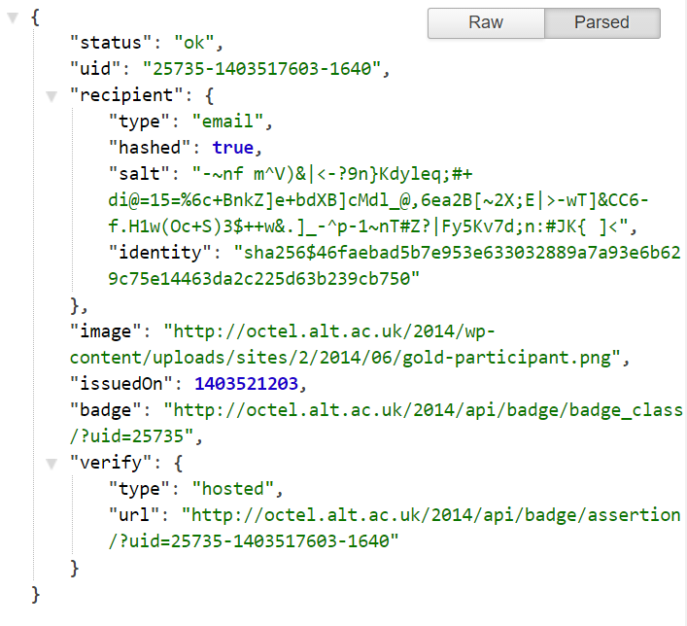
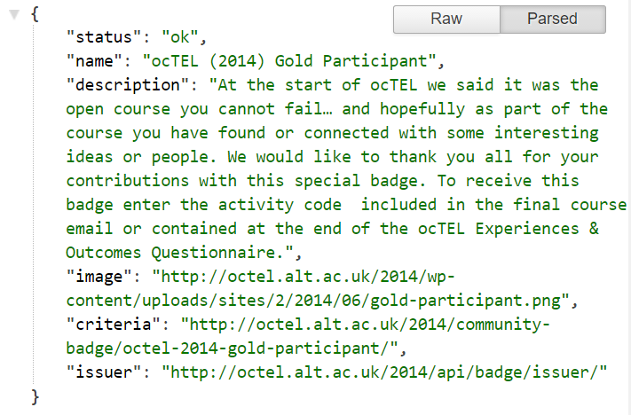
Badge … {JSON}

Slide 9


Administration
Alan Levine (cogdog)
https://flic.kr/p/pJRL8k
Notes:
Administering json files?

Slide 10

Wordpress
WordPress
Alan Levine (cogdog)
https://flic.kr/p/7ZBbUk
Notes:
Difference between self-hosted and .com
Plugin architecture

Slide 11
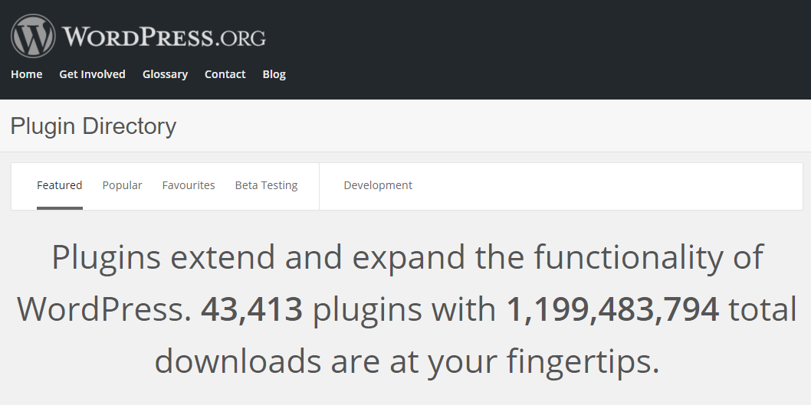
Wordpress Plugins

Slide 12

Single sign-on/registration
SSO - Single Sign On
Official GDC
https://flic.kr/p/r8r2Gn
Notes:
Single sign-on, federated access

Slide 13
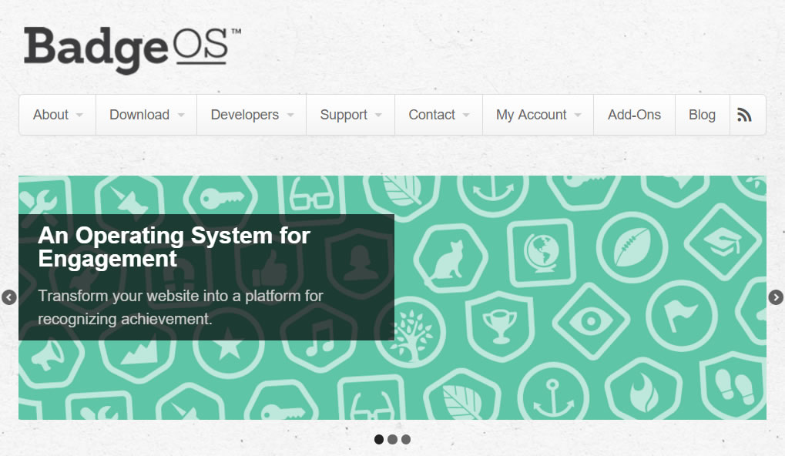
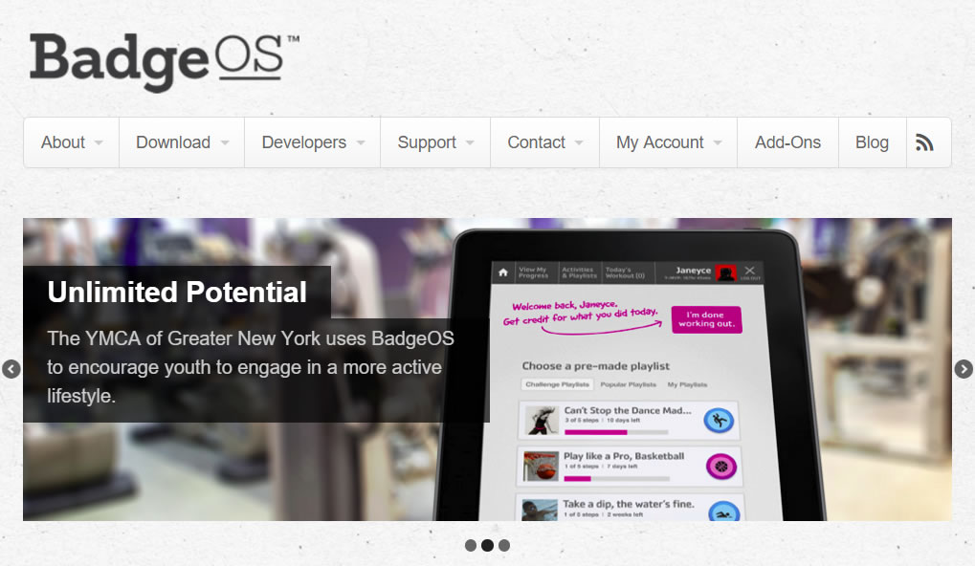
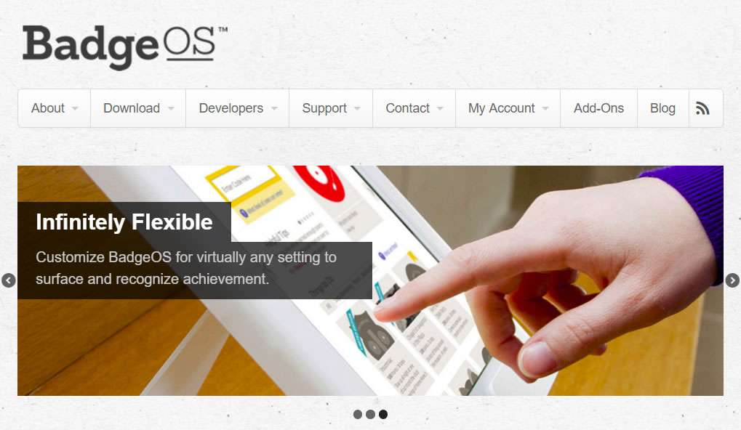
BadgeOS
Notes:
BadgeOS plugin for wordpress. Lets you create digital badges with the option to integrate with Credly

Slide 14
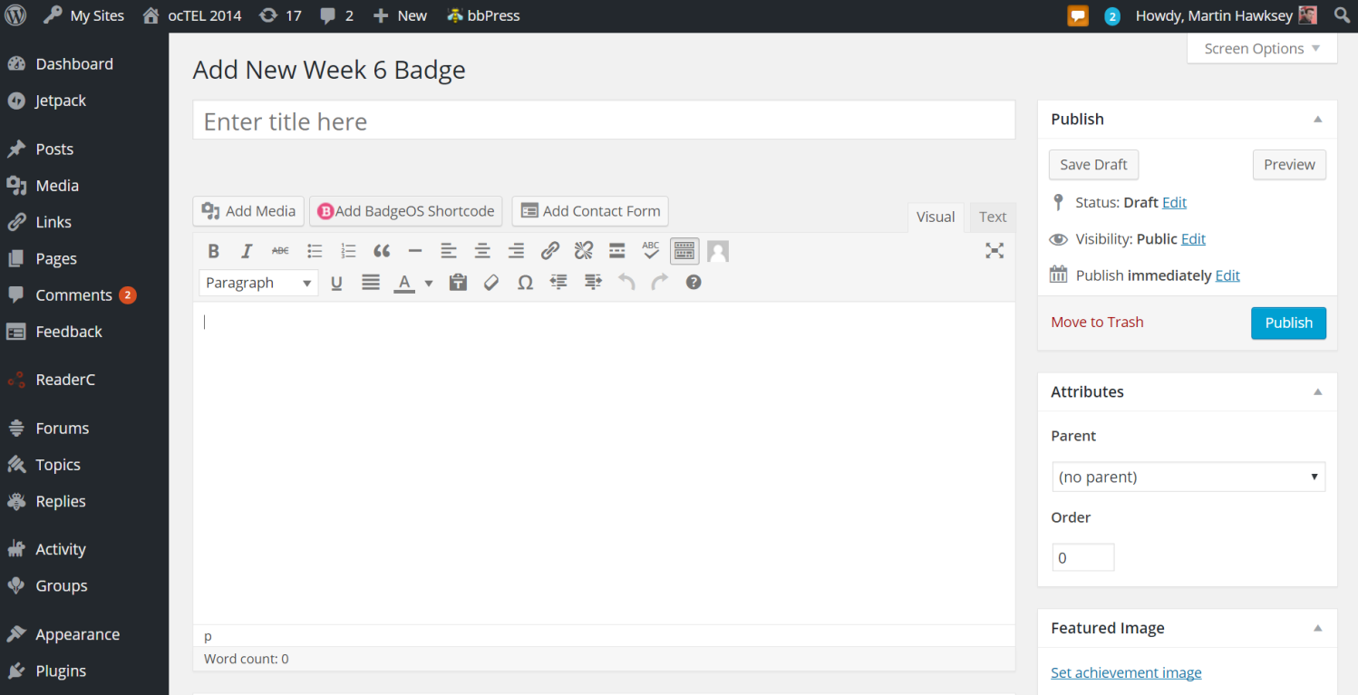
Make a badge
Notes:
Badge design is relatively straight forward. Embed badges in pages

Slide 15
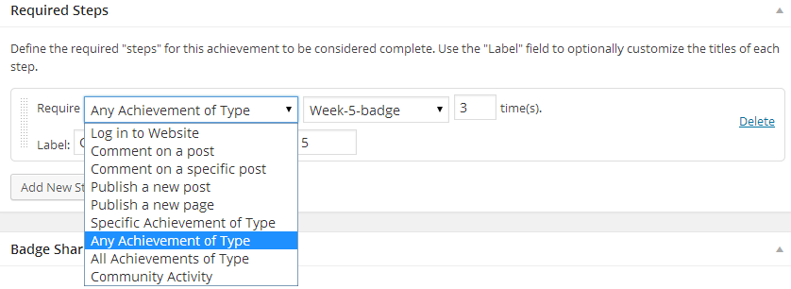

Slide 16
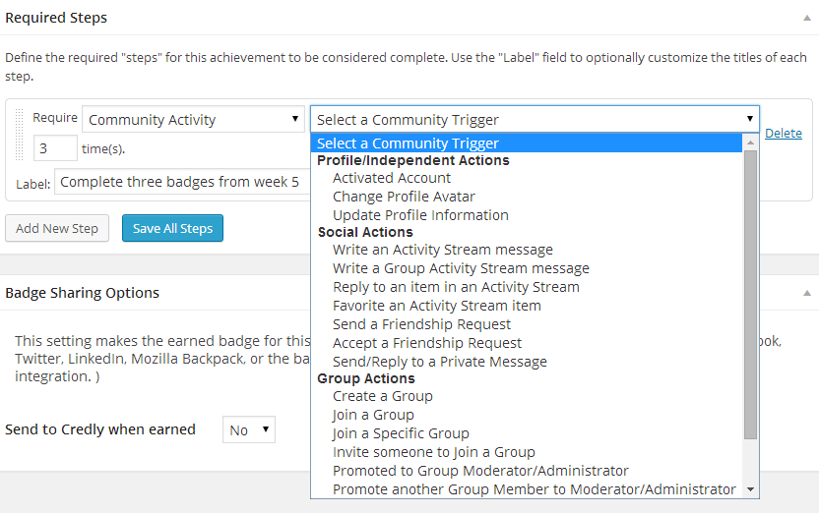
Notes:
… with some nice design features

Slide 17
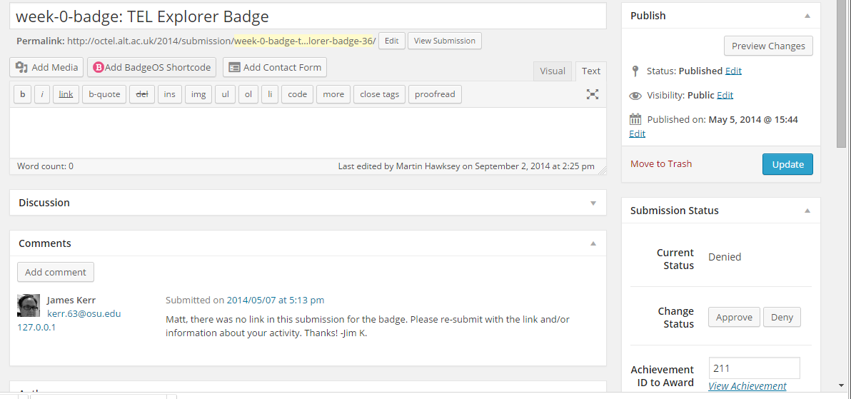
Reviewed

Slide 18

http://octel.alt.ac.uk/2014/

Slide 19
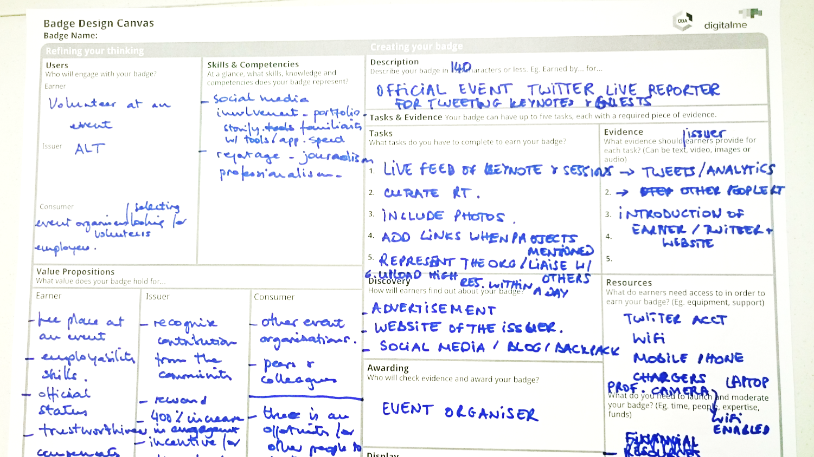
Badge Design/Lessons Learned

Slide 20

Digital First
Christiaan Colen
https://flic.kr/p/x9G5bQ

Slide 21
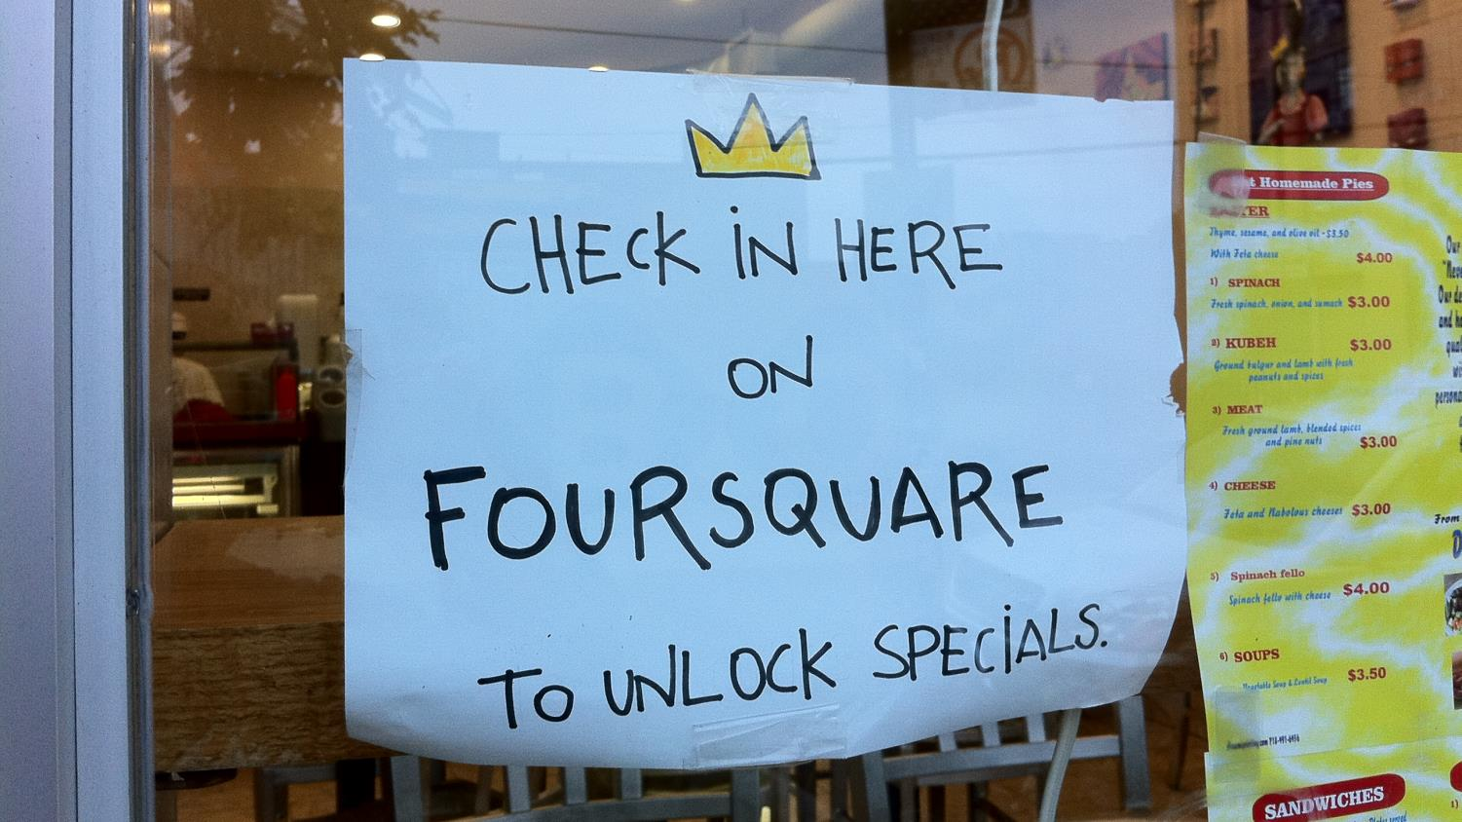

How do you feel about ‘check-in’?
Sean Salmon
https://flic.kr/p/8Ejors

Slide 22
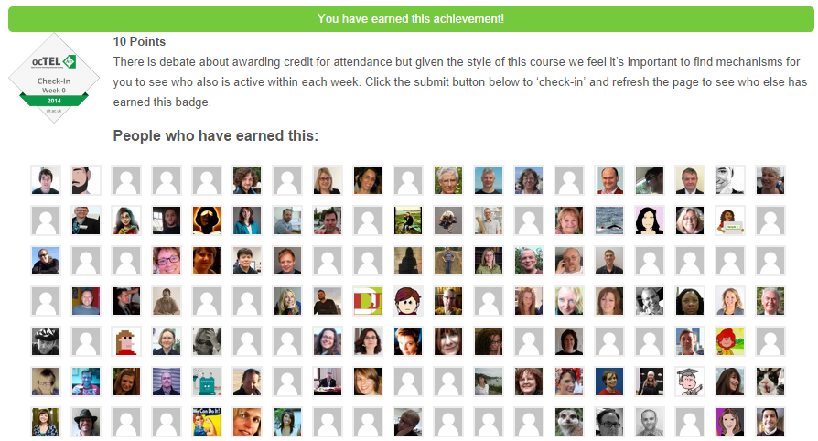
Situational awareness
Situational awareness

Slide 23
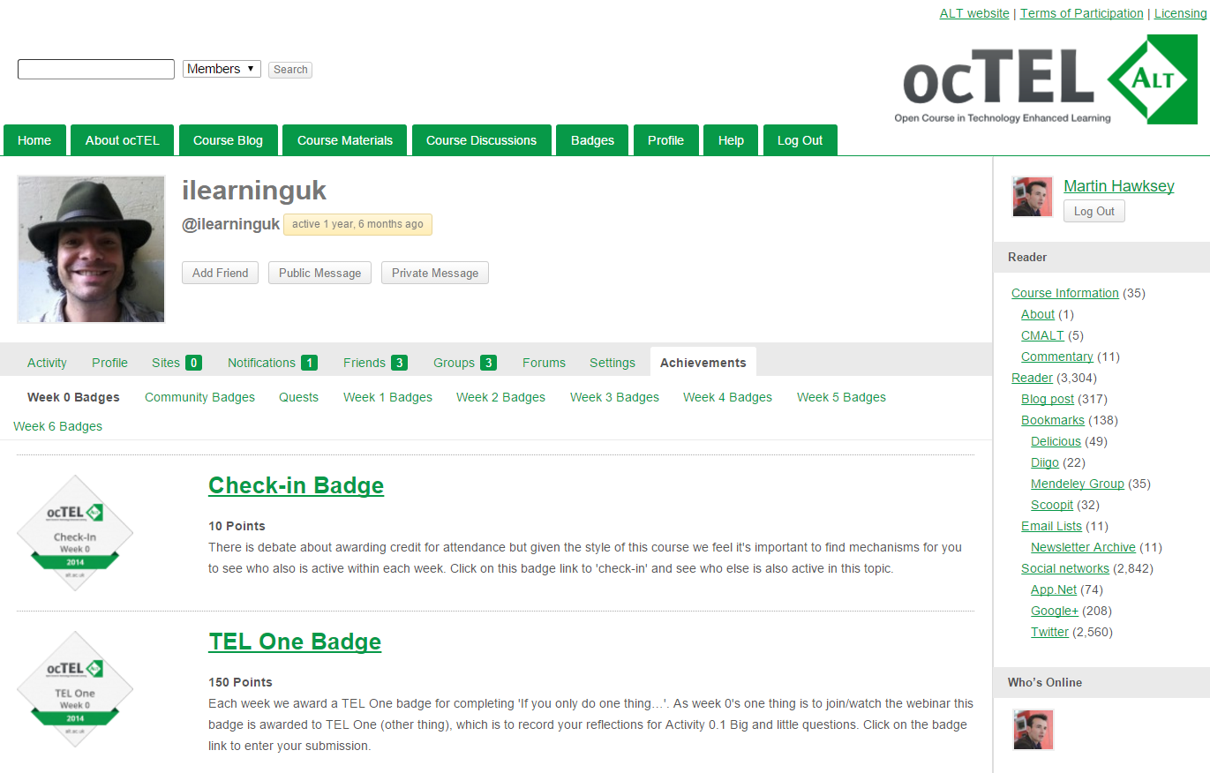
Learner profiles (BuudyPress)

Slide 24





Badge Pattern

Slide 25
Badge Pattern

Slide 26







Badge Pattern

Slide 27
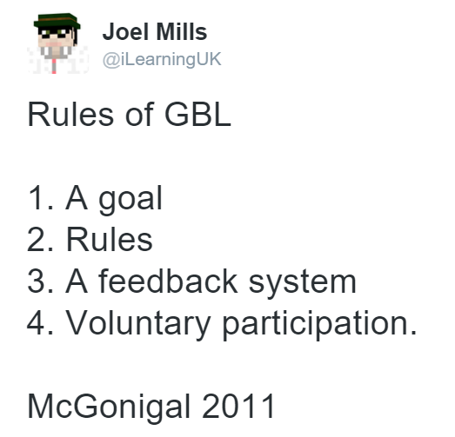
Opt-in

Slide 28

Going Open

Slide 29

Transitions
Transitions
Edmond Tsang
https://flic.kr/p/kFVdVT

Slide 30
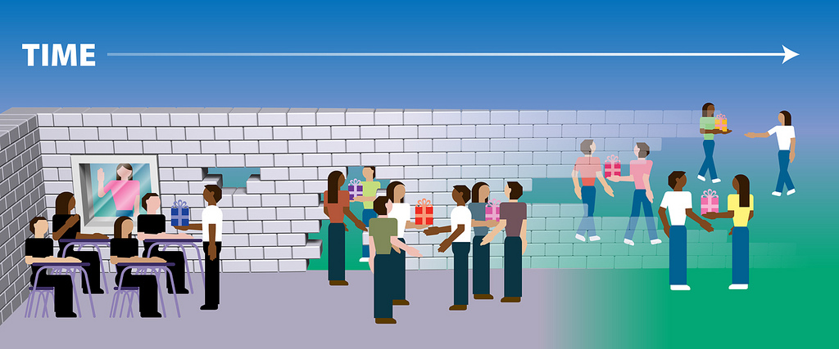

vulnerability
©Alec Couros
https://flic.kr/p/64ZQkd
Notes:
Having a closed space I think is important when you consider how vulnerable the learning process can be. It can be daunting to put your hand up in the perceived safety of a classroom, paralysing when it’s the world than might question your view. In commenting on ‘The vulnerability of learning’ George Siemens says:
“Learning is vulnerability. When we learn, we make ourselves vulnerable. … While the learning process can’t be short-circuited, and the ambiguity and messiness can’t be eliminated, it is helpful for educators to recognize the social, identity, and emotional factors that influence learners. Often, these factors matter more than content/knowledge elements in contributing to learner success.”
It’s impossible to eliminate vulnerability but you can counter it with confidence. There are various ways to build learner confidence and in an open/distributed context Alec Couros’ conceptualisation of ‘thinning the walls’ illustrates what is required in scaffolding an experience from a classroom or course to a more open/distributed setting.

Slide 31
Self-declared
To submit your evidence for this activity use the form below … these may include links to blog posts, forum responses or other evidence including links messages posted on sites like Twitter or Google+, our only stipulation is that these links are public

Slide 32

Email – identity issue
Identity
Steve Snodgrass
https://flic.kr/p/9mjS2L

Slide 33


Thank you!
+MartinHawksey
@mhawksey

