Slide 1
EPSRC HubNet
Defining the future research roadmap in electrical energy networks
Prof Paul Lewin 22 May 2012
Notes:
Please use the dd month yyyy format for the date for example 11 January 2008. The main title can be one or two lines long.

Slide 2
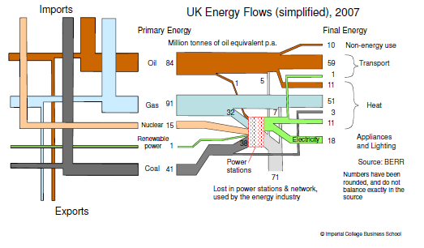
The future energy mix
What if by 2050, transport of bulk energy is predominantly electrical?

Slide 3
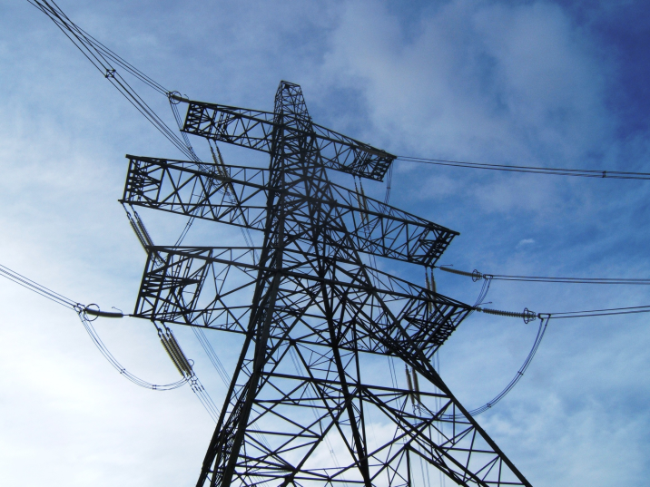
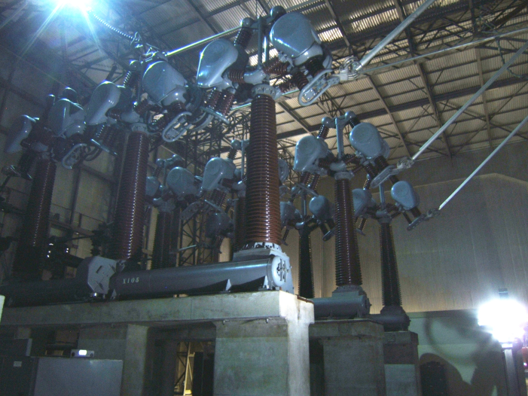
HubNet Aims
Research Leadership – ‘in-depth position papers’
Spur development of innovative solutions – sponsor speculative research in ‘unchartered areas’
Provide mechanisms for the exchange of ideas (researchers, industry, public sector)
Foster development of research proposals aligned to network needs
Interact with funding bodies (TSB, ETI, EU)
Engage/collaborate with researchers from other disciplines that will contribute to advances in energy networks
International researcher interaction
Enhance training opportunities
May’s pylon of the month
ABCB – A proper switch

Slide 4
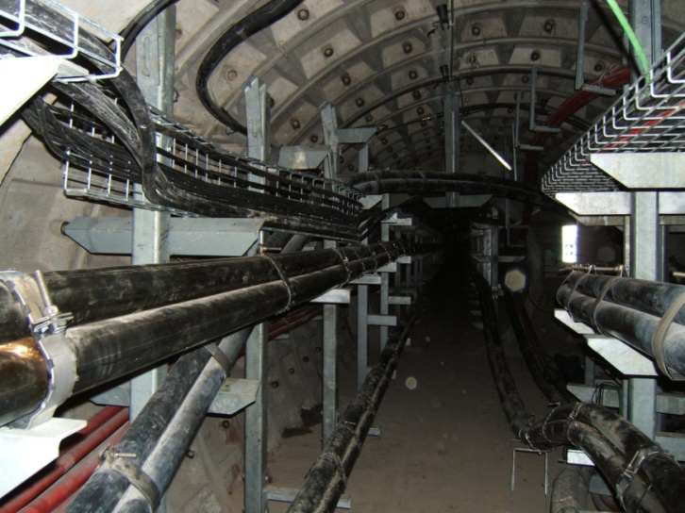
HubNet Primary Research Areas
Design of Smart Grids – application of communications technology in terms of system operation and harnessing the demand side for control and optimisation.
Mega-grids – European grid and beyond.
Management of transition assets.
New materials to improve power equipment design and performance.
Analysis of multiple energy vectors (coordinate and operate energy networks under uncertainty).
Cable Spotters Heaven

Slide 5
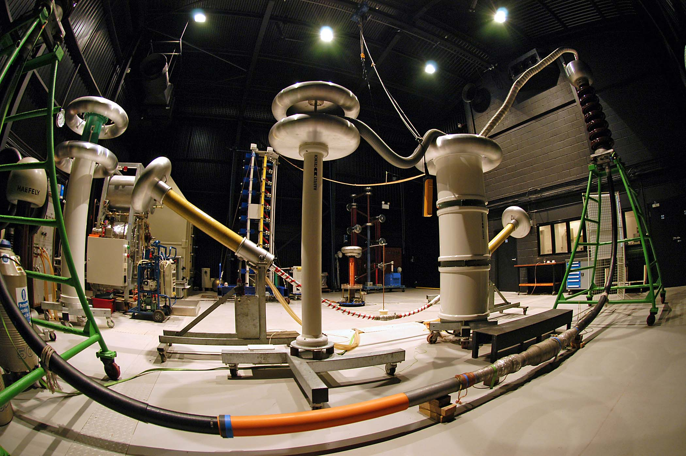
Carlsburg don’t do High Voltage Engineering…
but if they did…..
Notes:
You can use a full-bleed image to create impact on a page. Caption the image as shown.

