Slide 1
Energy Networks Grand Challenge – Transforming the Top & Tail of Energy Networks
Professor Steve Swingler (Paul Lewin & Alun Vaughan) Energy Research Away Day - 22nd May 2012
Notes:
Please use the dd month yyyy format for the date for example 11 January 2008. The main title can be one or two lines long.

Slide 2
Why Top & Tail ?
Majority of physical infrastructure will not change
Existing transmission (the ‘Middle’) needs to be smarter
A new top to connect offshore (European/wind & wave)
The Tail – difficult to change the infrastructure
A new tail - smarter operation/smarter consumers
Notes:
If using a school logo, make sure that if you have a long page title, it does not encroach on the logo. Allow about 2cm around the logo. Run the page title onto two lines if necessary.

Slide 3
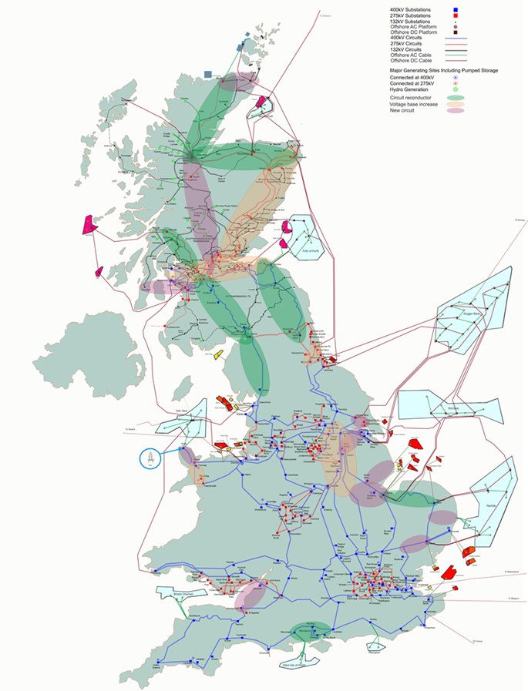
GB Links

Slide 4
The Top
The Top - the very highest transmission voltages
Driver – Connection to European grids / wind farms
High Voltage DC links – Planning & Operation
Building for high power (10 GW links)
New cable (the 1 MV, 5 kA Cable)
New semiconductor devices for ac/dc converters
Notes:
If using a school logo, make sure that if you have a long page title, it does not encroach on the logo. Allow about 2cm around the logo. Run the page title onto two lines if necessary.

Slide 5
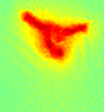
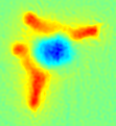
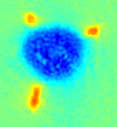
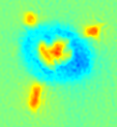
Nano-composite Insulation for HVDC
Finely divided (nano-scale) filler in polymeric matrix
Optimise matrix (polyolefin) and filler (nano-silica)
Modifying interfacial properties
Optimal electrical properties
Optimal thermal properties
Notes:
If using a school logo, make sure that if you have a long page title, it does not encroach on the logo. Allow about 2cm around the logo. Run the page title onto two lines if necessary.

Slide 6
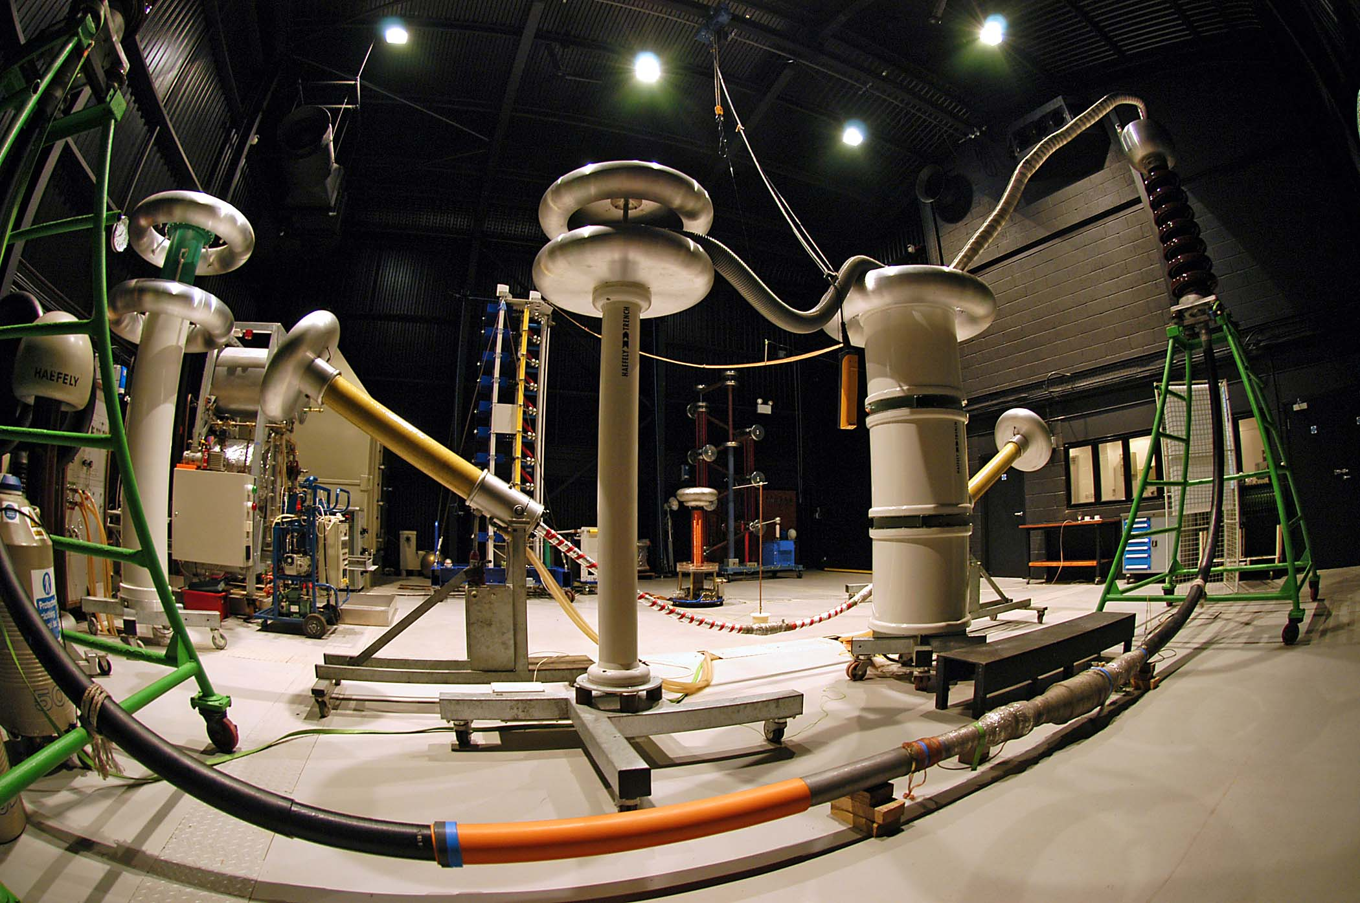
Thank You
Notes:
You can use a full-bleed image to create impact on a page. Caption the image as shown.

