Slide 1
Improving the Operational Performance of National Grid’s Cable Networks
Energy USRG Meeting
Dr James Pilgrim 22 May 2012
Notes:
Please use the dd month yyyy format for the date for example 11 January 2008. The main title can be one or two lines long.

Slide 2
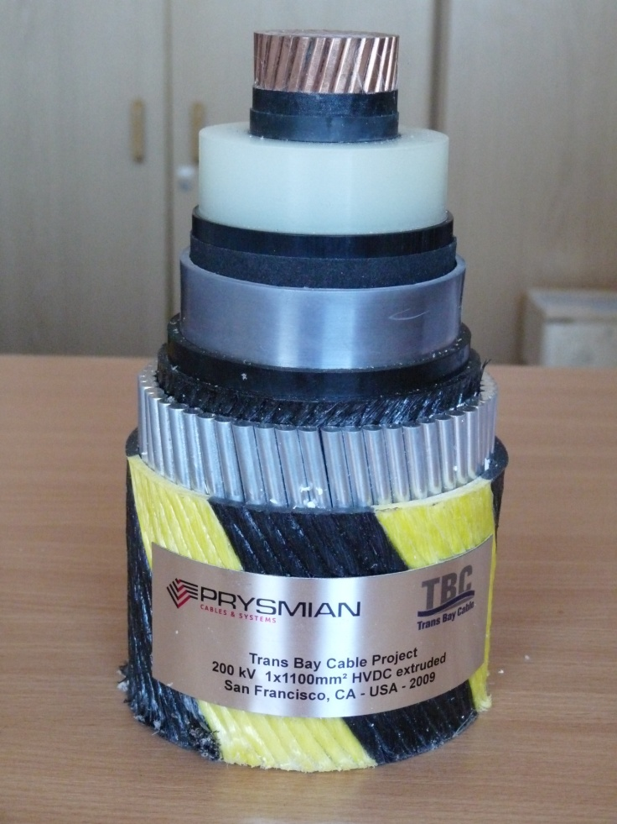
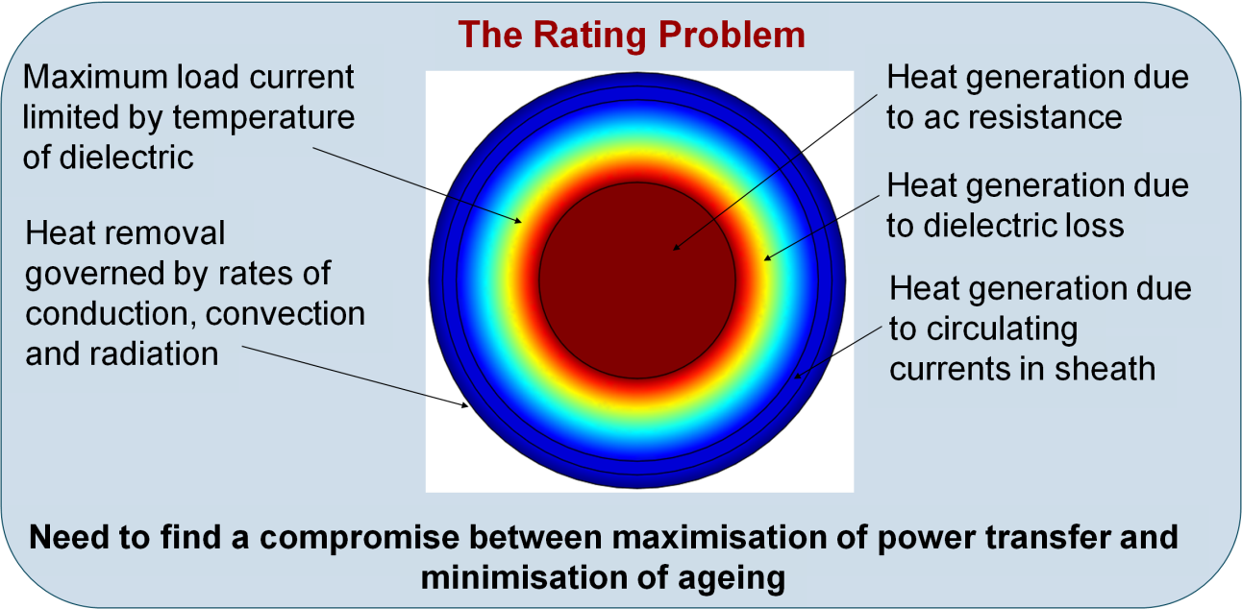
What is Operational Performance?
Defined by current ratings, losses and reliability/availability
Current ratings based on thermal/ electrical models
International standards exist for some scenarios, but are not always applicable
Notes:
If using a school logo, make sure that if you have a long page title, it does not encroach on the logo. Allow about 2cm around the logo. Run the page title onto two lines if necessary.

Slide 3
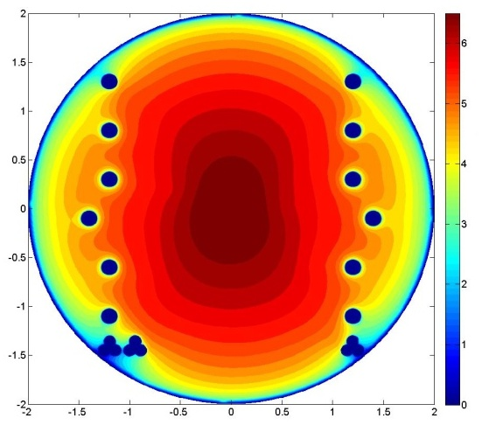
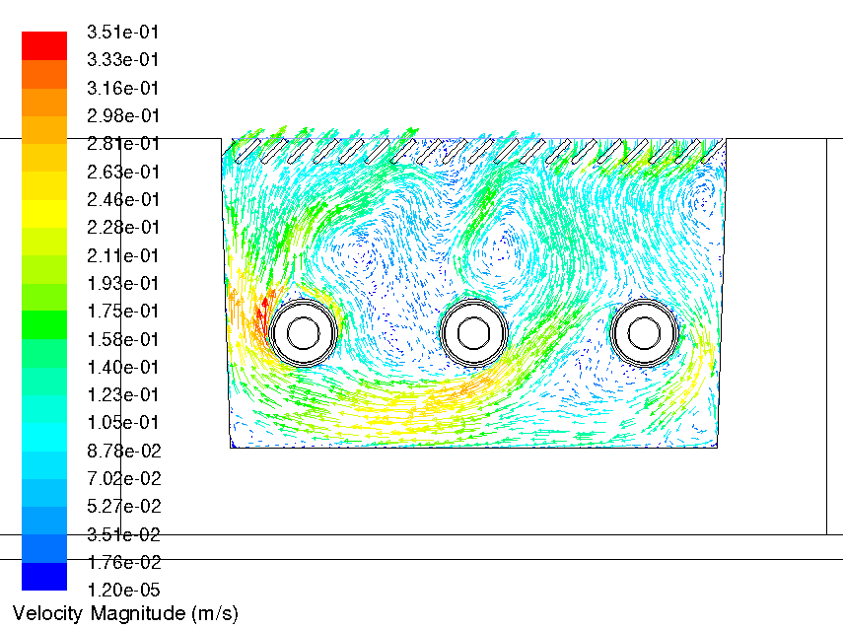
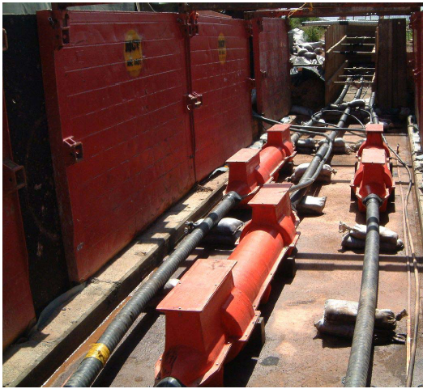
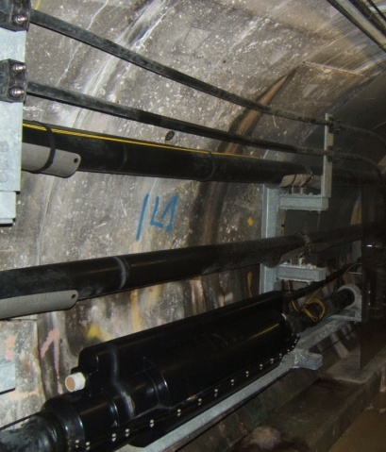
Our Contribution
Improvements to international standards through better modelling
Development of 3D finite element modelling techniques for 400kV cable joint bays
Improved modelling of cable tunnels allowing greater flexibility
Development of CFD-based models for novel cable trough installations
Thermal modelling for next-generation high temperature cable systems
Support National Grid with model development and verification for complex projects

Slide 4
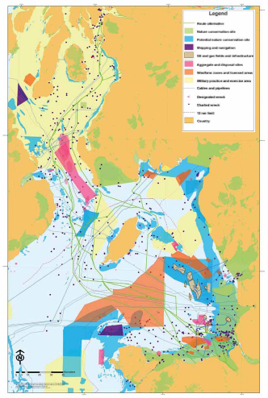
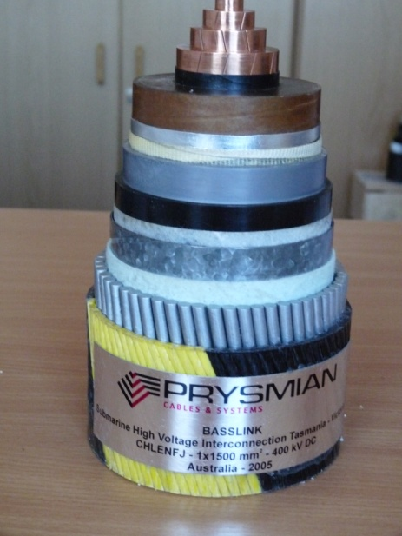
Impacts Achieved
National Grid have commissioned software builds of our new methods
Influencing the design of future 400kV cable tunnel projects
Methods recommended by international Cigre B1.35 WG on cable current ratings
Currently developing models for Western HVDC Link (worlds biggest cable project)
http://www.westernhvdclink.co.uk/files/_CD_WHVDC%20Consulation%20Document%20reduced.pdf

Slide 5
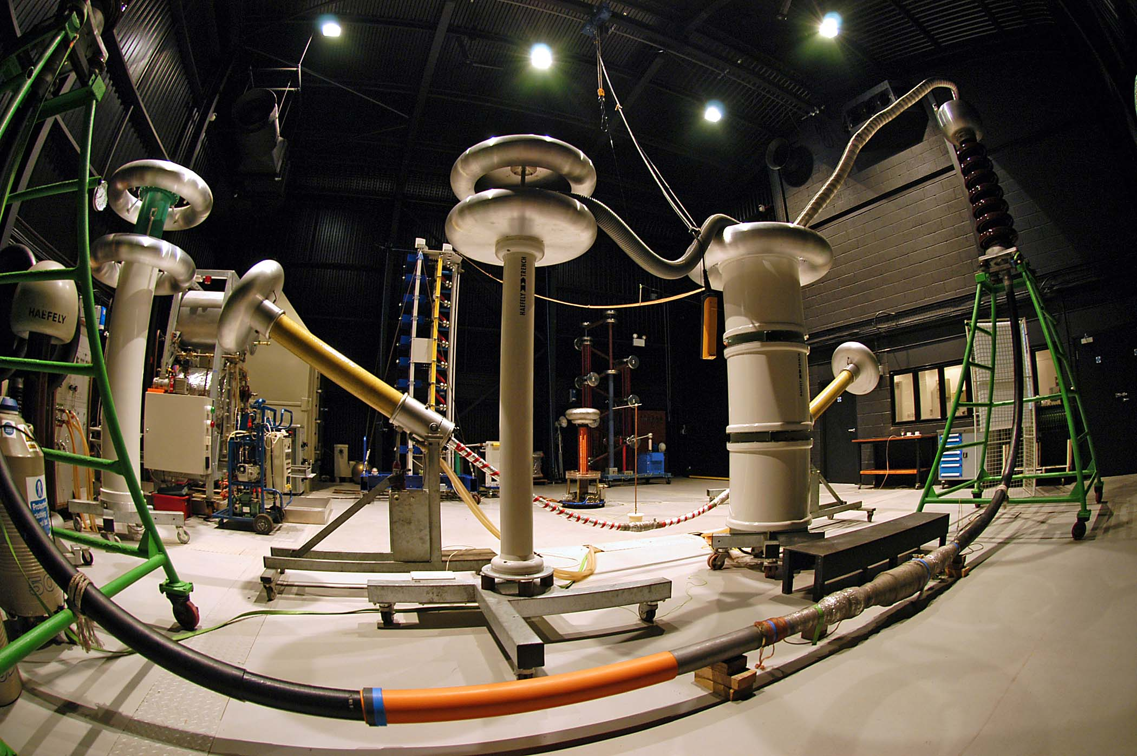
Notes:
You can use a full-bleed image to create impact on a page. Caption the image as shown.

