Slide 1
Putting the ‘smarts’ into the Smart Grid
A Grand Challenge for Artificial Intelligence (and the AIC group)
Gopal Ramchurn and Alex Rogers

Slide 2
The Smart Grid represents a modern vision of a dynamic electricity grid
Imagine the possibilities: electricity and information flowing together in real time, near-zero economic losses from outages and power quality disturbances, a wider array of customized energy choices, suppliers competing in open markets to provide the world’s best electric services, and all of this supported by a new energy infrastructure built on superconductivity, distributed intelligence and resources, clean power, and the hydrogen economy.
US Department of Energy (2009)

Slide 3
The Smart Grid represents a modern vision of a dynamic electricity grid
Imagine the possibilities: electricity and information flowing together in real time, near-zero economic losses from outages and power quality disturbances, a wider array of customized energy choices, suppliers competing in open markets to provide the world’s best electric services, and all of this supported by a new energy infrastructure built on superconductivity, distributed intelligence and resources, clean power, and the hydrogen economy.
US Department of Energy (2009)

Slide 4




We have a range of projects pursuing this vision of the smart gird
ORCHID: Human-Agent Collectives
£10M EPSRC funded (+ industry)
    www.orchid.ac.uk
Building Banter: Human Centred Design for Energy Efficient Buidlings
£100K TSB funded (project partner Arup)
    www.buildingbanter.info
iDEaS Project: Intelligent Decentralised Energy-Aware Systems
£1M industrial funding
    www.ideasproject.info
Intelligent Agents for Home Energy Management
£800K EPSRC funding
    www.homeenergyagents.info

Slide 5
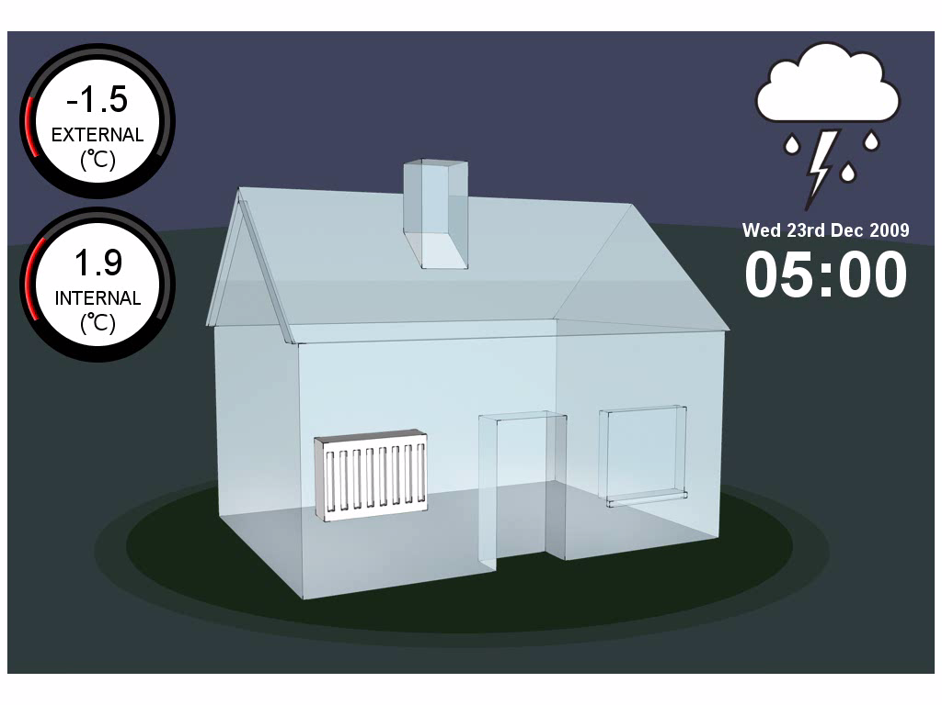
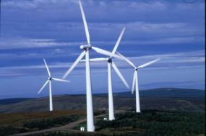
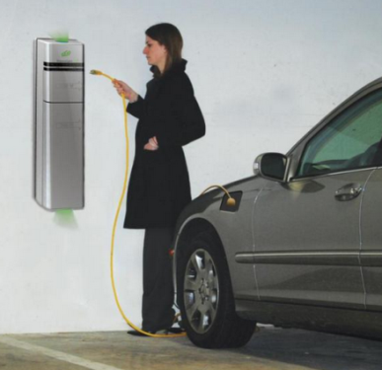
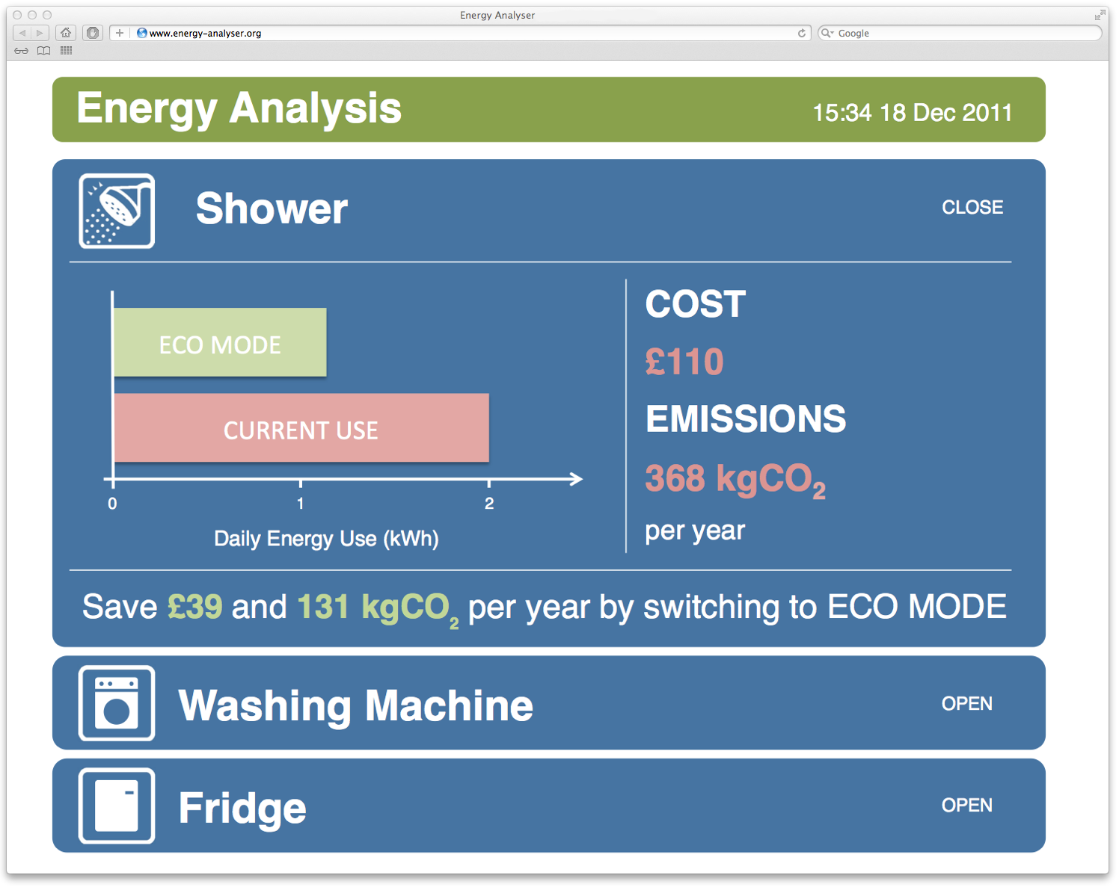
Some of the topics addressed in these projects cover:
Home energy management
  Optimisation of home heating
Energy storage
  Home and grid level optimisation
Virtual Power Plants
  Coalition formation between renewable generators
Electric vehicle charge pricing
  Mechanism design for allocating scarce resources
Smart Grid Optimisation
  Algorithms for Decentralised optimal dispatch of generators
Energy feedback

Slide 8



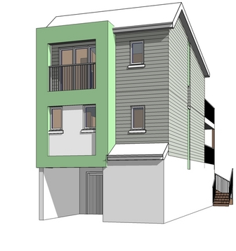
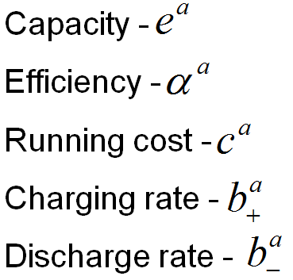







Smart Home
2
Demand (kW)
1
0
½ hour periods
Macroscopic
Market Model

Slide 9
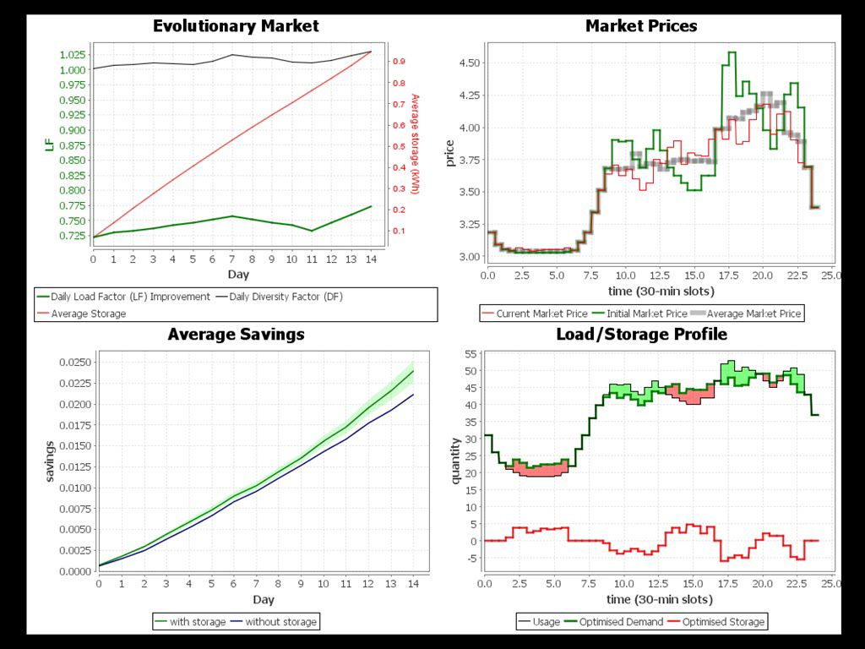

Slide 10
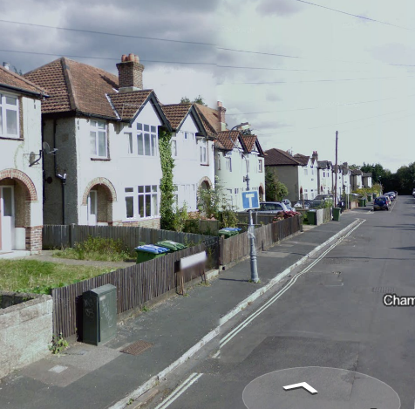
Developing a test site using 26 university owned homes in a single Southampton street
All currently being refurbished.
Installing energy metering and control:
  AlertMe energy monitoring.
  Moxia DC energy hub.
  Horstmann Controls Home Energy Controller

Slide 11



Pricing the charging of electric vehicle using mechanism design
Local transformer may limit EV charging in near future
How to price and schedule use this scarce resource?
  Online mechanism design to incentivise truthful reporting of requirement.
  Naturally prices impatience and high-charging rates.

Slide 12
Formulate as a distributed constraint optimisation problem (DCOP)
Decompose DCOP to a factor graph
Notes:
Discrete variables values

Slide 13


Applying coalition formation to form efficient virtual power plants (VVP)
Multiple small scale renewable generators come together to participate within the grid.
  Alternatives to feed-in-tariffs
  Flexible coalitions of generators to hedge their volatile generation to participate
  Coalitions reward their members to ensure stability

Slide 14
Providing Energy Feedback

