Slide 1
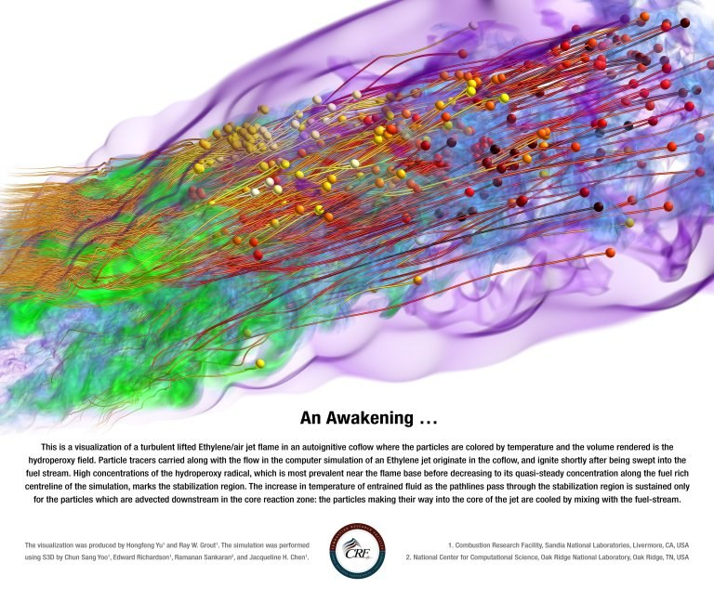
Advanced modelling for turbulent combustion (among other things)
Edward S. Richardson: e.s.richardson@soton.ac.uk
Lagrangian particles tracking the turbulent flow in an autoigniting jet of ethylene fuel.
Direct Numerical Simulation by E.S.Richardson, C.Yoo, R.Sankaran, and J.H.Chen,
“I am an old man now and when I die and go to heaven there are two matters on which I hope for enlightenment. One is quantum electrodynamics, and the other is turbulent motion of fluids. And about the former I am rather optimistic.” [Horace Lamb]
1
Notes:
Please use the dd month yyyy format for the date for example 11 January 2008. The main title can be one or two lines long.

Slide 2
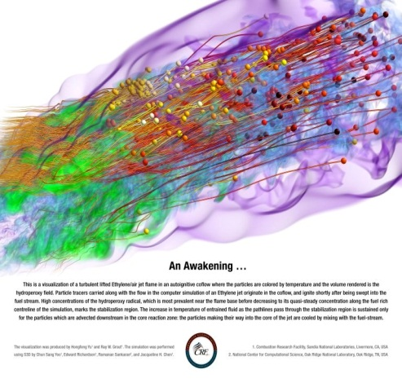
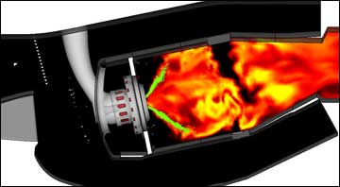
Modelling of turbulent reacting flows
Fundamental numerical experiments
Practical modelling for real applications
Development of modelling framework for including detailed small-scale physics in reacting flow models.
“Advanced modelling for two-phase reacting flow” (EPSRC fellowship 2010-2015)
Understanding and validation through high-fidelity simulation:
Multi-component single droplet evaporation
Turbulent combustion DNS – stratified & partially premixed.
Multi-component spray combustion (Lagrangian spray ‘DNS’).
Analysis of resolved evaporating spray (Demoulin 2011).
2

Slide 3
Wider applications
Dynamic modelling of engines and power systems:
Advanced engine concepts with Liquid Nitrogen injection.
Combined-cycle (micro) power systems.
Modelling statistical interactions and uncertainty propagation:
Air quality modelling
Plug-in Hybrid Electrical Vehicle charging
3

