Slide 1
Next-Generation Energy-Harvesting Electronics: Holistic Approach
Alex S. Weddell
22 May 2012

Slide 2
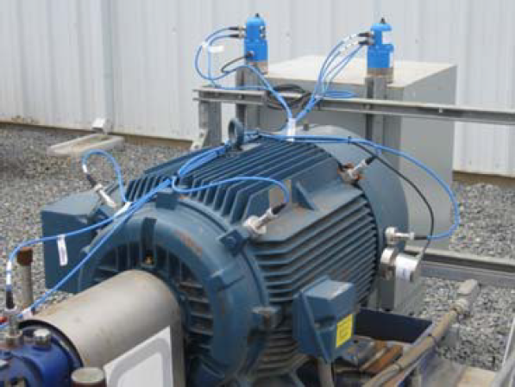
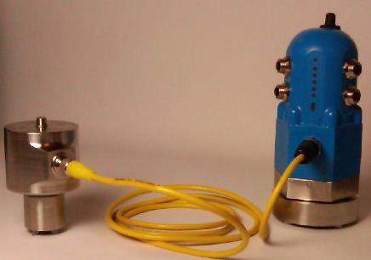
Applications of Vibration EH
Typically condition monitoring, using wireless sensors
Sensors can be retro-fitted without electrician/batteries
Also applications in asset tracking, monitoring of rotating machinery, even human health monitoring
Energy Harvesting used for Wireless Condition Monitoring, GE [Online]. Available: http://eh-network.org/events/dissemination2011/presentations/Tom%20Berry.pdf

Slide 3
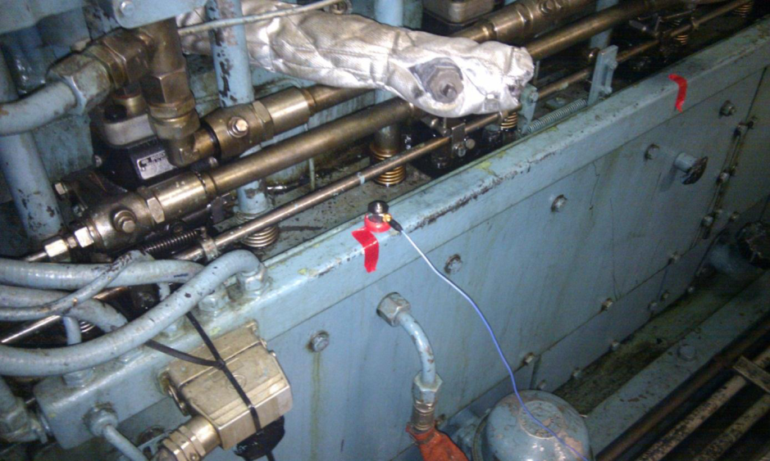
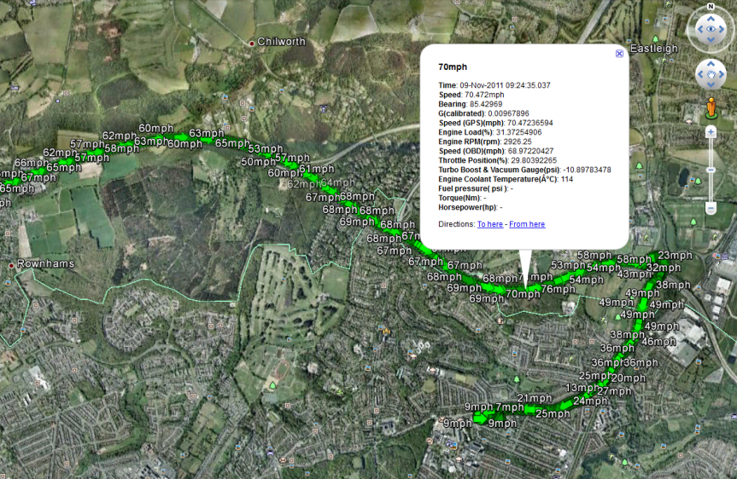
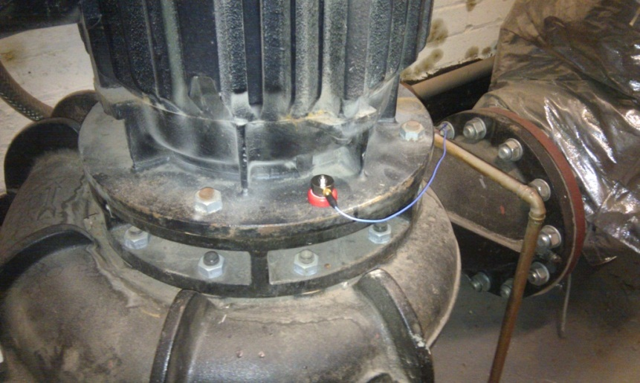
Collecting Real Vibration Data
Data available online at EH Network Data Repository www.eh-network.org

Slide 4
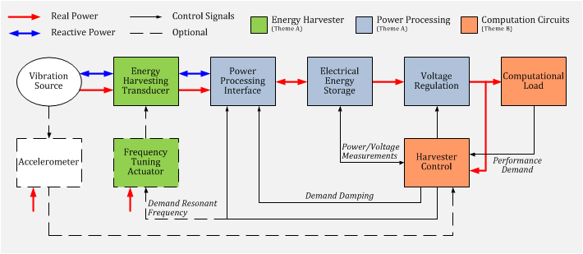
Project Themes
A: Adaptive, High-Efficiency Micro Generators
B: Energy Harvesting-Aware Computation Circuits
C: Integrated Modelling & Performance Optimisation for Energy Harvesting Systems
Energy Harvesting Systems: A Block Diagram (2010, July 16). Holistic Energy Harvesting [Online]. Available: http://www.holistic.ecs.soton.ac.uk/res/eh-system.php

Slide 5
Demonstrator: Tuneable VEH
Position Sensor
Tuning Magnets
Generator
Actuator
Accelerometer

Slide 6
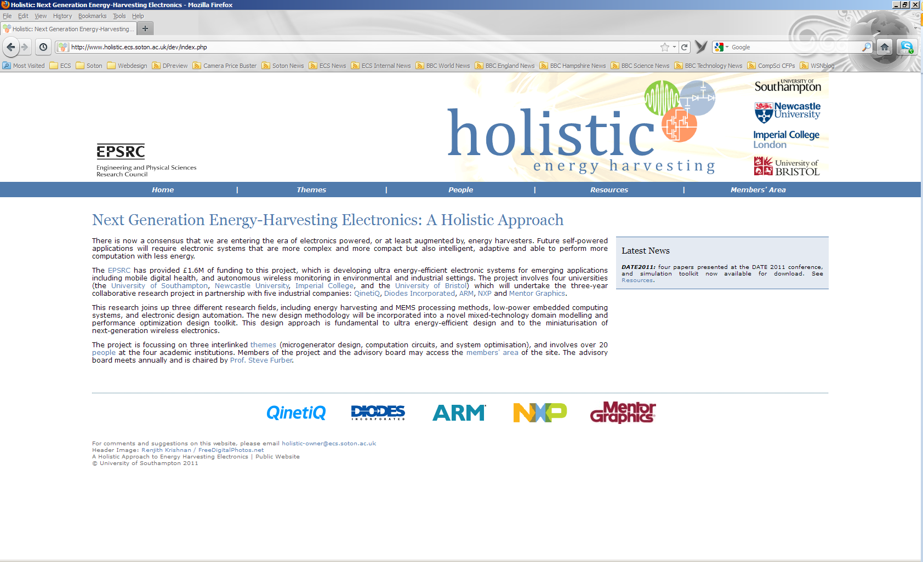
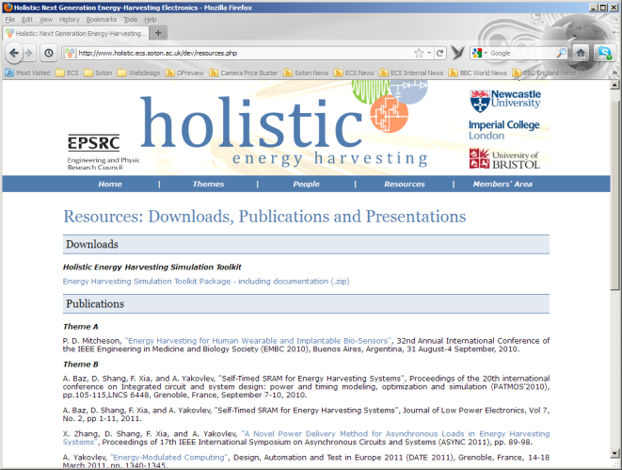
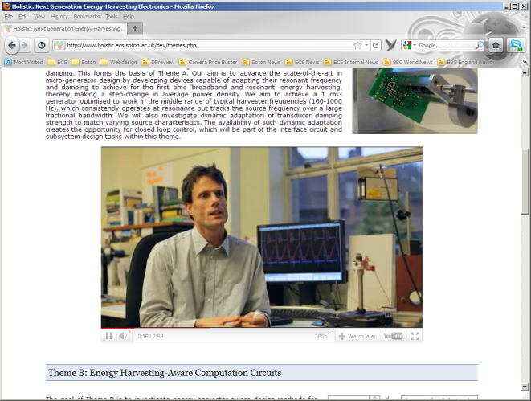
Thank You
Project Website – www.holistic.ecs.soton.ac.uk [or just search for “holistic energy harvesting”]

