Slide 1
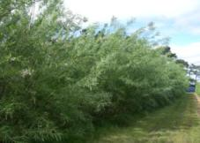
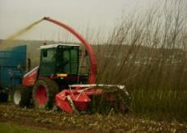
ForestGrowth-SRC, a process-based model of short rotation coppice (SRC) growth and yield. Used to predict optimum sites for supplying woody fuel to the bioenergy market.
Context and model evaluation.
Predicting SRC willow yield across the whole UK and out to 2050 under different scenarios of climate change.
Matthew J. Tallis, Eric Casella, Paul Henshall, Tim Randle, Matthew J Aylott, James IL Morison, and Gail Taylor
Notes:
Gail, Me Soton Aylott Soton, Aylott now NNFCC

Slide 2
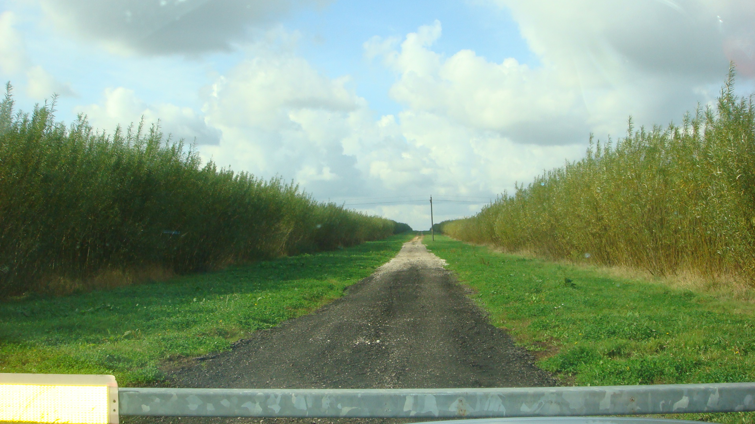
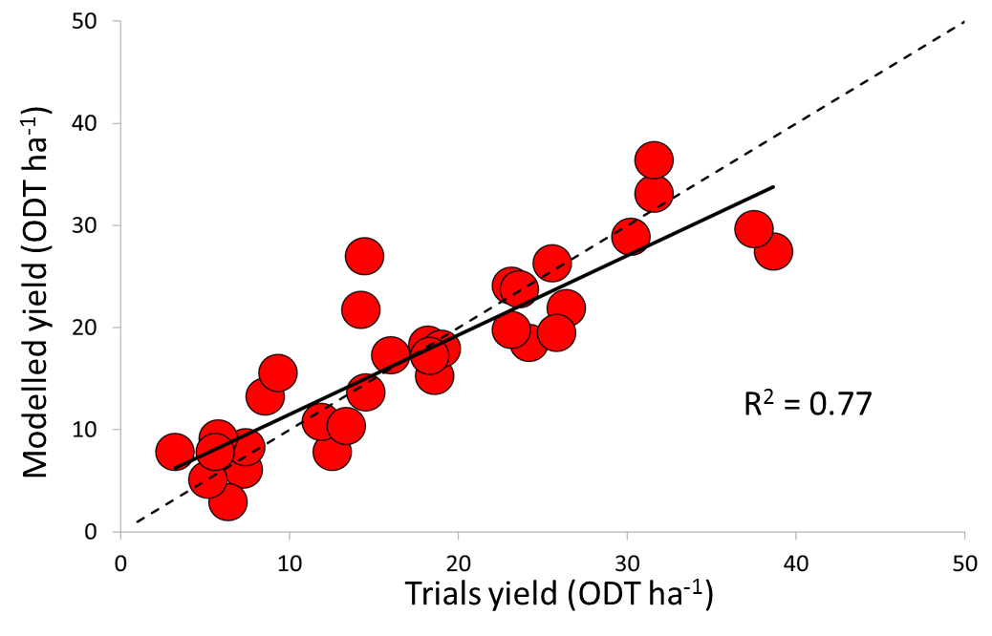
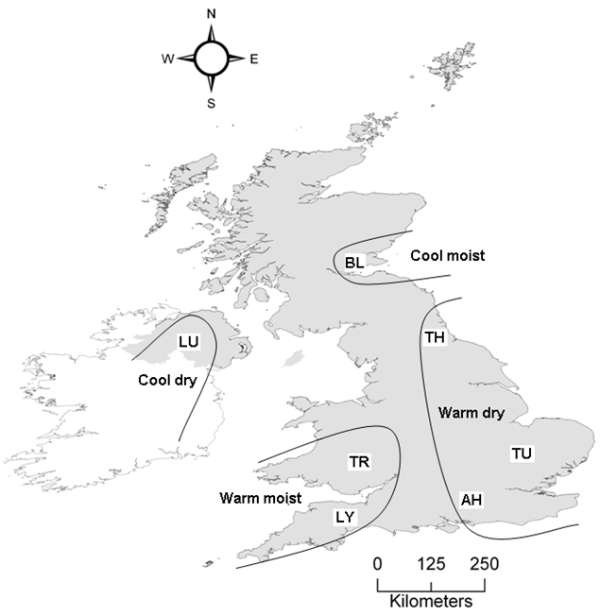
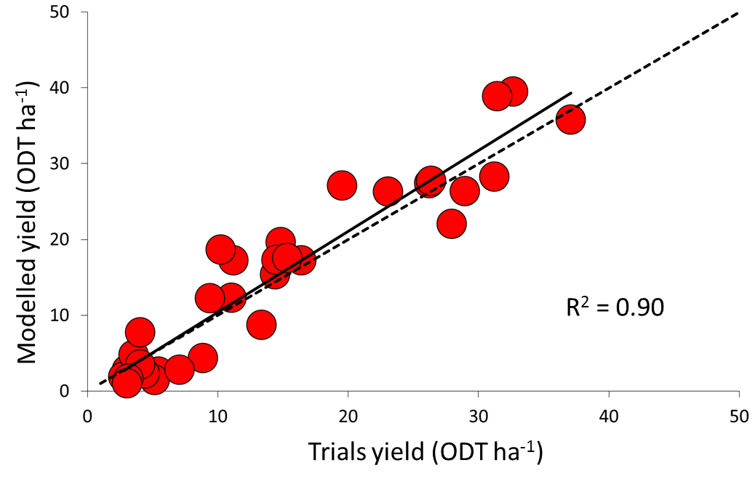
Currently ~5500 ha SRC willow in UK.
350,000 ha of SRC willow by 2020 to contribute to renewable directives with no impact on food supply (1M ha available in England alone).
Excluding biomass from future UK energy market could cost an estimated £44 Billion.
SRC Willow
SRC Poplar
cut
1 yr establishment
3 yr coppice growth
cut
3 yr coppice growth
cut
Notes:
Globally agriculture occupies about 38% of ice free land (12% cropland and 26% pasture), the remainder considered unsuitable for farming. 62% of crop production is allocated to human food, 35% animal feed, the remaining 3% is allocated to bioenergy, seed and industrial processes (Foley et al., 2012). The current spatial distribution of land for food production (Foley et al., 2012) suggests a bioenergy expansion in temperate zones to have a reduced impact on global food production, notwithstanding the predicted impacts of climate change which may shift biomes and require the needed for adaptive management strategies (e.g. irrigation or different crop types) (Berbengren et al., 2011).
Currently European bioenergy production supplies 7% of total European primary energy (IEA, 2010) from 3% of cropland (3.1 Mha), the feed stock for which is dominated by annual food crops ‘conventional crops’ (Don et al., 2012),

Slide 3
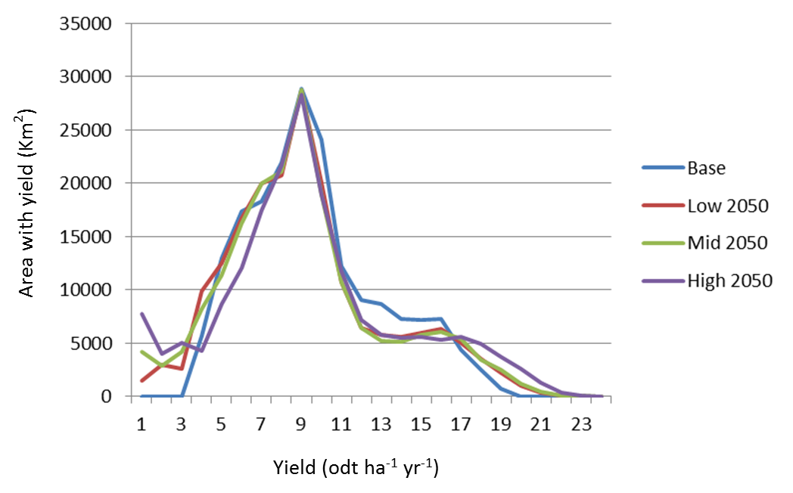
Evaluation of the modelled harvest yields with measured harvests from an additional 18 SRC willow sites.
Predicting SRC willow yields for the whole UK out to 2050
Up-scaled model predicts yields very well (R² = 0.58, RMSE = 1.27 odt ha⁻¹ yr⁻¹).
For current conditions mean UK yields = 9.0 odt ha⁻¹ yr⁻¹ (range 0.9 to 21.0 odt ha⁻¹ yr⁻¹ ).
Yield (odt ha⁻¹ yr⁻¹)
0.9 - 3.0
3.1 – 6.0
6.1 – 9.0
9.1 – 12.0
12.1 – 15.0
15.1 – 18.0
18.1 – 21.0
No data
The first process based model simulation of SRC in the UK with multi-site evaluations.
Data are provided to GHG and economic models to inform future plantings

Slide 4
Future thoughts
Eliminating water stress from the model gives UK willow yields ranging from 18 – 24 odt ha⁻¹ yr⁻¹. Site plantations where roots have permanent access to the water table – Water depletion and extraction issues. Model suggests averaged modelled WUE was 9.5 g kg⁻¹ (poplar) and 5.5 g kg⁻¹ (willow).
Modelled data support measured data suggesting SRC poplar is more water use efficient. European distributions between SRC willow and SRC poplar suggest SRC poplar is the feedstock of choice in more water stressed environments.
Need for comparison between SRC willow and SRC poplar for UK planting of second generation SRC biomass.
Assessment
cut
1 yr establishment
3 yr coppice growth
cut
3 yr coppice growth
cut
Notes:
Hall (2003) report modelled data suggesting SRC willow produces 2.18 g of above ground biomass for every mm of annual precipitation, and the model produced similar values of . of 2.3 g mm⁻¹ (poplar) and 2.14 g mm⁻¹ (willow). The average July/ August transpiration across all sites and for years three and six was 2.3 mm day⁻¹ (poplar) and 2.5 mm day⁻¹ (willow) peaking at 5.6 mm day⁻¹ (poplar) and 9.3 mm day⁻¹ (willow)and are well supported by measured values.

