Slide 1



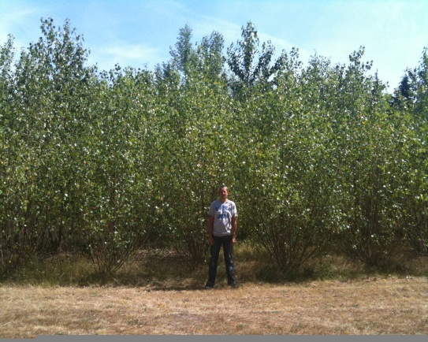
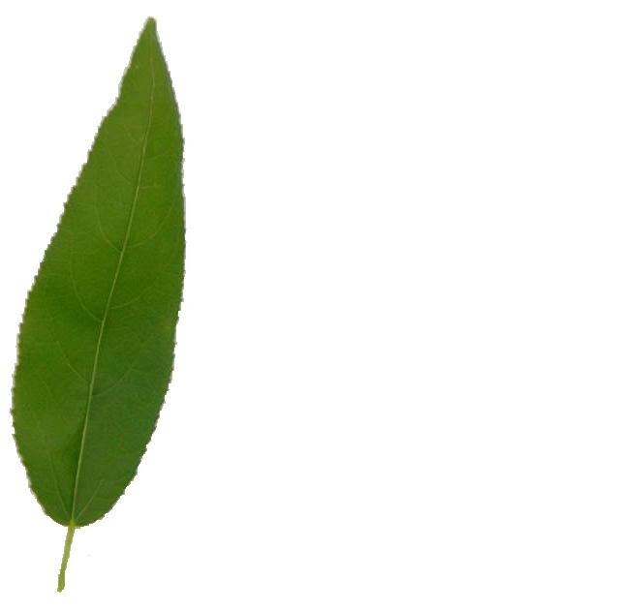
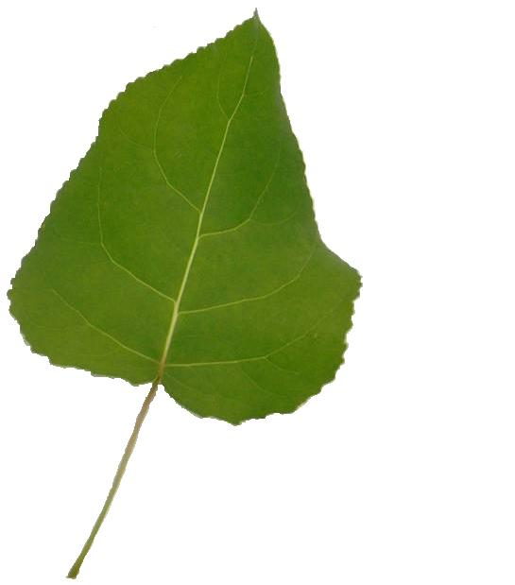
More Efficient Bioethanol from Poplar Wood?
Tues. 22nd May 2012, EnergyAway Day, Chilworth Manor
Adrienne Payne

Slide 2



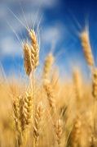




What is bioethanol?
Solar Energy and
Carbon Dioxide
Carbon Dioxide
Biomass
Harvesting
CO₂
Biofuels
CO₂
Pre-processing
CO₂
Enzymes break cellulose down into
sugars and microbes ferment sugars into
ethanol

Slide 3
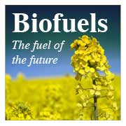
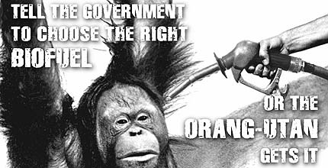
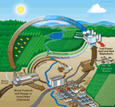
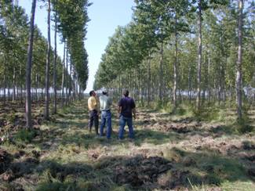
Bioenergy -concerns
Greenhouse gas balance?
Biodiversity? Loss of species?
Food crop displacement and prices?
Other indirect effects… tropical rain forests? Soil carbon?
Societal concerns? GM?
Landscape-scale changes?
Water use and management?
Biofuels good? Biofuels bad?

Slide 4
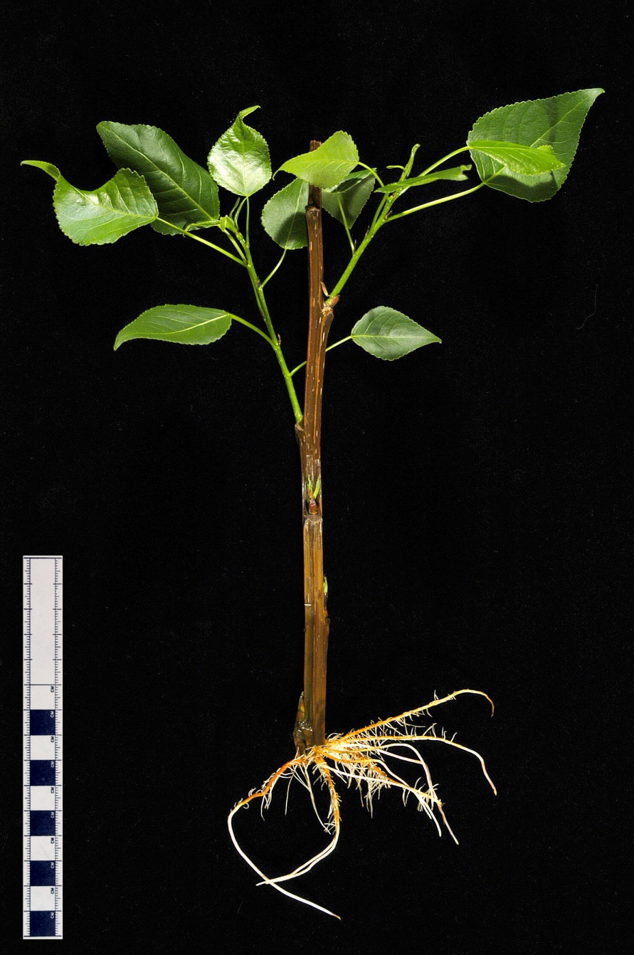
Why is poplar the ideal bioenergy tree?
Full genome sequence (15 Sept 2006)
Small genome (similar to rice)
Diversity of species
Fast growing and perennial
Clonal
Transformation system
Genetic collections and molecular maps
Activation tagged populations
EST and BAC libraries
Genomic and post-genomic tools

