Slide 1
FP7 ANASTASIA
Next generation insulation systems for large generators/motors.
Nicola Freebody 22nd May 2012
Notes:
Please use the dd month yyyy format for the date for example 11 January 2008. The main title can be one or two lines long.

Slide 2
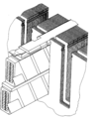
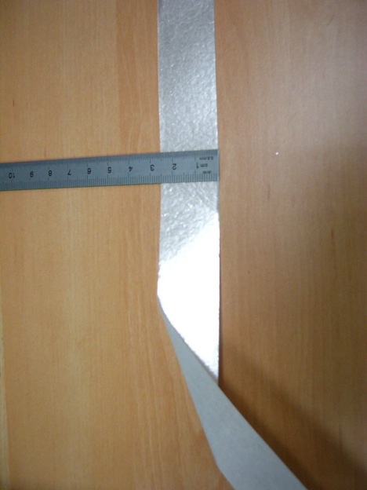
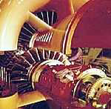
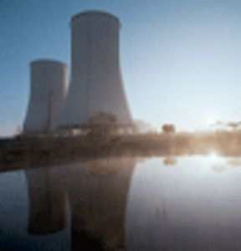
FP7 Anastasia
Efficiency of generators is limited by thermal and electrical strength of its insulation.
Traditional insulating materials and well established tape structures far behind the current state of the art insulating materials.
A small efficiency increase (+0,2%) equals a substantial energy saving (1.5 bn €)
2

Slide 3
FP7 Anastasia
limitations originate in multilayer structure.
Homogenisation requires higher performance materials, obtained by adjunct of inorganic nanofillers
Two proposed approaches: nanodielectrics polymer or inorganic polymers (sol-gel).
Notes:
Range pictures to the left and place underneath the bullet point text. Range captions to the bottom right hand corner of the picture. The image shown here is 7cm x 5cm.

