Slide 1
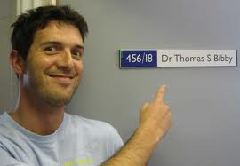
Plug and Play Photosynthesis:
the photosynthetic extracellular electrogenic pathway
Andy Hitchcock and Tom Bibby

Slide 2
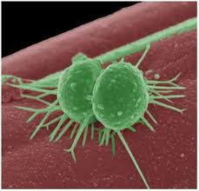
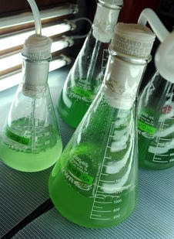
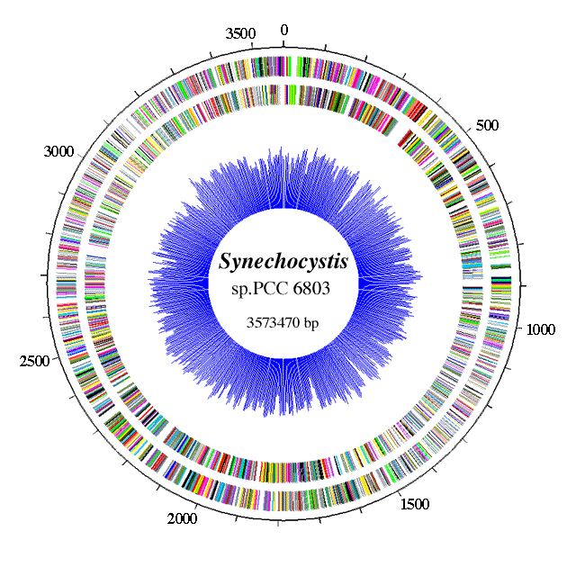
Can we harness excess potential to drive biofuel synthesis, electricity generation, the production of high value products?
Photosynthetic organisms show a light dependent electrogenic response, i.e. produce a current under illumination.
(Zou et al. 2009; Pisciotta et al. 2010; 2011; Bombelli et al.
2011; McCormick et al. 2011).
Aim of project is to characterise the electron transfer pathway(s) from water splitting to extracellular electron acceptors.
Using model photosynthetic cyanobacteria
Synechocystis sp. PCC 6803.
GMOs, photosynthetic/respiratory
physiology, electrochemistry, synthetic
biology, omics approaches.

Slide 3
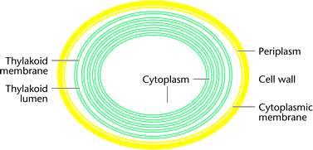
EXTRACELLULAR ELECTRON ACCEPTOR
Soluble shuttles
PILI
MTR
Outer membrane
Periplasm
Cytoplasmic membrane
RESPIRATION
e.g. Geobacter, Shewenella
???
Cytoplasm
PHOTOSYNTHESIS AND RESPIRATION
Thylakoid membrane
Thylakoid lumen

Slide 4
PROGRESS:
20+ knockout mutants
Indicative reduction assay
Controls
Mapping respiratory and PS contributions
Optimizing dye-based and electrochemical screens
Extracellular electron acceptor (e.g. an anode)
Electron flow
Ox
Red
Outer membrane
Periplasm
cC
Cytoplasmic membrane
PQ pool
Cyt b6f
RTO
RESPIRATION
Resp DHs
?
???
Calvin
cycle
NADPH
Flv2
Flv4
H₂
FNR
O₂
Resp DHs
Fd
Cytoplasm
PSII
PQ pool
Cyt b6f
PSI
RTO
PHOTOSYNTHESIS AND RESPIRATION
Thylakoid membrane
PC cC6
H₂O splitting
Thylakoid lumen

