Slide 1


Sustainable Catalysis for Renewable Energy Generation
Chris Hinde, Dr. Robert Raja¹, Prof. Andy Hor², Prof. Ajit Shenoi³
Chemistry, University of Southampton, UK
Institute of Materials Research and Engineering (IMRE), Singapore
Southampton Marine and Maritime Institute (SMMI), UK

Slide 2
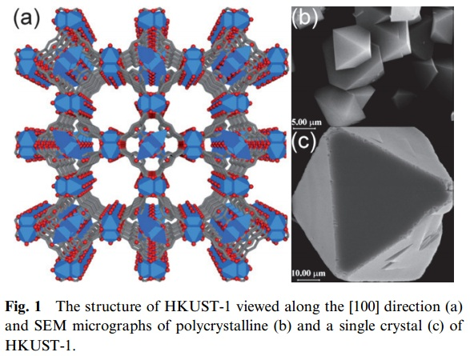
Materials with Porous Architectures
Porous materials can be engineered as catalysts
High surface areas
  Inorganic Frameworks ca. 100-600 m³/g
  Metal-organic Frameworks (MOFs) up to 10 400 m³/g
Maximise framework – substrate interactions
High potential for strategic positioning of active sites within frameworks

Slide 3
Hybrid Synergy with MOFs and Metal Phosphate Materials
Photocatalytic Oxidation of Water
H₂Storage and CO₂ capture
Gas release mechanisms
MOF-500 - [(Fe₃O)₄ (SO₄)₁₂(BPDC)₆ (BPE)₆]
[Co(II)-(PO₃F)]₄F[PO₂F₂]₂.H₂O
MOFs and ZIFS
Hierarchical formation of pores (4 different cavity sizes)
High tunability from organic linkers and metal centres
Potential for functionalization and selectivity control
Metal Phosphate Frameworks
Stabilization of complex anions in open-framework phosphate architectures (M = Mn³⁺, Fe³⁺, Co²⁺, Cu²⁺) etc.
Potential for fluorine incorporation
Multi-metallic combinations
Synergy

Slide 4
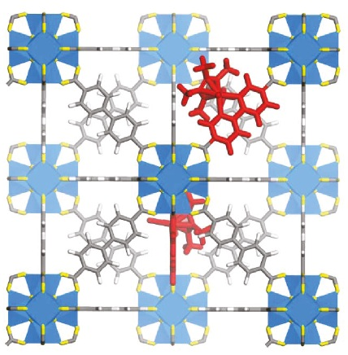
Current Status on Photolysis of Water using Porous Framework Materials
Examples that highlight the promise of MOFs as water oxidation photocatalysts include:
  A Zr-terephthalate based MOF has been shown to have a quantum efficiency of 3.5%^{[1]} (compared with rutile TiO₂ of 8%)
  A framework incorporated organometallic iridium species has shown promise for water oxidation, with heterogeneity allowing for recycling of the catalyst^{[2]}
Model of Iridium complex doped into a UiO-67 Framework
With a vast diversity of MOF structures, there is a vast untapped potential for hydrogen generation using MOF photocatalysts
[1] C. Gomes Silva, I. Luz, F. X. Llabrés i Xamena, A. Corma, H. García, Chem. Eur. J., 2010, 16, 11133.
[2] C. Wang, Z. Xie, K. E. deKrafft, W. Lin, J. Am. Chem. Soc., 2011, 133, 13445.

