Slide 1
Plasma Processing of Biofuels
Steve Gabriel
Professor of Aeronautics and Astronautics
EEE Group, ECS

Slide 2
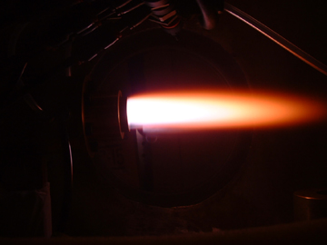
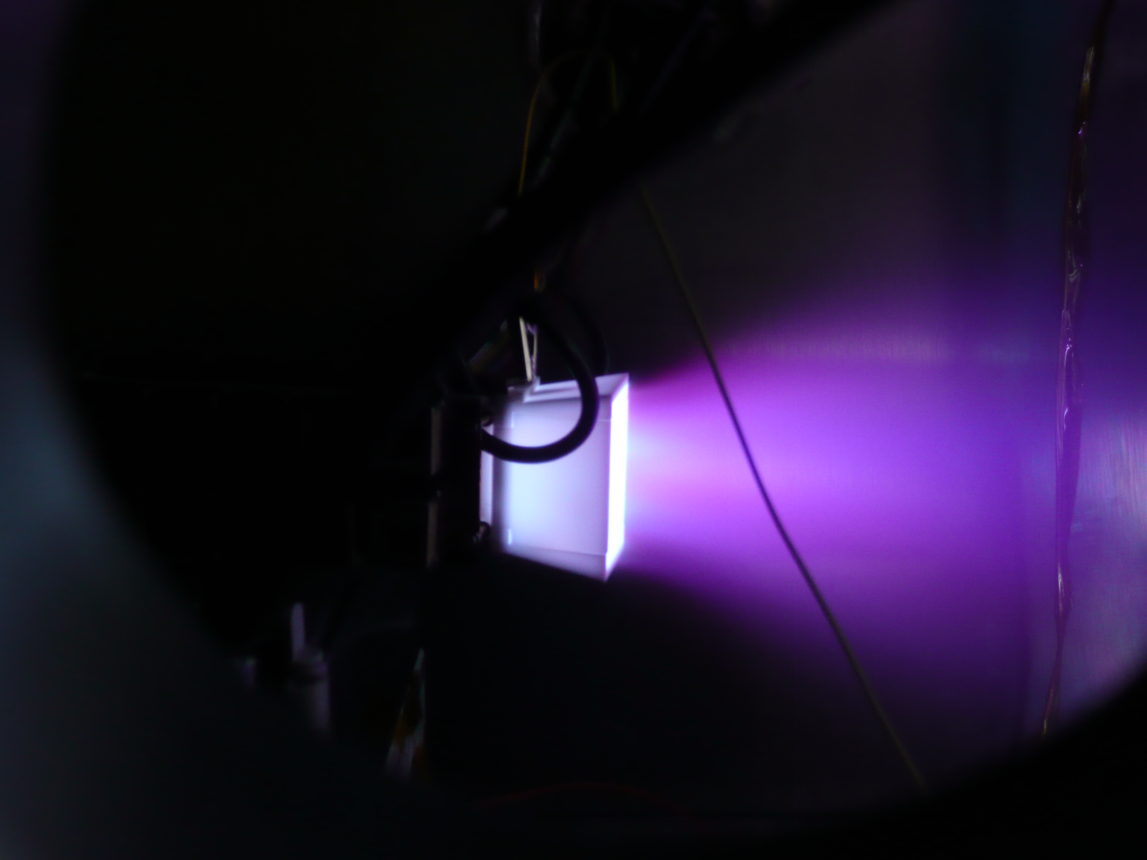
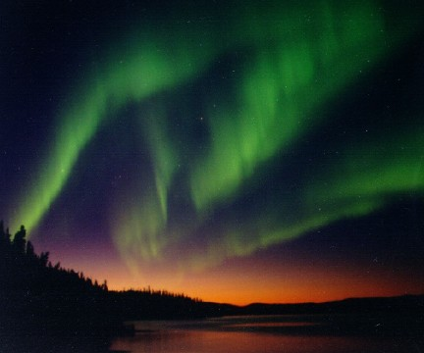
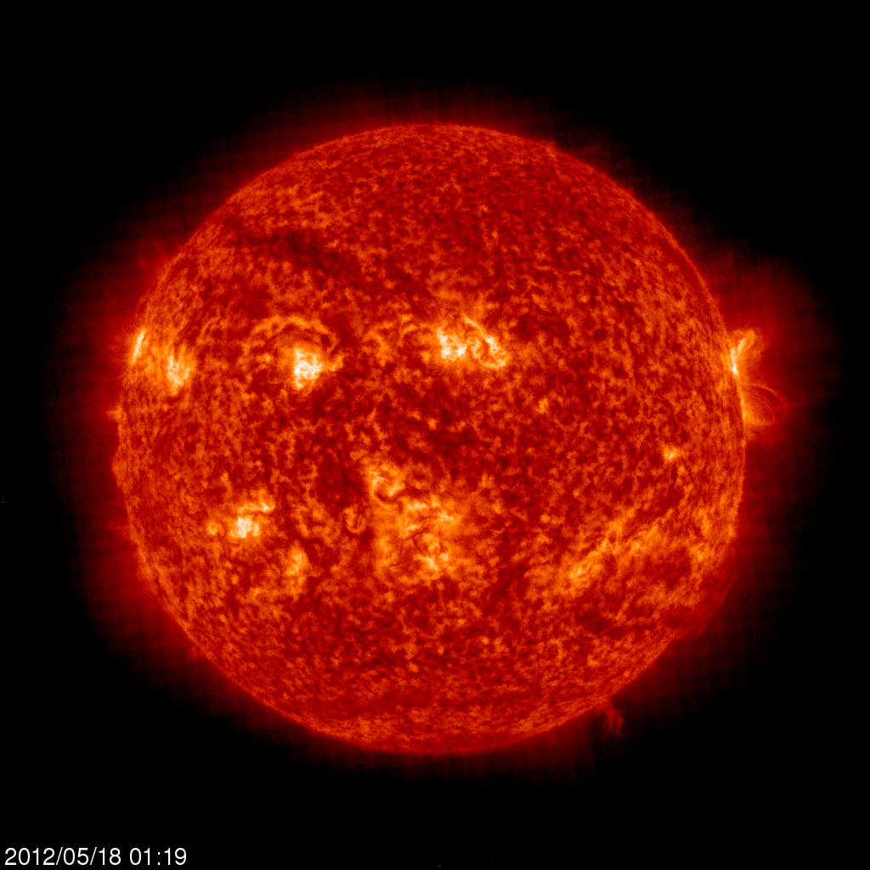
What is Plasma
Sometimes called 4th state of matter
Very high temperatures – thousands of degrees
Electrons, ions and neutrals present

Slide 3
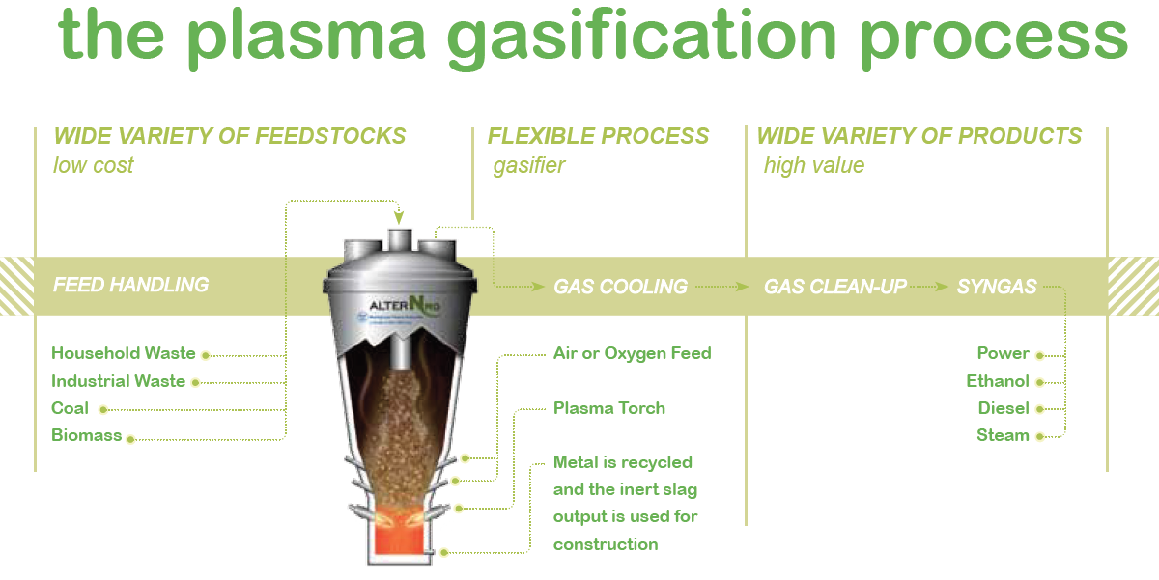
From “Energy Evolved
Clean, Sustainable Energy Recovery Through Plasma Gasification”
Westinghouse Plasma Corporation

Slide 4
Initial Perceptions
Not much plasma processing in the UK but significant number of companies and plants worldwide
Very little ‘research’ worldwide and almost nothing in this country
Not easy to discern what real gaps in knowledge are but 3 potential key areas could be:
Electrode lifetime
Plasma ( including flow and stability) modelling
Efficiency

Slide 5
Plans
MSc students (3) starting projects to look at plasma processing of biofuels ( experimental and modelling)
Possible PhD student on plasma modelling
EPSRC proposal

