Slide 1
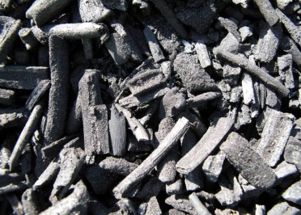
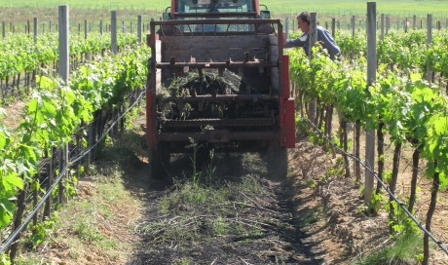
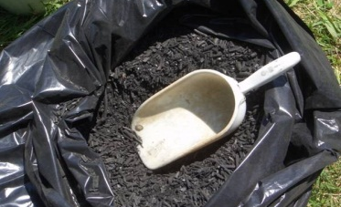
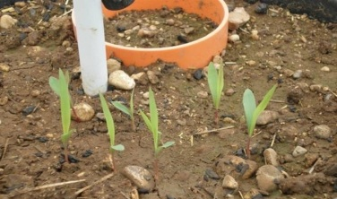
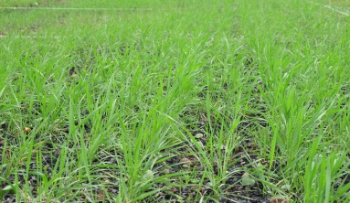
EuroChar :
Development of technologies for long-term carbon sequestration
Energy AwayDay
May 22nd 2012

Slide 2
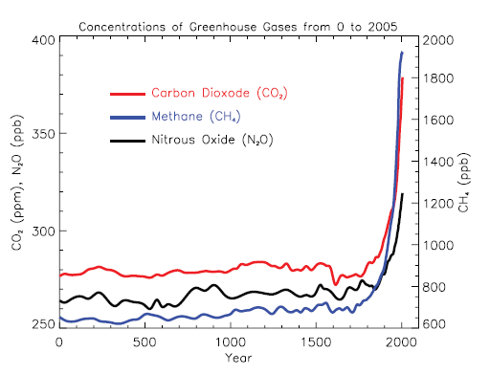
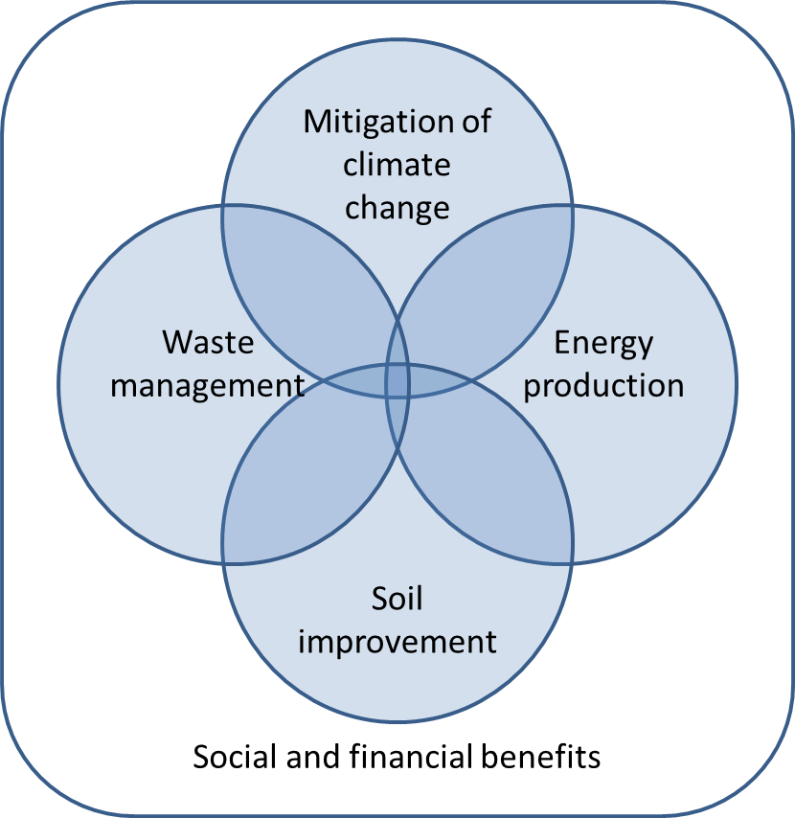
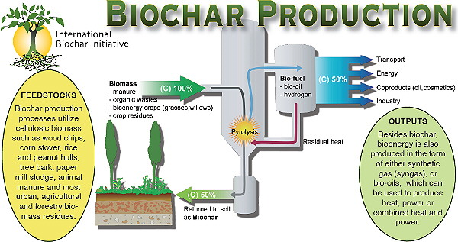
What is biochar and why we need it?
Global Biochar potential: the BIG picture
IPCC, 2007
Biochar is the product that is gained when biomass is heated with a limited supply of oxygen in a process called pyrolysis or gasification.
IPCC, 2007
Biochar is the product that is gained when biomass is heated with a limited supply of oxygen in a process called pyrolysis or gasification.
Lehmann and Joseph 2009
Biochar for Environmental Management: Science and Technology.

Slide 3
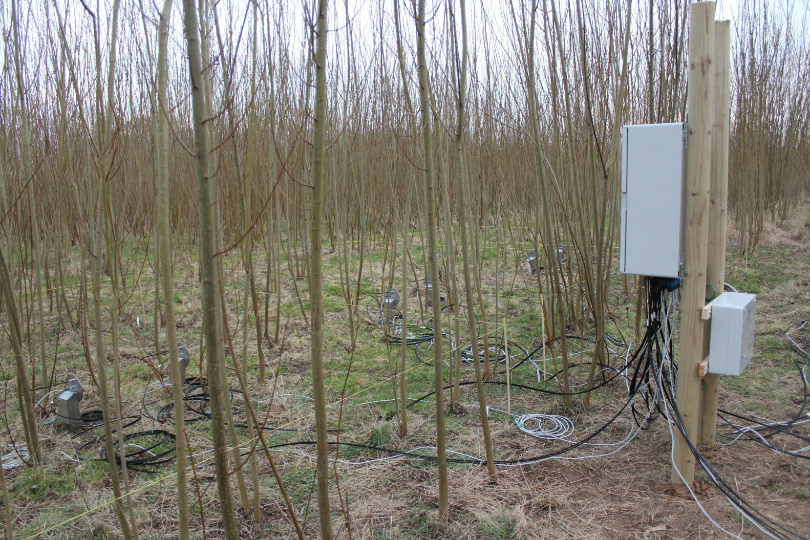
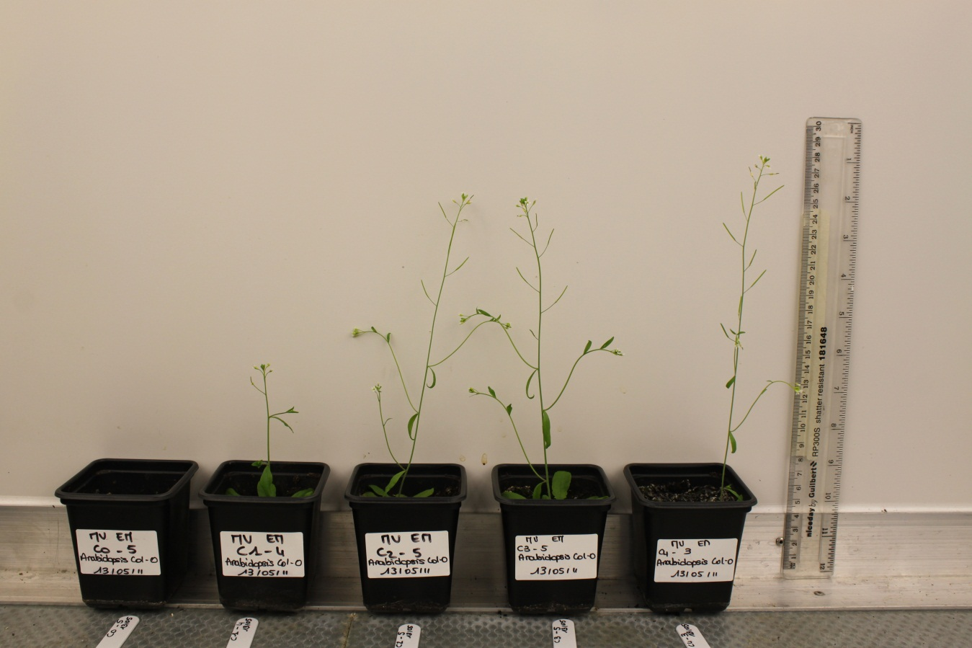
Monitoring of performance of Biochar production: Study of industrial processes and the potential risks of environmental pollution
Demonstration of Industrial Biochar production:
Produce Biochar at the pilot scale at two industrial plants in Germany and Italy using two different technologies: HTC (Hydrothermal Carbonization) and TC (Thermochemical Carbonization)
Life Cycle Analysis of Biochar production and large-scale application for carbon sequestration:
Assess the LCA of Biochar use, feedstock production, biomass to Biochar conversion processes and Biochar application pathways
Chemical and Physical properties of Biochar:
Data repository on chemical, physical and biological properties of Biochar. Test phytotoxicity of biochar on a model plant → Arabidopsis experiment
Short and long term stability of Biochar focusing on its quality, structure and age:
Short term stability of Biochar will be assessed investigating its degradation in soil during laboratory incubation experiments. Long term will be investigating using charcoal from archaeological forest and grassland sites where “dated” charcoal production sites exist
Biochar stability in Field Applications:
Field experiment in West Sussex (UK) – Biochar application on a willow commercial site: soil efflux of greenhouse gases and impact on yield
Metagenomic analysis
Scenario analysis:
Evaluate scenarios of large-scale application for C-sequestration, to understand the impact of large scale biochar agricultural application on the climate system
Notes:
Life Cycle Analysis of Biochar production and large-scale application for carbon sequestration:
The objectives are to assess the LCA of Biochar use, feedstock production, biomass to Biochar conversion processes and Biochar application pathways.
Short and long term stability of Biochar focusing on its quality, structure and age:
Short term stability of Biochar will be assessed by investigating its degradation in soil during laboratory incubation experiments.
Long term stability of Biochar will be investigating using charcoal from archaeological forest and grassland sites where “dated” charcoal production sites exist.
Scenario analysis:
The aims are to evaluate scenarios of large-scale application for C-sequestration, to understand the impact of large scale biochar agricultural application on the climate system and to understand potential “warming effects” by considering the reduction of net C-emission due to Biochar use at European scale to establish potential “cooling effects” due to changes in atmospheric CO concentration.
Biochar stability in Field Applications:
Field application will be conducted in three sites, in Italy, France and the UK, using non-food, second generation lignocellulosic energy crops, in order to analyse the stability of Biochar in a field-scale experiment. Additional measurements of field-scale will include the effects of Biochar on soil efflux of greenhouse gases and impact on yield.
Chemical and Physical properties of Biochar:
A data repository on chemical, physical and biological properties of Biochar will be created from different feedstock and from different carbonization technologies. Correlations between production technology and Biochar properties will be assessed. Carcinogenic effects of Biochar will also be studied.
Monitoring of performance of Biochar production:
The production of two types of Biochar will be monitored, focusing on the study of industrial processes and the potential risks of environmental pollution. System performance data will be studied including energy use and production, operating temperatures, gaseous emissions and maintenance activities.
Demonstration of Industrial Biochar production:
The objective is to produce Biochar at the pilot scale at two industrial plants in Germany and Italy using two different technologies: HTC (Hydrothermal Carbonization) and TC (Thermochemical Carbonization).

Slide 4
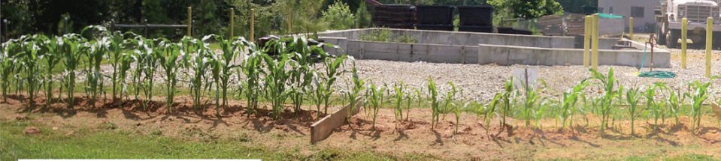
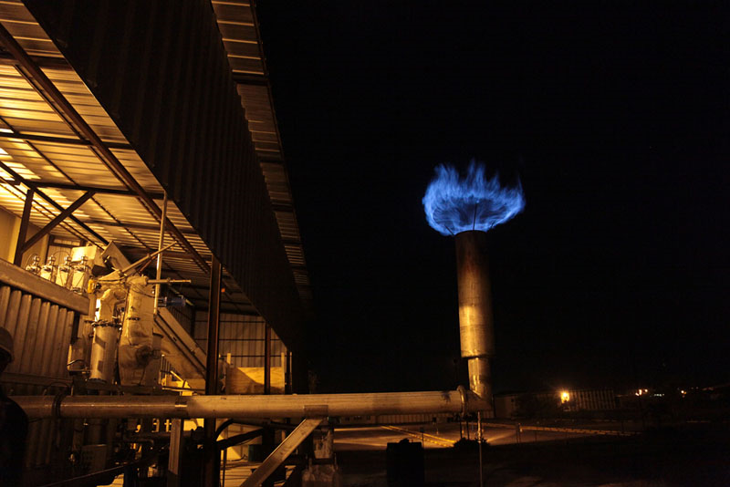
BIOCHAR: Energy production and Improved crop yields
During biochar production, liquids and gases are generated that can be used as energy or bioproducts (e.g. food flavouring).
Possible energy: heat, electricity, green hydrogen, methane, bio-oils or other liquid and gaseous fuels.
Biochar application → BIOMASS production increased
NATURE|Vol 442|10 August 2006

