Slide 1
GHG Balance and Carbon Mitigation Potential of Bioenergy Crops
Zoe M Harris
PhD Student
Funding: ETI
Project Name: ELUM (Ecosystems and Land Use Modelling)

Slide 2
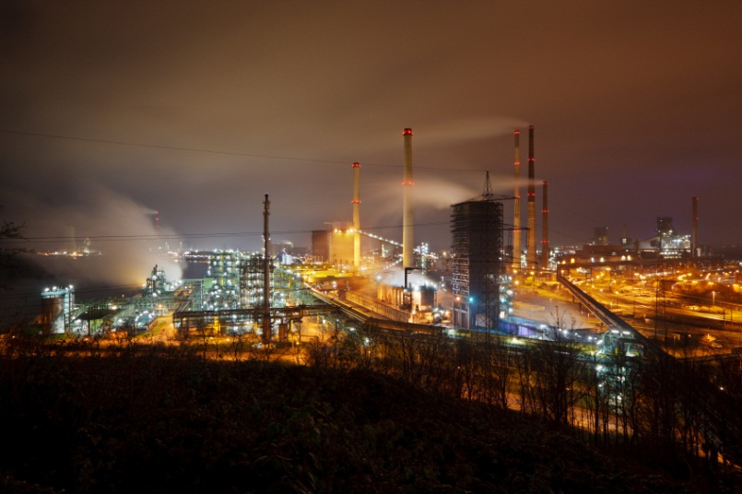
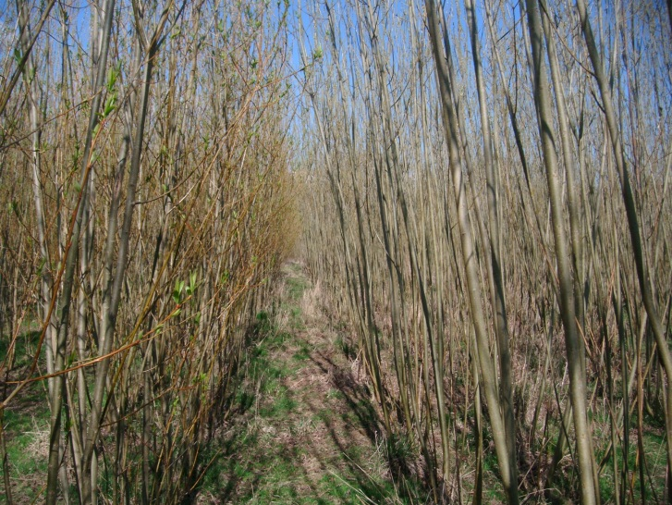
UK Specific Issues
Fossil fuels running out
Need to reduce GHG emissions
Need for more sustainable source of energy
Limited land capacity
http://www.map-of-uk.com/images/terrain-map-of-gb.gif

Slide 3
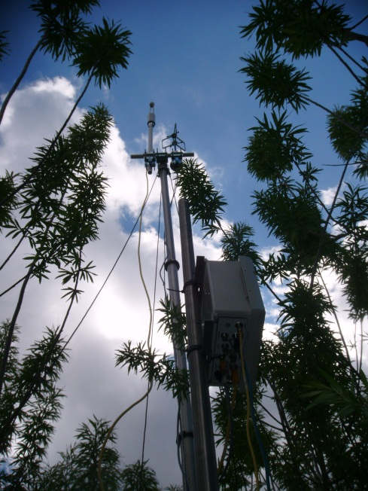
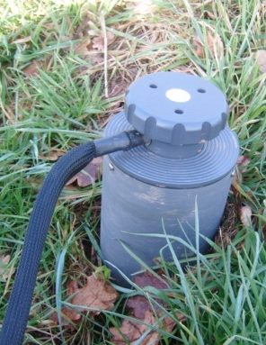
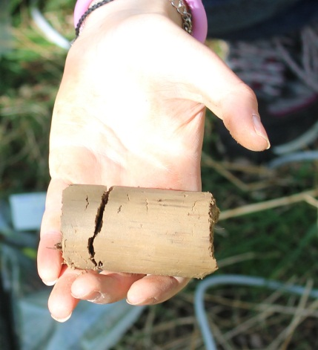
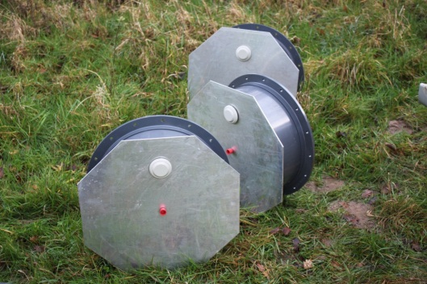
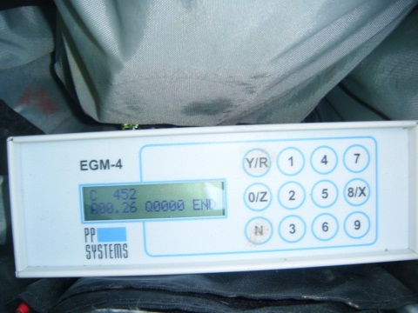
LUC effect of a transition from Grassland to SRC Willow on GHG Emissions & SOC
Eddy Covariance
Soil Analysis
IRGA
Static Soil Chambers
Ecosystem CO₂ flux
Soil CO₂, N₂O and CH₄ Flux
DOC, NH₄ & NO₃
Soil CO₂ Flux

Slide 4
Crops for Energy
Only way to convert suns energy into simple sugars
Potential to generate energy and sequester carbon
SRC is ideal due to rapid accumulation of biomass
Low inputs – fertilizer & water

