Slide 1

r-modes in superfluid neutron stars
Elena Kantor, Mikhail Gusakov
Ioffe Institute

Slide 2
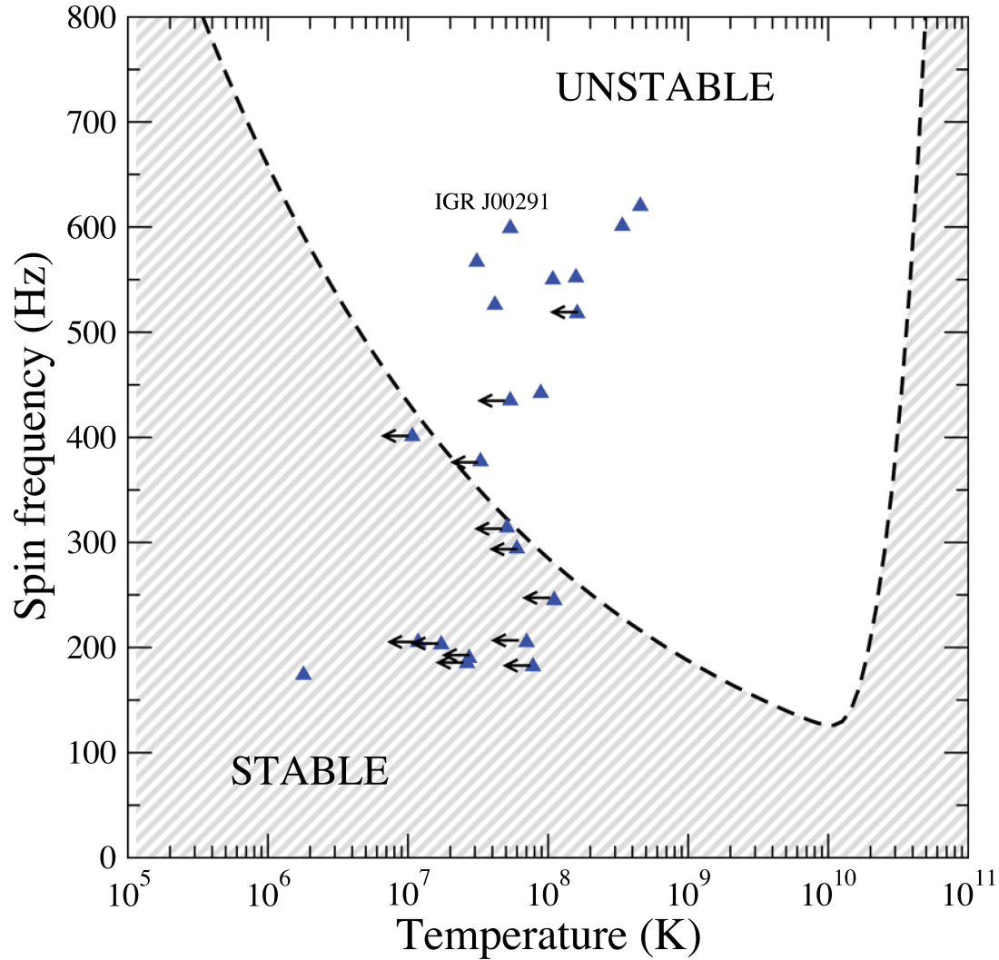
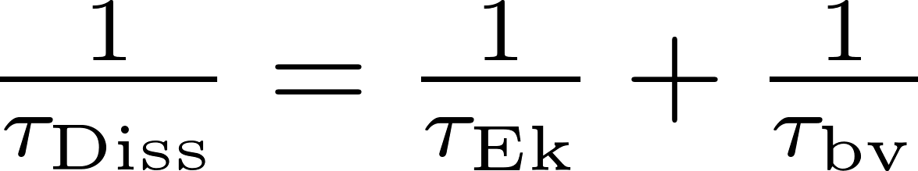

Rotating NSs support inertial oscillation modes, in particular r-modes, which are subject to gravitational-driven instability at any rotation frequency. Dissipation suppresses r-mode instability in a wide range of parameters. Only rapidly rotating and warm NSs are unstable with respect to r-mode excitation (“instability window”).
Typical instability window of an NS
B. Haskell, N. Degenaar, W. Ho, MNRAS, 424, 93 (2012)
Observed spin frequencies and internal temperatures of NSs in LMXBs.
instability window
excitation time
viscous damping time
m=2
modified Urca
Notes:
Естественным ограничителем является кеплеровская частота,
при которой звезда начинает терять вещество с поверхности.

Slide 3
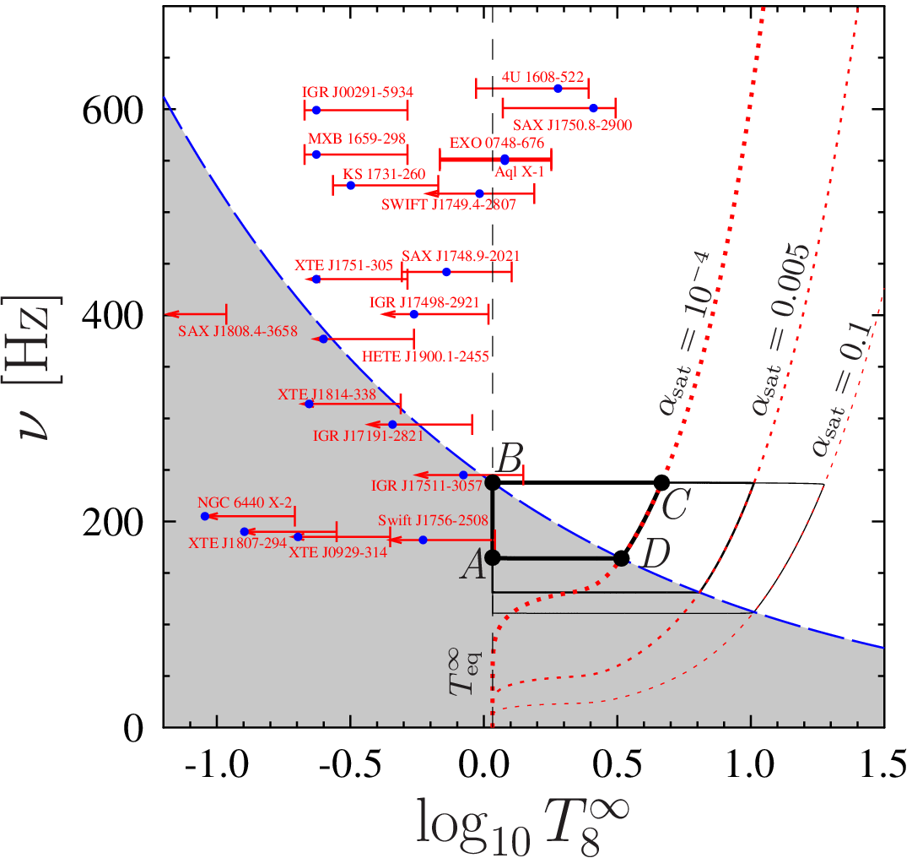

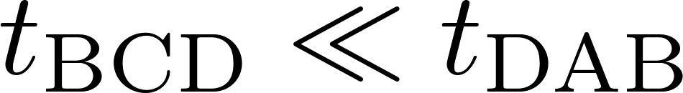
Standard scenario of NS evolution in LMXB predicts that probability to observe an NS in instability window is very small (Levin 1999)
Once an NS crosses the instability curve (in point B),
r-mode amplitude increases to the saturation value
(typically ) and rapidly heats the star and spins it down, so that the NS leaves the instability window.
The probability to observe an NS in instability region is very small.
But we see a lot of NSs there!

Slide 4
Gusakov, Chugunov, Kantor, PRL, PRD (2014)
proposed that NSs in LMXBs may be stabilized due to resonance interaction of r-mode and superfluid inertial modes.
The inertial modes of the superfluid NS:
normal modes (r-modes)
superfluid modes
Are almost the same as in nonsuperfluid NS
Eigenfrequencies are temperature independent (matter is strongly degenerate)
Correspond to co-moving oscillations of superfluid component (paired neutrons) and normal component (all other particles)
Almost no dissipation due to mutual friction
Are absent in nonsuperfluid NS
Eigenfrequencies are strong functions of NS temperature (because superfluid density is strong function of temperature)
Correspond to counter-moving oscillations of normal and superfluid components
Strongly damp due to very powerful mutual friction mechanism, that tends to equalize velocities of normal and superfluid components
Generally, normal and superfluid modes decouple and almost do not interact.
But at certain temperatures, when their eigenfrequencies are close, the interaction is strong.
The eigenfunctions of the superfluid mode admix to the eigenfunctions of the normal mode, and the latter experiences enhanced (resonance) dissipation due to mutual friction.

Slide 5
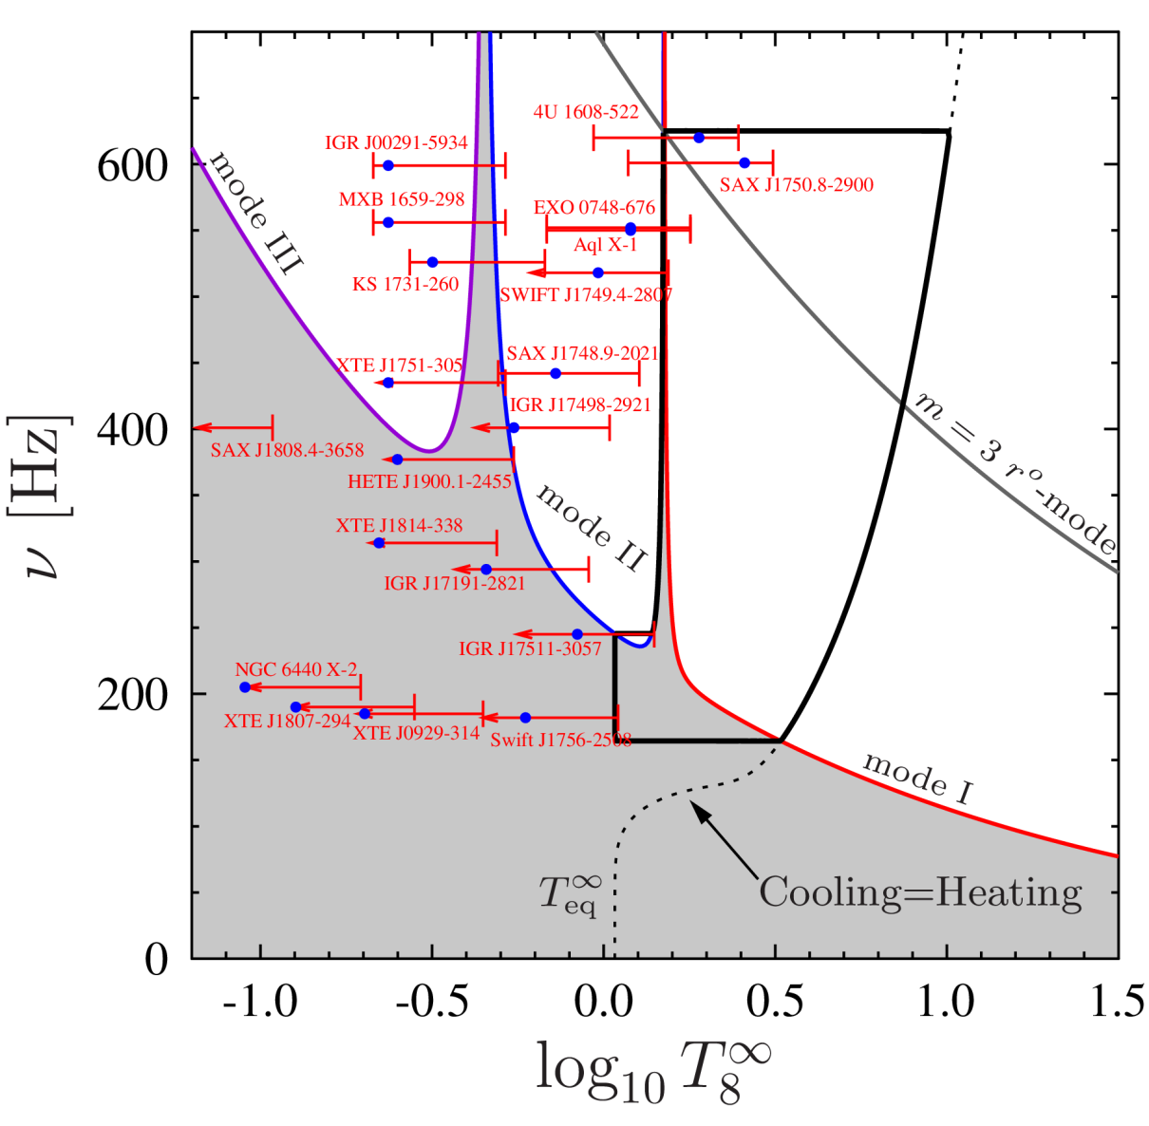
Gusakov, Chugunov, Kantor,
Phys. Rev. D, 90, 063001 (2014)
r-mode can experience enhanced damping due to mutual friction at the temperatures corresponding to the resonances with superfluid modes.
NS evolution proceeds along the stability peak.
Observed NS temperatures should correspond to the resonance temperatures in the oscillation spectrum.

Slide 6
It is important to calculate temperature dependent oscillation spectrum of superfluid rotating neutron star.
We present now the first such calculation.

Slide 7
We consider oscillations of slowly rotating Newtonian NS
in Cowling approximation.
We account for the superfluidity of baryons at finite temperature.
We consider npeμ composition.
We use Newtonian limit of the relativistic hydrodynamics of rotating superfluids
(Lindblom, Mendell 1991; Gusakov 2016)

Slide 8
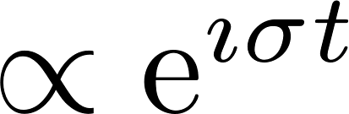
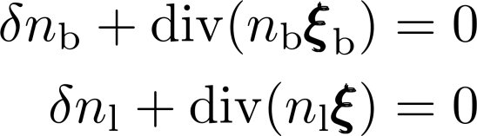

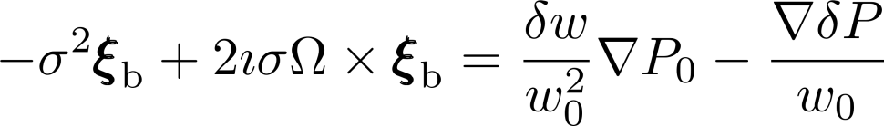



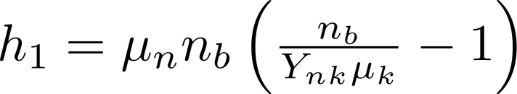

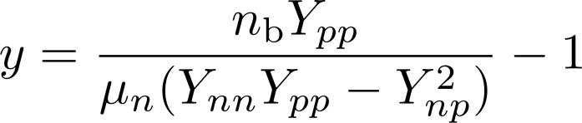


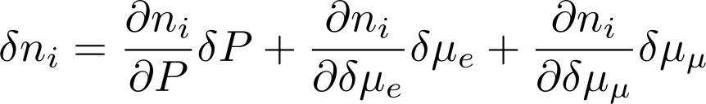
Consider perturbations in the frame co-rotating with the star.
The system of equations describing
Newtonian NS perturbations in weak-drag regime:
baryon displacement
non-superfluid particle displacement
heat function
superfluid displacement
responds for the entrainment between neutrons and protons
EOS:

Slide 9

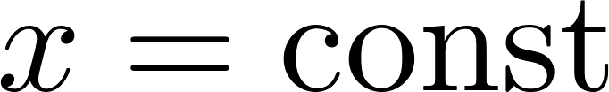


We will look for the inertial modes in slowly rotating NS. We expand eigenmodes in Taylor series in rotation frequency, and consider only the first two terms of this expansion. We account for the oblateness of the NS due to rotation:
Ordering relevant for inertial modes:
Barotropic surfaces .
We will look for purely toroidal solutions in the leading order in (r-modes).

Slide 10


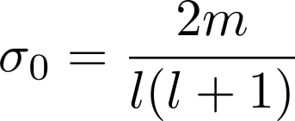
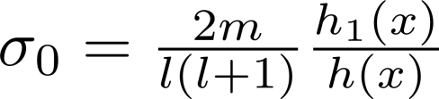
In the leading order equations decouple into two systems:
continuity equation for baryons + Euler equation (normal modes)
[continuity equation for baryons - continuity equation for electrons (or muons)] + superfluid equation (superfluid modes)
normal modes
superfluid modes
Generally, there is no global frequency for superfluid modes, thus there are no purely toroidal superfluid modes.

Slide 11
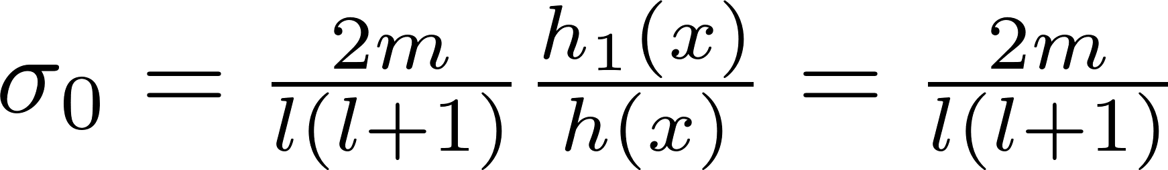
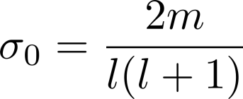
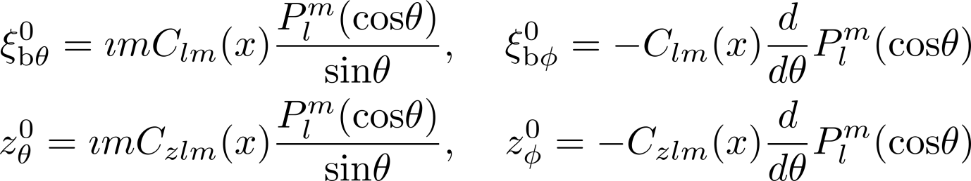

But, if
Eigenfrequencies of normal and superfluid modes in the leading order coincide.
Eigenfunctions:
In what follows we assume that .

Slide 12
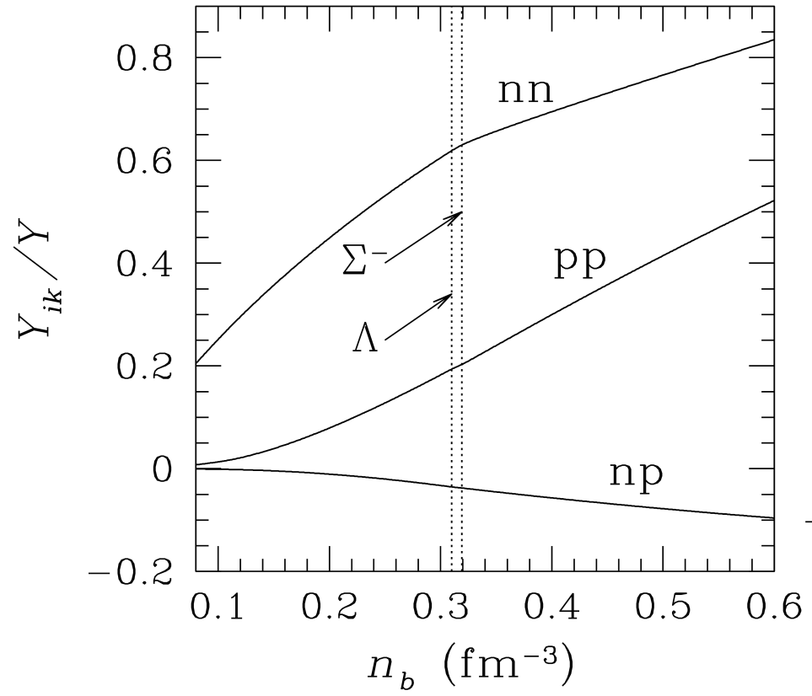

may be a reasonable approximation
Normalized entrainment matrix versus baryon number density for the third equation of state of Glendenning (Glendenning, ApJ, 293, 470, 1985)
Gusakov, Kantor, Haensel 2009
Not so easy… See the end of the talk.

Slide 13




To calculate dissipation we need to know eigenfunctions . In the leading order in eigenfunctions are not restricted. To determine them we need to proceed to the next order in .
Expanding equations
to the second order in the rotation frequency
we find that only r-modes are possible
we find and .

Slide 14
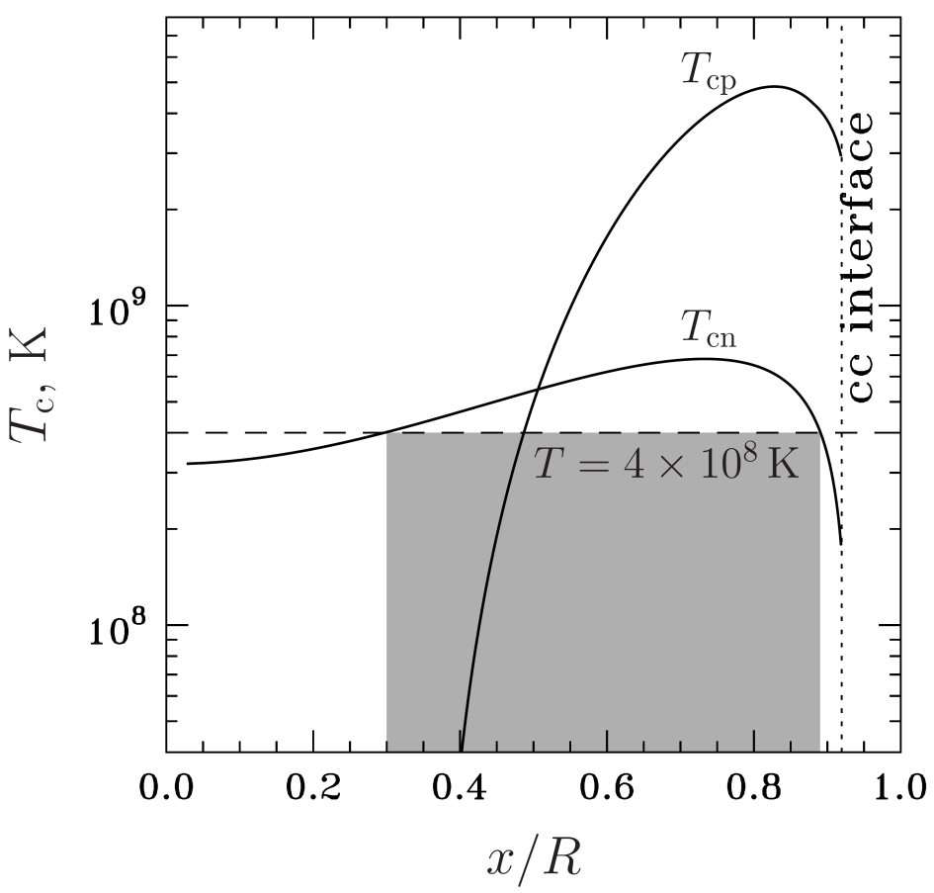


Numerical results. Physics input
EOS: parameterization (Heiselberg & Hjorth-Jensen 1999) of APR (Akmal, Pandharipande, Ravenhall 1998).
Superfluidity model
With the decrease of the stellar temperature
the size of the SFL-region increases.
superfluid region at
two and three layer configurations are possible
Two models: Model I – npe matter, Model II – npeμ matter

Slide 15
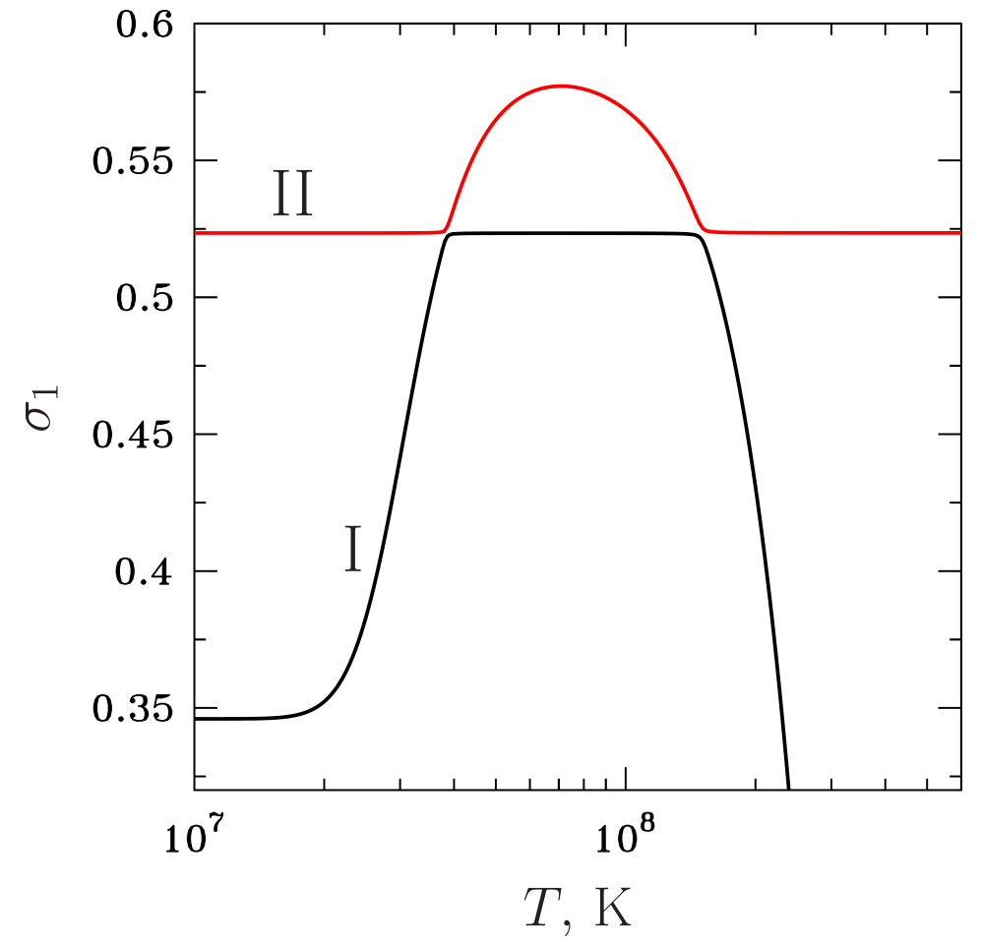

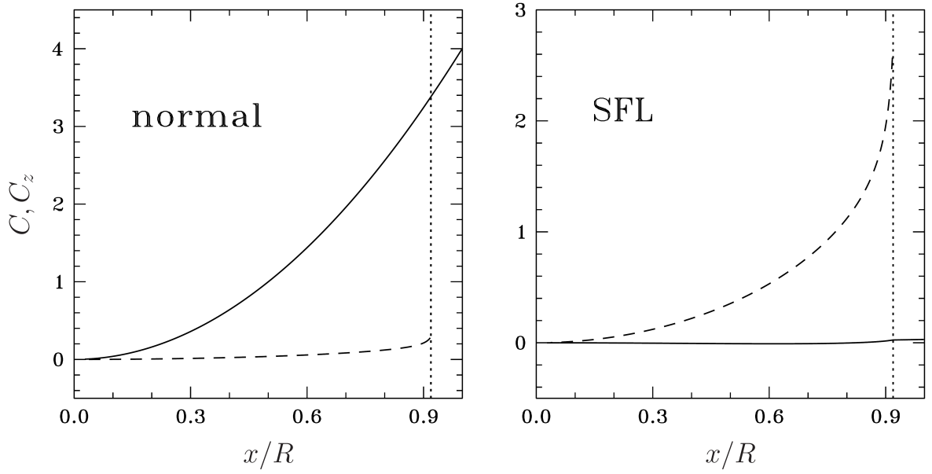




Numerical results. Spectrum
Model I – muons are disabled (npe composition)
Model I
Only two r-modes:
normal-like
(practically temperature independent)
superfluid-like
(depends on temperature)
avoided crossings
II
I
Eigenfunctions
for ,

Slide 16
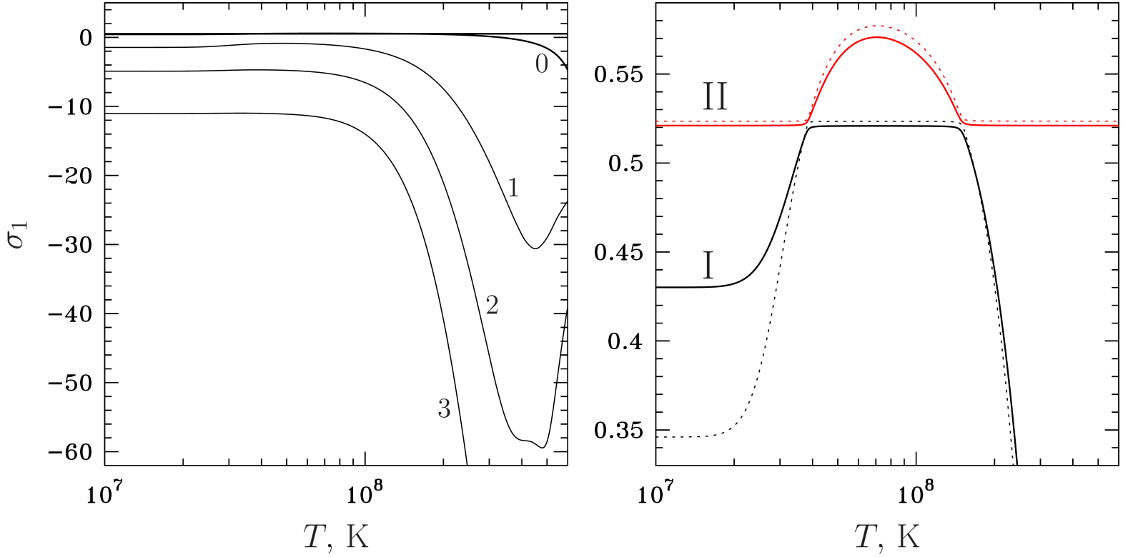

Model II – npeμ composition
Infinite set of
r-modes

Slide 17
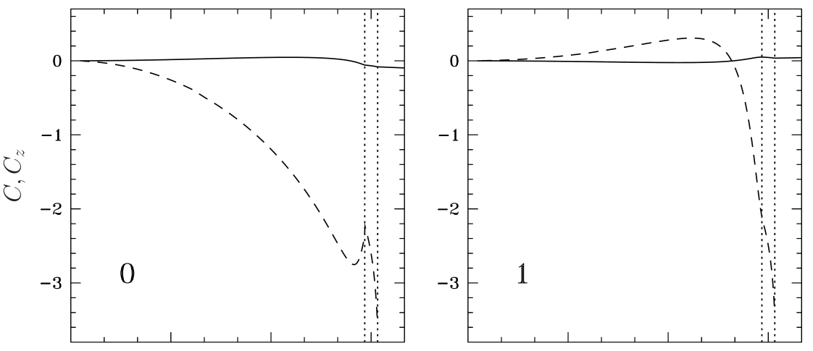
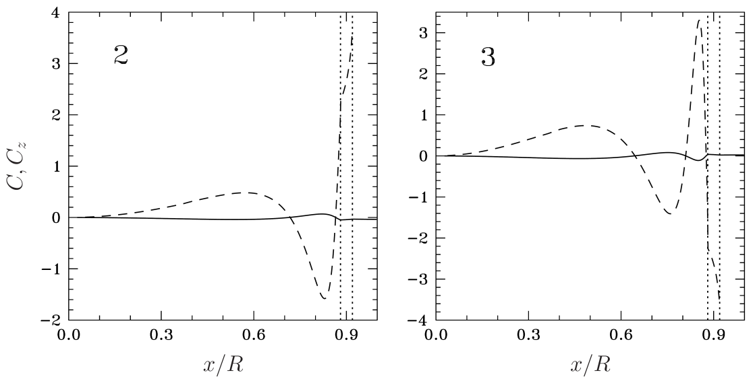
Model II – npeμ composition
Infinite set of
superfluid r-modes with nodes
Eigenfunctions of superfluid r-modes

Slide 18
Model II – npeμ composition
Only r-mode without nodes experiences avoided-crossings with normal r-mode.
Infinite set of
superfluid r-modes with nodes
Eigenfunctions of superfluid r-modes

Slide 19

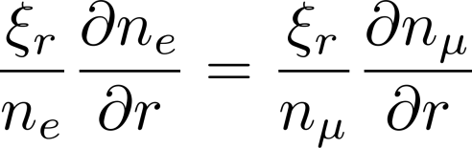


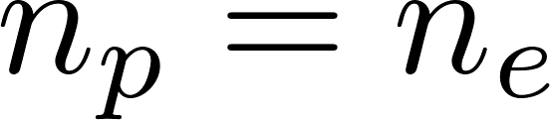


Why muons affect the spectrum so much?
Consider inertial modes ( ). Continuity equations for electrons and muons in the leading order:
It cuts some inertial modes in npeμ matter in slow rotation limit!
In the superfluid npe matter we have no such restriction (neutrons move with different velocity, protons are non-stratified ), thus can be .
The class of inertial modes in npe matter in richer!

Slide 20
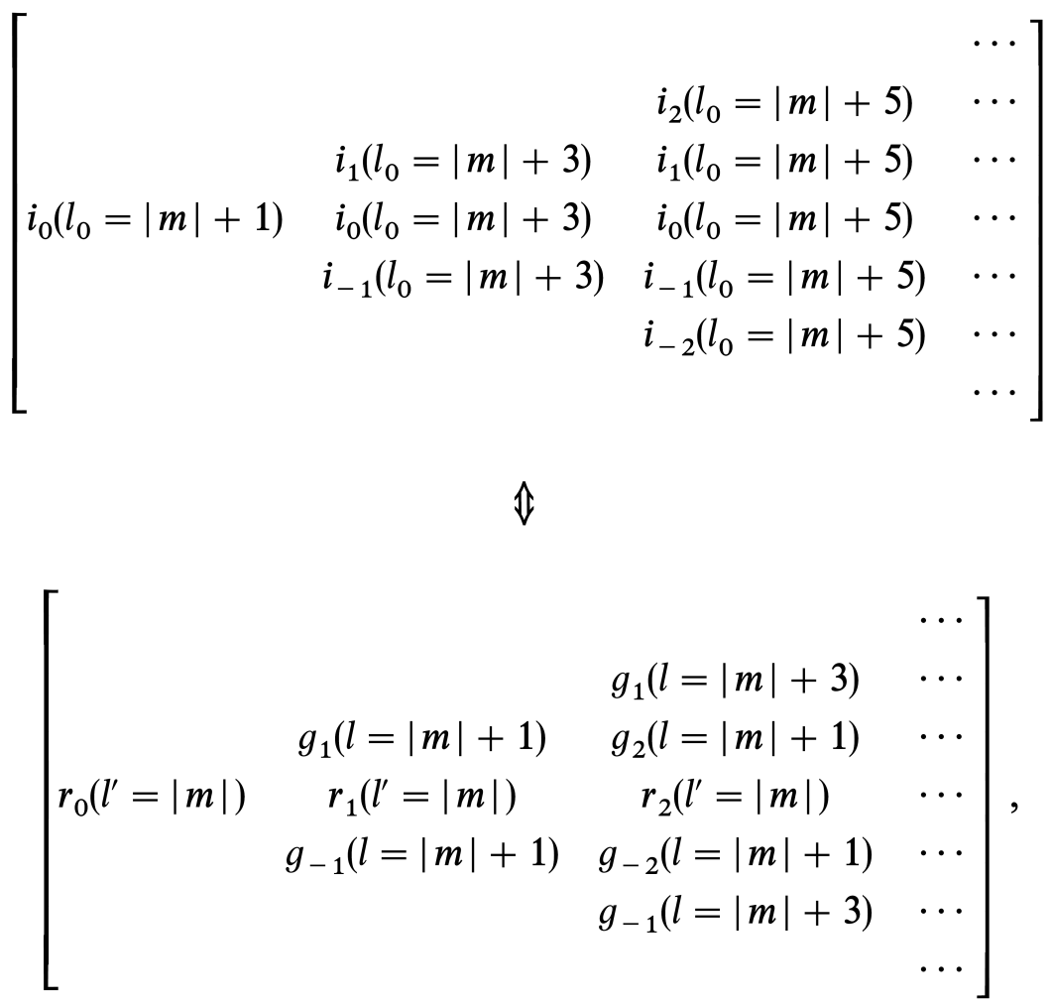
Superfluid npe matter is non-stratified
(Brunt-Vaisala frequency vanishes, Gusakov, Kantor 2013)
Admixture of muons stratifies superfluid matter (Kantor, Gusakov 2014).
Thus, in superfluid non-stratified npe matter
full set of inertial modes exists in slow rotation limit;
in superfluid stratified npeμ matter some inertial modes
transform into superfluid r-modes.
The same as in non-superfluid matter
(Yoshida, Lee 2000):
non-stratified matter supports
inertial modes in slow rotation limit;
in stratified matter inertial modes transform into r-modes or g-modes
correspondence rule

Slide 21


In analogy with non-superfluid matter, we suggest that at slow rotation
superfluid inertial -modes of npe NS transform into
superfluid r-modes with nodes in npeμ NS;
2. superfluid inertial -modes of npe NS transform into
g-modes in npeμ NS.
Lee & Yoshida 2003 considered superfluid npe NS and found that
-modes experience avoided crossings with normal r-mode;
2. -modes have higher frequencies
and do not experience avoided-crossings with normal r-mode.
Admixture of muons
transforms -modes into superfluid r-modes studied here;
increases frequencies of -modes letting them go to the corresponding g-mode frequency at slow rotation.
Thus, in the problem discussed here, normal r-mode can experience
avoided-crossings with superfluid r-modes only.

Slide 22




How small should be ?
=> no global frequency for the purely toroidal solution in the leading order in .
Instead generally we find x dependent eigenfrequency which should be regularized to some global value by an admixture of poloidal component.
Smaller , smaller admixture is needed.
At the first glance: if
If the eigenfrequency for the purely toroidal solution varies weakly through the star then the effect of the second order rotational corrections is more substantial than the effect of non-zero .
variation of purely toroidal eigenfrequency through the star

Slide 23





Not so easy
In npeμ matter => in the leading order in rotation frequency.
leads to excitation of and hence .
On the other hand, superfluid and normal modes are decoupled with a good accuracy. In the limiting case of the perfect decoupling this means that superfluid modes do not excite baryon displacements .
perfect decoupling => superfluid inertial modes have to be completely pushed out from the npeμ region at .
In reality the decoupling is not perfect and can be excited by superfluid modes to some extend in npeμ region, however the above consideration clearly indicates that decoupling leads to at least partial expulsion of the eigenfunctions from npeμ region at . Thus even small value of can in principle substantially modify superfluid eigenmodes if decoupling is good.
All this complicated behavior is driven by the interplay of three small parameters – rotation frequency, , and decoupling parameter.

Slide 24
stratification by muons is crucial for the spectrum of superfluid NS if we are talking about rotation frequencies
of the order of g-mode frequencies or lower.
Keeping in mind that g-mode frequencies in superfluid npeμ NSs are as high as hundreds of Hertz, account for muons appears to be crucial even for the most rapidly rotating NSs.

Slide 25
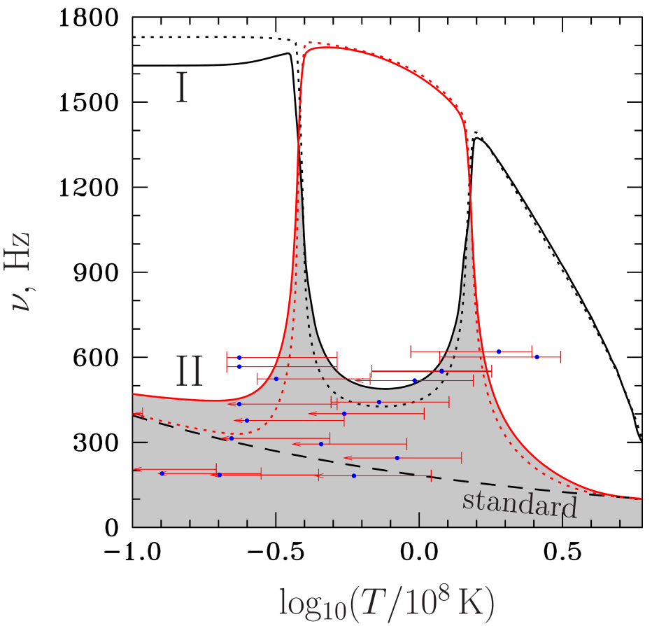
Results for the instability window
Instability curves for the two r-modes without nodes (I and II, solid lines for npeμ composition, dots for npe composition). Dashes show the ”standard instability curve”, when normal r-mode is damped by shear viscosity only. Circles with error bars represent observational data.
Stability region is very extended and hosts all the observed sources.
This is not surprising, since the relative motion of the normal and superfluid components is excited already in the leading order in rotation (because eigenfrequencies of the normal and superfluid modes coincide in the leading order for ).

Slide 27
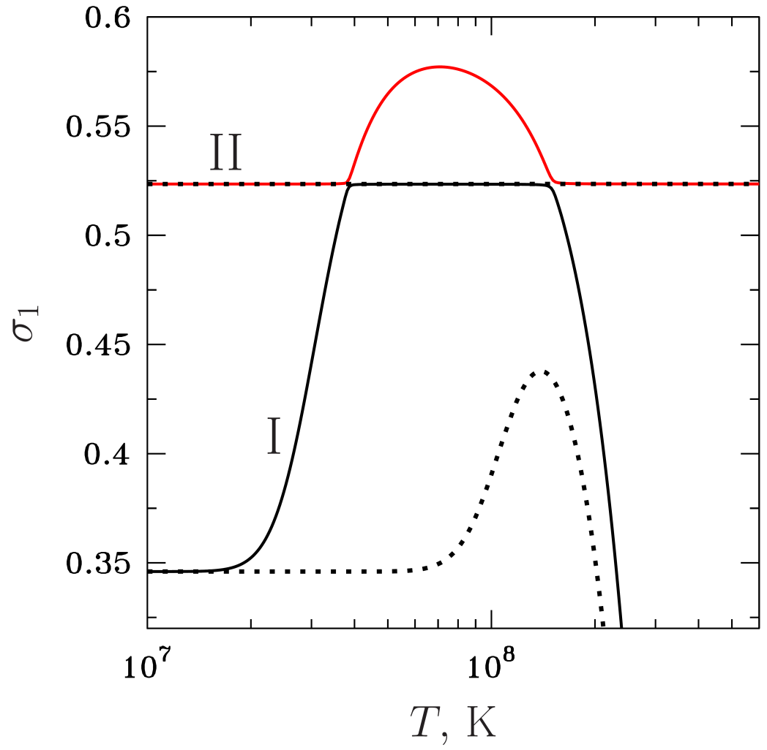
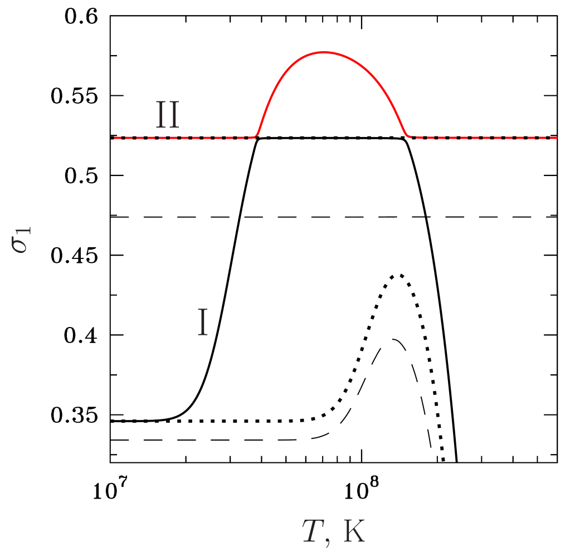


Model I
Model I
solid lines – density dependent profiles
dots –
dashes –
Normal mode is sensitive to stellar mass only.
Superfluid mode is sensitive to both stellar mass and superfluidity model.

