Slide 1

Partnering with a Clinical Trial Unit:
Key to a successful trial
Information for potential Chief Investigators
Cancer CTU Group

Slide 2
Summary
What is a CTU?
What does a CTU do / not do?
Why work with a CTU?
  What are the benefits of partnering with a CTU?
When to engage with a CTU
What to expect from the CI role
CTU = Clinical Trial Unit
CI = Chief Investigator

Slide 3
What is a CTU?

Slide 4
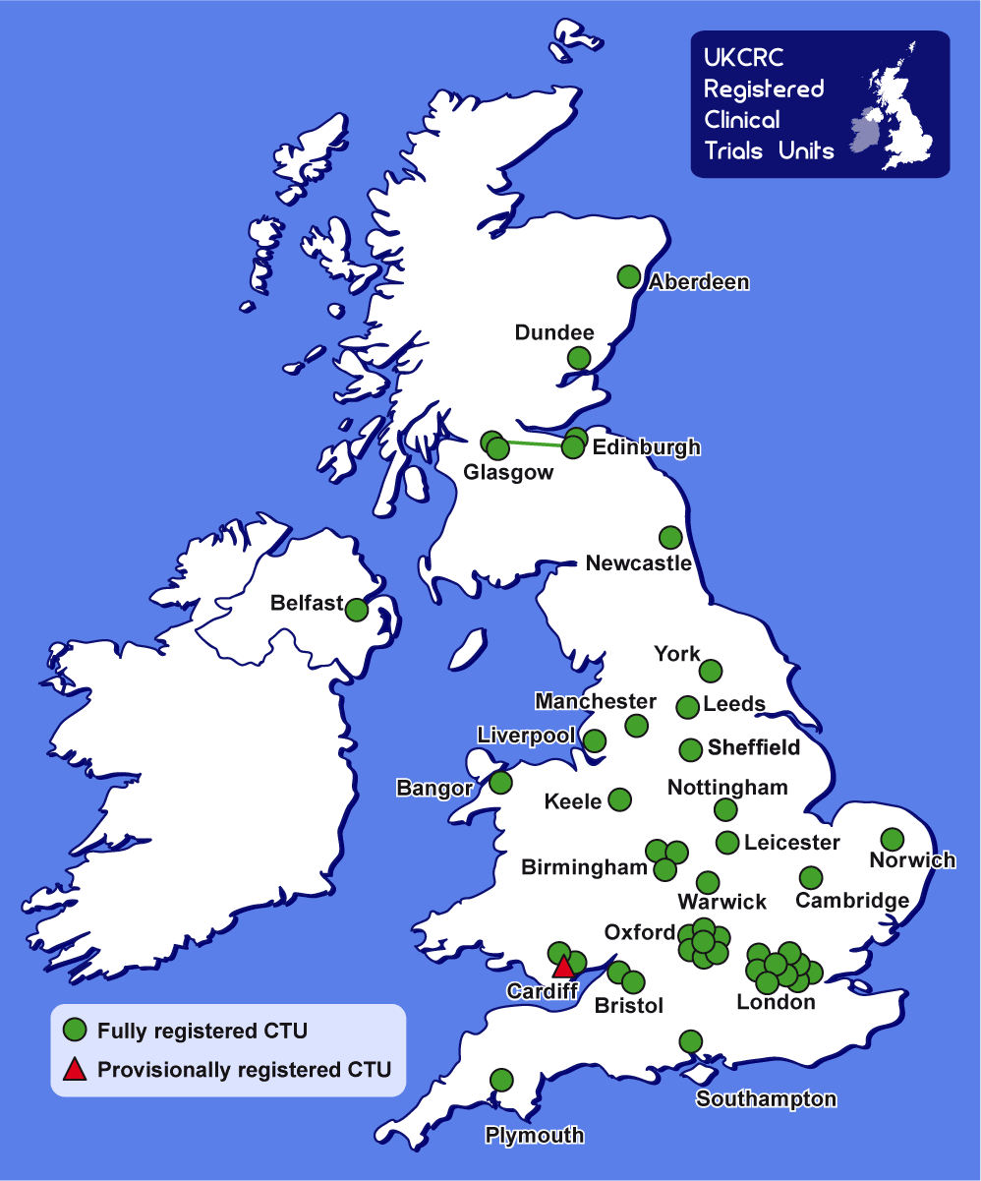
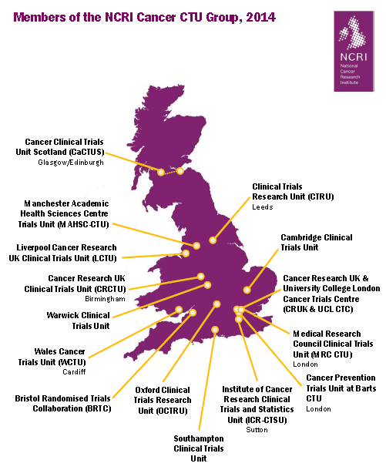
UK Clinical Trials Units (CTUs) Infrastucture
47 National UK Clinical Research Collaboration Registered CTU’s
15 NCRI Registered CTU’s with expertise in cancer

Slide 5
UKCRC CTU Registration
Full registration – key core competencies
  Track record of coordinating multi-centre Randomised Controlled Trials (phase II-IV) or other well-designed studies
  Presence of core team
    expert staff to develop and support studies
  Presence of robust quality assurance systems and processes
    to meet appropriate regulations and legislation
  Evidence of longer-term viability
    capacity for trials coordination
    development/maintenance of a trials portfolio
    core funding or evidence of a rolling programme of grants
    evidence of commitment from the host institution
Provisional registration
  have recognised expertise
  working towards full registration
Notes:
Basically a benchmark of expertise

Slide 6
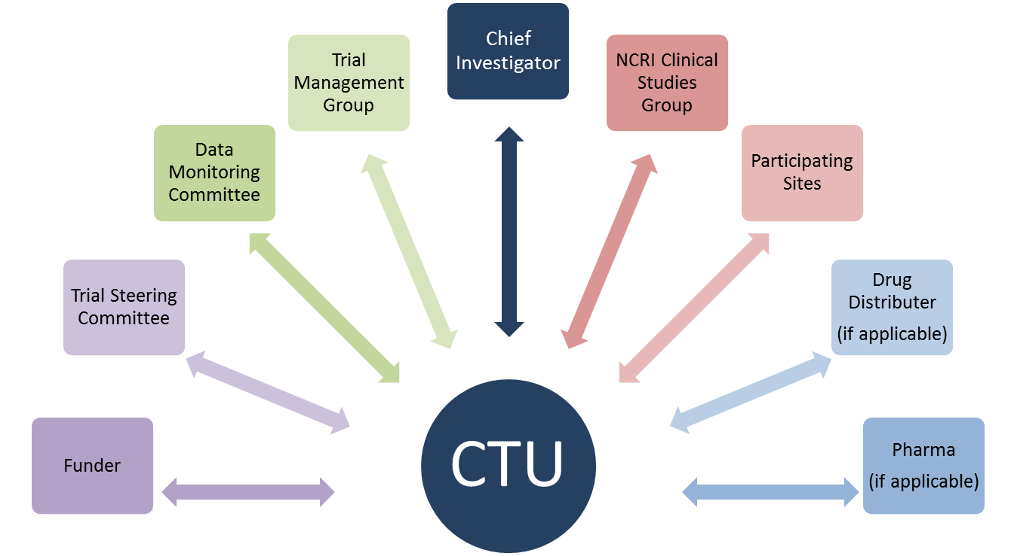

Key Relationships
Sponsor
Notes:
This is a simplified diagram

Slide 7
What do CTUs do?
Set-up
Conduct
Concept
Analysis & Reporting
Facilitate audits & regulatory inspections
Manage completion of grant application
Calculate research costs
Develop databases to track and monitor data & sample flow
Provide on-going oversight & advice to participating sites
Monitor & administer site payments
Centrally collate and enter data
Review data for completeness & accuracy - chasing data & querying where necessary
Conduct central and on-site monitoring
Develop newsletters & promotes the trial
Help Identify & address barriers to timely recruitment and conduct
Manage pharmacovigilance activities in accordance with regulations
Arrange, contribute to and administer Trial Management group (TMG) and Trial Steering Committee (TSC) meetings
Maintain trial approvals
Prepare reports for funders, regulators, sponsors etc
Maintain essential documentation
Arrange, contribute to and administer Independent Data Monitoring Committee (IDMC) meetings
Provide statistical reports for IDMC meetings
Conduct additional exploratory analyses as agreed by the TMG
Contribute significantly to drafting of manuscripts, abstracts and presentations
Administer the submission of manuscripts, abstracts and presentations
Present at (inter)national symposia as required
Advise on trial concept and trial design
Review available literature to inform sample size calculations
Conduct feasibility assessments
Develop all trial materials incl. protocol and PIS
Conduct risk assessment
Obtain regulatory, ethics and global NHS permissions
Ensure appropriate sponsorship arrangements
Oversee contract negotiations and development
Ensure appropriate arrangements for treatment allocation and labelling & distribution of trial drugs
Develop trial materials & guidance notes for investigator & pharmacy files
Ensure appropriate arrangements for sample collection and tracking
Develop plans for data management, central and on-site data monitoring and statistical analysis
Develop CRFs & trial database
Organise launch meetings & conduct initiations of participating sites
Provide a randomisation service
Conduct statistical analyses according to pre-defined analysis plans
Funding Period

Slide 8
Trial Development Process
Research Question
CTU Agree to Conduct Trial
Identify Sponsor, CI, Consumer Input
Literature Review,
Protocol Working Group Agree Design
Design Trial
Prepare Outline Proposal
Finalise Outline Proposal, Calculate Research Costs, Confirm Interest
Outline Proposal to Potential Funder, Sponsorship Negotiations
Assess Interest, Confirm Collaborators, Formulate Associated Sub-Studies e.g. QoL, Translational
Funding Approval, Protocol Development, Draft PIS/IC, Risk Assessment
Prepare Full Funding Application
Trial Set Up
Finalise: Protocol, PIS, IC Sub-Studies
Prepare: GP Letter, CRFs, Database construction, TMF, Trial Operating Procedures (TOPs)/Guidance (TOGs)/Guidance Notes (TGNs), Site Investigator/Pharmacy File
Obtain: EudraCT, ISRCTN, Sponsor Numbers, Update NCRN Website, Contracts, Drug Supply, Drug Labelling
Apply for Regulatory Approvals
Obtain Approvals: Sponsor, MREC, CTA, CSP, R&D
Local Investigator Site Accreditation and Initiation
Open
Trial
PIS = Patient Information Sheet
IC = Informed Consent
CRF = Case Report Form
TMF = Trial Master File
CT = Clinical Trial Application
CSP = Coordinated System for NHS Permissions
Notes:
Few terms/acronyms may need explaining eg EudraCT ISRCTN

Slide 9
During the Trial
Literature Review, Safety Update, Expert Input
Regulatory Submission, obtain approvals, circulate to sites
Amendments
Monitor trial recruitment against expected recruitment rate
Promote trial recruitment at sites, regular contact/meetings
Recruitment
Prepare regular reports for trial oversight committees
Prepare annual reports for submission to regulatory bodies/funders/ collaborators/ presentations
Open Trial
Reporting
Trial Closure
Pharmaco-vigilance & Quality Assurance
Review of SAEs, monitoring trial safety data and risk/benefit ratio
Monitoring visits, onward reporting of SUSARs, submit annual DSUR
Trial team oversight, review of milestones and trial finances
Provide training, hold regular trial oversight meetings
Trial Management
SAE = Serious adverse event
SUSAR = Suspected unexpected serious adverse reaction
DSUR = Development safety update report

Slide 10


End of the Trial
Trial Closure
Sent to sites and regulatory authorities
Notification
Closedown sites, reconciliation of drugs and trial documentation
Site Closure
Reporting
Prepare end of study reports to regulatory bodies/funders
Statistical analysis and publication of final trial manuscript
End of Trial

Slide 11
What CTU’s don’t do
Interface with patients
  Other than sending out patient reported outcome questionnaires eg quality of life
Store, label dispatch IMP’s, ATIMP’s or biological samples
  Although processes may be managed by CTU
IMP = Investigational Medicinal Product
ATIMP = Advanced Therapy Investigational Medicinal Product
Notes:
From Sue Tebbs UCL Comprehensive CTU : amend if different – ie some CTU’s fulfil site and central coordination roles

Slide 12
Why Work with a Registered CTU?
Grant success rate – some funders require it!
Core infrastructure support - before grant funding
Expertise
  Trial design
  Contract negotiation
  Trial costing
  Navigation through regulatory requirements
  Risk assessment
  Avoidance of preventable problems
Ready made systems and procedures

Slide 13
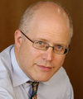
Working with a CTU
“As a CI you are expected to have detailed knowledge of every part of the study and the CTU is critical in ensuring that every area is covered. The CTU is essential...one needs the expertise that is available, running all the way from the finances, planning, protocol writing and regulatory issues.”
Daniel Hochhauser
Professor in Medical Oncology
UCL / UCLH
CI: PANTHER

Slide 14
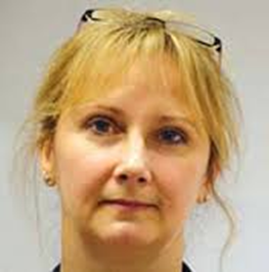
Working with a CTU
“Working with the CTU helped me to turn my academic ideas into practical reality. Nothing was ever "no". It was always just about how long, how many, how often, how much etc. Instead of being another constraint, their pragmatic approach was, paradoxically, freeing."
Adele Fielding
Professor in Haematology
UCL / Royal Free Hospital
CI: UKALL 14 & UKALL 60+

Slide 15
Alternatives to working with a CTU?
Research Design Service (RDS)
  Help with trial design /sample size only
Consider how you will manage
  Ongoing statistical support /analysis
  Sponsorship
  Contracts negotiation and sign off
  Regulatory support etc
  Database creation and management
  Staffing including training & supervision needs
  Initiation, monitoring, safety reporting
  Patient and public involvement
Notes:
RDS provide some statistical support at design stage but not necessarily throughout the trial and for final analysis
CTU’s statisticians are involved throughout the trial and CTU staff can help with all aspects of trial management and report/publication preparation - a considerable workload

Slide 16
Benefits of working with a CTU

Slide 17
Funding Success
CTU’s have proven track record
  Know what a fundable application looks like
  25% of HTA & CR UK grants are funded
  74% of CTAAC grants applications funded when NCRN CTU partnered application*
CTU’s are familiar with
  trial costings
  risk assessment
CTU’s assist with completing the application
*UKCRC CTU Oversight Group Review of CTU Capacity - Nov 2008
HTA = Health Technology Assessment
CTAAC = Cancer Research UK’s grant awarding committee until 2015
Notes:
Track record – individual CTU can mention no. of trials in their portfolio and funding streams they have experience of

Slide 18
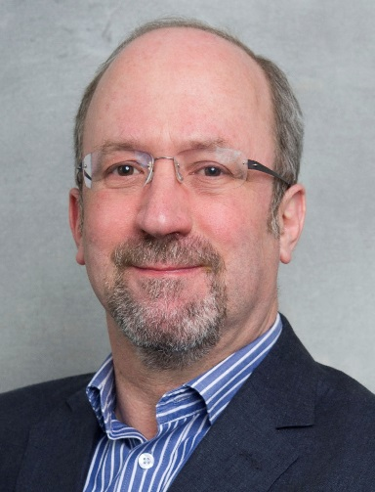
The view of the Funding Committees
“It’s very clear when high quality funding applications have been developed in collaboration with a CTU. Even proposals of scientific merit risk being turned down if the trial conduct, costings and trial design are not well presented. ”
David Sebag-Montefiore
Professor in Clinical Oncology
St James’s Institute of Oncology, Leeds
CI: ARISTOTLE & CR07
Former Chair CR UK CTAAC
Notes:
Echoes later quote that its better to delay an application to maximise your chances of getting funding.

Slide 19
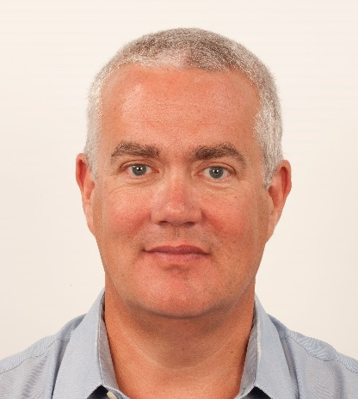
The view of the Funding Committees
What makes you look favourably on an application?
“Even though the applicant may be new, it's important that the group who they collaborate with has a good track-record and are experienced. Similarly, it is important to gain help from a clinical trials unit that is experienced in running such trials.”
Mark Saunders
Consultant Clinical Oncologist
Christie Hospital Manchester
Former CR UK CTAAC member

Slide 20
Access to CTU Infrastructure
Why is this important?
Trial lifespan longer than duration of the grant
Non-grant funded activity
  eg contract negotiations
  Specialist advice eg regulatory
Staff training and continuity
Accumulated knowledge and experience
  eg problem solving/ troubleshooting
Notes:
CTU could mention their own portfolio of trials eg no of new applications per year, no of active and no of follow-up trials

Slide 21
Contribution of Core and Project Funded Staff to Direct Trial-related Activities
Development
Set up
Accrual
Follow-up
Analysis & Publication
Long term Follow-up
Core funded staff
Project funded staff
UKCRC CTU Oversight Group Review of CTC Capacity - Nov 2008
Core activity is essential in underpinning and enabling Project-specific activity and ensuring development and delivery of projects is maintained and is conducted to highest quality.
Core activity not necessarily carried out by full time core staff. Often staff are partly funded through core and partly through project specific funding.
Notes:
Proportions may differ between CTU’s eg 70/30 core/project during development depending on funding models

Slide 22
Appropriate Trial Costing
What impacts on cost?
Risk of trial – monitoring requirements
Phase of trial
Duration
Intervention
Research costs to sites eg Trial specific assessments
Number and location of sites eg International sites
Sub studies eg
  QoL
  Sample collection
  Central QC – pathology, imaging etc
Notes:
NB. Monitoring requirement impacts on staffing levels, costs of visits, AE reporting QC/Audit etc

Slide 23
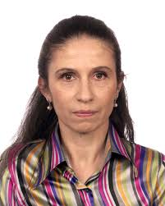
Getting the funding right
“As an investigator you are keen to start ASAP, but sometimes its wise to delay an application for funding; that way you submit the best possible application and haven’t missed the chance for funding by a rushing. The CTU team advice makes your study better and more likely to be funded.
Maria Hawkins
Associate Professor and Honorary Consultant Clinical Oncologist
Oxford University Hospitals
NHS Trust
CI: CHARIOt, SPARC & ABC07

Slide 24
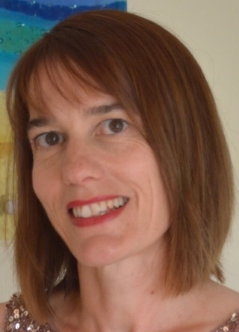
Getting the funding right
“The CTU will provide important information on costing, including all the “hidden” costs that may not be obvious to the new CI. They will guide you through the (sometimes confusing) definitions of research vs treatment costs. If all costs are not considered and applied for then it could prevent a study from proceeding smoothly.”
Charlotte Coles
Consultant Clinical Oncologist
Cambridge University Hospitals
NHS Foundation Trust
CI: IMPORT HIGH & LOW & PRIMETIME

Slide 25
Grant funding
Why do CTU’s vary?
  Core support from funder may reduce cost
  Institutional overheads
Notes:
Some early phase trials can be as costly to set up as some phase III trials. Core funding levels to support trial development and oversight varies from CTU to CTU.

Slide 26
CTU Funding requirements
Why does it cost so much?
Staffing (FTE depending on trial complexity)
  Trial manager
  Statistical support
  Database construction
  Data management
  Regulatory and Quality Management
Running expenses
  Computer, software, etc
  Administrative costs
Notes:
Salaries constitute largest cost. CTU costs vary and not all staff need to be full time.

Slide 27
Non-CTU costs
Site costs
Intervention
IMP distribution
Translational research
Don’t ask for too little
  Underfunding impacts on trial success
    Understaffed
    Patient safety at risk
    May cause delays
    Unethical!
Notes:
Could refer to high / low risk trials and difference in costs

Slide 28
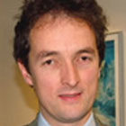
CTU Director Quote
“Beyond having a good question it’s important to engage with a CTU from the outset in order to ensure that all the vast regulatory and financial landscape can be addressed and to maximise the chances of successfully delivering the trial and obtaining a top quality answer to the question”
Professor Robert Jones
Professor of Clinical Cancer Research
Director: CR-UK Clinical Trials Unit
Beatson Oncology Centre Glasgow

Slide 29
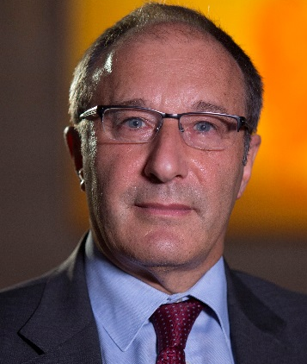
CTU Director Quote
“The consequences of not involving a CTU in the early stages of negotiations with Pharma can lead to problems with underfunding and a lack of clarity on who is responsible for what eg. who owns the data, who can publish what. This can lead to major problems and delays”
Professor Jonathan Ledermann
Professor in Medical Oncology
Director: CR UK & UCL Cancer Trials Centre

Slide 30
Negotiating with Industry
How can a CTU help?
Prior experience with a variety of companies
  Understanding the pitfalls
Requesting realistic funding
Contract negotiation
  Understanding the wider implications
Investigational Medicinal Product management
    What works
Notes:
Could mention - Contracts often require further negotiation eg they may not have provision for company withdrawing support, provide sufficient funds upfront etc

Slide 31
When to engage with a CTU?
Right from the start!
Why?
  It’s not just about trial design
  Contracts
  Costings
  Navigating the regulations
Notes:
Could expand and use real example of what happened when trial picked up by CTU at a later stage – eg problems with trial design, redesign of CRF’s, insufficient funding etc

Slide 32
Working with a CTU at concept stage
“The worst case scenario of not working with a CTU from concept stage is that the study even if funded, is then undeliverable due to fundamental methodological flaws. A more common situation is that the trial design is suboptimal and it takes a huge amount of work to modify it. The CTU brings an enormous amount of expertise and are not just there for advice on the power calculation!”
Charlotte Coles
Consultant Clinical Oncologist
Cambridge University Hospitals
NHS Foundation Trust
CI: IMPORT HIGH & LOW & PRIMETIME
Notes:
OPTIONAL: The Youtube link is to an animation of a researcher asking a statistician about sample size – and the difference in perspectives!
https://www.youtube.com/watch?v=PbODigCZqL8&app=desktop

Slide 33
Working with a CTU at concept stage
“The aim of the CTU is to help you design and run the best study possible and CTU staff time is allocated to your study. Once they know what the trial is about they help you a lot with feasibility, funding, regulatory, statistics questionnaires etc.
Maria Hawkins
Associate Professor and Honorary Consultant Clinical Oncologist
Oxford University Hospitals
NHS Trust
CI: CHARIOt, SPARC & ABC07

Slide 34
Engaging the right CTU
Factors to consider
CTU Expertise and track record
  Likely funder
  Disease area
  Intervention
  Setting eg primary care, international etc
  Methodology
How to find out
  Ask around
  http://www.ukcrc-ctu.org.uk/
Notes:
Don’t have to choose local CTU - consider expertise of CTU (in terms of disease area, intervention, outcome measure) or they will be on learning curve too!

Slide 35
Engaging with CTU’s
Key questions to ask a CTU
Will CTU collaborate if
there is only one site?
there are international sites?
the trial is sponsored by Pharma?
the trial is high risk?
they haven’t previously worked in disease area, setting etc?
the trial is already funded?

Slide 36
What types of trials do CTU’s take on?
Depends on the CTU!
CTU’s are the best option if the trial
  is multicentre
  involves an Investigational Medicinal Product (AT/IMP)
  is high risk
  is in a disease, trial intervention / outcomes area in which the CTU already has expertise
Notes:
Optional slide and can be adapted to specific CTU strategy

Slide 37
CI vs PI
What’s the difference?
Principal Investigator: responsible for the conduct of the trial at their site
Chief Investigator: responsible for the overall design, conduct (at all sites) and reporting

Slide 38

CI vs PI
“Taking on the role of a CI is a significant step up from PI.....”
David Sebag-Montefiore,
Professor in Clinical Oncology
St James’s Institute of Oncology, Leeds
CI: ARISTOTLE & CR07

Slide 39
CI vs PI
What’s the difference?
Additional responsibilities
Trial oversight / management of whole trial
Protocol development and trial design
Funding
Trial Master File and all essential documents
Data base validation and data management
Regulatory submission and compliance
Ethics submission
Risk assessment / Safety / IMP Oversight
Annual / End of trial Reports
Notes:
NB. GCP states 11 CI roles – 9 roles here

Slide 40
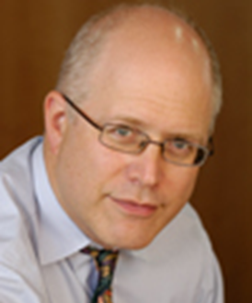
CI vs PI : How different is it?
“I think its quite different. The role was primarily what I expected but there was much that I did not anticipate, particularly the amount of detail you must be aware of as the CI such as pharmacy, toxicities etc.
You have to be really willing to take full responsibility.”
Daniel Hochhauser,
Professor in Medical Oncology
UCL / UCLH
CI: PANTHER

Slide 41
Time Commitment for CI’s
Prior to funding
  Very variable but start >3 month ahead of deadline
  It can take over a year to determine the right design
Post funding
  Estimate 2-4 hours a week - very variable
  Allow time to establish good working relationships
    CTU staff
    TMG
    Site PI’s
  Availability for troubleshooting
    Queries on eligibility, protocol, safety etc

Slide 42
Time Commitment – developing idea
“Its a time consuming process and it took a lot more time (to develop the protocol) than I had anticipated because of the company’s strategy, emerging knowledge about PK and side effects.”
Daniel Hochhauser,
Professor in Medical Oncology
UCL / UCLH
CI: PANTHER

Slide 43
Time Commitment : open trial
“I’m personally spending around 3- 4 hrs a week on issues relating to the study and that can be more or less on other weeks. We have regular 1hr fixed meetings every 2 weeks with the CTU.”
Daniel Hochhauser,
Professor in Medical Oncology
UCL / UCLH
CI: PANTHER

Slide 44
Partnership working with a CTU
“Be prepared for regular meetings, inquisitive questions and suggestions. Listen, think and learn! Initially things can be a bit hard but working as a team becomes easier (and is sometimes fun).”
Maria Hawkins
Associate Professor and Honorary Consultant Clinical Oncologist
Oxford University Hospitals
NHS Trust
CI: CHARIOt, SPARC & ABC07

Slide 45
Communication with CTU
“As a CI you will receive many e-mails from the CTU every month. You will need to be able to reply in a timely manner and prioritise your work accordingly.
As the CI of ARISTOTLE (actively recruiting) I have a teleconference with the CTU every 3-4 weeks. ”
David Sebag-Montefiore,
Professor in Clinical Oncology
St James’s Institute of Oncology, Leeds
CI: ARISTOTLE & CR07

Slide 46
What should you expect from a CTU?
Trial Design and Funding applications
  Expertise in trial design and good track record in obtaining funding
Trial Expertise
  Support and guidance in preparing ethics applications
  Protocols, case report forms and essential documents
  Trial coordination, database development and data management
Communication and Reporting
  Kept informed of issues at sites
  Preparation of trial reports for relevant committees and bodies
  Preparation work for publications and presentations
Compliance
  Navigation through relevant clinical trial regulations and guidance
  Best practice in clinical trial conduct from design to final publication
  Risk management
Notes:
With thanks to Sue Tebbs Comprehensive CTU at UCL

Slide 47
What will a CTU expect from you?
The 4 C’s
Collaboration
  Academic CTU’s are partners not service providers
Communication
  Keep CTU in the communication loop eg messages for funder, R&D, REC’s, MHRA, Investigators etc
Clinical input
  Timely input and review of clinical issues from protocol queries to safety reviews
Compliance
  Comply with CTU & Sponsor SOP’s and policies to ensure compliance with appropriate clinical trial regulations, guidance and funder requirements eg formation of Trial Steering Committee’s (TSC’s)
Notes:
With thanks to Sue Tebbs Comprehensive CTU at UCL

Slide 48
Acknowledgements
Concept and Construction of Slides
  Helen Meadows
    Cancer Research UK & UCL Cancer Trials Centre
  Claire Snowdon
    Institute of Cancer Clinical Trials Research & Statistics Unit (ICR-CTSU)
Additional thanks to
  All chief investigators
  Sue Tebbs
    Comprehensive CTU @ UCL for slides 11, 46, 47
  Senior Staff at
    Cancer Research UK & UCL Cancer Trials Centre
    Institute of Cancer Clinical Trials Research & Statistics Unit (ICR-CTSU)
Cancer CTU Group

