Slide 1

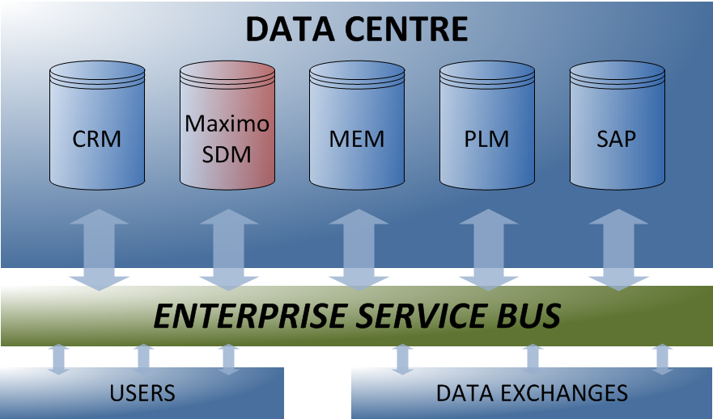
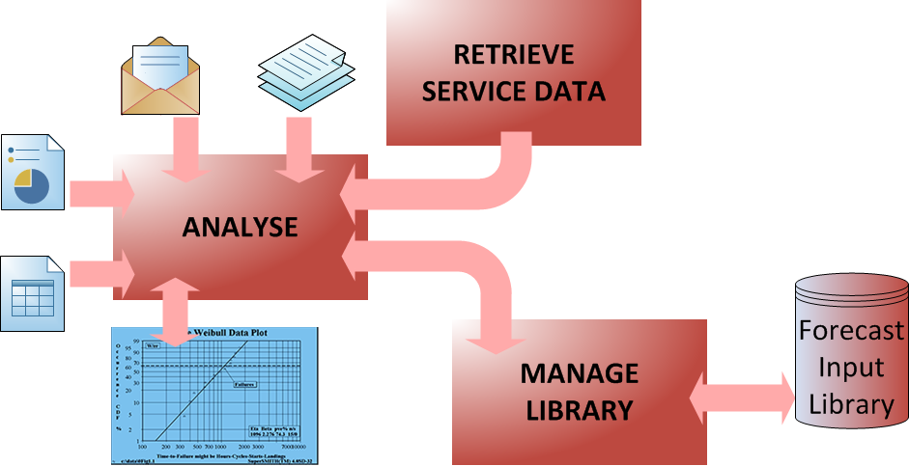
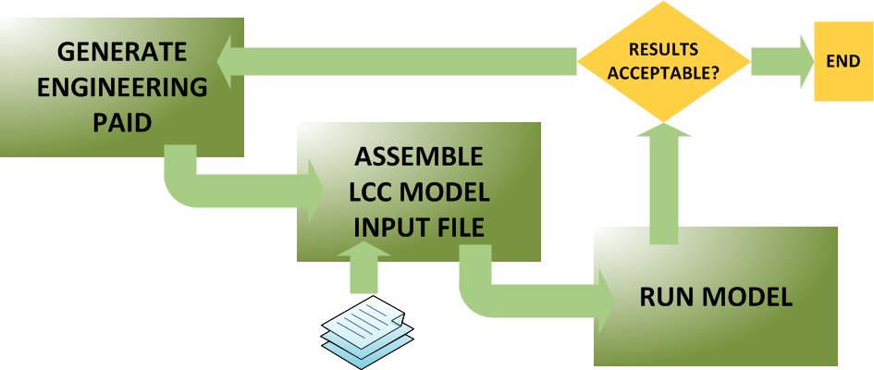
Accelerating Life Cycle Cost Modelling
Through Efficient Knowledge Management
UTC for Computational Engineering
Tai-Tuck Yu and Prof. Jim Scanlan, Faculty of Engineering and the Environment
Fay Bayley, Rolls-Royce plc
1. Running on low-grade fuel
Engineering or business technique without data offers only a partial solution. Further, the beneficial outcomes of good, robust techniques are often masked by the deleterious effects of low quality data. This is like running a high performance engine on low-grade fuel.
Rolls-Royce (RR) is a knowledge-intensive organization where the ready availability of information and the unhindered flow of high quality data, especially within its corporate boundaries, are essential to its business well-being. Decision support tools such as discrete-event life cycle cost (LCC) models depend on large amounts of product service data in order to generate forecasts which engineers and business analysts can be confident with.
2. Research objective
In this project, the efficiency metric is defined as “the lead time and resource per LCC analysis performed”. The as-is lead time generally ranges from three to six months. Hence, the goal is to decrease it by about an order of magnitude so that LCC results will still be as relevant and useful to RR and its customers as when the demand was initiated.
Figure 1: Enterprise data architecture
4. Accelerating data delivery
The Forecast Input Library, a single enterprise-wide repository, will contain all the data necessary for generating an engineering Product Attribute Input Document (PAID). The as-is lead time for performing an LCC analysis is very largely due to PAID production. This will be reduced by making PAID production semi-automatic, i.e. it will require human intervention in some parts of the input data preparation process.
In addition to the shortened lead time and reduced resources resulting from the implementation of the Forecast Input Library, the research objective is to be achieved by –
Planning the schedule of forecast input data supply so that up-to-date PAIDs are always available on demand to LCC analysts;
Implementing short, and more frequent, data update cycles;
Generating a PAID as an XML document so that it can be used without further processing as a data input file to an LCC model; and
Streamlining the end-to-end LCC modelling process by reducing the number of process interfaces and sign-offs .
Emails
Text
Drawings
Spreadsheets
Historical record of reliability parameters and their contextual documents
Figure 2: Populating the new Forecast Input Library
3. Increasing data quality
Currently, the repositories of enterprise-level data of various types are best described as “standalone”. However, they are being rationalised into 5 databases of which Maximo-SDM, containing engine service data, is relevant here (Figure 1).
The MoD/industry Logistic Coherent Information Architecture (LCIA) functional and information model for data exchange, used by all participants, helps to ensure that intra- and inter-organisational transfers are complete and consistent. Additional checks are carried out during data transfer – for example, that component life does not run backwards, and that an engine does not run with missing parts. Such errors are flagged and amended permanently in the database.
The service data for an engine part is retrieved incrementally from the Data Centre, analysed, and parameterised (Figure 2). These stochastic parameters are stored in the new Forecast Input Library together with other supporting documents which form the historical contexts of the analyses. Together, this body of knowledge will increase productivity by improving the traceability and maintainability of engineering, design, and manufacturing decisions made earlier.
5. Future work
A working prototype of the Forecast Input Library will be implemented by end-January 2012. It will enable the required data to be stored and an engineering PAID to be generated with some manual assistance.
Amend data and assumptions NO
YES
Information for repair & overhaul, fleet & engine management, contract terms, service provision costs, etc
Figure 3: An abridged overview of life cycle cost modelling
Acknowledgement
The Strategic Investment in LOw-carbon Engine Technology (SILOET) project is funded jointly by Rolls-Royce plc and the Technology Strategy Board’s Collaborative Research and Development programme (www.innovateuk.org).
http://www.soton.ac.uk/engineering/research/groups/CED/posters.page | email: ttyu@soton.ac.uk
Computational Engineering & Design Group, University of Southampton, SO17 1BJ, U.K.

