Slide 1
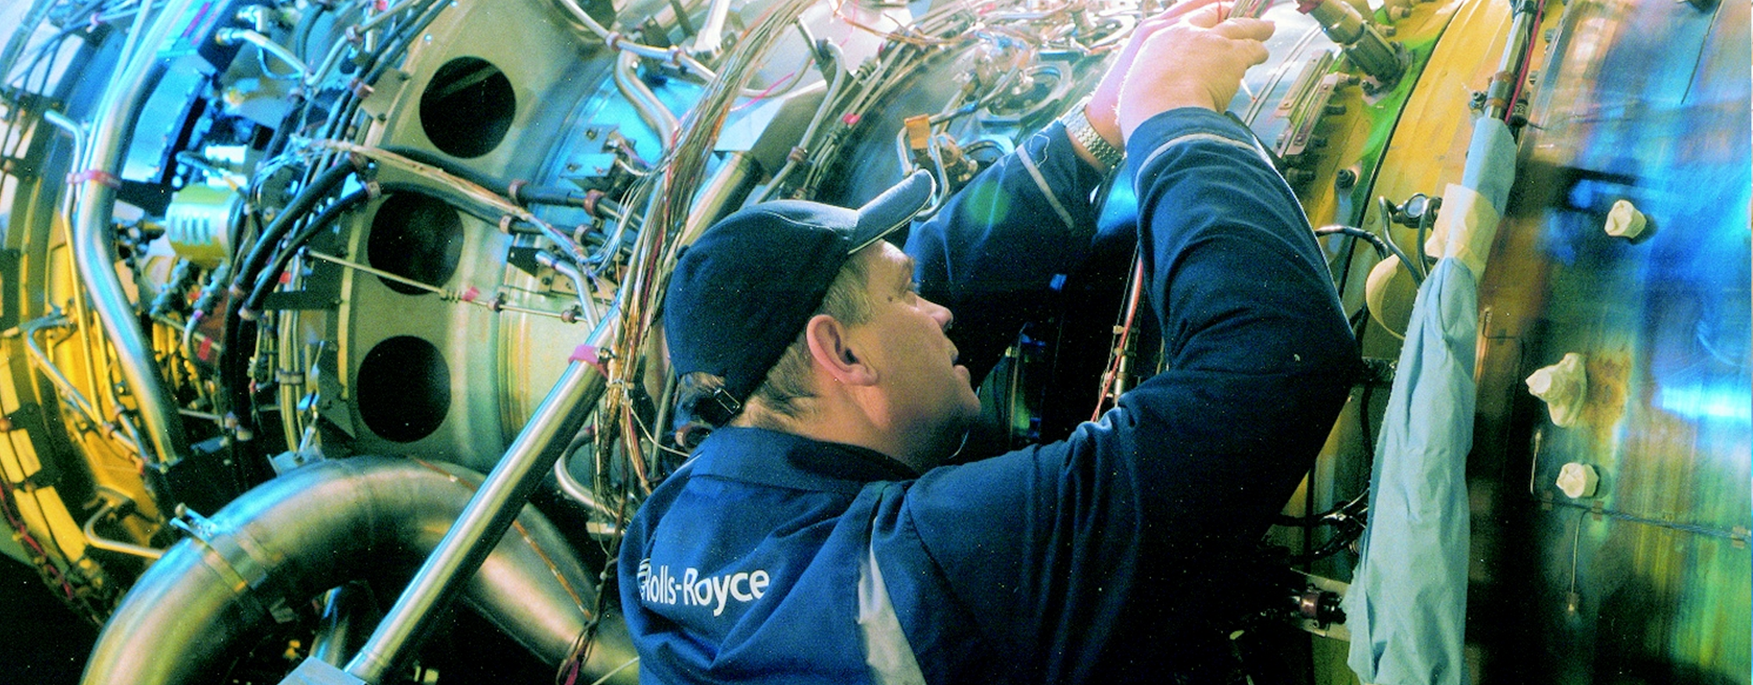
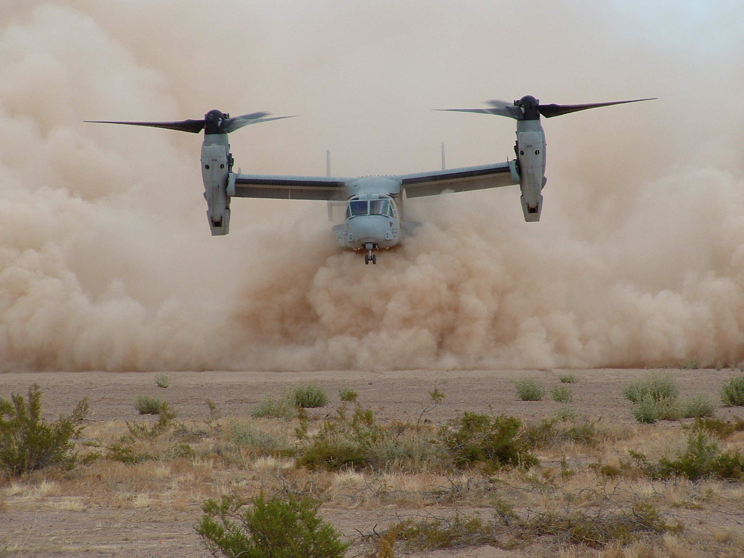
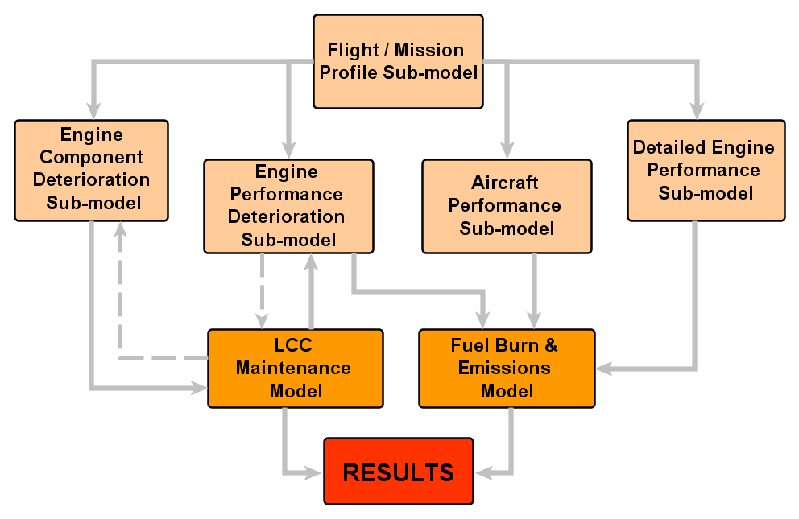
Systems Integration: Maintenance cost, Deterioration and Performance Modelling of Jet Engines
UTC for Computational Engineering
Sid Santos, Dr. Tai-Tuck Yu and Prof. James Scanlan, CEDG, School of Engineering Sciences
Steve Wiseall, Rolls-Royce plc.
1. Maintenance and Performance Modelling
Maintenance cost modelling of jet engines is relatively mature simulation ground. Similarly, the modelling of engine performance has been successfully accomplished using a variety of techniques. Generally speaking, maintenance and performance modelling have traditionally been tackled separately. This might have been the case partly due to conflicting interests emerging from the different business units developing these capabilities but also due to the generalised lack of understanding of the complex link between these two disciplines. This breach, however, makes a daunting task out of predicting the effect that specific maintenance work scopes would have upon key performance parameters.
2. Component Deterioration VS Performance Degradation
Historically, the link between component deterioration and performance degradation of jet engines has not been clearly established. Most of the research found focuses on analysing those engine components believed to be major drivers of performance loss – such as the deterioration of the low pressure compressor or the high-pressure turbine. Only a handful of individuals have managed to model such impacts (in isolation) resulting in different levels of success. Accurately quantifying the impact on performance characteristic of each module’s deterioration at once has always been a challenge and the varied and very sensitive nature of the data needed in order to understand the problem (operations, engine health monitoring system (EHMS), maintenance records, etc.) has been a hindrance from the very first attempts. Nevertheless, thanks to a combination of modelling tools and technical expertise, performance departments of major aerospace companies have managed to understand, in general terms, how the performance parameters of interest degrade as the engine fulfils a given operational schedule.
3. The Impact of Operations
When different aircraft operations are considered within the modelling framework a further degree of complexity is added to the problem. These would have an impact upon the conditions in which the engine works with the most important variables being temperature and those associated with the local atmospheric chemistry. The level of thrust demanded by the operator also has a strong impact on component deterioration levels – ergo component lives – and, in turn, on maintenance activities and very important performance parameters such as the Specific Fuel Consumption (SFC).
4. Fuel and Emissions: a Global Concern
SFC degradation has a very strong impact on the annual balance sheet of aircraft operators. Deteriorated engines could easily be using 4-5% more fuel than their new counterparts. With fuel accounting for 25-35% of the total operating cost of most airlines (see Figure 2), it is not surprising to observe them attempting anything and everything that could potentially lead to lower drag and weight figures which would in turn lead to less fuel burn. Defence organisations have also expressed a growing concern in relation to oil prices and this was evidenced by the RAF decision to reduce flight training back in 2008.
Airline | Total operating cost (£M) | Fuel cost (£M) | Total (%) | Estim. CO₂ (Megaton) | Carbon Tax 5% excess (£M)
British Airways | 8,225 | 2,372 | 28.84 | 8.016 | 16.032
Delta Airlines | 19,057 | 4,899 | 25.71 | 16.556 | 33.112
Singapore Airlines | 4,850 | 1,684 | 34.73 | 5.691 | 11.382
EasyJet | 2,785 | 733 | 26.32 | 2.477 | 4.954
Ryanair | 2,229 | 760 | 34.11 | 2.568 | 5.136
Fig2. Airline operating cost (Source: 09/10 companies’ annual reports).
Furthermore, the EU’s Emissions Trading Scheme – which has been applicable in some European countries for the past few years – will come into force in the UK from the 1st of January 2012. Under this scheme operators will have to pay a tax for every ton of CO₂ generated which exceeds a tailored emissions allowance. Figure 2 also shows the extra cost that airlines would have had to face if this system happened to be in force during 2010, allowances were exceeded by 5% and the tax applied was of £40/ton – research suggests that this figure could be of up to £100.
5. Research objectives: Multidisciplinary model integration
This research will be focusing on establishing the necessary links between component deterioration, performance degradation, maintenance cost and fuel burn / emissions to develop an integrated costing tool. Figure 3 shows an example of the different models and sub-models required to implement this holistic solution. Such a system would enable cross-disciplinary trade-off studies such as:
Operational alternatives VS fuel burn and emissions
Assessment of alternative routes and climb/descent/taxi procedures, impact of emissions at different altitudes, etc.
Maintenance cost VS fuel burn and emissions
Compressor wash frequency/cost against fuel saving, maintenance schedule optimisation, work scope optimisation, etc.
Operational alternatives VS Maintenance cost
Spares/inventory optimisation, flight training schedule optimisation, (military), etc.
This system would also aid profit maximisation of Power-by-the-hour like contracts and it would provide an opportunity for emission taxes to be included within the life cycle cost (LCC) modelling framework. Ultimately, the knowledge drained from the mentioned trade-off studies could potentially have an impact on both performance-driven and value-driven design activities.
THRUST
Min. Margin before shop visit
New Engine
Cycles
TGT Limit
TGT
Fig1. Effect of deterioration on thrust and Turbine Gas Temperature (TGT) values
Fig3. Representation of integrated model
http://www.soton.ac.uk/engineering/research/groups/CED/posters.page | email: ssss1v07@soton.ac.uk
Computational Engineering & Design Group, University of Southampton, SO17 1BJ, U.K.

