Slide 1

In pursuit of equity and effectiveness
Mapping a policy intervention in Aotearoa New Zealand
Associate Professor Annelies Kamp
University of Canterbury
Christchurch, New Zealand
Invitational seminar at Southampton Education School
March 17 2021

Slide 2
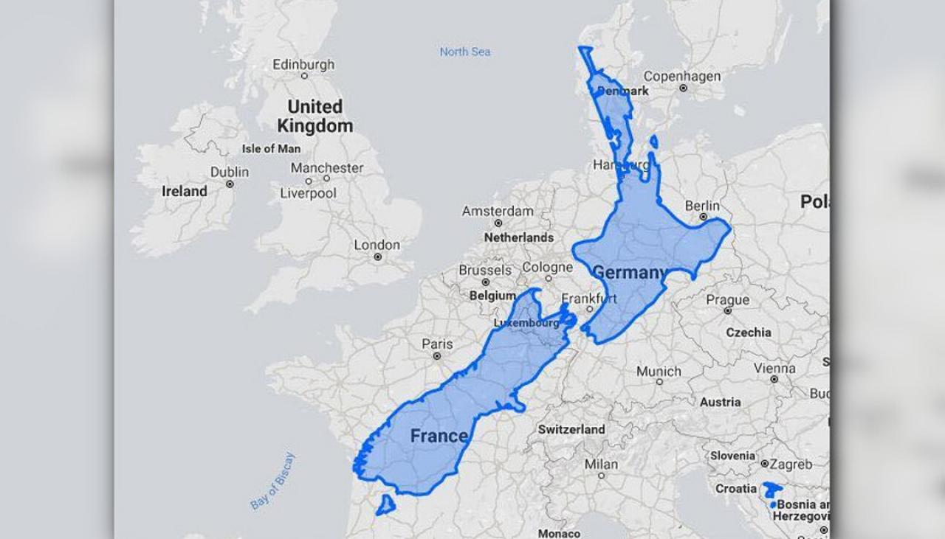
Just a little nation in the South Pacific …
A bicultural, culturally diverse, South Pacific nation with a population of some 4.8 million people living for the most part on two main islands
The integration of the name Aotearoa in ‘Aotearoa New Zealand’ signifies the country’s history.
1840 signing of te Tiriti o Waitangi [the Treaty of Waitangi]
Source: Newshub.co.nz

Slide 3
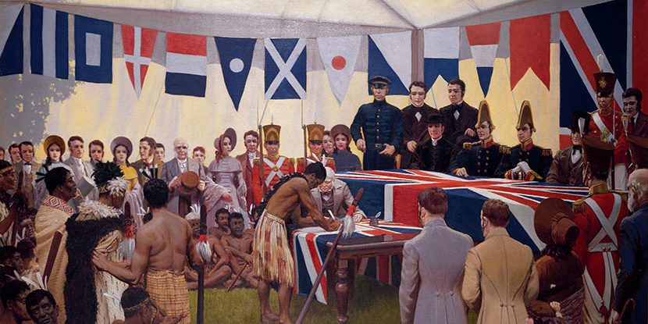
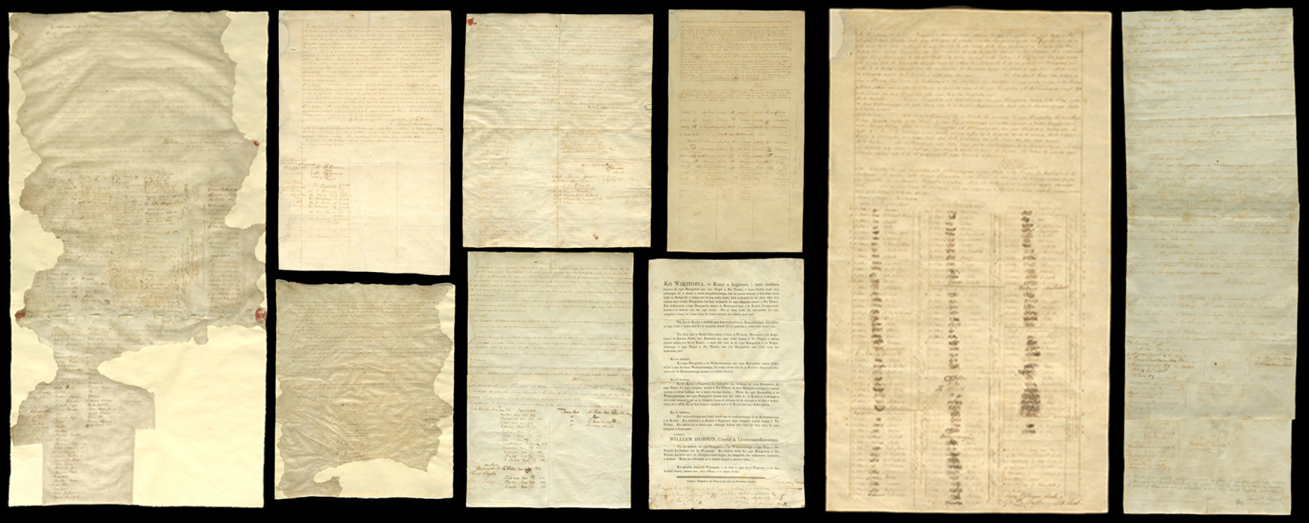

Slide 4

As a society …
Queen Elizabeth II is Head of State; unitary parliamentary representative democracy
Prime Minister is Jacinda Ardern (Labour)
Characteristics ranked highest by New Zealanders
  freedom, rights and peace
  environment
  the people of New Zealand (StatsNZ 2016)
Economic and political stability; high levels of government and judicial transparency (transparency.org)
A World Bank ‘high income’ country; open economy based on free market principles
Source: Parliament New Zealand

Slide 5
Schooling landscape
2,536 schools including
  twenty-five Teen Parent Units
  thirty-seven specialist Year 1-13 schools for students with very high needs
Majority of schools are state schools
  15 per cent of students attend private or state integrated schools
Primary, intermediate, and secondary level
  some ‘composite schools’
  a unique structure of intermediate schools as two-year (Year 7 and 8) between primary and secondary.

Slide 6
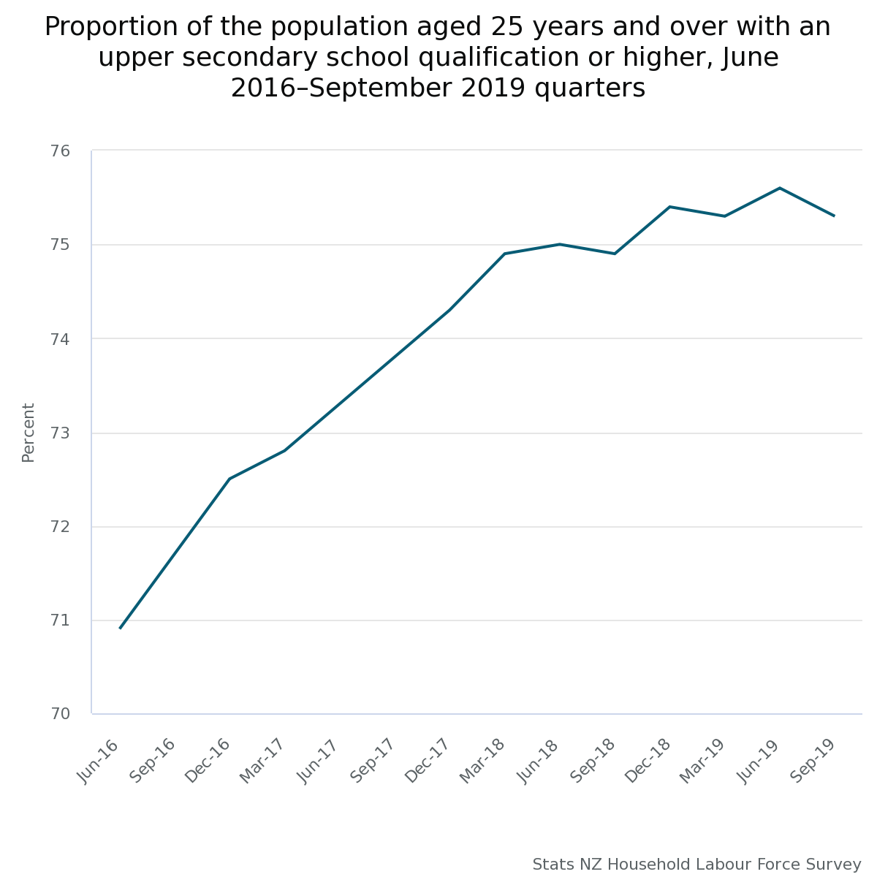

Slide 7
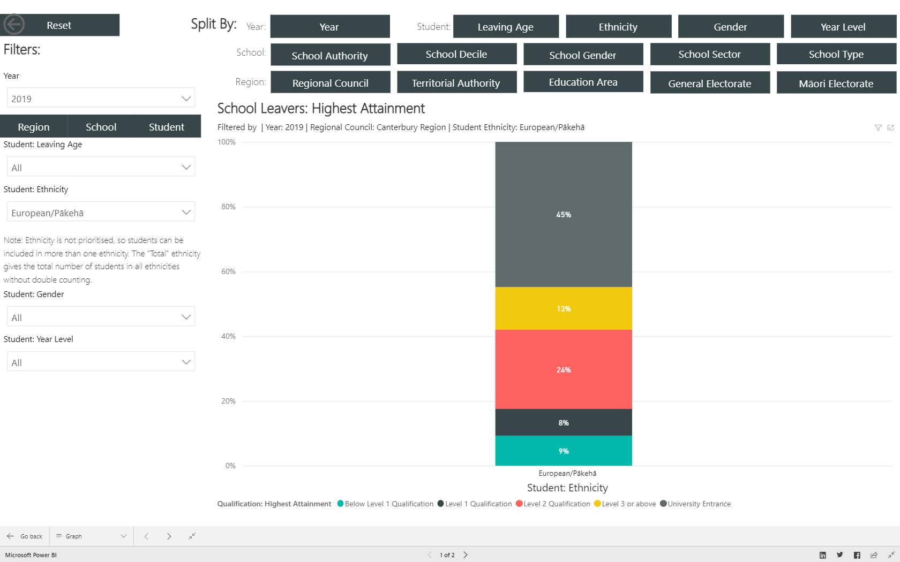

Slide 8
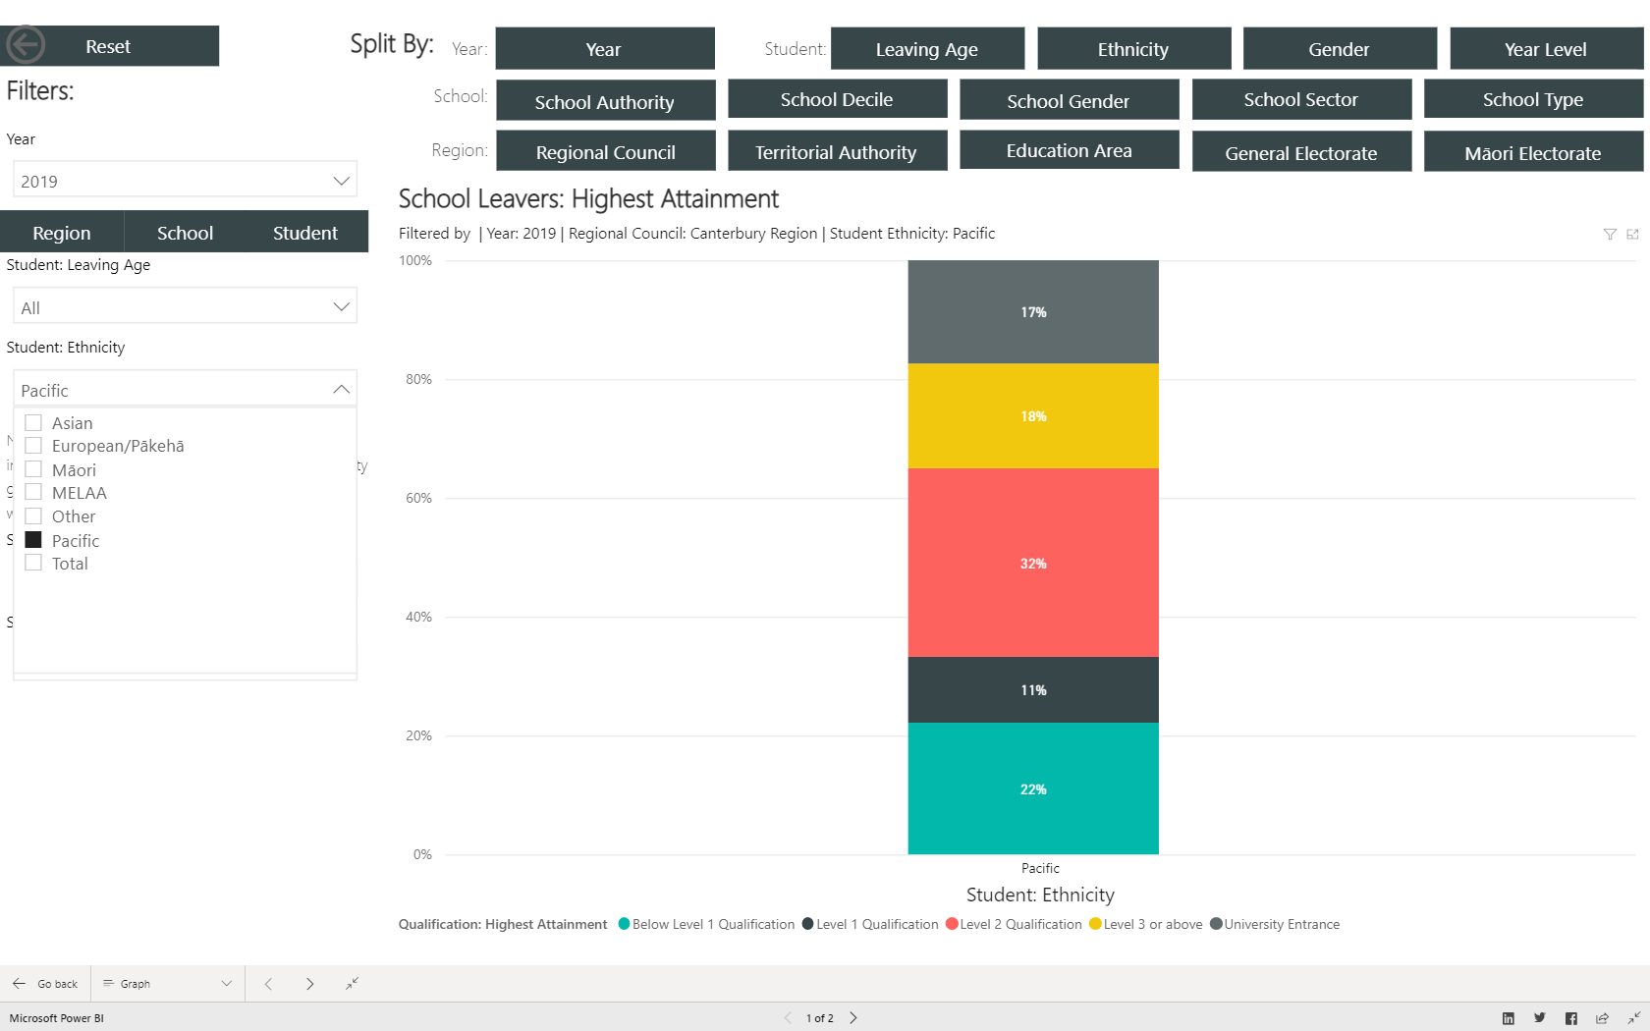

Slide 9
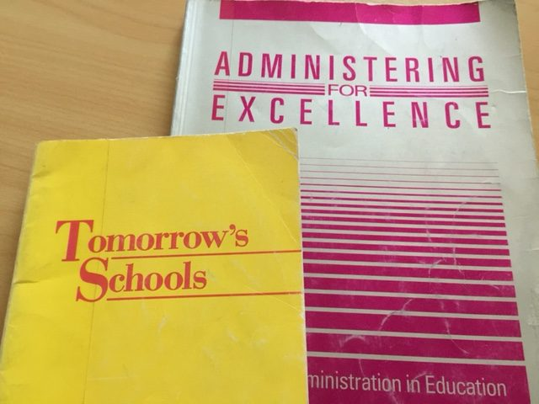
Tomorrow’s Schools
There is little doubt that the Tomorrow’s Schools reforms have positioned articulate, active parents in the more affluent classes to assert their influence in repositioning public schools to act as private goods serving their own interests … In the absence of an intermediary authority responsible for equity concerns and accountable to the wider community, state schools are reconfigured to serve the interests of such parents, as well as the interests of the schools in a competitive environment, in excluding students who might drag down the schools’ reputation. (Lubienski 2014: 432)
Source:
John Laurenson. https://briefingpapers.co.nz

Slide 10

Investing in Educational Success
2013
Fifth National Government policy. NZD359m, with NZD155m per year thereafter
‘targeted tools and resources to build teaching capability and improve learning … and achievement for all students’ (MoE 2016)
Three instruments:
Kāhui Ako | Communities of Learning
Teacher-led Innovation Fund
Principal Recruitment Allowance

Slide 11
Ardern government, first three years …

Slide 12
Notes:
A word about process – this process has been conducted through Education Conversation during 2019.

Slide 13
Reform Tomorrow’s Schools system
Key decisions:
More frontline support for schools through a new Education Service Agency, as part of a redesigned Ministry of Education
More support for principals and school boards including a new centre of leadership and local leadership advisor roles
New independent disputes panels for parents and students
Management of school property simplified and/or transferred to the Ministry to free up boards’ time
Enrolment zones to be managed locally, not by each school
In Objective Five - strengthen collaborative networks across the system
https://conversation.education.govt.nz/conversations/tomorrows-schools-review/

Slide 14
A guide to support the development of collaborative practice
MoE (2018), p.3

Slide 15
Four dynamics for attention
Appreciate all the actors involved
Understanding the nature of our connections and how to mobilise them
Appreciate the need to innovate
Understand leadership dynamics of collaboration

Slide 16
Watch out for all the actors …
The biggest thing I’ve gained as lead principal is that one person can’t do it. The success of the Kāhui Ako is not going to come down to the success of one person.
I see myself, in essence, as leading a network of teams, as opposed to the Kāhui Ako lead, the across school leads, and the within school teachers. Each team connects with a lead from each school, and team members connect back to teams in their own schools, hence a network of teams.

Slide 17
Social capital
networks foster norms of reciprocity which provide a mechanism to cooperate in competitive situations.
networks facilitate coordination and communication and amplify information about the trustworthiness of other individuals thereby reducing transaction costs.
networks embody past success at collaboration, they provide a template of how to collaborate in future.
  But you need to be able to visualise the ‘how’ of the network.

Slide 18

Supporting innovation
What is the level of trust, and is it sufficient?
Develop multi-level accountability
Capture the repertoire
  This means we need to think about research and recording …

Slide 19
Four qualities of eco-leadership
Connectivity and interdependence
Systemic ethics
Leadership spirit
Organisational belonging
Western, S. (2019). Leadership. A Critical Text
(3rd Ed). Sage

Slide 20
Leading between
Network leaders lead from the outside in
Network leaders mobilise disparate supplies of energy – it is not about decisive action but more about contact.
Network leaders foster trust and empower others to act. Trust is the most important commodity.
Network leaders help people grow beyond their comfort zone
Network leaders are lead learners
Network leaders nurture other leaders – they did it themselves.
(Paul Skidmore in McCarthy, Miller, & Skidmore, 2004)

Slide 21

Policy as both planned, and emergent
Policy brings both endorsement and constraint
Prepare for the expected and the unexpected
    vested interests
    Moving beyond ‘comfortable collaboration’
Minimum specification

Slide 22
Active engagement of Boards of Trustees
Know the ‘why’ of the collaboration: the essential, and time-consuming, first task
Acknowledge the role of leaders, wherever they may be, as nodes
Fourth, structures in the service of learning
Focus on process rather than structure.
  Wicked problems cannot be solved but, rather, demand the application of judgement, over and over again. (Kamp, 2019)

Slide 23
Final words
I hope [Kāhui Ako] will survive. They will need to … evolve, one would expect even if they were highly functioning now, they would still … evolve as experience happens. If … they don’t survive then it will need to be something better because we sure as hell do not want to give that money back to those Principals. We know, unfortunately, where that’s going to lead, which is back to working hard for my community, which unfortunately leads to tunnel vision for my community.

Slide 24
References
Greany, T. and Kamp, A. (forthcoming 2021). Leading educational networks: theory, policy and practice. Bloomsbury.
Kamp, A. 2013. Collaborative possibilities for a Deleuzian century. Peter Lang.
Kamp, A. 2019. 'Kāhui Ako and the collaborative turn in education: emergent evidence and leadership implications', New Zealand Annual Review of Education, 24: 177-91.
Lubienski, C. 2014. 'Re-making the middle: dis-intermediation in international context', Educational Management Administration & Leadership, 42: 423-40.
McCarthy, H., P. Miller and P. Skidmore. 2004. Network Logic. Who governs in an interconnected world? DEMOS.
MoE. 2016. ‘Communities of Learning Guide for Schools and Kura’. Wellington: Ministry of Education.
Thrupp, M. 2018. 'To be 'in the tent' or abandon it? A school clusters policy and the responses of New Zealand educational leaders.' in J. Wilkinson, R. Niesche and S. Eacott (eds.), Challenges for public education: reconceptualising educational leadership. Routledge.
Wylie, C. 2012. Vital connections: why we need more than self-managing schools. NZCER.

Slide 25
Contact details:
Associate Professor Annelies Kamp
School of Educational Studies & Leadership
University of Canterbury
Christchurch, New Zealand
Twitter: Anneliestbk
LinkedIn: Annelies (ter Brake) Kamp
UC: Annelies Kamp

