Slide 1
Proposed changes to your pension
A consultation on planned changes to the University of Southampton Pension & Assurance Scheme for Non-Academic Staff (PASNAS)
July 2022

Slide 2
Agenda
◉
The starting essentials
How a valuation works and the PASNAS results
The proposed changes to re-balance the scheme
Assessing the effect of the proposed changes
The consultation process, and your views and comments
Timeline, and what next?
Questions and answers
◉
◉
◉
◉
◉
◉

Slide 3
◉
The starting essentials
PASNAS is a workplace pension scheme – valuable pensions and other benefits for you and your family
A defined benefit scheme, which is final salary in design, which needs to be reviewed at least every three years (checks on funding and contributions)
The scheme is run by the trustees, separate from the University, who have legal duty to deliver the pensions promises within the law
The benefits that have already been built-up are protected and cannot be changed
Make decisions regarding your pension very carefully, taking guidance and advice if you need it
This is not advice or guidance, and the scheme rules and communications are definitive
Further information at: https://www.southampton.ac.uk/finance/services/pasnas.page

Slide 4
◉
How a valuation works and the PASNAS results
The trustees have to undertake a valuation at least every three years; it checks on the financial health of the scheme
Two primary areas: is there sufficient money to pay the promised benefits, or a plan to put this right – and to set the contributions needed for future benefits
PASNAS benefits are promises, and trustee has the job to deliver them whatever the circumstances
Checks made on other things, like size of the scheme, strength of the employer, how fund investments have done and what they will do in the future, longevity etc.
Trustee takes specialist advice, has to be ’prudent’ by law, and act in line with Pensions Regulator’s guidelines

Slide 5
◉
How a valuation works and the PASNAS results
The valuation has revealed an increased deficit
Actuarial valuation of PASNAS | 2018 | 2021
Total expected cost of accrued benefits | £263.3m | £339.5m
Market value of assets | £224.8m | £283.0m
Surplus / (Deficit) | (£38.5m) | (£56.5m)
Funding Level | 85% | 83%
This shows that the deficit has grown to £56.5m, despite the extra contributions of £2m per year having been paid since the last valuation
The trustees must decide how this deficit is met, in conjunction with the University, which involves paying extra deficit contributions

Slide 6
◉
How a valuation works and the PASNAS results
And the cost of providing future benefits has increased
Future service benefits as at 31 July 2021 | Cost as % of salary
Contribution rate for accrual of pension | 26.1%
Contribution to expenses and death benefits | 1.5%
TOTAL | 27.6%
Current employer contribution rate | 13.85%
Current member contribution rate | 7.2%
TOTAL | 21.05%
Extra required | 6.55%
The above table shows that the cost of continuing to provide future benefits has grown by 6.55% of salary

Slide 7
◉
How a valuation works and the PASNAS results
The two primary issues raised in the 2021 valuation
£56.5m
6.55%
The scheme deficit which needs to be met through an appropriate recovery plan including extra contributions
The extra contributions which would be needed to maintain the same level of future benefits

Slide 8
◉
The proposed changes to re-balance the scheme
The benefits provided by the scheme are currently …
The rate of pension which builds-up for each year of pensionable service
1/80th
of pensionable salary
The rate at which lump sum at retirement builds-up
3x
the annual pension
Normal Retirement Age
Age 65
The rate of member contributions
7.2%
The scheme is based on final salary, and there is a range of death and incapacity benefits payable. Employer contributions are 13.85% of salary, plus £2m per year to the deficit

Slide 9
◉
The proposed changes to re-balance the scheme
Some of the levers available to address the rising cost of future benefits (6.55%):
Reduce the pension accrual rate (and the lump sum) to bear all of the increased costs | This would require deep changes to the pension (and lump sum) accrual rate – with pension accrual rate weaker than 1/90ths
Make other changes to future benefits, to normal retirement date, death and incapacity benefits, final salary design etc. | Some changes to retirement age might be sensible, but envisage strong support to maintain family and life event benefits, and final salary design
Increase member contributions to bear all of the cost | Would raise member contributions to unsustainable levels, especially at current times – leading to opting-out and no pension provision
University and other employers pay all the cost | Unsustainable for the University and employers, member pensions are more valuable therefore reasonable to share burden
A package which draws from these levers is proposed as the solution …

Slide 10
◉
The proposed changes to re-balance the scheme
The benefits changes proposed in the consultation are …
The rate of pension which builds-up for each year of pensionable service
1/85th
of pensionable salary
The rate at which lump sum at retirement builds-up
3x
the annual pension
Normal Retirement Age
Age 66
The rate of member contributions
8.6%
The scheme is to remain based on final salary; no structural changes to the death and incapacity benefits payable
Employer contributions include payments to £56.5m deficit (up-front contribution of c£30m plus ongoing deficit contributions)

Slide 11
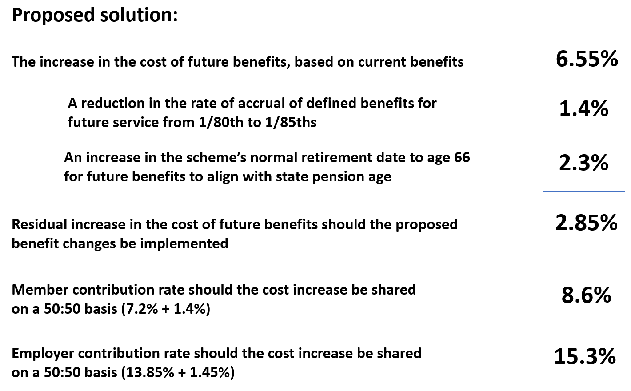
◉
The proposed changes to re-balance the scheme

Slide 12
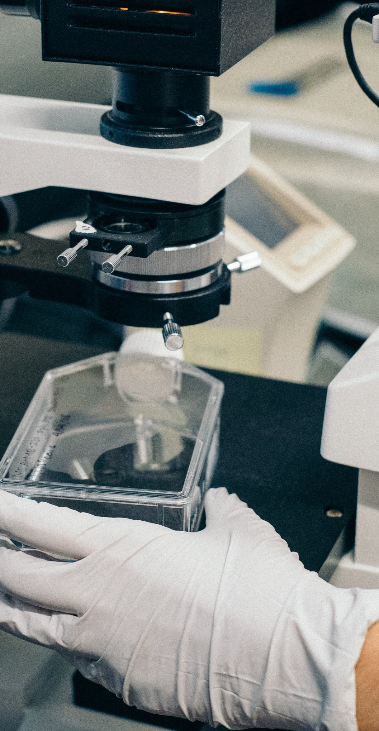
The proposed changes to re-balance the scheme
◉
The proposals are a package, including changes to future benefits and to contributions – intended to spread the impact rather than (for example) bigger increases to member contributions
The University is making very substantial contributions to the scheme deficit (and to share future service cost increases)
Designed to keep PASNAS as a final salary scheme
It might be possible to use the latest market conditions if produces a better outcome – but this can’t be guaranteed due to volatility. If so, savings could be c2% of salary, in which case lower the increase in member contributions
Your comments on the balance of the package are welcomed

Slide 13
◉
Assessing the effect of the proposed changes
The guide sets out some ways for you to assess the impact – which is different depending on your age, salary, length of service, planned retirement date etc.
Eight example personas show the estimated reduction in pension is between 1% to 9.7% (and between 0.7% and 7.6% to the lump sum)
To show the effect of higher contributions there is a table which shows that for salaries between £21k and £27.5k there is a reduction in net pay of between £16 and £21.50 per month
No changes can be made to the benefits you have already built-up

Slide 14
The consultation process, and your views and comments
◉
This is a genuine consultation process, there are several ways to submit questions and feedback:
Attending one of these briefings
Completing the feedback questionnaire available through https://www.southampton.ac.uk/finance/services/pasnas.page
Email to pasnasmc22@soton.ac.uk
Write to PASNAS Consultation c/o Clerk to the PASNAS Trustees, University of Southampton, Highfield, Southampton, SO17 1BJ
Questions about the proposals will be answered in a “Frequently Asked Questions” document at https://www.southampton.ac.uk/finance/services/pasnas.page

Slide 15
◉
Timeline, and what next?
The following are the key milestones in the consultation:
Wednesday 6 July 2022 | Formal consultation on proposed changes commences (this will run for a period of 66 days)
Friday 16 September 2022 | Formal consultation closes – comments and views should be made no later than this date
31 October 2022 | Final decisions need to be taken and valuation finalised
1 January 2023 | Planned commencement date of changes

Slide 16
Questions and Answers

Slide 17
Whilst every effort has been made to ensure that the slides and presentation are factually correct, the speaker accepts no responsibility for any errors, omissions, misstatements or mistakes contained therein. The views expressed in these slides and the presentation are the views of the speaker and are not necessarily those of University nor of the PASNAS trustees. No responsibility for loss occasioned to any person acting or refraining from action as a result of any material in this publication can be accepted by the speaker or the University. Neither these slides nor the presentation is intended to provide commercial, financial or legal advice and should not be treated as a substitute for specific advice concerning individual situations. The data and information presented in this document are, to the best of the speaker’s knowledge, correct at the time of writing. PASNAS is governed by a trust deed and rules and if there is any inconsistency between this publication and the trust deed and rules, the latter will prevail.

