Slide 1
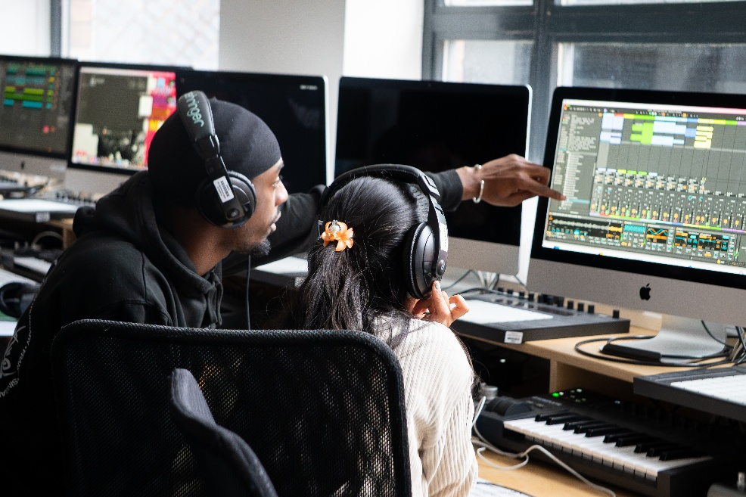
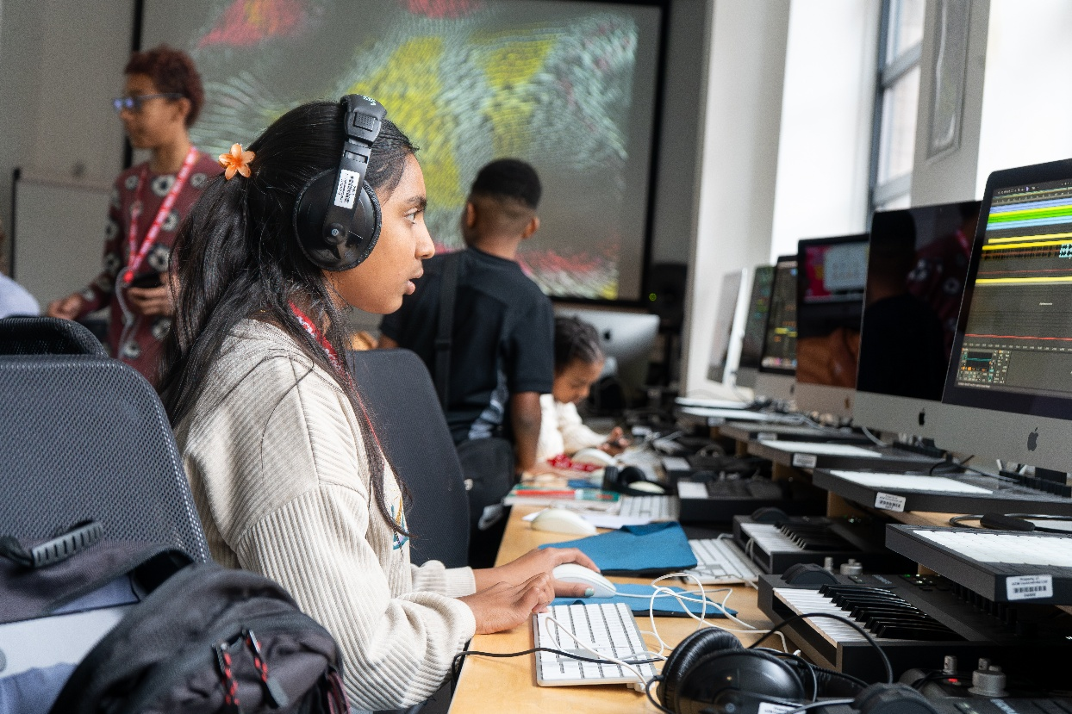


Bringing Black British and Electronic Music into the Classroom
Diversifying music education: not either/or, but widening what schools teach
EQUALIZE is led by Young Sounds UK with the Black Music Research Unit (University of Westminster), and partners Punch Records (Birmingham), Bradford AllStar Entertainments and Bradford Music & Arts Service. Funded by the AHRC Hub for Public Engagement with Music Research. Poster: Amna Smith, University of Southampton.
THIS IS NOT CLASSICAL VERSUS ELECTRONIC
Teachers want to teach it all. They value every genre, they just lack experience and confidence in Black British and electronic music.
Problem
[ Insert workshop photo ]
EQUALIZE workshop, Bradford / Birmingham, 2025–26
Black British and electronic music are the dominant popular music young people listen to and make, yet they are largely missing from school music.
▸ The system, and the mindset, built around the classical canon has restricted their provision in schools.
▸ Black British musicians are severely underrepresented in the workforce (ICM, 2021).
EQUALIZE’s approach
Co-creative workshops with young people in Bradford and Birmingham, with strong engagement (Robinson, 2026).
▸ Young people chose their genre, their starting point, and whether to work solo or together.
The evidence
EQUALIZE workshop, Bradford / Birmingham, 2025–26
▸ Across the Bradford schools, Black British Electronic was the largest genre grouping of what students listen to, with Grime most named.
▸ Black music is the UK’s dominant popular music and a major economic driver (Black Music = Business, 2026).
▸ 38% of music fans attend live events specifically for electronic music (CGA & NIQ, 2025).
Outcomes
▸ Improved genre understanding, cross-genre connections and self-expression.
▸ Talent surfaced that conventional classes miss.
EQUALIZE workshop, Bradford / Birmingham, 2025–26
“It’s a lot easier to express yourself if it’s the music you already listen to.”
Birmingham workshop participant
Policy recommendations
1. Schools and exam boards integrate Black British and electronic music into KS3 and GCSE, with assessment not reliant on prior private tuition.
2. Music hubs deliver inclusive, genre-diverse workshops.
3. Teacher training and CPD adopt the EQUALIZE model.
KEY TAKEAWAY
Inclusive music education means also teaching the music that already shapes young people’s lives, and equipping teachers to do it well.
Scan for the full report and references.
QR

Slide 2
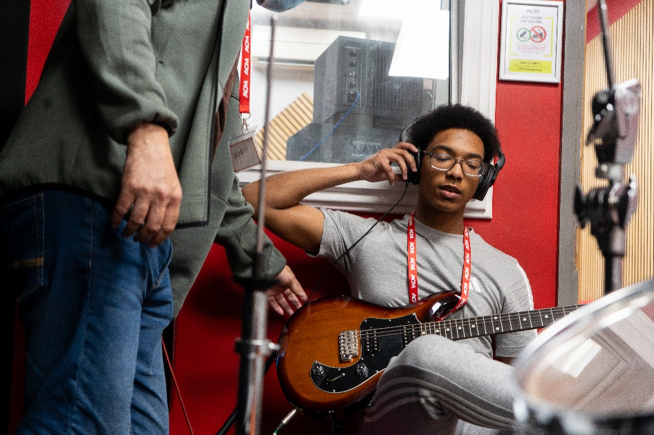
A Training Model for Black British and Electronic Music
Diversifying music education by building teacher capacity to bring these genres into the classroom
EQUALIZE is led by Young Sounds UK with the Black Music Research Unit (University of Westminster), and partners Punch Records (Birmingham), Bradford AllStar Entertainments and Bradford Music & Arts Service. Funded by the AHRC Hub for Public Engagement with Music Research. Poster: Amna Smith, University of Southampton.
THE FINDING THAT CHANGES THE ASK
The barrier is not student demand, it is teacher capacity: skills, confidence, time and funding.
Problem
[ Insert workshop photo ]
EQUALIZE workshop, Bradford / Birmingham, 2025–26
Black British and electronic music shape young people’s lives but are largely absent from secondary classrooms.
▸ GCSE music has the widest disadvantage attainment gap of any subject.
▸ Only about 15% of state-school pupils access musical tuition (DfE, 2025).
▸ Black and Asian musicians remain underrepresented in the industry (ACE, 2021).
What EQUALIZE did
Electronic and Black British music workshops in Bradford and Birmingham (2025–26), co-designed with young people.
▸ Reverse-engineered Ableton templates (Grime, UK Garage, Drum & Bass, Bassline, Afrobeat, UK Rap) let beginners produce convincing music immediately.
What we found
EQUALIZE workshop, Bradford / Birmingham, 2025–26
▸ Black British Electronic was the largest genre grouping among Bradford students, with Grime most named.
▸ Pedagogy beats technology: learner choice and agency drove engagement, confidence and creativity.
▸ Most teachers believed the approach could work in their classroom with the right support.
“Music influences me because my community’s built around me. It’s mostly influenced by music.”
Birmingham workshop participant
Policy recommendations
1. Fund a national, DAW-agnostic CPD model that equips teachers to teach Black British and electronic music.
2. Embed culturally relevant, participatory workshops in schools and music hubs.
3. Adopt EQUALIZE as the evidenced pilot for the National Centre for Arts and Music Education (from September 2026).
KEY TAKEAWAY
Equip the teachers, not just the pupils, and the next generation of Black British and electronic music creators can thrive within the school system.
Scan for the full report and references.
QR

