Slide 1




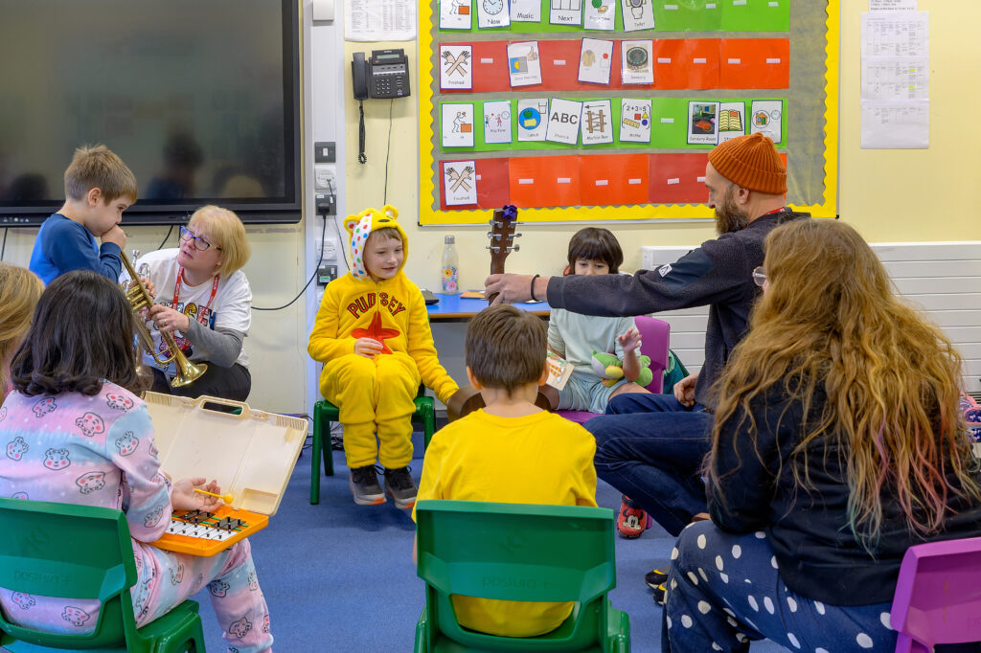

Musical Connections
Making music education more accessible for autistic learners
Kristina Risley and Chi Ying Lam, University of Southampton; Beth Pickard, University of South Wales; Karen Irwin and Alex Lupo, Live Music Now
KEY EVIDENCE
WHY THIS MATTERS
FURTHER LEARNING
0
UK academic studies found on music education in Autism Resource Bases
“Many of our learners are musically led.”
Provision is uneven and often depends on local capacity, staff confidence, budget and access to expertise.
Music provision in Autism Resource Bases (ARBs) is not only a curriculum issue. It can support communication, regulation, social connection and self-expression.
Meaningful access is not the same as physical presence. Pupils need music provision that is safe, responsive and available on their own terms.
Flexibility, co-creation, sensory awareness, relationship-building and pupil-led practice are central to effective provision.
ARB staff and provision leads may be isolated within wider school systems. Music could help build networks, raise visibility and support shared inclusive practice.
113
survey responses from settings across the UK
36%
of responding settings had contact with a local Music Hub, Music Service/equivalent
100%
of survey respondents valued music’s social and emotional impact
340+ learners / 24 ARBs
Pilot work informing the project
“Music flows through the children.”
HEADLINE FINDINGS
A UK-WIDE PROJECT, NATION-FOCUSED POLICY
1. Access may be lower than the headline suggests
The survey commonly reported 1 to 3 hours of music per week, but pilot and residency evidence suggest more limited provision in some settings.
Provision depends heavily on school staff
ARB staff delivered most music in 52% of responding settings.
Participation is not always visible
Attending, listening, watching, moving away, returning, choosing an instrument or engaging through sensory exploration can all be meaningful forms of musical participation.
Music matters beyond curriculum entitlement
Respondents valued music for social and emotional development, not only subject learning.
Scotland
Curriculum for Excellence and Additional Support for Learning provide supportive principles, but the project’s Scottish response base was smaller and further mapping is needed.
Priority: map provision and strengthen local partnerships with instrumental music services.
Northern Ireland
The Education Authority, EA Music Service and Specialist Provision in Mainstream Schools provide a practical delivery route.
Priority: build workforce confidence through training, partnership and specialist provision.
England
Music education infrastructure exists, but Autism Resource Bases may still be overlooked.
Priority: make Autism Resource Bases visible in Music Hub and local music education planning.
Wales
Curriculum for Wales, Additional Learning Needs system and the National Music Service for Wales create strong policy alignment.
Priority: connect music with person-centred planning and expressive arts provision.
RESEARCH APPROACH
Strength-based, neurodiversity-affirmative positioning
Steering group of three autistic musicians
UK-wide online survey of ARBs and equivalent provision
Scoping review using multiple UK terms for specialist provision
Mosaic methods in two Musician-in-Residence projects
Collaborative analysis shaped by autistic perspectives
WHAT GOOD PROVISION LOOKS LIKE
Safety
Acceptance
Pupil-led
Interest-driven
Co-created
Balance
Playful
Holistic
Good provision is flexible, sensory-aware, relationship-based and responsive to how
autistic pupils choose to participate
PROJECT OUTPUTS: FROM RESEARCH TO CHANGE
Three national policy briefs
Toolkit for schools & support staff
Film & case study resources
Training & support resources
Academic publications
Foundations for future work

