Slide 1




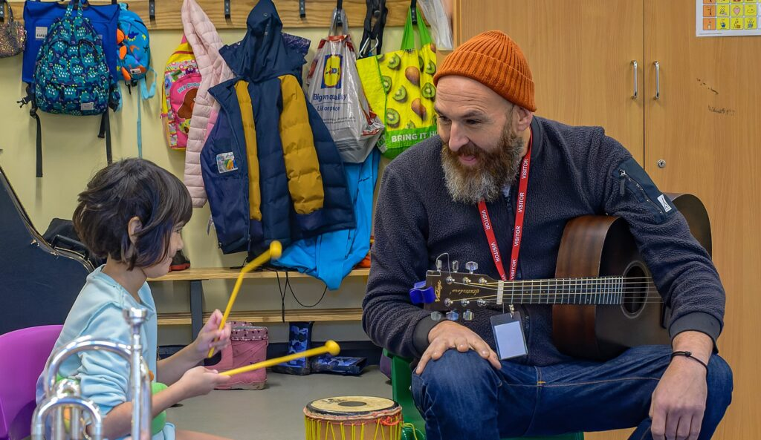
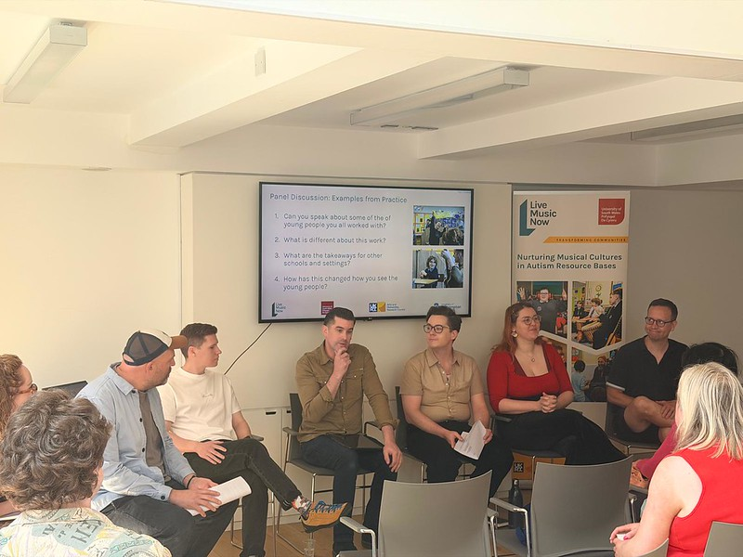
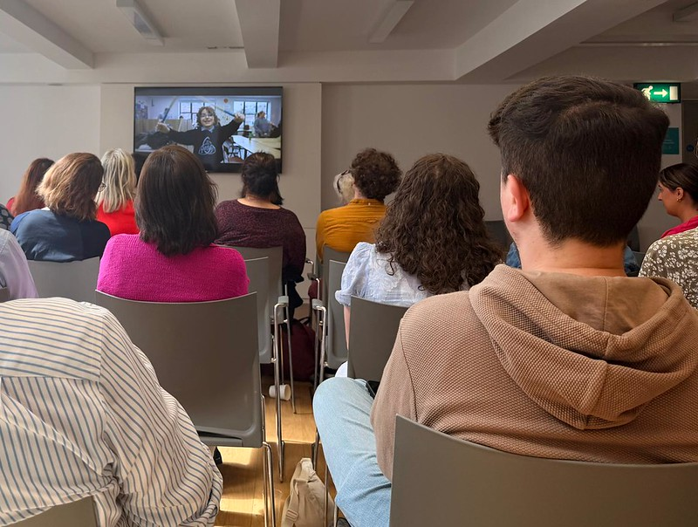
Musical Connections
Making music education more accessible for autistic learners
Kristina Risley and Chi Ying Lam, University of Southampton; Beth Pickard, University of South Wales; Karen Irwin and Alex Lupo, Live Music Now
KEY EVIDENCE
SURVEY RESPONSES
340+ learners / 24 ARBs
Pilot work informing the project
England
40%
113
survey responses from settings across the UK
Wales
29%
36%
of responding settings had contact with a local Music Hub, Music Service/equivalent
Northern Ireland
21%
52%
reported ARB staff delivered most music
Scotland
10%
RESEARCH METHODS
NATION-FOCUSED RECOMMENDATIONS
Scoping review using multiple UK terms for ARB/equivalent provision
UK-wide online survey of 113 settings
Stakeholder events and focus groups
Songwriting workshop with autistic pupils
Two 10-week Musician-in-Residence case studies in South Wales and Northern Ireland
Mosaic data: questionnaires, interviews, weekly reflections, observations and focus groups
Collaborative analysis with a steering group of autistic musicians
England
Make ARBs visible in Music Hub inclusion planning.
Plan music into specialist provision from the outset: staffing, environment, curriculum planning, budgets and partnership arrangements.
Fund scalable partnership models connecting ARBs, Music Hubs, autistic musicians and specialist music orgs.
Wales
Make ARBs visible in National Music Service planning.
Link music to individual development and local curriculum design where relevant.
Fund music provision in ARBs at scale through sustainable funding models across ARB models, local authorities and partnership structures.
Northern Ireland
Make SPiMS and equivalent visible in EA music planning.
Include music within person-centred planning where it supports wellbeing, communication, regulation, or learner voice.
Use evidence to support inspection, planning, resourcing and scale, with appropriate workforce capacity and long-term investment.
Scotland
More representation is required to inform a Scotland-focused policy briefing.
Gather Scotland-specific evidence on:
ARB/equivalent provision
Local authority routes
Instrumental music services
Workforce confidence
Partnership models.
PROJECT RECOMMENDATIONS
Curriculum and cultural entitlement
Workforce confidence
Autistic representation
Funding, scale and sustainability
Music is part of autistic pupils’ curriculum and cultural entitlement, not a discretionary enrichment activity dependent on local goodwill.
Frame music as curriculum access, expressive arts entitlement, participation and inclusion.
Support teachers, support staff, musicians, Music Hub/practitioners and music service staff to deliver neuro-affirmative, sensory-aware and pupil-led practice.
Use practical training routes, not one-off awareness raising.
Autistic people are experts in autistic experience and should be involved in co-design, delivery and evaluation.
Workforce planning should support autistic musicians and educators to contribute to and lead practice.
Move from isolated projects to funded, sustainable models.
Attend to cost, workforce time, long-term investment and partnership structures.

