Slide 1




Identifying suitable locations for offshore wind through GIS analysis; a regional case study
Cedric Muscat, Hugo Putuhena, Susan Gourvenec
RAEng Centre of Excellence for Intelligent & Resilient Ocean Engineering (IROE)
Southampton Marine and Maritime Institution, UK
University of Southampton, UK
THALASSA 2024 - Marine Sciences Conference
28 and 29 May 2024, Larnaka Cyprus

Slide 2

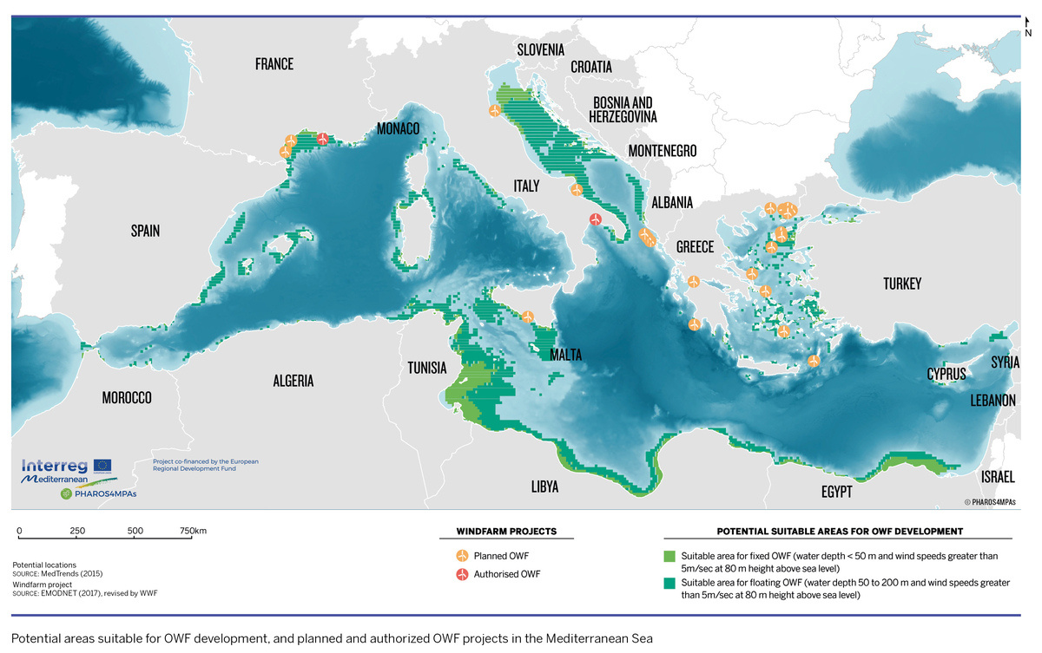
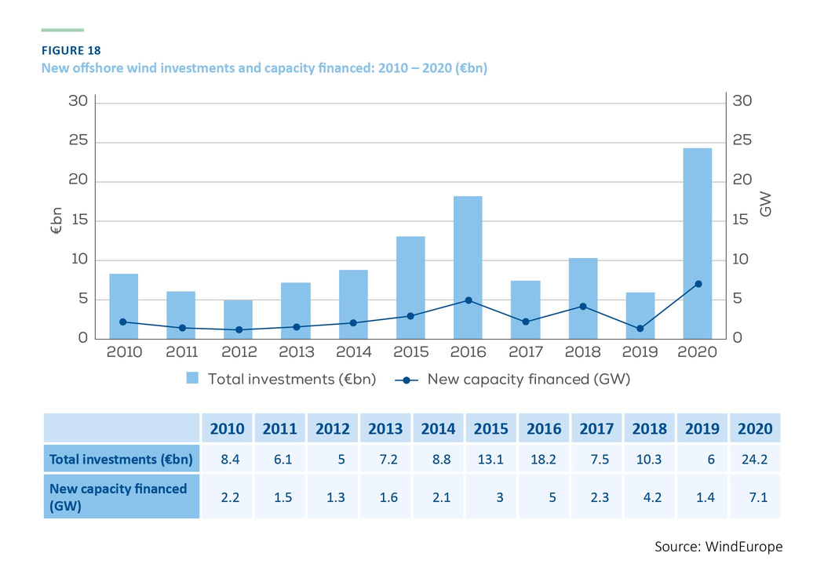
Introduction
  Transition to renewable energy crucial for reducing fossil fuel dependency
  Offshore wind (OW) rapidly growing sector key to meet net-zero targets globally
  European Union targets 60GW of OW by 2030 and 340GW by 2050 (European Commission, 2023)
  Mediterranean emerging as a key player in renewable energy with 30+ OW projects planned
INTELLIGENT & RESILIENT
OCEAN ENGINEERING
Offshore wind investments in Europe 2010- 2020: WindEurope
1
Map of planned OW farms in the Med: Plan Bleu

Slide 3
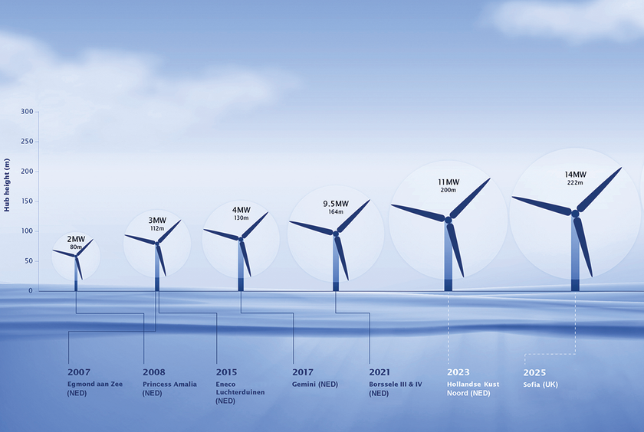
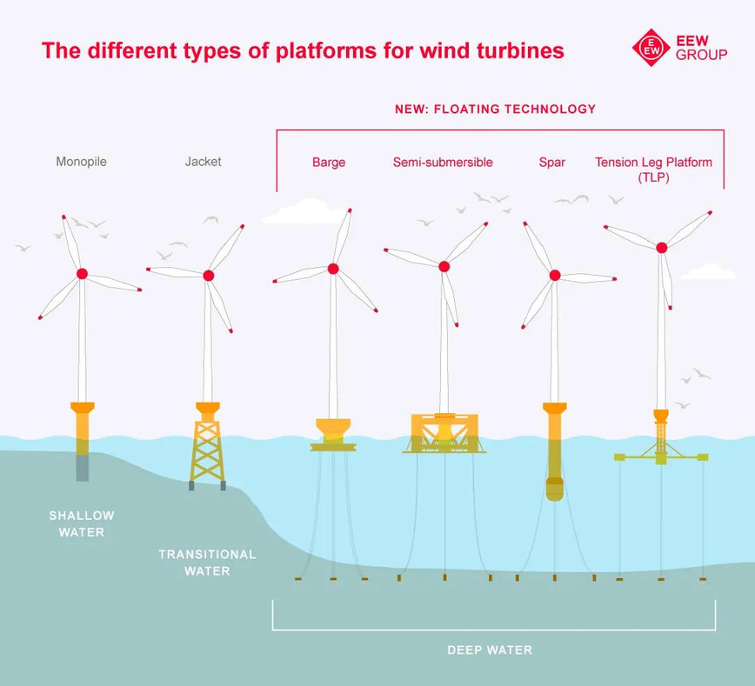
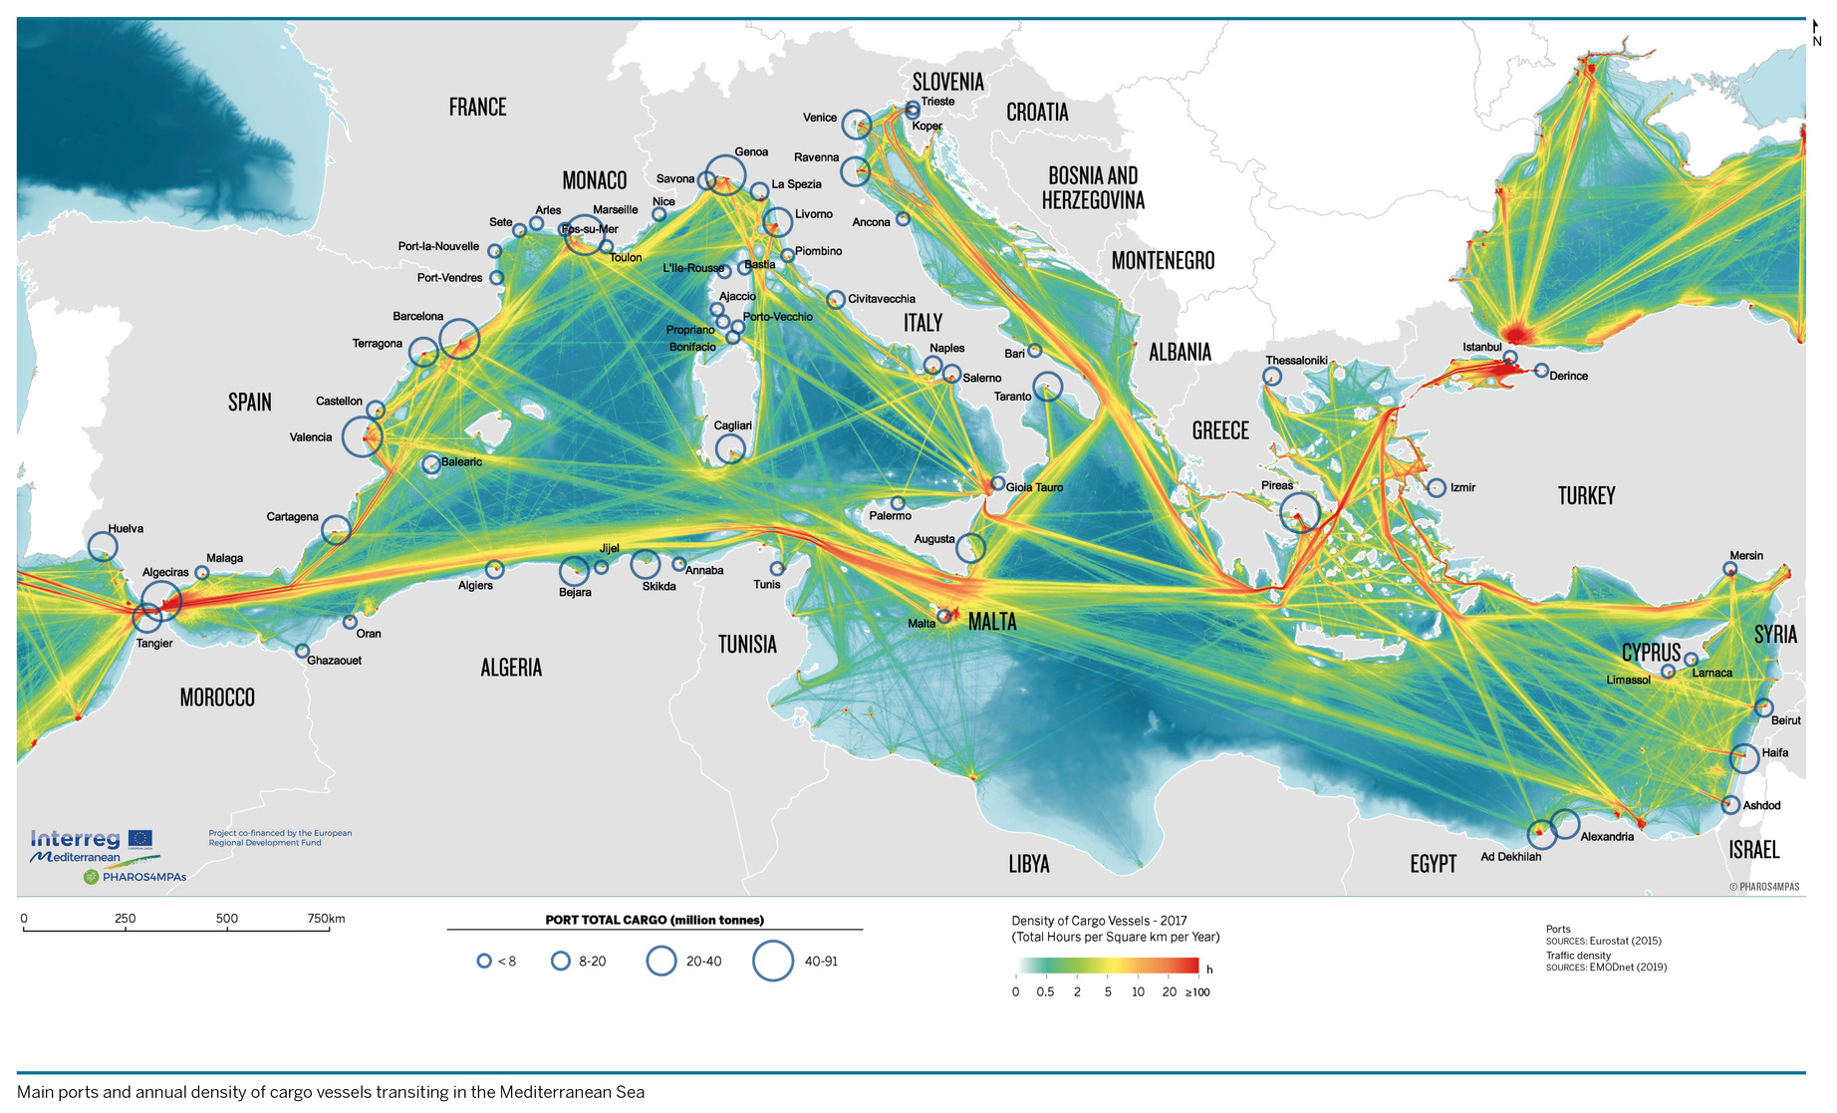
Innovation in technology
  Advancements in technology: floating OW beyond 60m suitable for Mediterranean’s deep water
  Increase in blade size and power output over the years
  Scale of OW balanced with protection of ocean ecology and heritage sites
  Sharing marine space: co-existence with other activities (ecological and heritage assets)
INTELLIGENT & RESILIENT
OCEAN ENGINEERING
Growing size of wind turbines
Windpower monthly
Different platforms for OW
EEW GROUP
Annual density of cargo vessels in the Mediterranean WWF
2

Slide 4
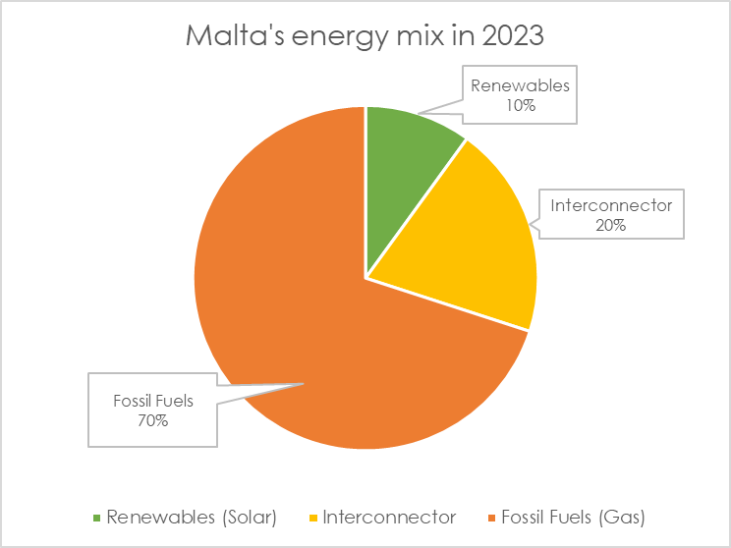
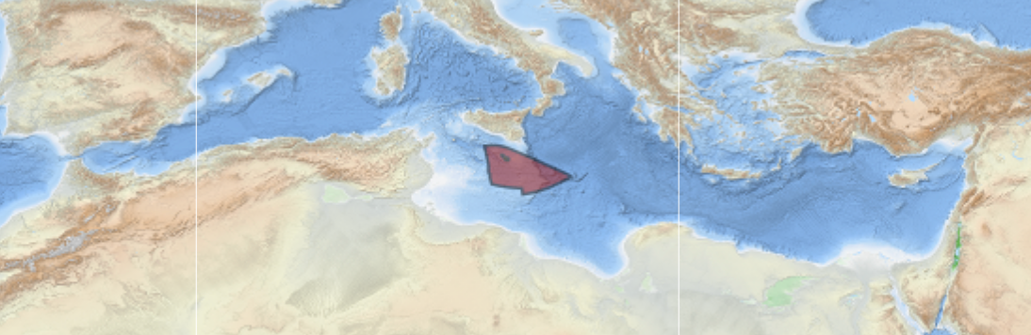

Regional application of method: Malta context
  Malta, centrally located in the Mediterranean, has a potential Exclusive Economic Zone (EEZ) over 70,000 sq.km - (200x its land area)
  Producing currently only 10% of its energy from renewables, Malta targets net zero by 2050, making offshore wind a critical solution given its limited land space
INTELLIGENT & RESILIENT
OCEAN ENGINEERING
Malta’s EEZ: MarineRegions
6
Malta’s energy mix in 2023: National Energy Statistics

Slide 5

Methodology outline
  Geographic Information System (GIS) method to analyse spatial constraints from Putuhena et al
  Process integrated various spatial layers, including metocean conditions, geoscience, ecological, and anthropogenic features into a binary and non-binary mask
  GIS map split into a grid to count and compare different spatial constraints
  Areas ranked by suitability to identify potential offshore wind sites
  Power output estimated and compared with targets
7
Identify suitable locations by constraints
INTELLIGENT & RESILIENT
OCEAN ENGINEERING
6
Integrate your branding into your business.
5
Identification of no-go zones
4
Classification of constraints
3
Integration of layers
2
Pre-processing of data
1
Data collection
Flowchart showing methodology
Identify relevant ocean features
4

Slide 6
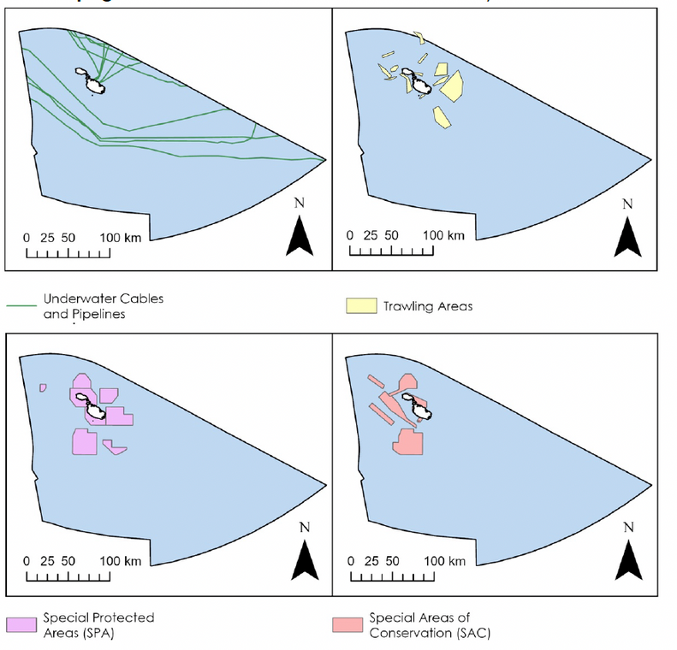
Malta case study
  Method applied to identify suitable locations for offshore wind within Malta’s EEZ
  In the Malta case study 10 spatial constraints were identified
  Data was collected from several European and national databases
  Using GIS these constraints were systematically integrated to map
  No-go areas and potential zones for OW identified
INTELLIGENT & RESILIENT
OCEAN ENGINEERING
Anthropogenic | Environmental & Geological
Special Areas of Conservation | Wind speed 100m asl
Special Protection Areas | Geogenic reefs
Vessel traffic density | Bathymetry
Cables & pipelines | Pre-quaternary faults
Trawling areas | Seabed substrate folk 5
10 spatial layers used for Malta
7
4 of the spatial features integrated into GIS

Slide 7
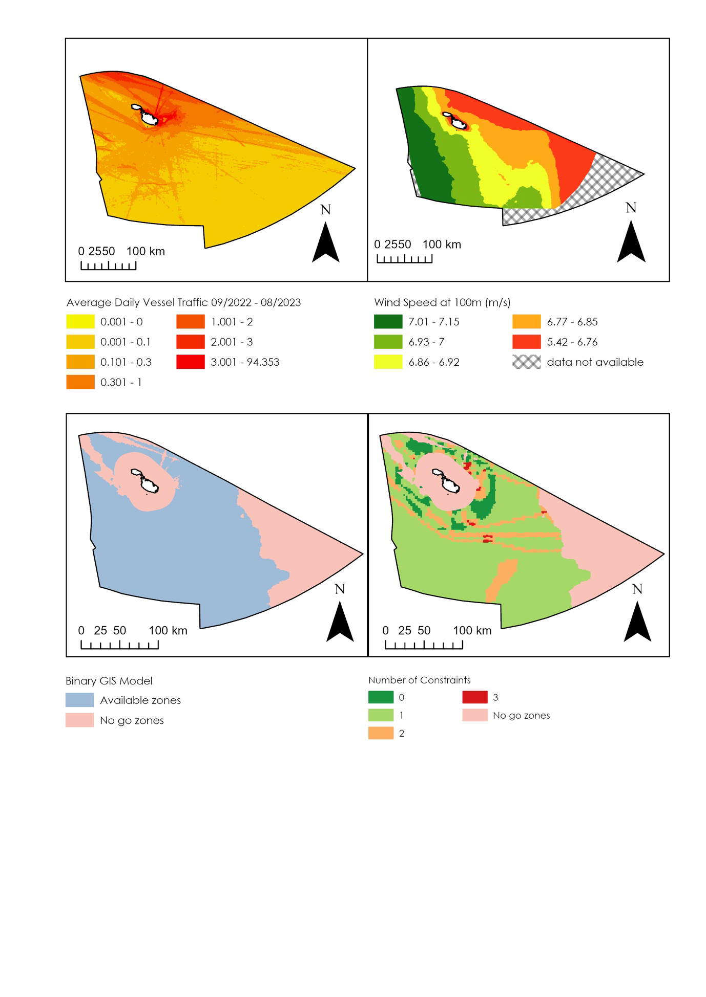

Classification of constraints used
  Binary method used to identify no-go zones
    Average wind speed below 5 m/s (minimum operational speed)
    Water depth beyond 1000m
    Average daily vessel traffic above 2 (although ships could pass through)
    Territorial water (state legislation)
  Non-binary method to list number of constraints
    Marine Protected Areas
    Cables & pipelines
    Pre-Quaternary faults
    Rocks & boulders
    Trawling areas
    Beyond 25 nautical miles fom shore
INTELLIGENT & RESILIENT
OCEAN ENGINEERING
8
Binary GIS model distinguishing no-go and available zones
GIS model depicting number of constraints

Slide 8
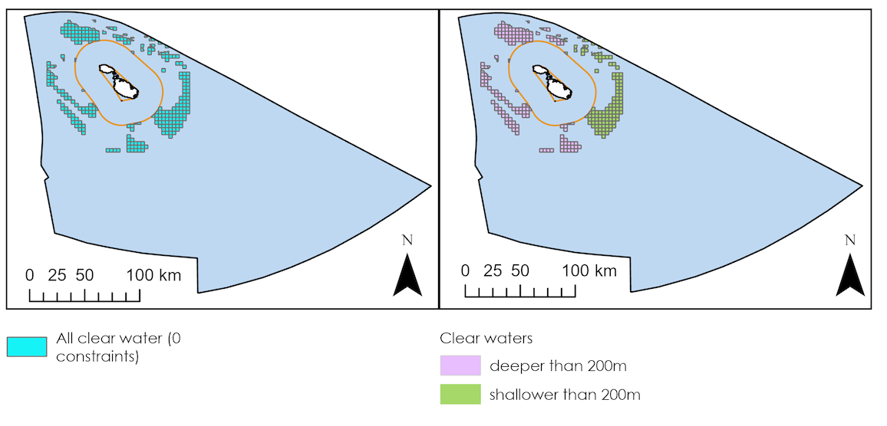
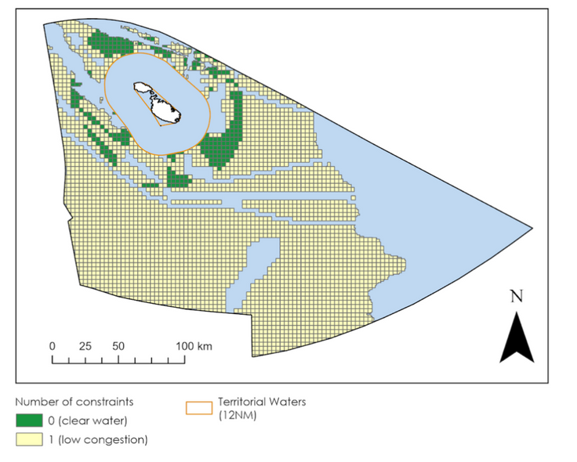
Results and analysis
  GIS analysis identifies over 40% of Malta’s waters as suitable for OW, primarily in deeper waters (>60m) requiring floating technologies
  Utilising a tenth of this space could produce
  7 times Malta’s peak energy demand
  Clear water identified as suitable area without constraints
  Low congestion water identified as suitable area with only 1 constraint
INTELLIGENT & RESILIENT
OCEAN ENGINEERING
Suitable locations grouped as clear and low congestion
Clear water split by depth below and above 200m
9

Slide 9
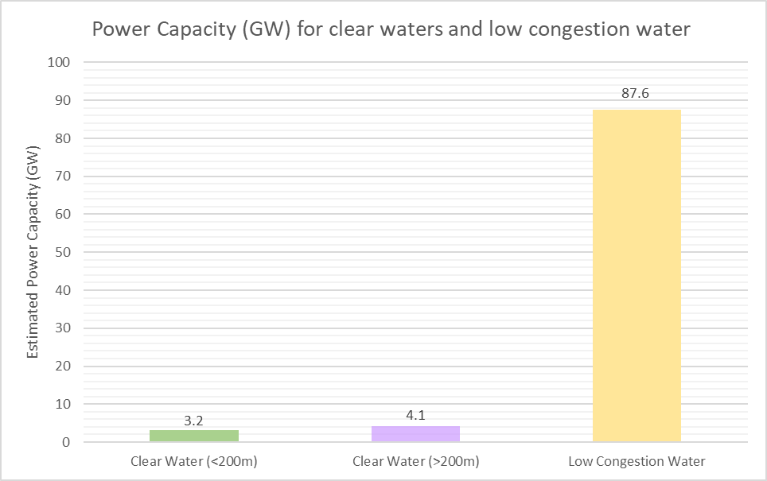
Potential power output
  Conservative estimate of 3 MW per sq km, considering wind speeds and height
  From the identified suitable areas, the estimated power output is several times Malta's peak energy demand of 1GW
  Clear water areas (<200m depth) show a potential power capacity of 3.2 GW
  Total potential in clear water areas
(all depths) rises to 7.3 GW
  Considering also low congestion water with 1 constraint potential reaches 87.6 GW
INTELLIGENT & RESILIENT
OCEAN ENGINEERING
Estimated power capacity
11

Slide 10
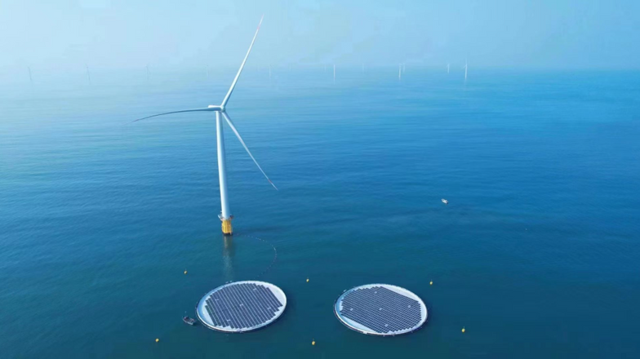
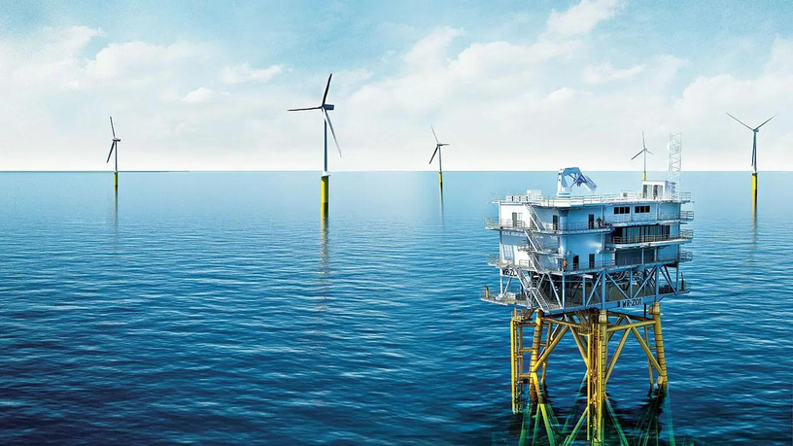
Opportunities identified
  Energy surplus provides opportunity for Malta to meet its domestic energy needs and export surplus energy enhancing regional energy connectivity
  Exploration of green hydrogen production using surplus energy from OW as a form of energy storage could mitigate intermittency
  Challenges include deep water, distance from shore and rocky seabeds pose cost considerations
  Possibility of combining floating solar panels between installations to maximise output
INTELLIGENT & RESILIENT
OCEAN ENGINEERING
Combined floating solar and offshore wind farm in Shandong coast : SPIC
Concept hydrgen production from offshore wind: Ramboll
12

Slide 11
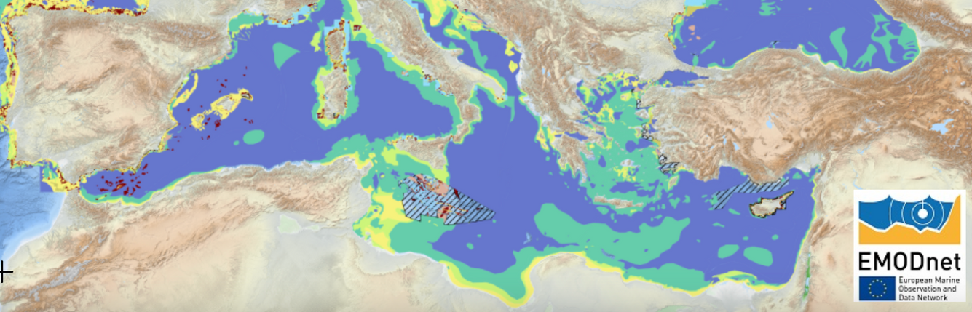
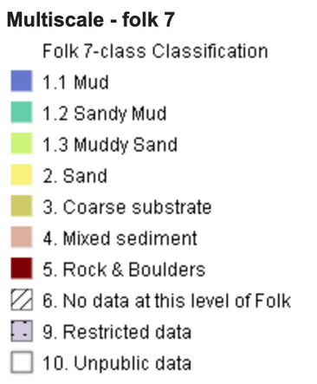
Possible future works
  Scarcity of detailed sediment data necessary for precise geological assessment
  Sediment type and thickness required to choose appropriate anchorage system as some systems require 30m+ of softer stratum
  Further studies are needed to explore advanced anchoring technologies for deep and rocky seabeds to reduce installation costs
  Conduct long-term environmental impact assessments of OW farms
INTELLIGENT & RESILIENT
OCEAN ENGINEERING
Figure showing incomplete sediment data: EMODnet
10

Slide 12
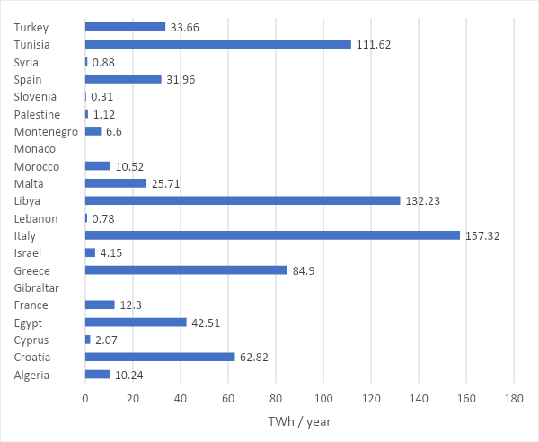
Broader Mediterranean application
  Application of the GIS method in Malta demonstrates potential for adaptation to other Mediterranean countries with similar marine characteristics
  Countries in the region can leverage this approach to explore their OW potential, tailored to meet unique regional spatial and environmental challenges
  Approach promotes a strategic and environmentally sensitive development of OW, contributing to regional energy security and sustainability goals
INTELLIGENT & RESILIENT
OCEAN ENGINEERING
Theoretical max. annual OW production for Mediterranean countries
Source: Pantusa et al 2019
13

Slide 13
Conclusion and Q&A
  Project Overview
    Demonstrate the effective use of GIS method to identify suitable locations for offshore wind
    Approach used for Malta’s case study can be applied across the Mediterranean or other regions
  Key opportunities
    Significant potential for Mediterranean to harness offshore wind energy
    Aligns with local and global sustainability goals encouraging renewable energy implementation
  Innovative integrations
    Potential to integrate floating solar PV systems with offshore wind farms
    Surplus energy could enable green hydrogen production
INTELLIGENT & RESILIENT
OCEAN ENGINEERING
14

Slide 14
Southampton Marine and Maritime Institute
https://www.southampton.ac.uk/iroe

