Slide 1
Glitches in rotating supersolids
Silvia Trabucco
Based on: PRL 131, 223401 (2023)
silvia.trabucco@gssi.it

Slide 2
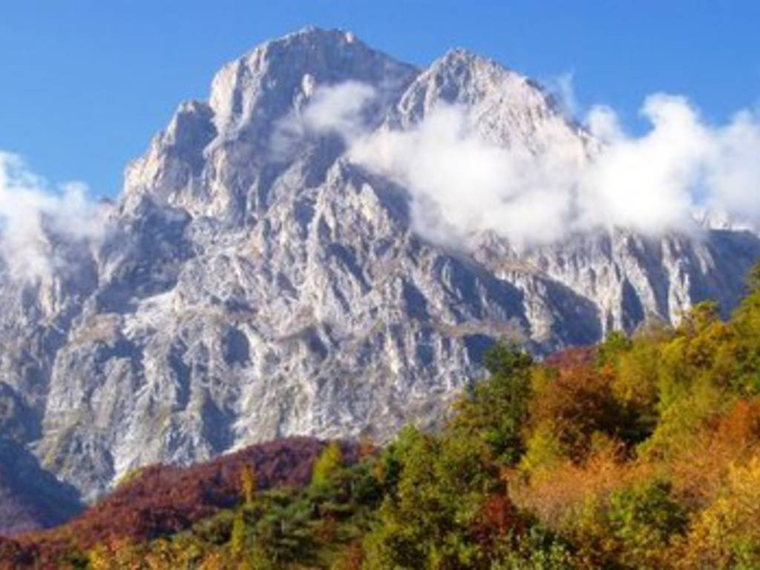
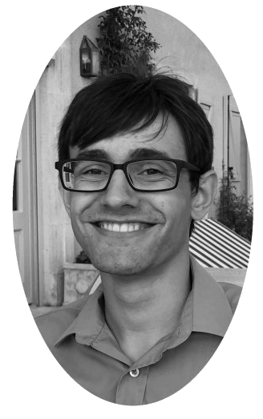
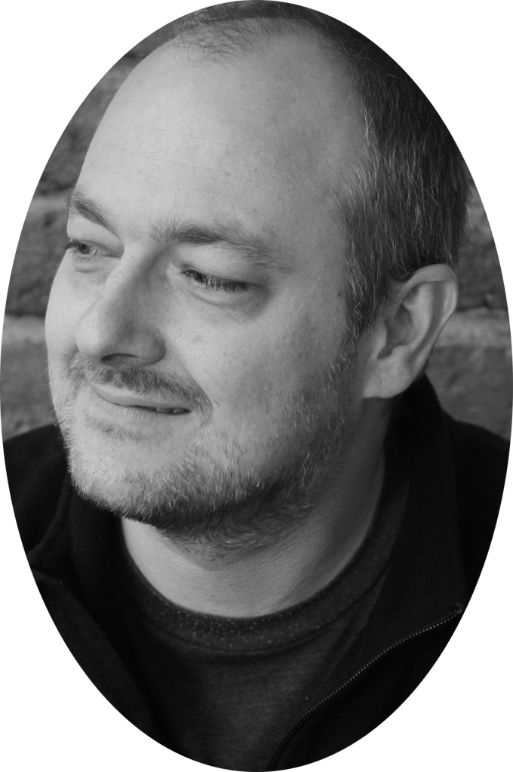
The collaboration
Innsbruck
Gran Sasso

Slide 3
Outline
Glitches in Neutron Stars Ultracold matter: supersolidity Glitches in rotating dipolar supersolids

Slide 4
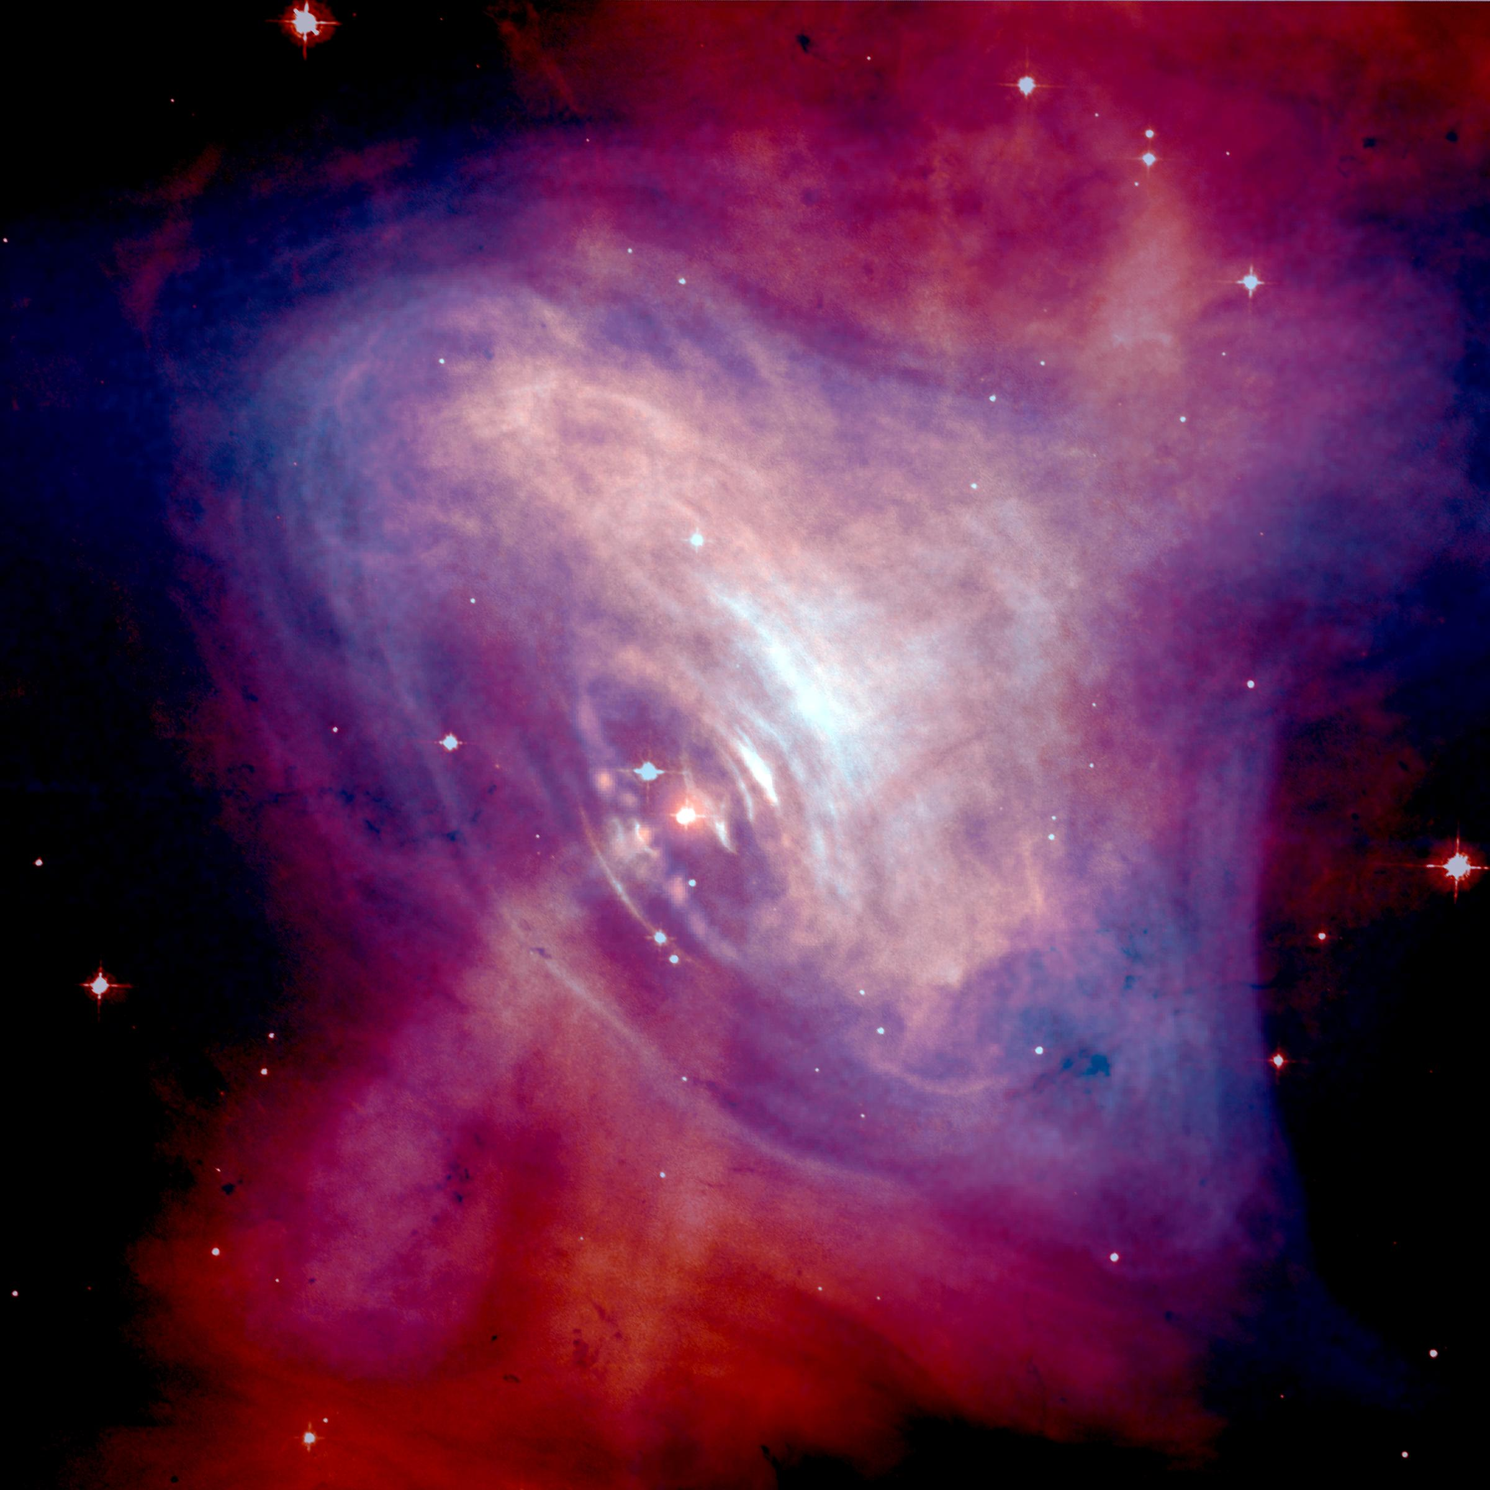
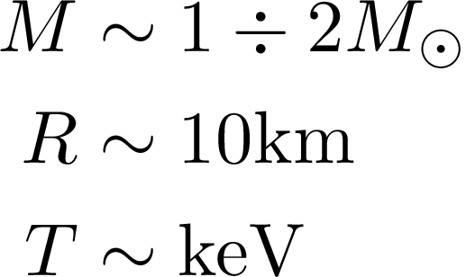
Neutron Stars
Credits: NASA

Slide 5
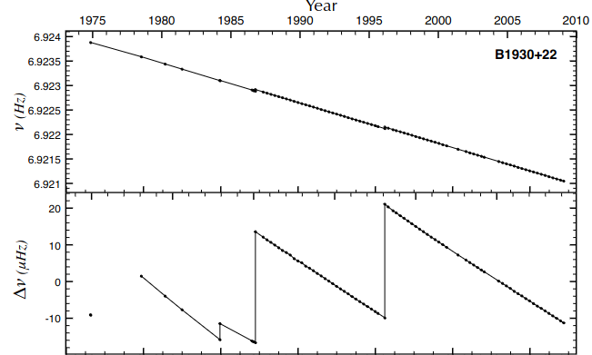
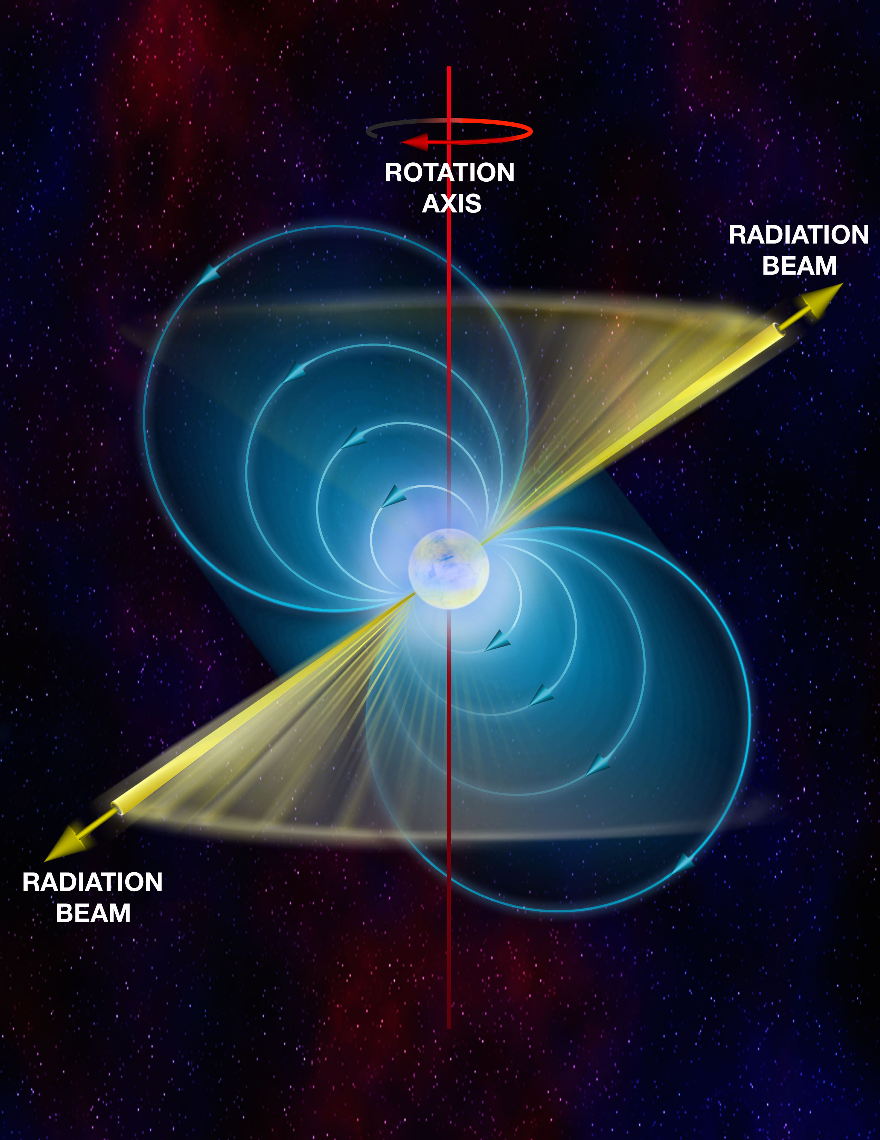
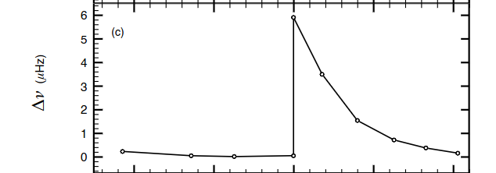
Glitches in Neutron Stars
Spin-down
Espinoza+ MNRAS, 414,2 (2011)

Slide 6
Glitch event
Espinoza+ MNRAS, 414,2(2011)

Slide 7
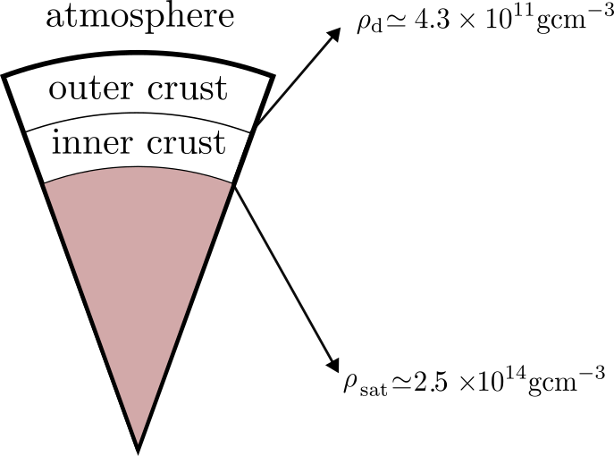
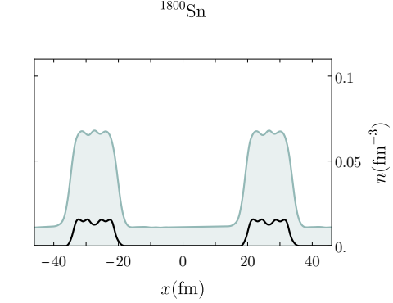
Neutron Star structure
Superfluid neutrons
core
Protons
Negele+ Nucl. Phys. A207,298 (1973)

Slide 8
Vortices unpinning in the inner crust transfers angular momentum to the outer crust
Superfluid neutrons
Warszawski+ MNRAS, 415,1611 (2011)

Slide 9
Ultracold matter

Slide 10
Ultracold bosons
Dilute gas with short-range isotropic interaction
Mean Field theory
Gross- Pitaevskii Equation

Slide 11
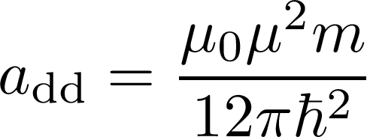
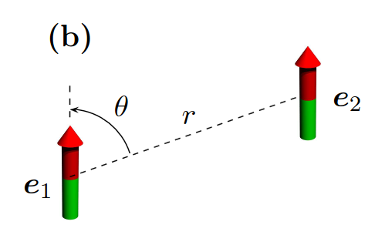
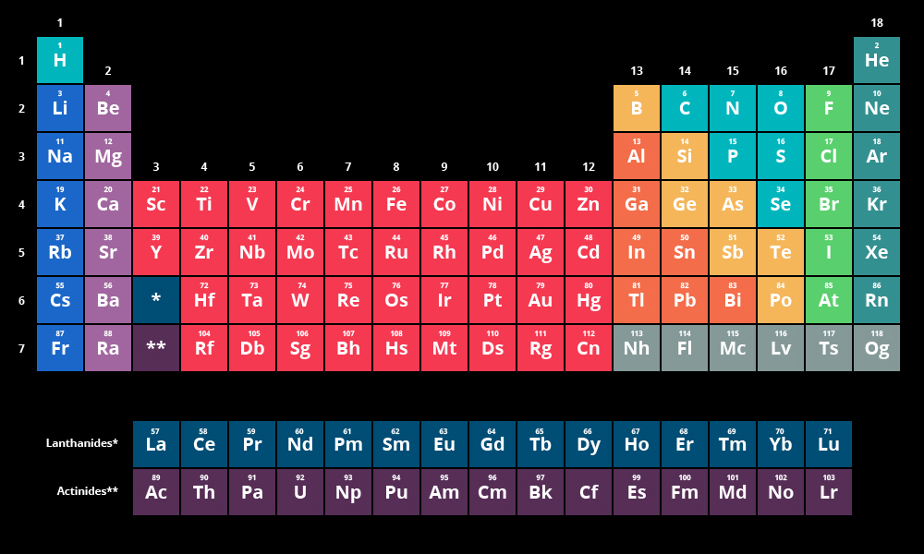
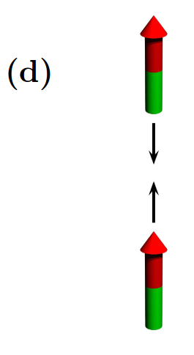
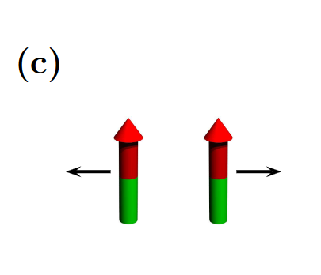
Ultracold dipolar atoms
Long-range interaction
polarized
repulsive
attractive

Slide 12
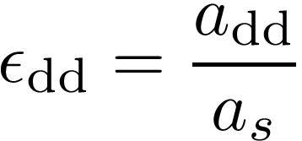
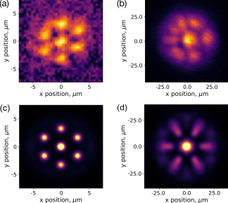
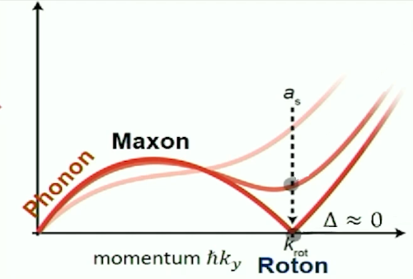
Supersolidity
Observations also in Pisa/LENS (Modugno), Stuttgart (Pfao)
Bland+ PRL 128, 195302 (2022)

Slide 13
Our results

Slide 14
Neutron stars vs Supersolids
Poli+ PRL 131, 223401

Slide 15
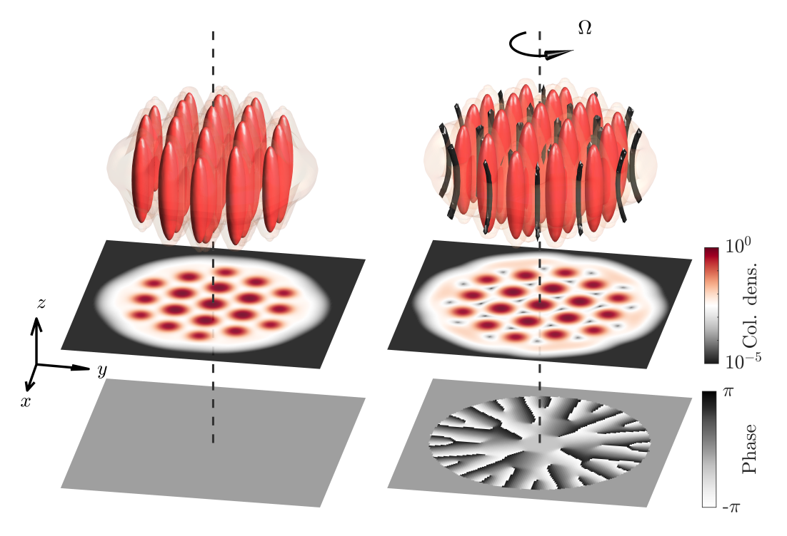
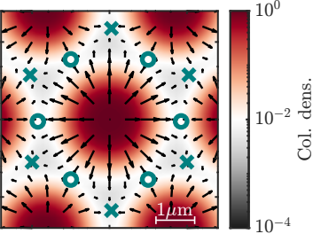
Rotating a supersolid
X = stable
O= metastable

Slide 16
Supersolid inertia
related to the “amount” of superfluidity
Educated ansatz
Legget PRL 25, 1543 (1970)

Slide 17
Evolution
Given
Feedback
Time evolution

Slide 18
Evolution
Given
Feedback
Dissipation
Time evolution

Slide 19
Numerical evolution
Imaginary time evolution to extract the ground state wavefunction in the rotating frame for fixed and
Extract the value of
Start the time evolution
Use feedback equation to update
Use the updated and go to step 3)

Slide 20
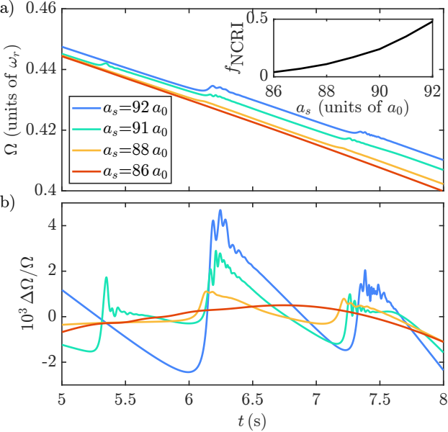

Slide 21
When as for glitches do not occur

Slide 22
Conclusions
Numerical observation of supersolid glitches
Simulations of inner crust vortex interstitial pinning
Observation of crystal oscillations and vortices percolation
Scalability of pulse shape
Vortices dynamics across the lattice
Extension to nuclear pinning

Slide 23
Thank you for the attention!

Slide 24
Backup slides

Slide 25
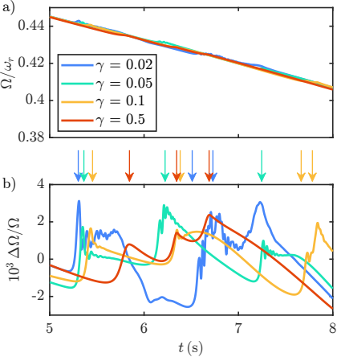
Different values of mimicks different coupling with the outer crust
Parameters

Slide 26
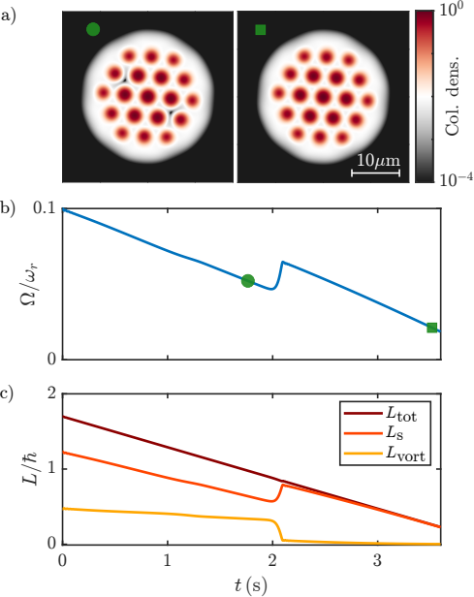
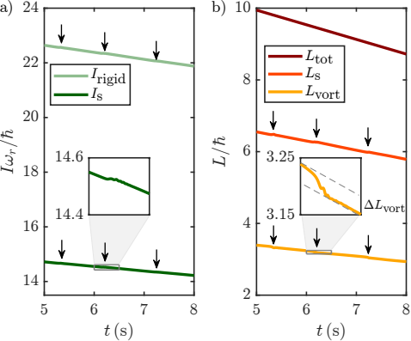
Testing the angular momentum decomposition

Slide 27
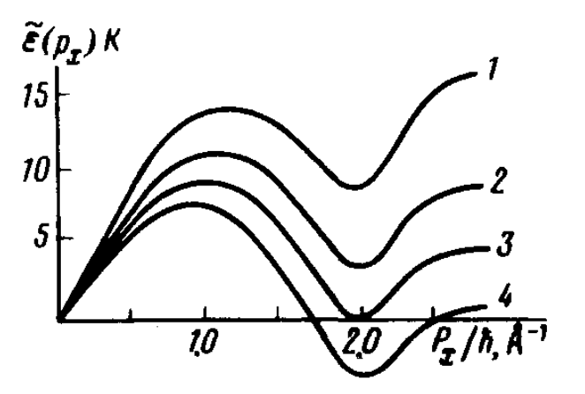
Ultracold bosons
An old idea in Helium
Pitaevskii JETP Lett. 39, 511 (1984)

