Slide 1
Extraction, LVS and
Post-layout simulation
Dr Basel Halak

Slide 2
Custom Design Flow
Layout design
DRC Checking
Specification
DRC
Schematic design
LVS Checking
Simulation
LVS
Meets the spec?
no
Parasitic Extraction
Simulation
yes
no
Meets the spec?
Completed design

Slide 3

Learning Outcomes
After completing this unit, you should be able to:
Use layout versus schematic (LVS) tools
Perform an extraction with parasitic elements
Use the hierarchy editor
Run a post-layout simulation

Slide 4
Learning Outcomes
After completing this unit, you should be able to:
Use layout versus schematic (LVS) tools
Perform an extraction with parasitic elements
Use the hierarchy editor
Run a post-layout simulation

Slide 5
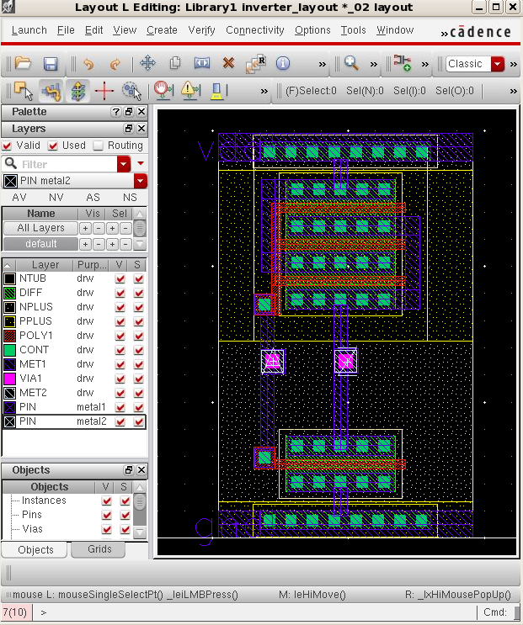
Where we left off
In the last lecture, you saw how to use Virtuoso to create a basic layout cell.
Your layout much be free from all DRC errors before you do LVS checking

Slide 6
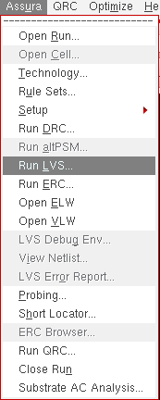
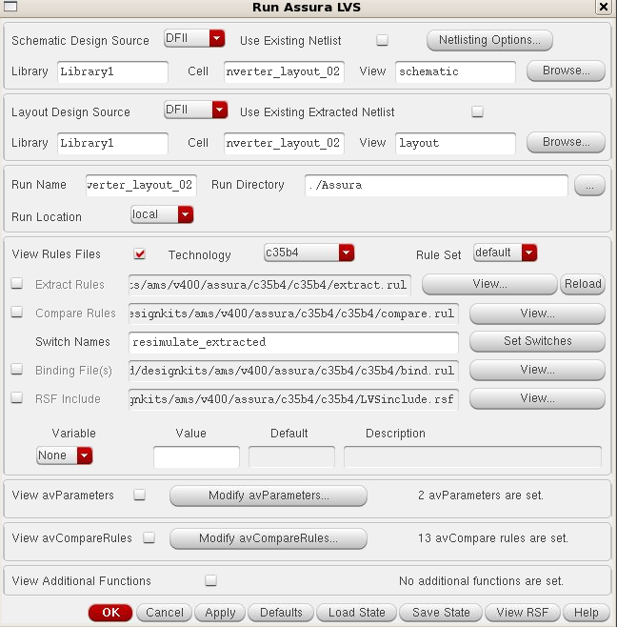
Extraction
The extraction tool is invoked from within the Layout window
This bring up the extract form (Run Assura LVS)

Slide 7
Layout versus schematic (LVS)
Layout versus schematic compares the extracted netlist to the schematic
You can invoke the LVS tool from the Layout view window

Slide 8
Layout versus schematic (LVS)
Here we will perform the circuit extraction, that is, all the parasitics resulting the layout of the devices (capacitances, diodes, and other components that can exist due to the interaction between different layers). The layout view will also be compared with the schematic (Layout versus Schematic, or simply LVS)
Without any DRC error, select Assura → Run LVS. In the main form press Set Switches, select the resimulate_extracted option and press OK. This ensures the use of this LVS run for RCX.

Slide 9
Running the LVS check
In the RUN Assura LVS window:
The Cell name should be the same as your Run name.
Technology should be chosen by c35b4.
The extract rule should be:
/home/esdcad/designkits/ams/v400/assura/c35b4/c35b4/extract.rul
The Compare rules should be home/designkits/ams/v400/assura/c35b4/c35b4/compare.rul
The binding files should be /home/esdcad/designkits/ams/v400/assura/c35b4/c35b4/bind.rul
RSF include should be
/home/esdcad/designkits/ams/v400/assura/c35b4/c35b4/LVSinclude.rsf
Select the switches option resimulate_extracted to ensure ensures the use of this LVS run for RCX.

Slide 10
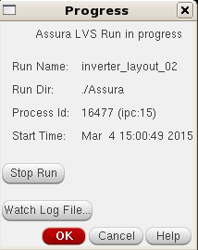
Layout versus schematic (LVS)
In the main form press OK to start LVS. Then you will see the progress window.

Slide 11
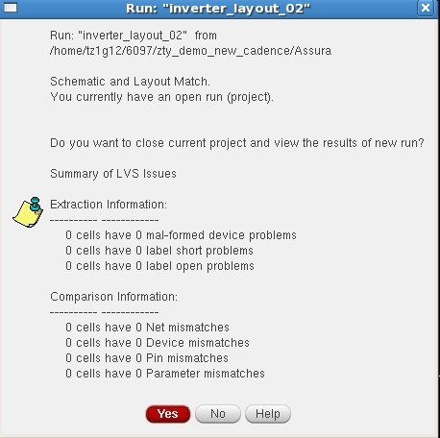
Checking the LVS output
If there is nothing wrong, you will receive this message.
Notes:
You can check LVS results by reading the reports

Slide 12
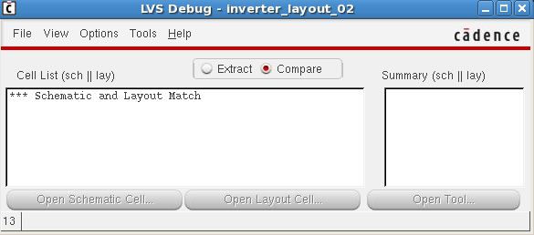
Layout versus schematic (LVS)
Click Yes. You will see the Schematic and Layout Match.

Slide 13
Typical LVS errors
In our case you should get at least one error – the terminals don’t all match
Reading further on, it is clear that the problem is with the Z terminal in the layout
Clearly, I have labelled the output Z in the layout and Y in the schematic – an easy fix.

Slide 14
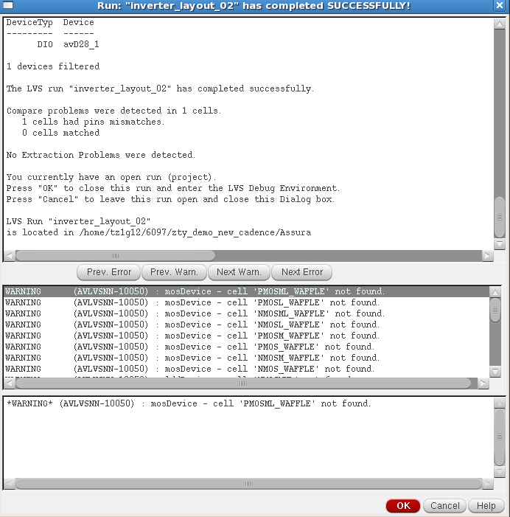
Typical LVS errors
So of you have LVS errors you will receive the following message which lists all errors. Click ok to go to Debug Window

Slide 15
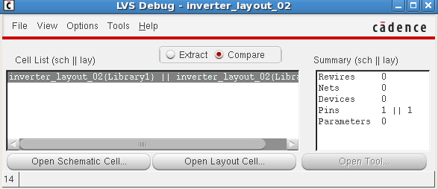
Typical LVS errors
LVS Debug Window gives more details on each error in the summary box
Double click the Pins

Slide 16
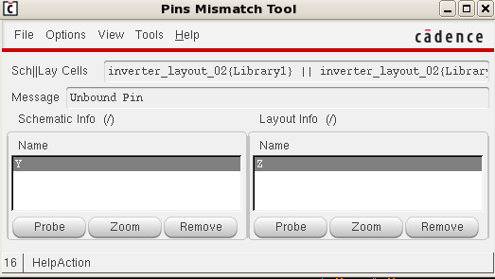
Typical LVS errors
You can find the mismatch detail and fix it.

Slide 17
Learning Outcomes Outcomes
After completing this unit, you should be able to:
Use layout versus schematic (LVS) tools
Perform an extraction with parasitic elements
Use the hierarchy editor
Run a post-layout simulation

Slide 18
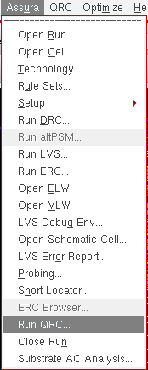
Extraction
You need to ensure that your design is free from LVS errors before you can proceed with the extraction b
The extraction tool is invoked from within the Layout window: as follows: Assura → Run QRC and to choose Extraction tab.
For the reference node (Ref Node) write gnd!. Proceed with OK.

Slide 19
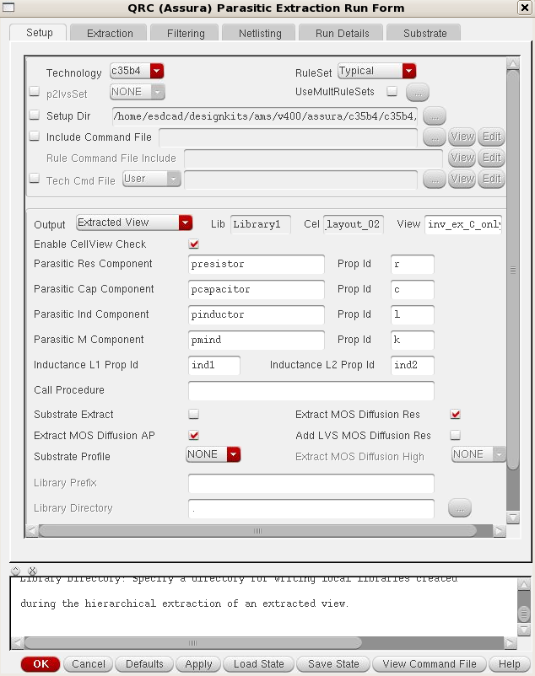
Setup tap
The Technology in Setup page should be c35b4.
Ruleset Typical
Output should be
Extracted view
You should pick a good view name to make it easy to differentiate between extraction versions.

Slide 20
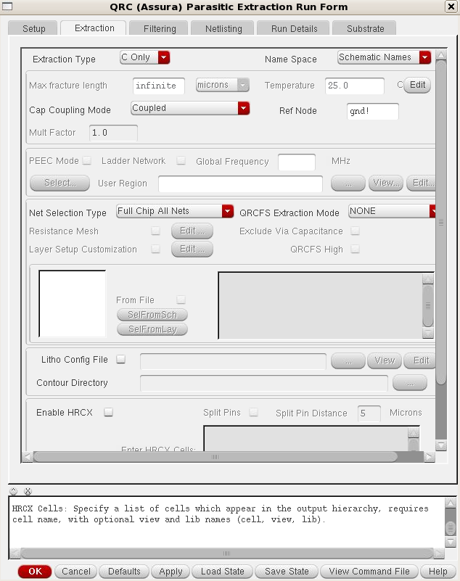
Extraction Tap
Extraction Type should be C Only, the other options can be used in further development.
Cap Coupling Mode is Coupled(i.e. into account coupling capacitances ).
Ref Node is gnd!

Slide 21
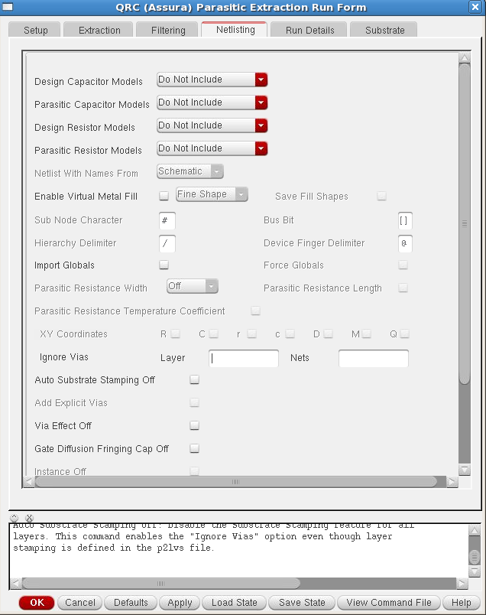
Netlisting Tap
Design Capacitor Models, Parasitic Capacitor Models, Design Resistor Models and Parasitic Resistor Models are all chosen Do not include.

Slide 22
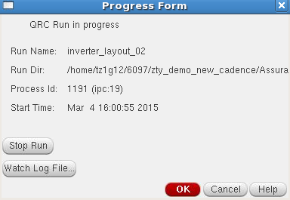
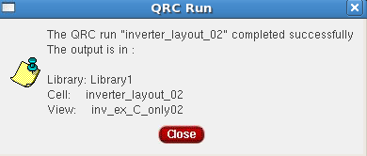
Run the extraction
Click OK to run the extraction
  Extraction can take a while on a large circuit
  Check for no errors
  Errors are rare – typically just ‘check and save’ errors

Slide 23
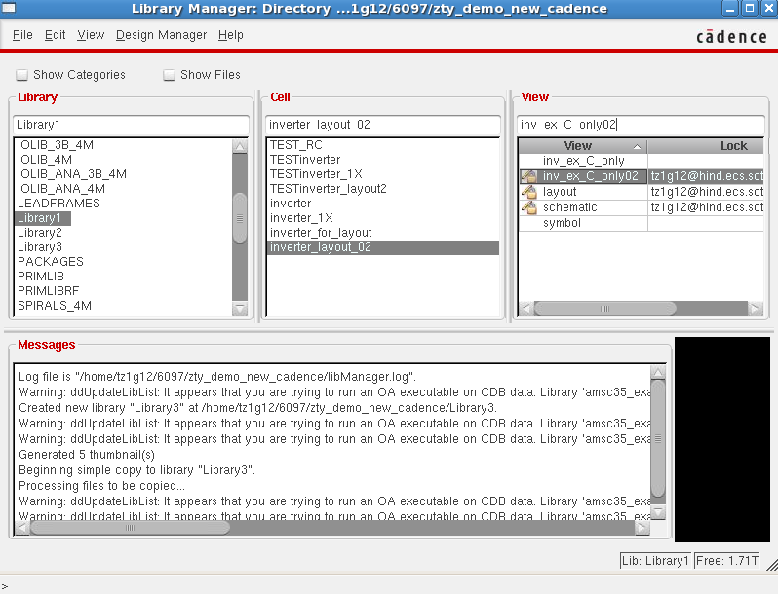
The extracted view
This has created a new cell view called ‘inv_ex_C_only02’

Slide 24
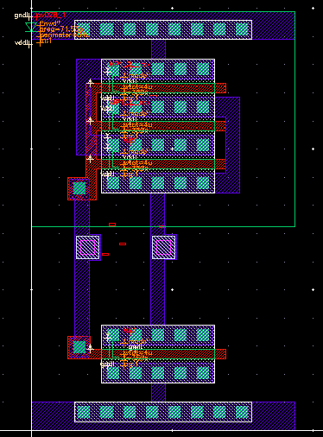
The extracted view
Looks a bit like the layout
It is a layout view, but with extracted devices and parasitic shown

Slide 25
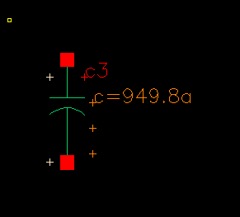
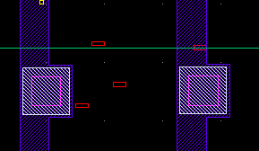
Extracting with parasitics
The extraction will take longer than before, due to the extra rules it needs to run
Check the CIW (main ICFB window) for any errors
Open the extracted view
Spot the extra capacitances
AMS uses a lumped model – i.e. total capacitance from one node to another.
Notes:
In order to show the paracitics
Schematic window
Launch - Plugins - choose paracitics
The parasitic tap will appear in the menu
Click on paracitics – Setup and choose your extracted file and click ok
Then click on Paracitics - show paracitics
This will show all the paracitics with lumped model

Slide 26
Learning Outcomes Outcomes
After completing this unit, you should be able to:
Use layout versus schematic (LVS) tools
Perform an extraction with parasitic elements
Use the hierarchy editor
Run a post-layout simulation

Slide 27
Extracting with parasitics
We want to simulate the parasitic components in the layout to see their effect on the performance
  E.g. rise time, fall time
Parasitic components consist of Rs and Cs
  Resistance of interconnect
  Capacitance between layers
The AMS kit allows us to extract the parasitic capacitances only

Slide 28
Post-layout simulation
The schematic you have drawn is not realistic
The extracted layout, containing parasitic capacitances is far more realistic and it is useful to simulate this to increase confidence in your design
First we need a test circuit for our inverter, then we need to tell the simulator to use the extracted view, not the schematic view

Slide 29
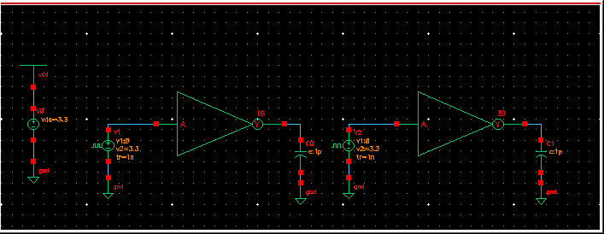
Post-layout simulation
  For this simulation you need to use the inverter cell which has the following views (schematic, layout, extracted and symbol)
  Create a new test schematic called Test_Inverter_layout as shown below using your fixed dimension inverter in it

Slide 30
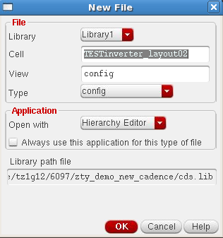
How to use the Hierarchy Editor
We need to create a config view for the Test_Inverter_layout cell , to tell the simulator which view to use
From Library Manager, go to File ->
New cell view
Choose the name of the cell Test_Inverter_layout
Choose Type to be config
Click ok and the Hierarchy Editor will appear

Slide 31
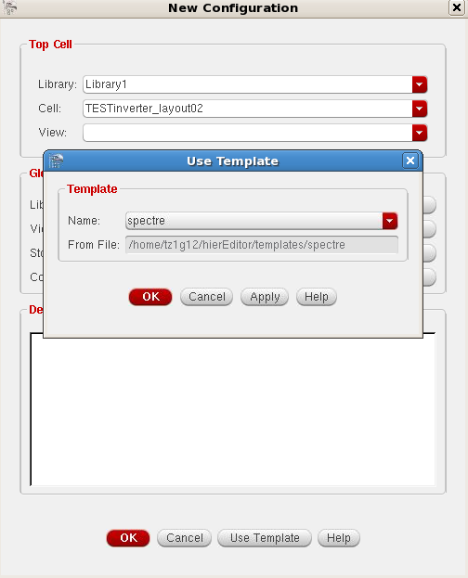
How to use the Hierarchy Editor
Click ‘Use template’ and choose a template name ‘spectre’
Click ‘Ok’

Slide 32
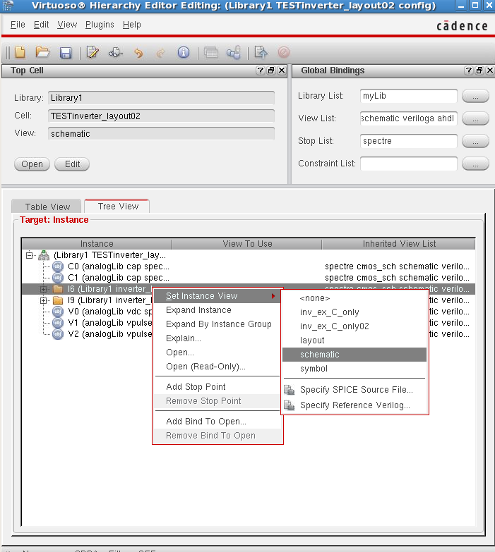
How to use the Hierarchy Editor
From the View Tap, Switch to the tree view in the hierarchy editor
You can see the
two inverter
instances there
Right click the ‘Set Instance View’ column to select the view
Choose Schematic
for one inverter and choose extracted view for the other

Slide 33
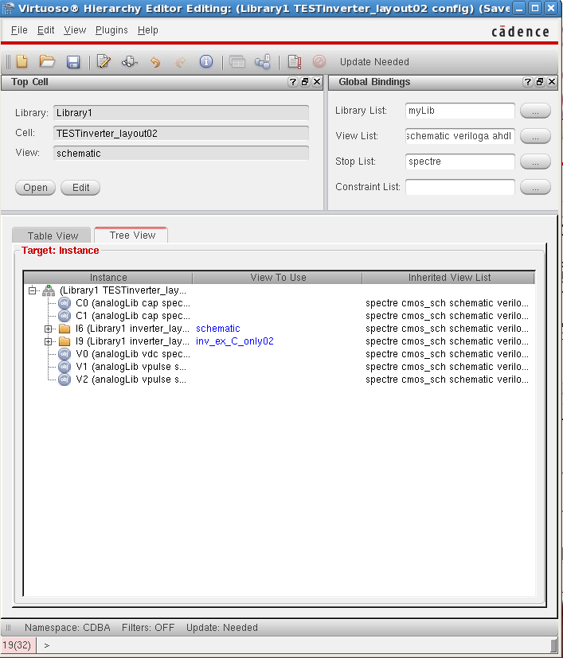

How to use the Hierarchy Editor
Update the instance by clicking

Slide 34
How to use the Hierarchy Editor
Open your test from Schematic Config mode

Slide 35
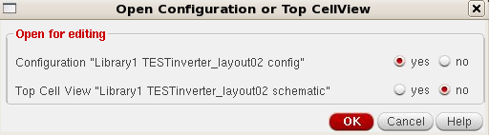
Post-layout simulation
Now, whenever you want to use the config view in your simulations, you must open the config view to open the schematic, not just open the schematic
This will give you the option of opening the hierarchy editor and/or schematic
Normally you just want to open the schematic
Try descending into each of the inverters in the schematic
  One will descent into the schematic, and one into the layout
Start ADE as usual.
  ADE will have loaded the config view as it initialised

Slide 36
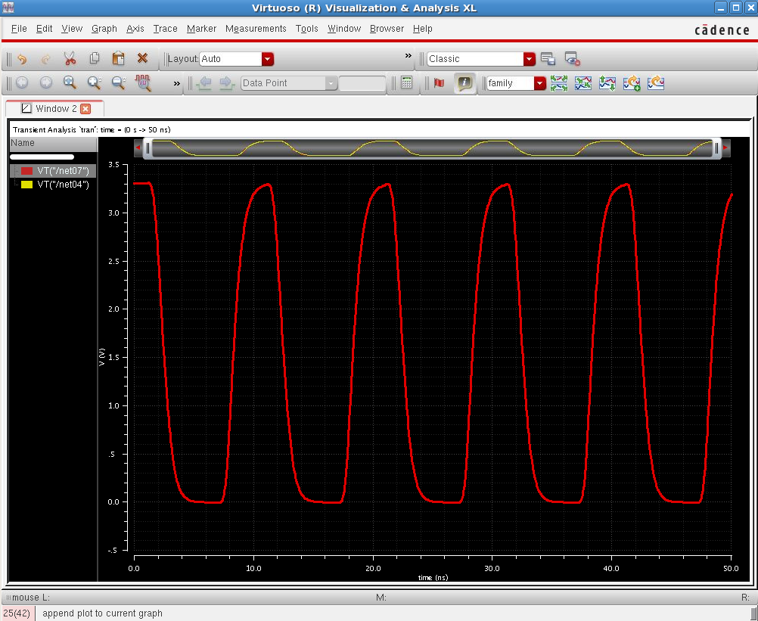
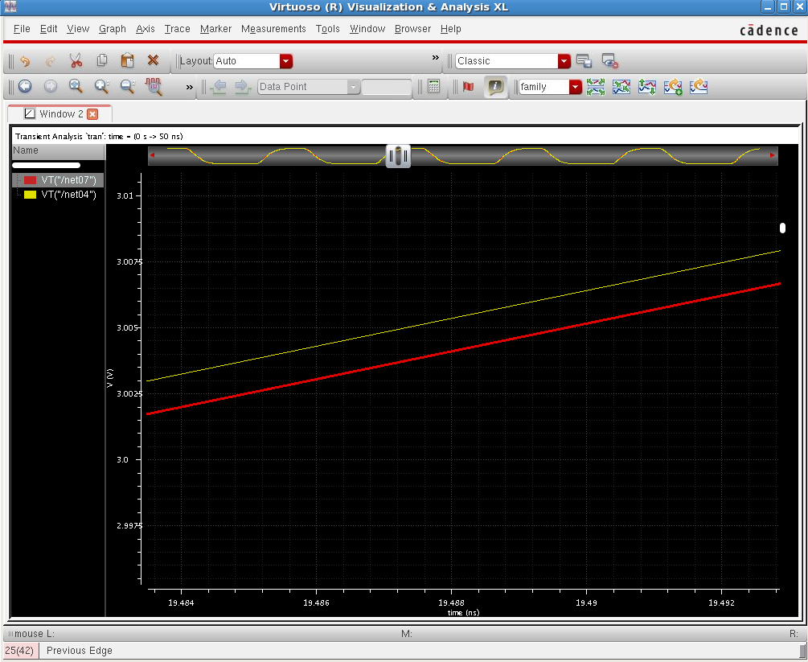
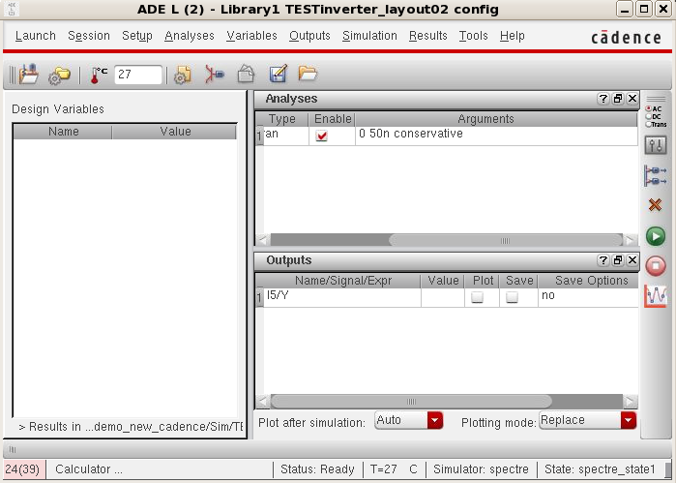
Post-layout simulation
Set up a simulation as before
Run the simulation
Plot the output of both
inverters in the schematic
Slight difference

Slide 37
Summary
Extraction creates a netlist from your layout
LVS compares the extracted netlist with your schematic
Extraction can extract parasitic components
The hierarchy editor can be used to configure which view to use for schematic instances
Post layout simulation is important
for increased confidence in your
design

Slide 38
Lab: Layout
Extract the layout netlist
Objective: Extract your layout, run LVS, use the hierarchy editor and run a post layout simulation
Run LVS to compare with schematic
Extract again, with parasitics
Post layout Simulation

