Slide 1
Inverter Layout In Cadence
Dr Basel Halak

Slide 2
Custom Design Flow
Layout design
DRC Checking
Specification
DRC
Schematic design
LVS Checking
Simulation
LVS
Meets the spec?
no
Parasitic Extraction
Simulation
yes
no
Meets the spec?
Completed design

Slide 3
Manual and semi-automated layout
There are two main ways to create a layout
  Standard design Flow (Automated) e.g. (Digital Design Flow)
  Full custom layout – placing transistors and interconnects manually
Today we will learn about custom layout, but there are a number of ways of approaching this
  Pcells are parameterised layout cells, typically of transistors and vias, which do the hard work for you
  Pcells create the transistor features automatically
  LayoutL allows you to place the transistors in your layout from the schematic dimensions, saving time

Slide 4
Learning Outcomes
After completing this unit, you should be able to:
Use LayoutL to place transistors in a layout
Construct a simple layout, step by step
Use the DRC checking tool
Search and explain errors

Slide 5
Learning Outcomes
After completing this unit, you should be able to:
Use LayoutL to place transistors in a layout
Construct a simple layout, step by step
Use the DRC checking tool
Search and explain errors

Slide 6
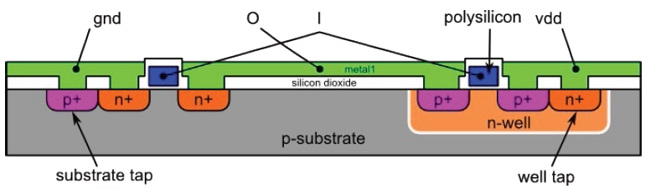
Inverter Layout
Notes:
This is what we will try to create using Cadence tools

Slide 7
Set up the current working directory
Create aa folder for this lab and move into it
Copy the display.drf file to your working directory or alternatively you can copy this file from the following location: /home/esdcad/designkits/ams/v400/cds/HK_ALL/env
Type the following:
  tcsh
  source /opt/esdcad/scripts/ams_v400_tcshrc

Slide 8
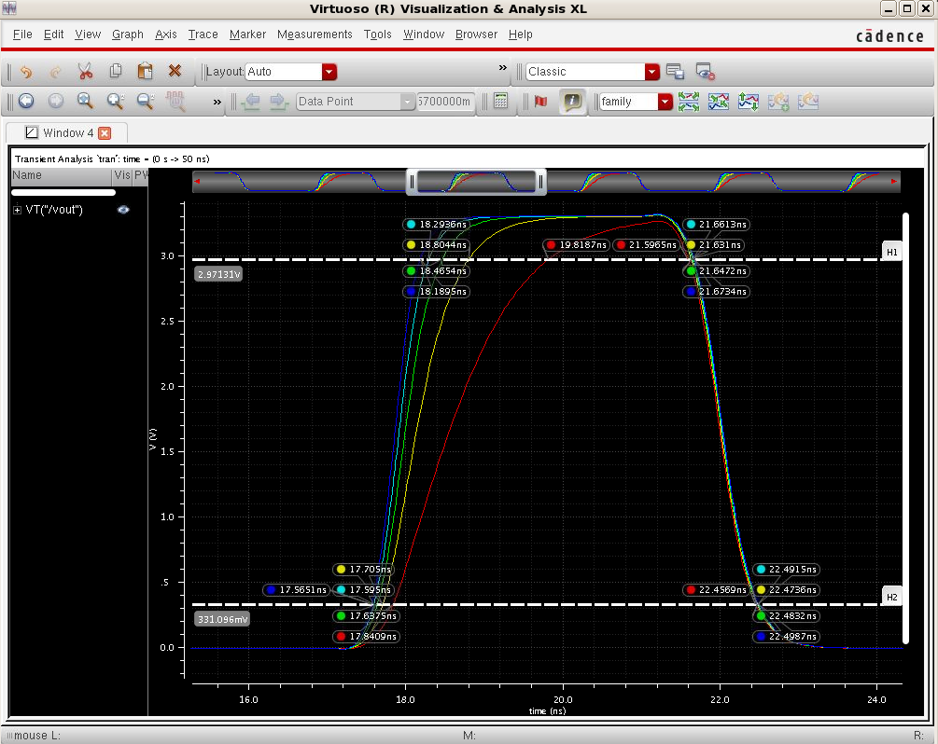
Where we left off
In the last lecture, you saw how to simulate your inverter test circuit.

Slide 9
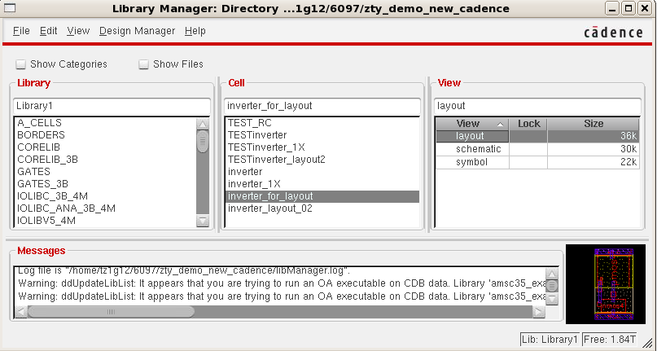
Layout in Cadence
In this lecture you will learn how to use the Cadence layout editor, called Virtuoso
A cell has multiple cell views
  You have already created a schematic view and a symbol view
  Today we will create the layout view
All the views can
be seen in
Library Manager

Slide 10
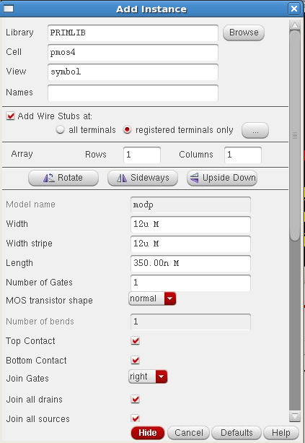
Create a new inverter cell with fixed dimensions
For layout, we need a fully defined schematic
The inverter schematic from the last lecture does not have fixed dimensions (we used pPar(“”))
We must create a new inverter schematic with fixed dimension as follows :
  NMOS 4u/0.35u
  PMOS 12u/0.35u
Create a symbol view for your new schematic

Slide 11
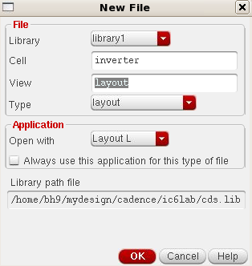
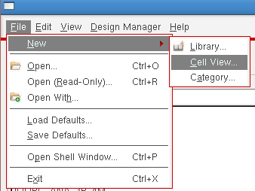
Create a layout view fro your inverter
From the Library Manager, start LayoutL
Choose New - Cell View
You need to create a
layout view from your
schematic
Two windows will open, the LSW and the empty layout view

Slide 12
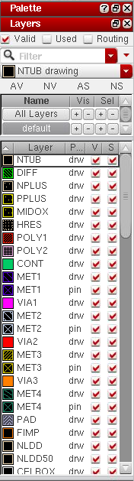
About the LSW
The layer selection window (LSW) shows all the layers you can use in the layout
There are LOTS, however you will only need to use the ones towards the top (MET1, POLY1, NTUB, NPLUS, PPLUS)
Each layer has a number of entries in the LSW, the one you need to use is the ‘drawing’ layer ‘dg’
The buttons at the top are useful:
  AV: all visible, NV: none visible
  AS: all selectable, NS: none selectable

Slide 13
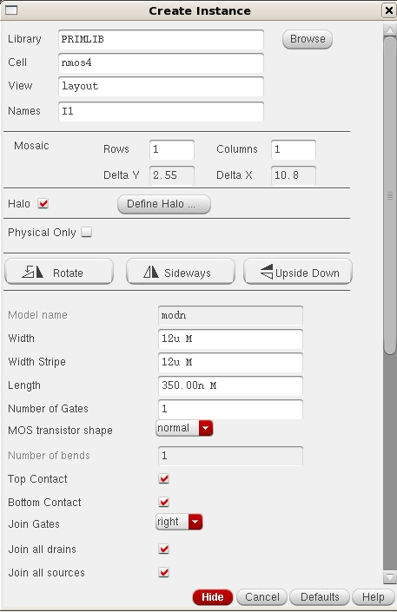
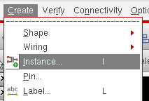
Placing the transistors
Add Instance from the Create menu
You need two transistor from PRIBM lib with the following dimensions
  NMOS 4u/0.35u
  PMOS 12u/0.35u

Slide 14
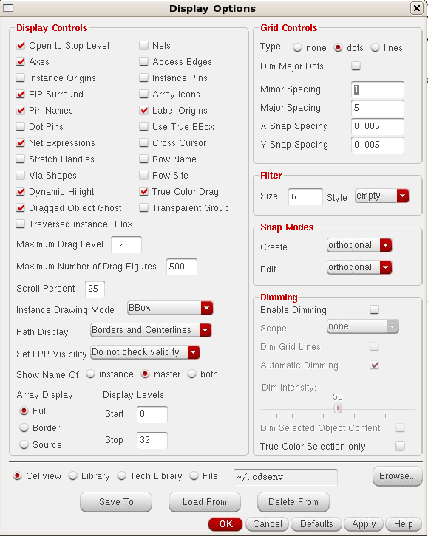
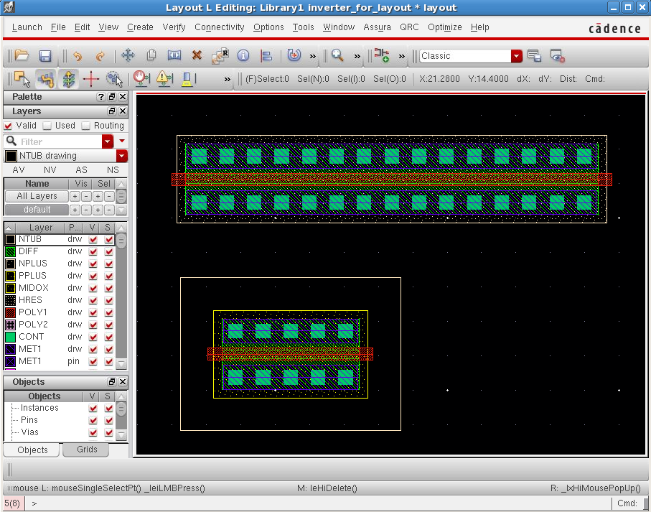
Selecting the display layers
If you cannot see the transistors, you may not have enough layers selected.
Go to display->options
Change settings as below

Slide 15
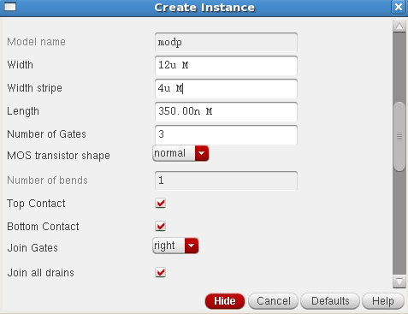
Customising the pcells
LayoutL has traversed our schematic and figured out that we have two transistors
  NMOS 4u/0.35u
  PMOS 12u/0.35u
It has saved us a huge amount of time by creating the transistor structures for us using pcells
We can customise the way the transistors have been generated by looking at the properties
Change the number of gates to ‘3’

Slide 16
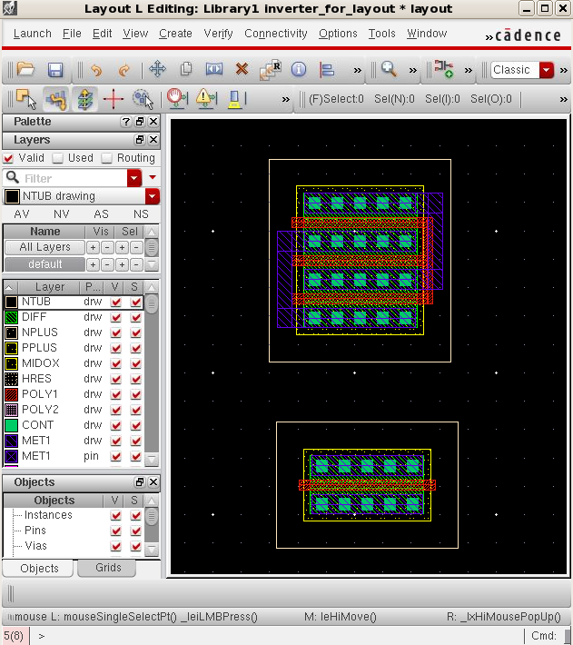
Customising the pcells
The pcell has been regenerated with three gate strips.
Play around with the properties of the pcell, to see how it affects the generated transistor
You can see that the PMOS has an nwell around it

Slide 17
Basic layout operations
Move items using ‘m’
Stretch using ‘s’
Move around layout with arrow keys
Right click zooms as usual
Shift ‘z’ zooms out
Fit the layout with ‘f’
Control ‘d’ deselects everything (very useful)
Create a rectangle with ‘r’
Create a via with ‘o’
Create instance with ‘i’
Create a path with ‘p’
Create a pin with control ‘p’
Chop with shift ‘c’
Split with control ‘s’
Add ruler with ‘k’
Delete all rulers with shift ‘k’
For options press F3

Slide 18
Learning Outcomes
After completing this unit, you should be able to:
Use LayoutL to place transistors in a layout
Construct a simple layout, step by step
Use the DRC checking tool
Search and explain errors

Slide 19
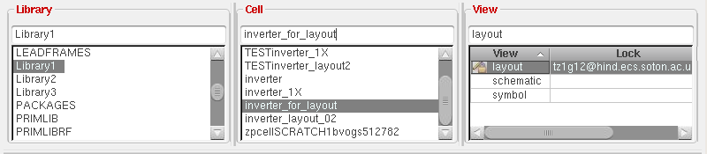
Back to manual layout
Now we have used LayoutL to create the transistors, we will do the rest manually.
Stop LayoutL by saving the layout, then closing it and opening from Library Manager
In the case of an inverter, it is probably just as easy to create the transistors manually.
LayoutL is useful for large schematics

Slide 20
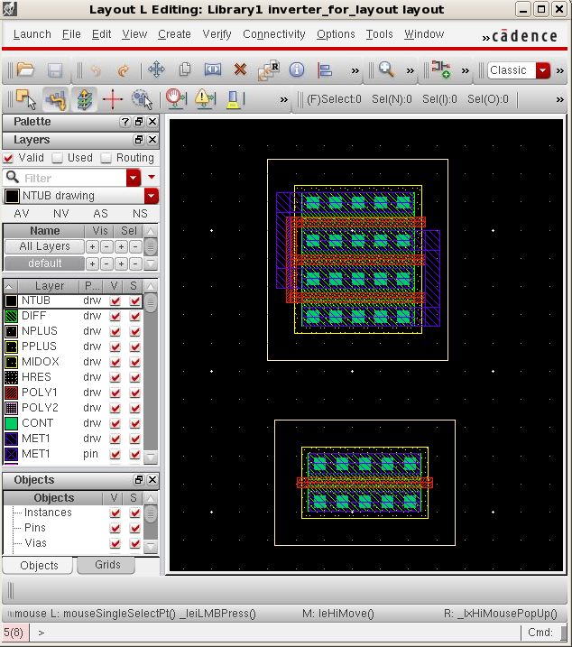
Creating the inverter layout, step by step
To begin with we have the PMOS and NMOS transistors
Make sure they are in line, and 3.3um apart
Use rulers ‘k’ to measure
If you need to flip the PMOS, use ‘m’ for move, then press F3 and in the options form press the ‘sideways’ button
Notes:
How high (in 2D) does the cell needs to be?
If you want to use this cell as an additional cell in standard cell, then the dimensions of this cell should comply the specifications in terms of height for that library
About Standard Cells
First, a brief overview of standard cells:
When a circuit design is synthesized, high-level code written in (usually) Verilog or VHDL is converted
to a collection of generic logic gates and other generic elements.
·
Then, these generic cells are mapped to a particular library of pre-built VLSI circuits, such as the cells in
our "NCL Library".
·
These "standard cells" all follow the same layout rules: they are all of the same height - only the width
can vary; they all have a VCC and GND rail running along the top and bottom of the cell; the top half of
the cell is an n-well.
·
· On the chip itself, these cells are layed out in rows, with common VCC and GND rails.

Slide 21
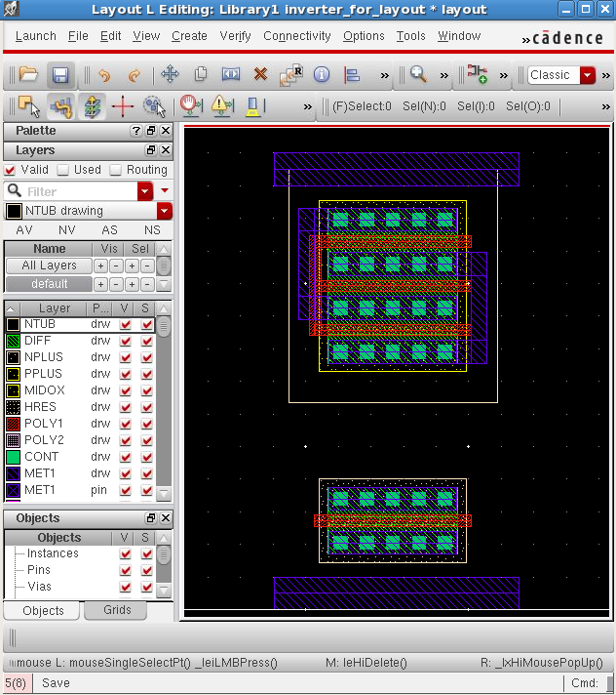
Creating the inverter layout, step by step
Draw the metal vdd and gnd paths
Make sure that MET1 dg is selected in the LSW
Use the path command ‘p’ to start the path, and press F3 to bring up the options
Set the width to 1um
Make the paths 0.7um above/below the other MET1

Slide 22
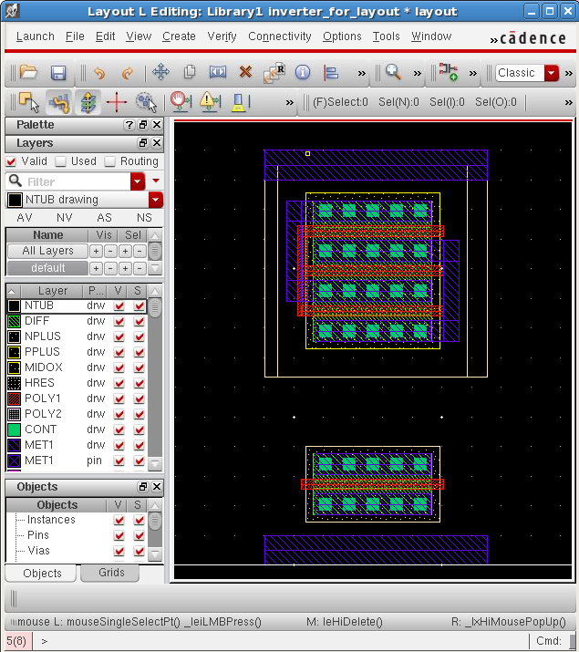
Creating the inverter layout, step by step
Extend the N tub
Select NTUB in the LSW
Draw a rectangle with ‘r’
Draw the N tub from the top left of the vdd MET1 to the bottom of the N tub generated by the PMOS pcell
Notes:
This is needed because this process is P-well (the black area is p-substrate) process so we need to extend the n-well around the PMOS
Drawing the N-Well
In this process, the silicon substrate is originally doped with p-type impurities. NMOS transistors can be realized on this p-type substrate simply by creating n-type diffusion areas. For the PMOS transistors however a different approach must be taken: A larger n-type region (n-well) must be created, which acts like a substrate for the PMOS transistors.
From the process point of view, the n-well is one of the first structures to be formed on the surface during fabrication. Here we chose to draw the n-well after almost everything else is finished. Note that the drawing sequence of different layers in a mask layout is completely arbitrary, it does not have to follow the actual fabrication sequence.

Slide 23
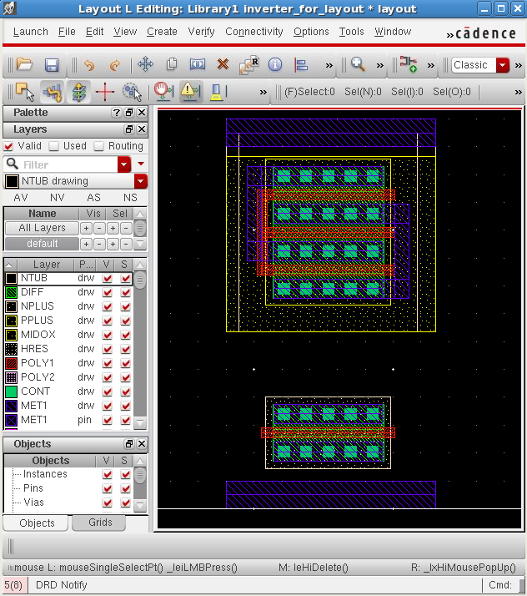
Creating the inverter layout, step by step
Extend the PPLUS
Select PPLUS in the LSW
Use ‘r’ to draw the rectangle shown
Extend above the PPLUS generated by the PMOS pcell by 0.5um
Notes:
This is just to achieve higher Ohmic contact between the vdd and the PMOS by extending the PPLUS around the PMOS and connecting it to the NPLUS around the contact, other reason for this is to create a standard cell. This step might not exists in different technologies

Slide 24
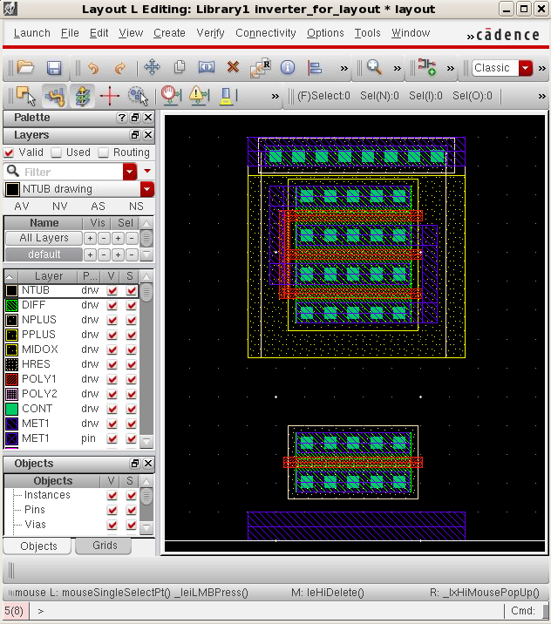
Creating the inverter layout, step by step
Add taps to the PPLUS
Press ‘o’ for add contact
Select the ND contact
Choose 8 columns
Place the array centrally above the existing PPLUS by 0.1um

Slide 25
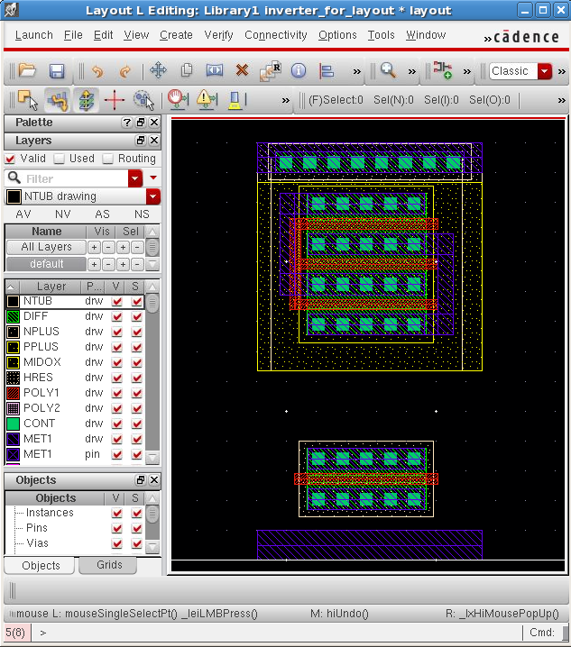
Creating the inverter layout, step by step
Extend the contact NPLUS
Select NPLUS in the LSW
Draw a rectangle ‘r’ from the top left of the vdd MET1 to the top of the PPLUS
Notes:
This is the low ohmic contact of the bulk (nwell) to vdd.

Slide 26
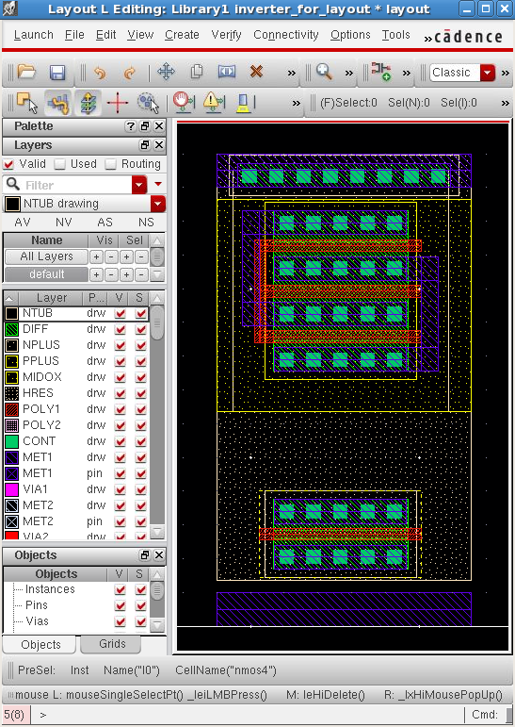
Creating the inverter layout, step by step
Extend the NPLUS around the NMOS
Select NPLUS from the LSW
Draw a rectangle with ‘r’
Join it to the PPLUS of the PMOS
Finish 0.1um below the NPLUS generated by the NMOS pcell
Notes:
This is just to achieve higher Ohmic contact between the gnd and the NMOS by extending the NPLUS around the NMOS and connecting it to the PPLUS around the contact, other reason for this is to create a standard cell. This step might not exists in different technologies

Slide 27
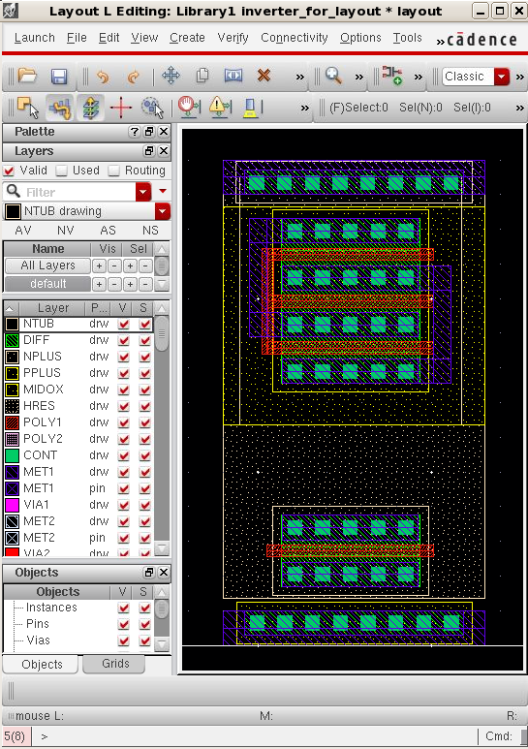
Creating the inverter layout, step by step
Place the NPLUS contacts
Press ‘o’ for contact
Choose the PD contact
Set columns to 8
Align the array centrally and 0.1um below the NPLUS

Slide 28
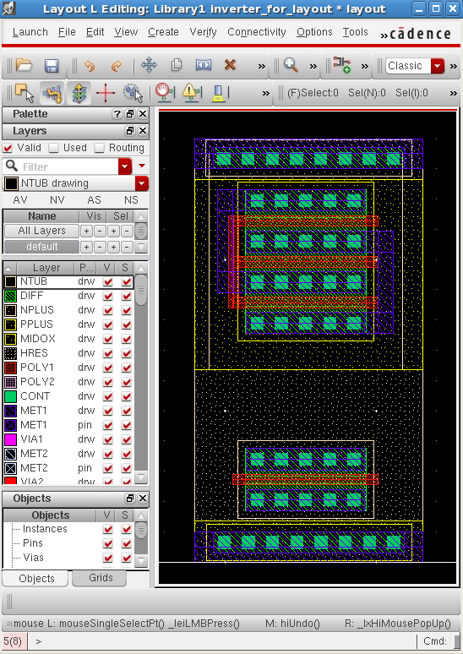
Creating the inverter layout, step by step
Extend the PPLUS around the contacts
Select PPLUS from the LSW
Draw a rectangle with ‘r’
Start from the bottom right of the gnd MET1 and join to the NMOS NPLUS
Notes:
This is the low ohmic contact of the bulk (pwell/p-substrate) to gnd.

Slide 29
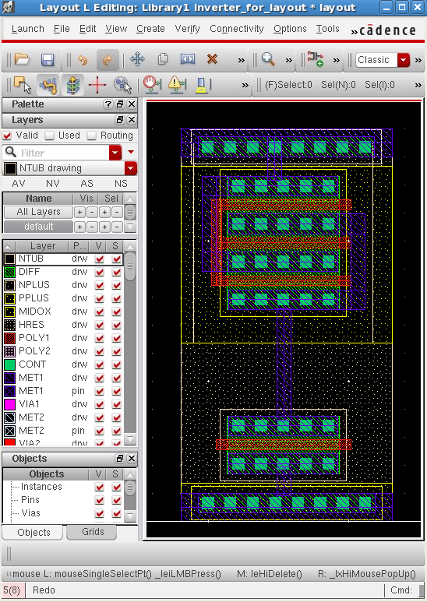
Creating the inverter layout, step by step
Add metal connections
Select MET1 dg in the LSW
Draw path with ‘p’
Press F3 while drawing the path to get the options box
Change the width to 0.5um
Draw the paths as shown

Slide 30
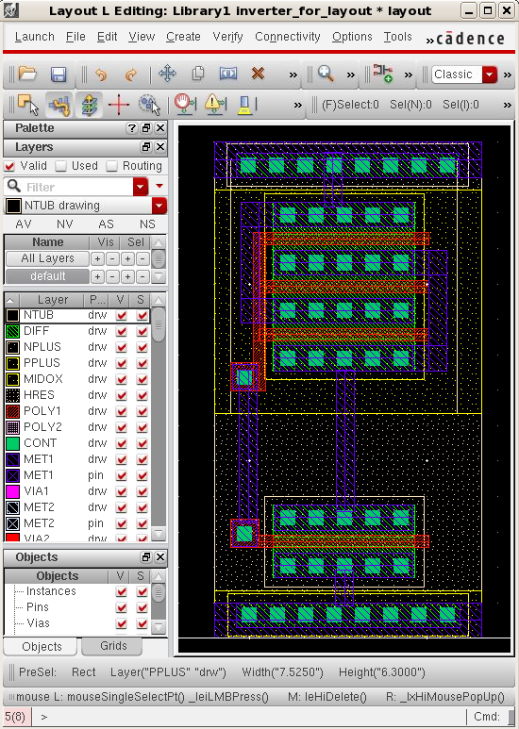
Creating the inverter layout, step by step
Connect the gates
Press ‘o’ for contact
Choose P1 contact
Place as shown
Add POLY1 path to connect gates to contacts
Add MET1 path to connect the contacts together

Slide 31
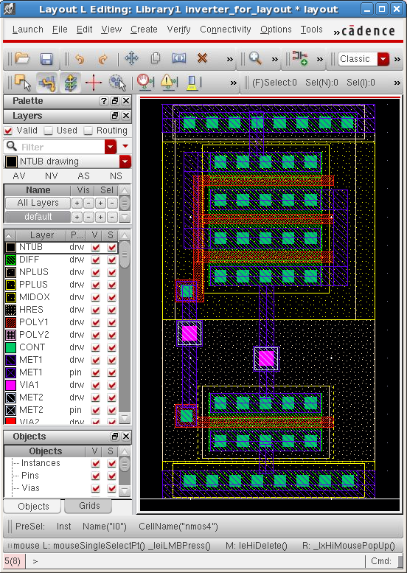
Creating the inverter layout, step by step
Add MET2 contacts
Press ‘o’ to add contact
Choose VIA1 contact
Place as shown

Slide 32
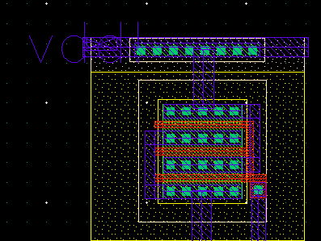
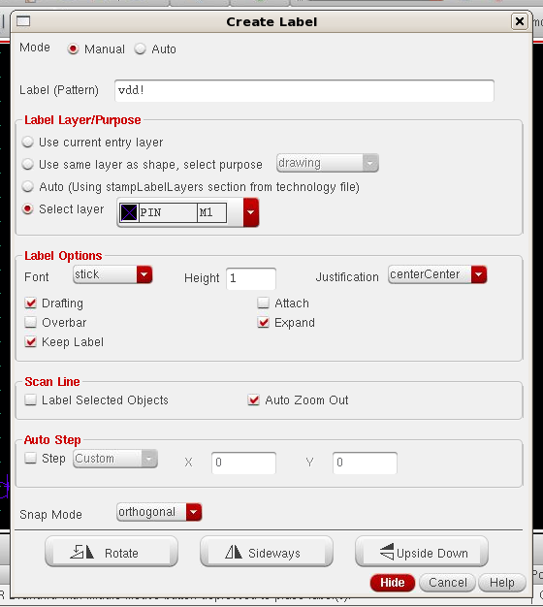
Creating the inverter layout, step by step
Add LABELs.
select ‘Create’ ‘Label’.
Add ‘vdd!’ first. Make sure MET1 is selected for vdd/gnd, MET2 for A/Y.
You must name the nodes to match with the schematic view: A, Y, vdd! and gnd!.
Generally, the labels are created for metal1 layers. In the Layers tab select the layer PIN metal1.
If you feel necessary, change the Height size to about 0.5.
Important: Do not forget to select the layer PIN metal1 before you create the label. For instance, in the figure, we have vdd! with metal1. Therefore, we have selected PIN metal1 in the Layers and just after that we have created the label. Note that in the figure, the '+' defines the layer that is associated to the label.
Notes:
On which layer(s) do the pins need to be? The vdd and gnd pins might need to be on metal 1 layer, but
the input/output pins might need to be on different layers (metal 2). Again, if you plan to use this cell with other
cells, you need to make sure you know the specs

Slide 33
Learning Outcomes
After completing this unit, you should be able to:
Use LayoutL to place transistors in a layout
Construct a simple layout, step by step
Use the DRC checking tool
Search and explain errors

Slide 34
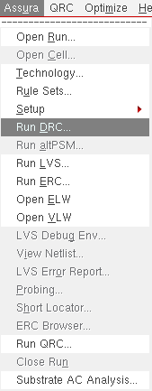
Running the DRC check
Now you must check if there are any errors in your layout, that is, you have to perform the Design Rule Check (DRC).
In this tutorial, the Assura software will be used. Thus, select Assura → Run DRC in the layout editor.

Slide 35
Running the DRC check
For now, just specific rule validations will be checked. A group of rule validations is commonly known as switches. You can find them in the window Run Assura DRC. To define the switches you should select Set Switches and then with the CTRL key you can select more than one switch. Some key information about the technology we are using in this tutorial:
Until the final stage of the layout of circuit, one can use the switches: no_coverage and no_generated_layers.
During the phase that we are more interested in the drawing rules violation, one can use also the switches: no_erc andno_info.
All the other DRC parameters must not be changed.

Slide 36
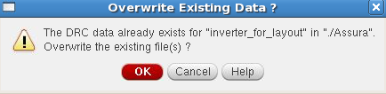
Running the DRC check
If you repeat the DRC and if there is already previous data, select OK to overwrite and OK to stop seeing the current one. After that, select Yes to display the results.

Slide 37
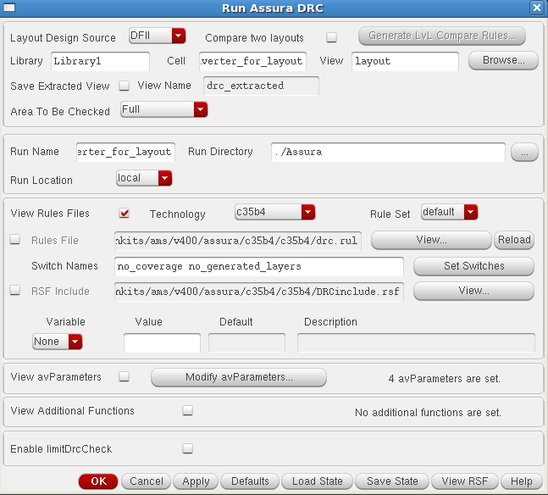
Running the DRC check
In the RUN Assura DRC window:
The Cell name should be the same as your Run name.
Technology should be chosen by c35b4
The design rule file should be
home/designkits/ams/v400/assura/c35b4/c35b4/drc.rul
Select the switches no_coverage and no_generated_layers

Slide 38
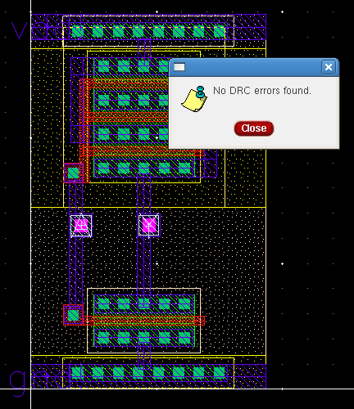
Running the DRC check
Ideally you should get no DRC errors!

Slide 39
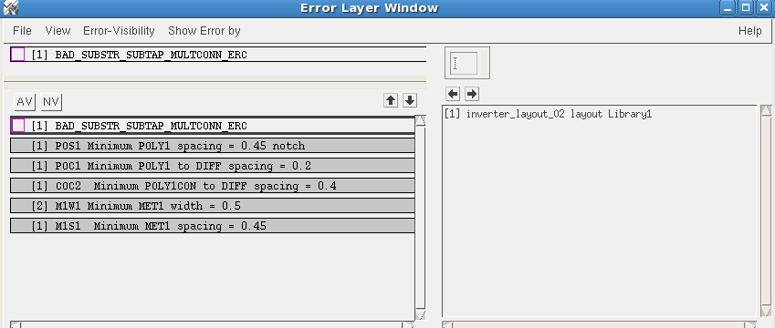
Lots of errors
But you will typically get many, many errors
This is normal – one small thing can cause many errors

Slide 40
How do we find the errors?
You can select a fault and click on the arrow and the tool will zoom in to the location of your specific DRC error.

Slide 41
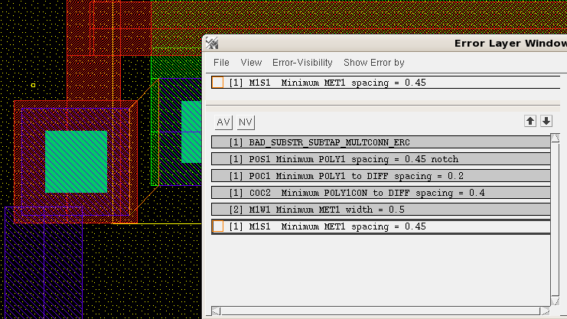
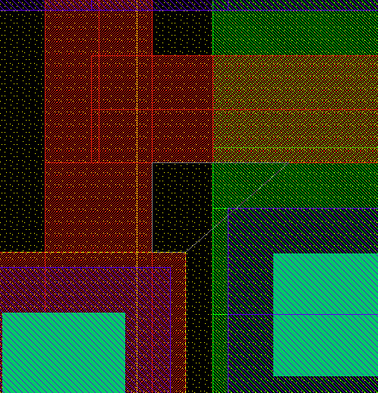
How do we find the errors?
In this case: contact is too close to the diffusion.
If we want details on an error, use the explain marker tool then click on the error.

Slide 42
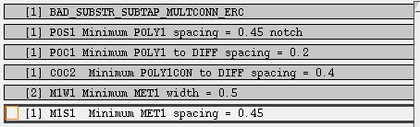
How do we find the errors?
This will list the reason for all markers which are beneath the place you clicked
You can check the correct spacings, then using a ruler ‘k’ you can correct the layout

Slide 43
DRC Examples
CPU TIME = 00:00:01 TOTAL TIME = 00:00:04
********* Summary of rule violations for cell "counter4bit layout" *********
# errors Violated Rules
2 INFO: hot nwell
1 Label/Pin is on a net with a different name
1 M1R1 Minimum density of MET1 area [%] = 30
1 M1S1 Minimum MET1 spacing = 0.45
1 M2R1 Minimum density of MET2 area [%] = 30
13 M2S1 Minimum MET2 spacing = 0.5
1 M3R1 Minimum density of MET3 area [%] = 30
1 M4R1 Minimum density of MET4 area [%] = 30
5 ODC3 Minimum NDIFF to HOT_NTUB spacing (no PTAP in between) = 2.6
1 POR1 Minimum density of POLY1 area [%] = 14
27 Total errors found
Notes:
his means that the amount of metal1 shapes in your design is less
that 30% of the chip area. 30% is the minimum required.
Depending on the process you're working on, the min MET1 density could
be required at both chip level or 'window' level. Let me explain.
Suppose your die size is 1000um*1000um. In order to achieve a good
planarity and to make the metal etching as required, your foundry will
ask for a minimum of 30% of metal1 over the entire die. That's a
global density rule. Let's suppose you've got a very dense digital
bloc as the half of your die. I guess this would be enough to achieve
the required density even the other half of the die is fairly 'empty'.
But some processes don't support big metal density gradients between
different areas. In this case, foundries put in place 'Local' density
rules as well. An example is a min MEt1 density is required by windows
of 100um*100um. In this case, your DRC engine will parse your die as a
matrix of 100*100 squares and make the density check in there. Hope it
is clear for you. As I said earlier, density is very important for
planarity and pattern etching. It is important to avoid the dishing/
erosion in the modern nanotechnologies with Copper BE.
Many IP designers are complaining about the density rules being
checked at IP level. Many of them ask to check the densities at chip
TOP level only. I've seen many TOP assembly engineers struggling to
reach the density because the IPs haven't been thought with regards to
this problem. So my point of view is to take this into account at the
early stages.
So how to solve this problem ? you just need to add 'dummy' MEt1
shapes into your layout. These are floating bits of metals without any
electrical functionality. Well, you've to be careful though because
those pieces of metals are adding some parasitic to your true design.
Many 'modern' PDKs come with 'dummy filling' procedures that saves you
from a hand-made filling. Please ask your PDK provider.

Slide 44
DRC Examples
2 INFO: hot nwell
  One of the reasons for this errors VDD is not connected to the N-well
  For digital design: the best bet is to create a new layout cell view, that you instantiate the imported cell into, that connects VDD and GND correctly.

Slide 45
DRC Examples
Multiple Stamped Connections
You may have a short through the substrate or nwell
This kind of error might indicate that you have more than one well contact, with the metal connected to different nets. This means you've got a "soft connect" through the well (not quite a short, because the well is resistive). It may be that you're making a connection via the well, which is almost certainly not what you want!

Slide 46
DRC Examples
Latchup rule LAT3 distance s/d diff pgate net_welltap > 20
This error could be generated if the distance between the s/d region and the welltap is larger than 20. To avoid such an error, keep the distance btween your transistors and VDD or GND less than 20

Slide 47
What about the metal minimum area errors?
M1R1 Minimum density of MET1 area
This means that the amount of metal1 shapes in your design is less that 30% of the chip area. 30% is the minimum required. Density is very important for planarity and pattern etching. It is important to avoid the dishing/
erosion in the modern nanotechnologies with Copper BE.
In fact the vendor will solve this problem by adding 'dummy' MEt1shapes into your layout.
In our case, use the no_erc switch when you do DRC

Slide 48
Summary
LayoutL can be used to automatically place the transistors in a layout
There are many shortcut keys to learn for layout
The DRC check and error correct cycle takes the majority of your time during layout
DRC errors can be viewed on the
layout directly and then explained,
or searched for
There are many many advanced
layout techniques

Slide 49
Lab: Layout
Place transistors in the layout
Objective: Create the layout for your inverter design. DRC check the design and correct errors until the design is error free
Use simple commands to built the interconnects and required layers
DRC check the design
Examine and correct DRC errors

