Slide 1
The Principles of Automated Place and Route

Slide 2
Learning Outcomes
At the end of this lecture you should be able to:
Describe the basic principles of design planning
Outline the different options of placement and CTS
Describe the main stages of routing
Explain the additional routing challenges in 90nm technologies and beyond

Slide 3
Learning Outcomes
At the end of this lecture you should be able to:
Describe the basic principles of design planning
Outline the different options of placement and CTS
Describe the main stages of routing
Explain the additional routing challenges in 90nm technologies and beyond

Slide 4
Digital Design Flow
Design Specification
Architecture design
Verification
Logic Synthesis
Verification
no
yes
Floorplanning,
Placement & Routing
no
yes
Verification
Finished design

Slide 5
P&R Process
Set up the Library
Floor Planning
Power Planning
Placement
Clock Tree Synthesis
Routing

Slide 6

Digital IC Design Flow: Place&Route
Logic Synthesis
(Synthesis tool)
Cell Library
(Physical description)
Gate-level Netlist (Verilog / VHDL)
Design Constraints (sdc file)
Physical Design
(Physical design tool)
Layout
GDSII
Notes:
The physical design (PD) flow refers to the steps that are required to take a synthesized verilog netlist and a set of design constraints from the front-end, and produce a tape-out ready gds. This portion of the design flow is also referred to as the “back-end”, or the “place and route flow”. The PD flow should contain all design steps and checks to ensure the final gds respects all design rules required by the foundry and also meets the design requirements for timing, power, area, etc..
GDSII is a database file format which is the industry standard for data exchange of IC layout design information.
SDC (Synopsys Design Constraints) is a tcl based format for describing IC design constraints.

Slide 7
P&R Process
Set up the Library
Floor Planning
Power Planning
Placement
Clock Tree Synthesis
Routing

Slide 8
Why Plan the Design?
The goal of design planning is to arrange the chip so that the “Place and Route” flow can converge quickly and easily.
  Critical paths are short
  Congestion is minimized
  Adequate power is delivered
Design planning considers the following
  Die size
  IO / Hard-IP placement
  Global clock distribution
  Power planning
  Flat versus hierarchical design
Notes:
Design planning is a process which considers issues such as die size, IO and macro placement, clock and power distribution and EDA tool implementation.
The goal of design planning is provide a good starting point by arranging the chip so that the “place and route” flow can converge quickly and easily.

Slide 9
Floorplanning
Floorplanning Goals:
  Determine die size
  Shape and arrange hierarchical blocks
  Integrate hard-IP efficiently
  Predict and prevent congestion hotspots and critical timing paths
Notes:
Here we have split design planning into two parts, floorplanning and power planning.
Floorplanning looks at issues related to the area and shape of our design and the location of I/O pads and Hard IP within our design. Different floorplans can be compared by considering routing congestion, timing of critical paths and area. For hierarchical designs, floorplanning also handles design partitioning and pin placement between hierarchical blocks.
Power planning simply refers to the process of arranging the strutcture of our power grid and the placement of any power pads. For designs with power gating or mulit-voltage region this can introduce a tremendous amount of design complexity and consume a large portion of the design planning time.
Design planning is an iterative process that generally requires some interaction with the front-end designers in order to make smart decisions given only rough estimates and/or limited information. For example, we must build a power grid without knowing the final placement of all cells, we have only a trial placement. This means our initial power estimates may not be accurate and we need to use ur experience and intuition to determine the amount of margin to add to the design.

Slide 10
Floorplanning – Important considerations
Die Size: Larger dies are easier to route, provide less congestion, lower capacitances (decrease signal/power integrity related problems), faster design cycle. The tradeoff is an increase in fabrication costs and power consumption
Utilization refers to the percentage of core area that is taken up by standard cells. A typical starting utilization might be 70%, but this can very a lot depending on the design. High utilization can make it difficult to close a design because of routing congestion.
Notes:
It is important be aware of any large increases of utilization after any optimization stage as this can potentially be a symptom of a synthesis or floorplanning problem.
In general, increasing die array and available routing resources will speed up the design cycle by making it easier to close timing. The tradeoff is an increase in fabrication costs. There is a similar tradeoff during power planning between increasing the density of the power grid for increased reliability, and the impact of less signal routing resource or the requirement of an extra metal layer.

Slide 11
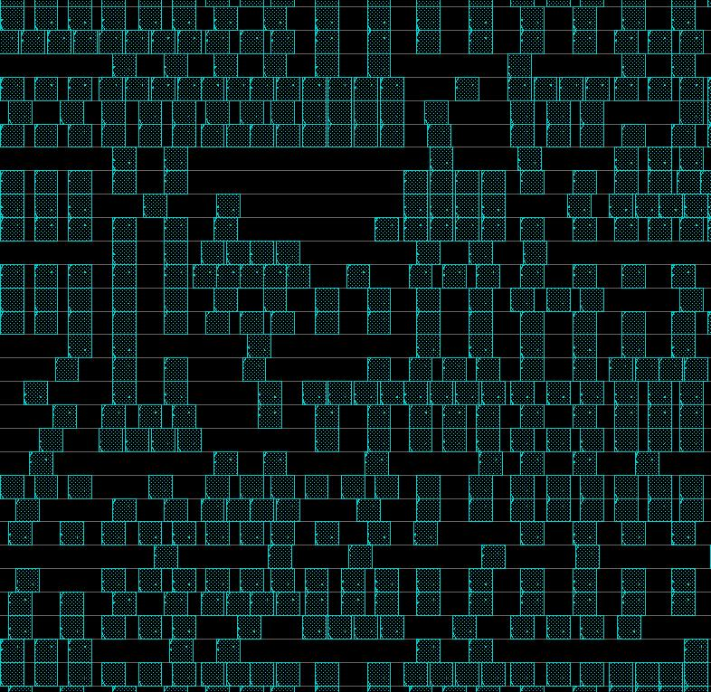
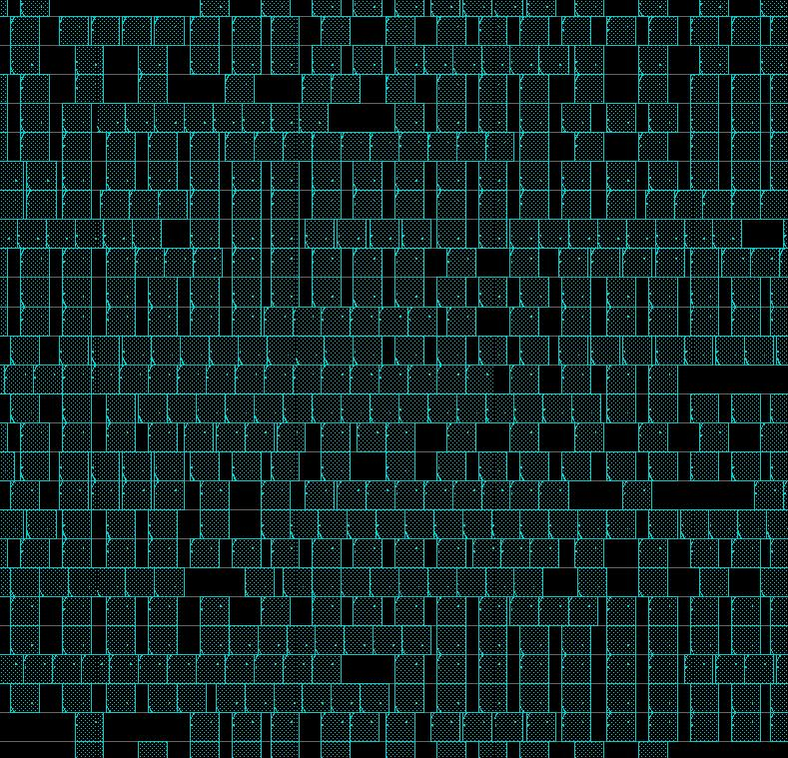
Floorplanning – Utilization
Low standard-cell utilization
High standard-cell utilization
Notes:
If we look at a screen shot from an EDA tool GUI, we can see the difference between a region of standard cells with low utilization and one with high utilization.
Obviously the area with high utilization has much greater pin density, which in turn requires more dense routing and has higher potential for routing congestion or crosstalk related problems. In addition having more cells in a particular area increases the local power requirements, which can affect the design of the power grid and thus the available signal routing tracks.
On the other hand, very low utilization is generally not ideal either, as this can result in unnecessarily long nets requiring more buffering or higher drive strengths. Not to mention higher relative die costs.
Typically, starting utilizations in the range of 60-80% are reasonable.

Slide 12
Power Planning
Power Planning Goals
  Create power distribution grid
    Consider IR drop and Electro migration
  Implement power saving techniques
    Power gating
    Multi-Voltage design / Voltage islands
Notes:
Here we have split design planning into two parts, floorplanning and power planning.
Floorplanning looks at issues related to the area and shape of our design and the location of I/O pads and Hard IP within our design. Different floorplans can be compared by considering routing congestion, timing of critical paths and area. For hierarchical designs, floorplanning also handles design partitioning and pin placement between hierarchical blocks.
Power planning simply refers to the process of arranging the strutcture of our power grid and the placement of any power pads. For designs with power gating or mulit-voltage region this can introduce a tremendous amount of design complexity and consume a large portion of the design planning time.
Design planning is an iterative process that generally requires some interaction with the front-end designers in order to make smart decisions given only rough estimates and/or limited information. For example, we must build a power grid without knowing the final placement of all cells, we have only a trial placement. This means our initial power estimates may not be accurate and we need to use ur experience and intuition to determine the amount of margin to add to the design.

Slide 13
Power Consumption and Reliability : IR-Drop
The drop in supply voltage over the length of the supply line
  A resistance matrix of the power grid is constructed
  The average current of each gate is considered
  The matrix is solved for the current at each node, to determine the IR-drop.
VDD Pad
VDD
Notes:
IR drop refers to fluctuations of the supply voltage over the length of the supply line.
For IC design we consider both static & dynamic IR drop.
The amount IR drop is determined by solving the resistance matrix of the power grid and the gate current source models. For static IR drop the average gate current is used. For dynamic IR drop, the gate current as a function of time is used by examining the actual switching events of the circuit.

Slide 14
Power Consumption and Reliability : IR-drop
IR-drop effects
Logic failures due to reduced noise margins
Unpredictable performance (eg. Effect of crosstalk enlarged)
Decreased performance (timing)
Excessive clock skew (clock drivers)
Ideal voltage level
3.0V
Actual voltage level
Minimum
Tolerance
Level
Notes:
IDESA - IC Design Skills for Advanced DSM Technologies
14
So what effect does IR-drop have on overall signal-integrity and reliability?
For signal-integrity additional IR-drop will mean that the noise margins for the transistors are reduced so that if a fast transitioning signal is routed next to a signal whose performance has been degraded by IR-drop it becomes more likely that the resulting noise will cause either glitches or timing failures on the IC. This is because the noise can now pull the signal below the minimum noise tolerance level of the cells with the degraded voltage supply.
When the supply voltage is reduced on cell instances in the IC, the drive strength on those instances is reduced. This results in a transition time degradation and can lead to reduced performance for the IC.
If this effect occurs on clock drivers, which is common because of the power required by the high drive needed for clock signals, it becomes likely that some clock network drivers will have less IR-drop and some will have increased IR-drop. If the IR-drop difference across the clock network is great you will have cells with low IR-drop performing significantly better than those with high IR-drop, thus creating excessive clock-skew on the clock network.

Slide 15
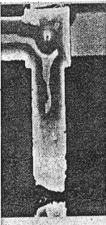
Power consumption and reliability : Electromigration EM
Electromigration refers to the gradual displacement of the metal atoms of a conductor as a result of the current flowing through that conductor.
  Transfer of electron momentum
Can result in catastrophic failure do to either
  Open : void on a single wire
  Short : bridging between to wires
Even without open or short, EM can cause performance degradation
  Increase/decrease in wire RC
Notes:
Electromigration (EM) problems occur when the power grid is not sufficient to handle the current densities required by the design.
EM can occur on the signal nets driven by high drive strength cells if the wires are too narrow, or on the power grid when several large current hungry cells are placed near to each other and are fed by inadequate power grid routing.
EM design rules set the required metal width of wires on each metal layer as a function of the max current density and the operating temperature, in order to maintain a less than x% change in the wires resistance over a operating lifetime of y Khours (where x and y are variables).

Slide 16
Power Grid Creation
Tradeoff IR drop and EM versus routing resources
  Require power budget
    initial power estimation
    average currents
Need to determine
  General grid structure (gating or multi-voltage?)
  Metal layers to be used
  Width and spacing of straps
  Hierarchical block shielding
  ….
Notes:
Now let us take a look at the steps to appropriately handle power grid planning.
First, at the top-level of the design the correct number of power pads must be added to the design to handle all of the power and ground needs for the whole chip. If there are multiple voltages that are going to be required and multiple power planes needed, as with any analog content that might be on-chip, all of the pads for every voltage and power plane must be added, and enough must be added to ensure a stable power supply for the whole chip. This means that if power gating is going to be used the pads must be able to handle in-rush needs as well as providing a stable power plane during normal operation.
The next step is to determine which metal layers will be used for the power and ground routing. Normally the top layers of metal provide the least resistance and will thus have the best IR-drop characteristics. But, this same characteristic makes these layers useful for routing clocks and high-fanout nets as well, so thought must go into determining the best layers to balance the overall needs of the design. The routing resources need to be looked at carefully, as well, with regard to what percentage of wiring resource will need to go into power routing so that the die is appropriately sized to ensure enough resource is still available for signal routing.
Once the layers are defined thought must go into how wide the power mesh and rings will need to be to be able to handle the current requirements for both normal operation and also wakeup if power gating is being done on the design.
Next the overall structure of the block and macro-level power routing needs to be defined. This includes determining if there need to be rings around blocks or if just strapping will be sufficient. It also will include defining virtual power and/or ground meshes for blocks being shut down as well as adding enough main power routing to ensure that there is sufficient resource available to minimize IR-drop to always-on logic in the shutdown blocks, like retention registers and control logic or power gating (MTCMOS) switch cells.
Once the power planning is complete it is always necessary to make sure that the IR-drop and EM characteristics of the defined power mesh is appropriate and within specifications. Power network analysis is done to check these. In order to make sure the analysis is accurate it is always a good idea to run power analysis with switching activity from an RTL simulation to make sure that accurate power numbers are used. This will make the quality of the power network analysis much more accurate and help to ensure that the final design will meet the IR-drop and EM requirements for sign-off.

Slide 17
Power Grid Creation
Extreme way to reduce IR and EM
Power lines
Mx
Mx
Mx-1
Mx-1
Mx-2
Mx-2
Signal routing area
Notes:
There is always a tradeoff between the routing resources of the power grid and the signal nets.

Slide 18
Learning Outcomes
At the end of this lecture you should be able to:
Describe the basic principles of design planning
Outline the different options of placement and CTS
Describe the main stages of routing
Explain the additional routing challenges in 90nm technologies and beyond

Slide 19
P&R Process
Set up the Library
Floor Planning
Power Planning
Placement
Clock Tree Synthesis
Routing

Slide 20
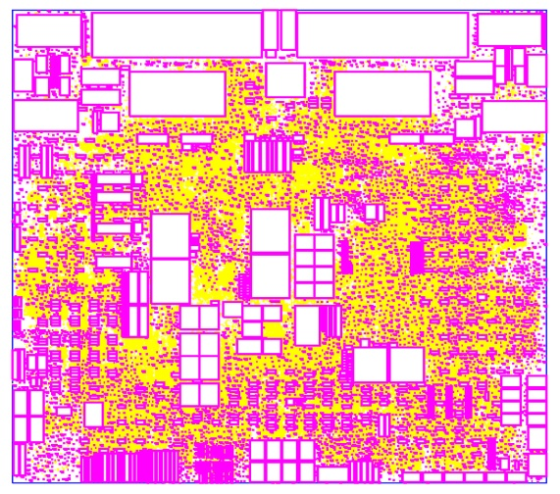
Placement Methodology
Traditional definition of placement
Placement – Exact placement of the modules (modules can be gates, standard cells, macros…). The goal is to minimize a particular cost function (e.g. total area , interconnect length...)
The quality of the attainable routing is highly determined by the placement.
Circuit placement becomes very critical in 90nm and below technologies.
Notes:
Placement is one of the most important steps of IC physical design flow and it is the glue of the physical synthesis.
According to traditional definition the placement is the exact accommodation of the modules (modules can be gates, standard cells, macros…). The goal is to minimize the total area and interconnect cost.
Actually during placement a netlist and fixed-shape cells (e.g. standard cells) are given, it s necessary to find the exact location of the cells to minimize area and wire-length. Placement is consistent with the standard-cell design methodology. Modules used during placement are usually fixed, have equal height (exception: double height cells), the location of some are fixed (e.g. I/O pads). As mentioned the objective of placement is area reduction and shortening of wire length. Besides, additional cost components are: timing, congestion and other criteria. The quality of the attainable routing is highly determined by the placement as routing follows placement stage.
It must be noted that traditional definition of placement (channel routing) and corresponding methods have conditional nature and correspond to those technologies in case of which the high performance of transistors dominates over high performance interconnects. It corresponds to 250nm and above technologies. In case of that criteria of minimal area and overall interconnects length dominate. For 180 and 130nm technologies, performance of interconnects is becoming important and gradually with the above mentioned criteria, timing criteria will also become important. At present channel routers which used to minimize the total area, are not used and the goal of placement now depends on the design and can be area, timing and/or power. Circuit Placement becomes very critical in 90nm and below technologies as serious interconnect issues occur (delay, routability, noise) in deep-submicron design.

Slide 21
Placement New approaches for modern technologies
Cost components
Methods of consideration
Area
Wire length
Traditional methods of Placement
Overlap
Timing
Timing-driven Placement
Congestion
Congestion-driven Placement
Clock
Clock Gating
Power
Multivoltage and Multisupply Placement
Notes:
New cost components (timing, congestion, clock, power) of physical designing and placement are added to traditional (channel routers) ones (area, wire length, overlap), in case of 130nm and below technologies, i.e. from the moment that the channel routers were replaced by newer methods. From different viewpoints, improvement of placement means:
Area - packing all the modules very tightly.
Wire length - minimizing average wire length. This would result in tight packing of modules with high connectivity.
Overlap – keeping minimum permissible distance between cells.
From the viewpoint of area, wire length and overlap, traditional methods of placement are considered to be methods of consideration.
Timing – there is not a direct correspondence with wire length minimization, but consistent on average. From the timing point of view, timing-driven Placement is considered to be a method of consideration.
Congestion - measuring of routability, tends to move cells apart. From the viewpoint of congestion, Congestion-driven Placement is considered to be a method of consideration.
Clock – clock-gating.
Power - Multi-Voltage (V_{dd}) and Multi-Threshold (V_{th}) Optimization.

Slide 22
P&R Process
Set up the Library
Floor Planning
Power Planning
Placement
Clock Tree Synthesis
Routing

Slide 23
Clock Tree Synthesis
CLK
CLK
Unbuffered clock tree
Buffered/balanced clock tree
Skew
Area (#buffers)
Power
Slew rates
+ Minimize total insertion delay (latency)
Notes:
IDESA - IC Design Skills for Advanced DSM Technologies
23
The general concept of CTS is quite simple. We start from a netlist with an un-buffered clock tree and we want to generate automatically a buffered and balanced tree. There are of course some criteria we would like to be fulfilled.
Firstly skew minimization is necessary to avoid timing problems in a synchronous system. There is more about this in the next slides. It is also important to keep the number of buffers as low as possible in order to keep the area needed by the clock tree as low as possible. The more buffers you add in the clock tree, the less area remains for routing and to buffer other signal nets. Power and slew rate are related because the slew will determine the internal short current inside the buffers when these are switching. It is very important to make sure that the power in the tree is optimized since CT has the highest switching activity and it is therefore the largest consumer of dynamic power in state-of-the-art ICs. Finally the total insertion delay or latency due to the clock tree should mostly be kept to a minimum.

Slide 24
Clock Signal is not Ideal…!
It is very hard to distribute clock instantaneously with a perfectly regular period
Clock

Slide 25
Clocking System is not ideal..
power supply
interconnect
clock generation
capacitive load
capacitive coupling
PLL
clock drivers
Variations in PLL
Variations in wire length, metal width and height, coupling caps
Variations in local clock load, local power supply, local gate length and threshold, local temperature
Notes:
clock is distributed using multiple matched paths to the sequential elements. The clock path includes the wiring and the associated distributed buffers required to drive the interconnect and loads.
What matters is the relative arrival time at the register points at the end of each path – not the absolute delay through the clock distribution path.
Both systematic (nominally identical from chip to chip and predictable – so easy to model and correct for at design time) and random (due to manufacturing variations – so are difficult to model and eliminate)
Clock skew is due to spatial variations in the arrival time of a clock transition
Clock jitter is due to temporal variations in the clock period (T changes on a cycle-by-cycle basis)

Slide 26
Clock Skew: Spatial Clock Variation
Clock Skew Static (constant over time) point-to-point variation (of clock arrival time to FFs).
Clock skew between two flip-flops is computed as the difference in arrival times of clock signal.
Skew
B
A
Skew = | t₁ – t₂ |
t₁ t₂
Skew
A
CLK2
Time
B
CLK1
Time
Clock Source (ex. PLL)
Time
Latency

Slide 27
Causes of Clock Skew
Designed variations – mismatch in buffer load sizes, interconnect lengths
Process variations – process spread across die yielding different L_{eff}, T_{ox}, etc. values
Temperature gradients – changes MOSFET performance across die
IR voltage drop in power supply – changes MOSFET performance across die
Notes:
Clock and power gating may make things worse as it lead to change in data activity across the chip
IR drop is the drop of power supply results from the resistive power distribution wires

Slide 28

Negative Skew Impact on Performance
Clock and data flow in opposite directions
R1
R2
In
Combinational
logic
D
Q
D
Q
t₁
t₂
clk
delay
T_{clk}
1
T_{clk}+ skew
3
2
skew < 0
4
$$T_{CLK−MIN}≥T_{D}+T_{IC−MAX}+T_{SETUP}−Skew$$
$$T_{HOLD}≤T_{D}+T_{IC−MIN }−Skew$$
Skew < 0: Degrades performance
Notes:
For lecture
a negative skew adversely impacts the performance of the system.
However, assuming thold + delta < tcdreg + tcdlogic, a negative skew implies that the system never fails since edge 2 happens before edge 1 – i.e., there is never a race condition.
Unfortunately, for general logic signals flow in both directions so skew can be both positive and negative in the same circuit
What is the impact of this skew on the timing of the design? First we get an impact on the setup. As you see in the figure the clock uncertainty on F1 and F2 has as a first effect that the amount of logic that can be put between both flops is reduced because the max timing path has become shorter. This means that the max frequency of the clock is reduced by the skew.

Slide 29
What is a realistic skew to achive
Setting a skew constraint = 0 ps
  Makes no sense
  Insertion delay (latency) will increase
  Power consumption will increase
  Area will increase
  Rule of thumb : skew values : 100 – 150 ps for 90 nm
Notes:
Skew between flops occurs due to some un-balance in the clock tree. This can be caused by several reasons.
Depending on the circuit and especially it’s clock gating different levels of buffering can occur. Also the cells used for the buffering may be different and also the interconnect delay and the routing capacitance of the clock nets will be different.
You can try to obtain a zero skew value for your CT but this makes no sense. You will notice that you get a large amount of buffers in the CT resulting in an “unacceptable” latency, increased power consumption and a substantial area increase. Having a skew of zero is not needed since you can take this skew into account as we will see in the next slides. Therefore for 90 nm we try to obtain a skew between 100 and 150 ps. This is a rule of thumb.

Slide 30
Clock Tree Optimization
After
FF
FF
FF
FF
FF
FF
FF
FF
FF
FF
After
FF
FF
FF
FF
FF
FF
FF
FF
FF
FF
Buffer relocation
3X
2X
4X
3X
3X
4X
Buffer sizing
4X
4X
Gate relocation
Before
After
FF
FF
FF
FF
FF
FF
FF
FF
FF
FF
FF
FF
FF
FF
FF
FF
FF
FF
FF
FF
3X
2X
4X
3X
2X
5X
Gate sizing
4X
Delay insertion
4X
4X
Notes:
It is usually possible to optimize clock tree by the following options:
Gate/Buffer Sizing - sizes up or down buffers/gates to improve both skew and insertion delay. In this case the clock tree structure is not modified during this optimization process.
Buffer/Gate Relocation - physical location of the buffer is moved to reduce skew and insertion delay. In this case hierarchy is not added or removed during optimization process.
Delay Insertion - delay is inserted for shortest paths.
CTO could already be performed after the post CTS design optimization but there it does only make sense if the clock routing has already been performed as part of CTS. Mostly however the clock routing is not done yet. This means that the detailed clock RC delays are not known yet and this detailed optimization is useless at this point. If the routing was already done it is mostly not fixed and later in the flow some changes are still possible due to design optimizations. Also in this case CTO is rarely done at this stage. After routing it makes much more sense.

Slide 31
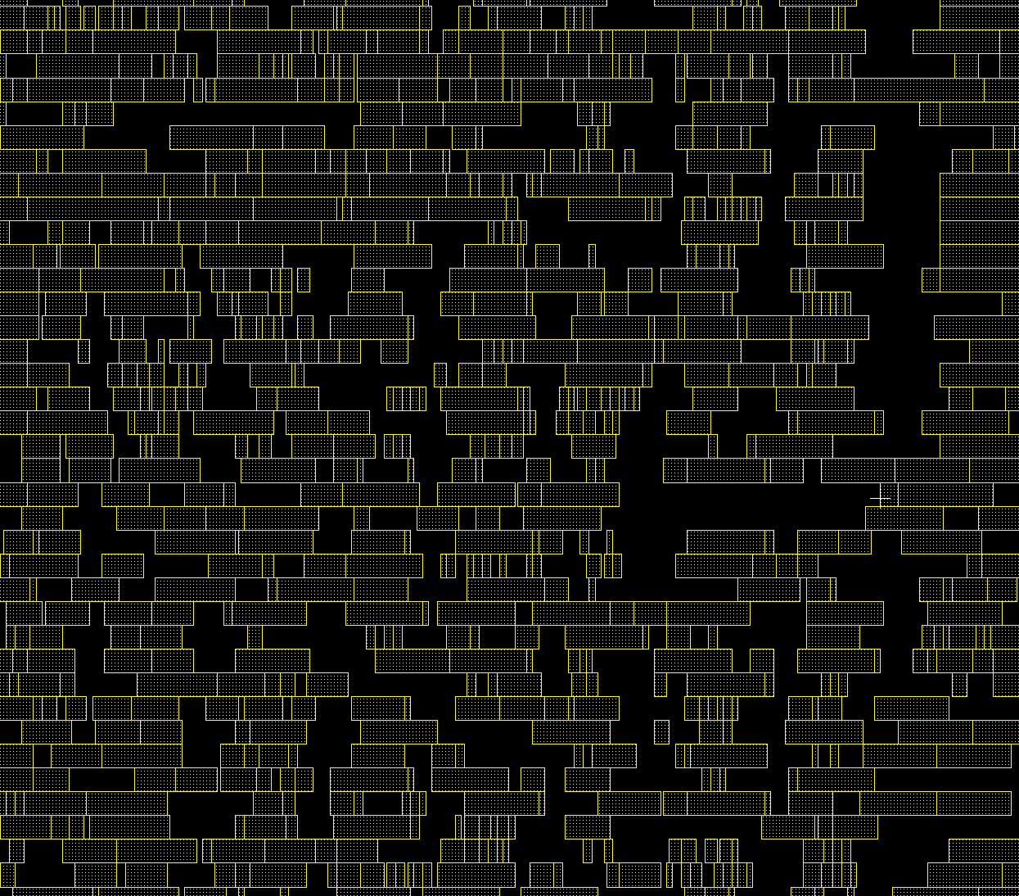
Effects of Clock Tree Synthesis
Clock buffers added
Congestion may increase
Non clock cells may have been moved to less ideal locations
CTS
Inserting clock trees can introduce new timing and max tran/cap violations
Notes:
IDESA - IC Design Skills for Advanced DSM Technologies
31
The congestion pattern should be similar to the one before CTS. It is, however, generally higher due to the extra clock buffers added during CTS. If the optimal location for the CTS buffer overlaps with cells placed previously then the previously placed cells need to be moved to open up space for the clock tree buffers.

Slide 32
Learning Outcomes
At the end of this lecture you should be able to:
Describe the basic principles of design planning
Outline the different options of placement and CTS
Describe the main stages of routing
Explain the additional routing challenges in 90nm technologies and beyond

Slide 33
P&R Process
Set up the Library
Floor Planning
Power Planning
Placement
Clock Tree Synthesis
Routing

Slide 34
Routing Fundamentals
Goal is to realize the metal/copper connections between the pins of standard cells and macros
  Input :
    placed design
    fixed number of metal/copper layers
  Goal:
    routed design that is DRC clean and meets setup/hold timing
Consists of two phases
  1. Global route
  2. Detail route
Standard cell pin
Horizontal routing tracks
Vertical routing tracks
Notes:
Goal is to realize the metal/copper connections between the pins of standard cells and macros
We take a design where all the standard cells have been placed and we determine the location for vias and signal traces on every layer.
Default routing uses minimum width wires with minimum spacing aligned along vertical and horizontal routing tracks. Routing tracks are provided to the router in order to minimize the solution search space. It’s possible for routers to go off-track, and/or to route in non-preferred direction, however this is only done when it is too difficult to find an on-track / preferred layer solution.
Routing in a horizontal/vertical grid pattern is referred to as manhatten-style routing. There are some tools that can support X style routing where you have alternating layers of H-V-X1-X2-H-V , however the benefits using this approach have shown to be marginal, and may only useful for very specific designs.
If you did an optimization after CTS you will need to route your clocks in case some of the flops moved during legalization.
It’s important to route clocks first for several reasons. Clock trees toggle frequently making them more succeptible to SI problems, so having nice clean routes with extra spacing is important. Also, clock trees were built to minimize skew while assuming straight routes, if routes are loopy you may introduce unnecessary skew.
One can imagine the complexity of routing a design with 9 or 10 metal layers and more than half a million standard cells, each with multiple pins. The number of possible different solutions is virtually infinite. To reduce the complexity of the problem for the EDA tools, we typically break the routing process into global route and detail route.
Global route provides initial net topologies which then guide the detail route stage.
DFM steps are usually run post-detail route for yield improvement

Slide 35
Routing Fundamentals: Constraints
Placement constraint
Number of routing layers
Delay constraint
Meeting all geometrical constraints (design rules)
Physical/Electrical/Manufacturing constraints
Δ
w
s
Δ
Two-layer routing
Geometrical constraint
Notes:
Routing performance depends on routing constraints which can be placement constraint, number of routing layers, delay constraint, geometrical constraints, physical/electrical/manufacturing constraints. Placement constraints define the geometry of routing area, depending on which routing type is selected (area routing, channel routing, etc). The number of routing layers defines net distribution in the layers and depending on it, the number and location of vias. Delay constraints define the constraints put on wire lengths. Geometrical constraints are presented in the form of design rules. Crosstalk, yield or lithography issues, process variations depend on physical/electrical/manufacturing constraints.

Slide 36
Design Styles and Routing: Types of Routers
Global routers
  function
    determining routing areas
    assigning net to routing areas
    minimizing global routing area, path lengths
  congestion, approximate path length
Detail routers
  goal
    routing actual wires
    minimizing routing area, path lengths
  general-purpose - maze, line probe
  restricted -channel, switchbox, river routers
Specialized
  power, clock routers
Notes:
The multiple types of today's ICs and their complex structures require different routing methods, each of which is suited for specific cases. Since the routing of these devices is a complex problem, it can’t be solved in a single step. As seen from the figure, according to the sequence of each solution, routing has to be global (for the initial solution), and detailed (for final solution). Specialized methods are a separate group for power/ground and clock nets, each of which differ in their specific structures. Global and detailed routing methods are mainly used for routing signal nets. It must be noted that different routing methods are based on different algorithms, which differ in performance, accuracy and machine resource requirements. Each algorithm is selected by looking at the specifics of their unique challenges and the capabilities of the physical design tools used. Global routers determine routing areas, assign net to routing areas, minimize global routing area, path lengths, etc. They consider congestion and deal with approximate path length. Detail routers route actual wires, minimize routing area, path lengths. In this case maze and line probe routers are used. Routing areas are restricted with channels, switchboxes, river routers, etc. The methods of power and clock routing were observed in the previous lectures.

Slide 37
Global Route
In the global route stage we divide the routing area into an array of rectangular sub-regions called global cells (Gcells) and assign a routing capacity to each layer/direction of each Gcell based of the available routing tracks (typically 10 or so per Gcell). Then we ignore the specifics of locally attaching the nets to the cell pins, but instead simply try to assign a path through specific Gcells for each net.
Vertical routing capacity = 9 tracks
Y
Horizontal routing capacity = 9 tracks
X
X
Y
Notes:
IDESA - IC Design Skills for Advanced DSM Technologies
37
IDESA - IC Design Skills for Advanced DSM Technologies
37
In the global route stage we divide the routing area into an array of rectangular sub-regions called global cells (Gcells) and assign a routing capacity to each layer/direction of each Gcell based of the available routing tracks (typically 10 or so ber Gcell). Then we ignore the specifics of locally attaching the nets to the cell pins, but instead simply try to assign a path through specific Gcells for each net.

Slide 38
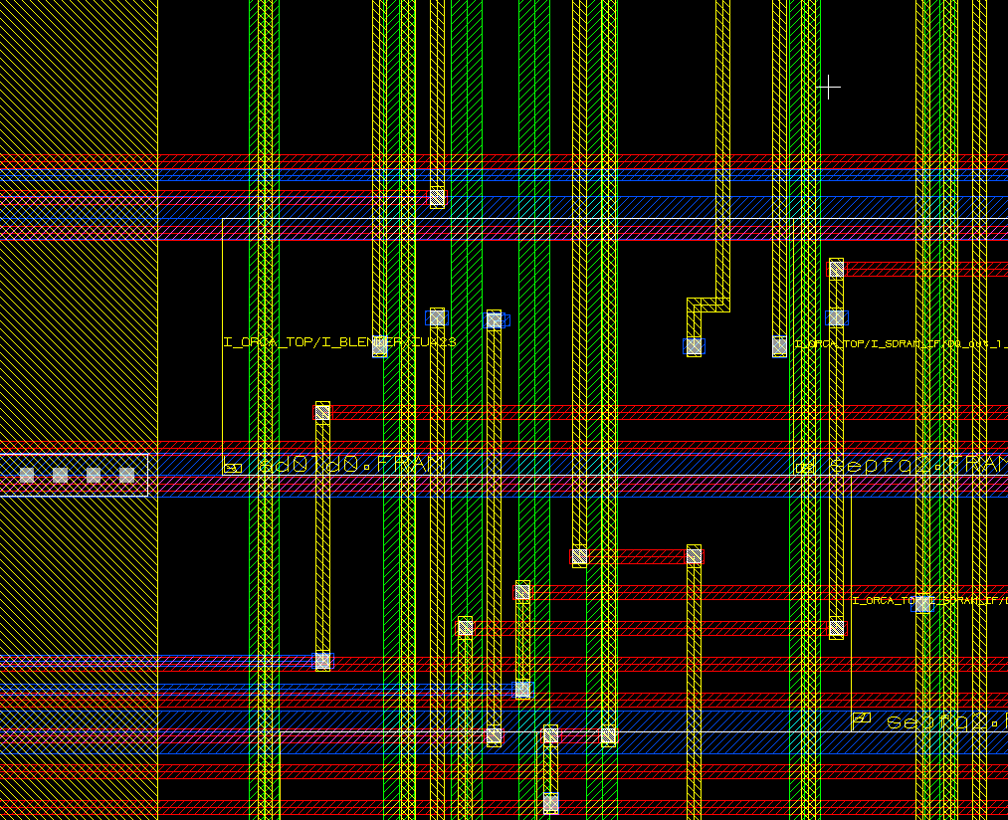
Detail Route: Track Assignment
For nets that traverse multiple GCells
Assigns each net to a specific track and lays down the actual metal traces
Makes long, straight traces and
Reduces the number of vias
TA does not check or follow physical DRC rules
Preroute
TA metal traces
Jog reduces via count
Notes:
IDESA - IC Design Skills for Advanced DSM Technologies
38
IDESA - IC Design Skills for Advanced DSM Technologies
38
Track assignment (TA) assigns each net to a specific track and lays down the actual metal traces. It also attempts to make long, straight traces and reduce the number of vias. TA does not check or follow any physical DRC rules.
Track assignment tries to reduce the number of jogs and jumps in metal traces. This will generally improve timing (since each jump requires a via to jump to a higher or lower level metal layer). Reducing the number of vias is generally a plus for reliability and yield since their failure rate is higher than that of a simple, straight metal track in a modern, planarized process.

Slide 39
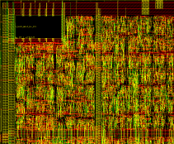
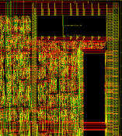
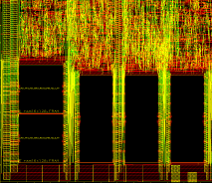
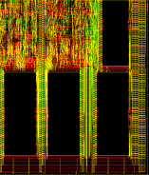
Detail route : Solve DRC Violations
Solve
shorts
Detail Route Boxes
Notch
Spacing
Notch
Spacing
Thin&Fat
Spacing
Min
Spacing
Notes:
IDESA - IC Design Skills for Advanced DSM Technologies
39
IDESA - IC Design Skills for Advanced DSM Technologies
39
Detail route focuses on fixing all the DRC violations after track assignment. The detail router does not work on the entire chip at the same time. Instead, it works by rerouting within the confines of a small area called an SBox (Synopsys) or GRC / Global Routing Cell (Cadence). It traverses the entire design box by box until the routing pass is complete. The router takes different passes through the chip (default 20 iterations).
The size of a GRC equals the average size of a standard cell. This window is moved from left to right by half a window while the violations are solved if possible.
In the Post route fixing this window is increased.
Four cases are illustrated in the left side of the slide, all resulted in meeting DRC requirements. Routing variants are shown for each case, which eliminates DRC violations.

Slide 40
Learning Outcomes
At the end of this lecture you should be able to:
Describe the basic principles of design planning
Outline the different options of placement and CTS
Describe the main stages of routing
Explain the additional routing challenges in 90nm technologies and beyond

Slide 41
Routing Fundamentals : Advanced Issues
Timing driven routing
  Timing budget for each net
  Minimize critical paths
Signal integrity aware : 90nm and below !!!!
  Minimize crosstalk
Notes:
With older/larger technologies the majority of delay in our timing paths came from cell-delay, in that case, as long as our router met DRC rules it wasn’t really a problem if we had long loopy nets, as the extra wirelength didn’t really hurt timing. However as we shrink geometries we find that more and more timing paths are dominated by net delay. This makes it more important to consider timing during our routing, thus our routers need to run a quick static timing analysis and try to minimize the wirelength for critical routes.
Secondly, with shrink geometries, the wires are getting closer together but the layers aren’t getting correspondingly thinner, so the coupling capacitances are getting higher, leading to signal integrity issues. When we talk about signal integrity for digital we refer to crosstalk.
Third, is DFM / DFY, fabrication guidelines are much tighter and it’s important to follow recommend rules from the foundry to increase yield for the chip. This includes more than just meeting DRC rules.

Slide 42
Timing Driven Routing
At 90nm net delay becomes significant
  Quality of route can effect timing
Optimize critical paths
Route some nets first
  Most routing freedom at start
  Use shortest paths possible
Net weights
  Order of routing (priorities : eg. Default : Clocks 50, others 2)
Wire widening
  Reduce resistance
If you have a congested design you may need to set the timing driven effort to “low”
Beware when changing default options
Notes:
As technology sizes have shrunk, net delay (rather than cell-delay) has become a more significant portion of the total datapath delay. This fact has made it important to consider the timing impact of different routing topologies.
EDA routing tools can use static timing analysis engines to predict which paths are timing-critical and attempt to optimize the routes for these paths, by routing them first and with minimal detouring. Designers can also manually specify particular nets as important by assigning net weighting attributes or non-default routing rules.
Generally the tools will have some sort of option to turn on timing driven routing, or perhaps a variable (low,med,high) effort_level for timing driven routing. However, it is important to not blindly use high effort level without considering the full mpact, since for highly congested designs, timing-driven routing may exasperate the congestion even further.

Slide 43
Signal Integrity: Crosstalk
Crosstalk is one of the main source of errors on buses
Crosstalk is the coupling of energy from one line to another via:
  Mutual capacitance (electric field) (this is called capacitive crosstalk)
  Mutual inductance (magnetic field)(this is called inductive crosstalk)
Mutual Capacitance, Cm
Mutual Inductance, Lm
Zo
Zo
Zo
Zo
far
far
Cm
Lm
Zs
near
near
Zo
Zs
Zo

Slide 44
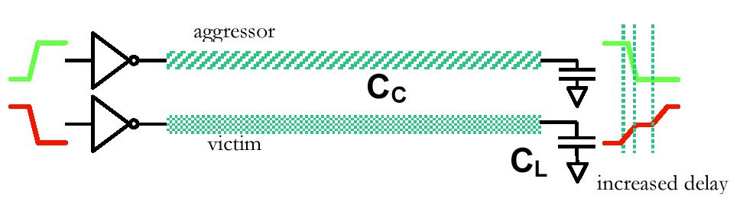
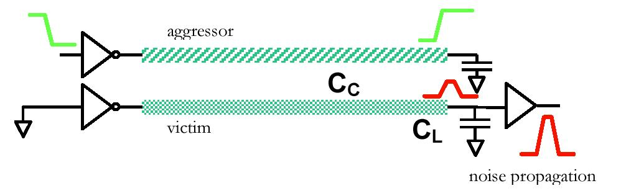
Signal Integrity : Crosstalk
Crosstalk may lead to:
Performance degradation as it increases signal delays
Reduce in system reliability by generating voltage glitches on adjacent lines
Effects on Delay
Noise Propagation

Slide 45
Crosstalk Prevention : Design Optimization
Noise depends on
  Coupling capacitance
  Total net capacitance
  Strength of the driver (Rd of the victim net)
Design optimization
  Increase drive strength, often easier (only local effect)
  Buffer long nets
Notes:
SI analysis tools read in the netlist, parasitics, design constraints and the timing libraries, and determine the possible switching windows for each net. Using the switching windows, the aggressor and victim nets can be identified and the timing delta delays can be annotated onto regular static timing analysis. Glitch analysis can also be performed.
When analyzing nets for SI, the coupling capacitance, total net cap and the relative driver strength determine the amount of noise.
One way to fix SI violations is to increase the drive strength of the victim net’s driver. i.e. Upsize BUFFX2 -> BUFFX4
Another option in the case of a long victim net with large cap, is to split up the victim net with a buffer.
However it is often preferable to have the router initially lay down each route in such a way as to prevent SI issues in the first place. If this is indeed possible.

Slide 46
Crosstalk Prevention : Routing
Routing solution
Limit length of parallel nets (H&V)
Wire spreading (skip track - clocks)
Shield special nets
Coupling free routing
Notes:
IDESA - IC Design Skills for Advanced DSM Technologies
46
IDESA - IC Design Skills for Advanced DSM Technologies
46
In order to reduce crosstalk, the following is can be done during routing:
Limit length of parallel nets
Wider routing grid
Shield special nets
A routing example is presented where the parallel cross section of two interconnects is large and where it will have a high crosstalk. After routing optimization, the parallel cross sections will be moved apart and therefore the crosstalk will be reduced.
The second example shows a direct prevention during the initial routing steps.

Slide 47
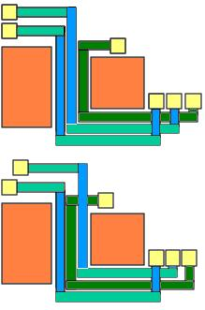
Crosstalk Prevention : Reduce Cross Coupling Cap
Critical Nets
Extra space
Grounded shields
Spacing
Shielding
Same layer (H)
Adjacent layers (V)
Net Ordering
Notes:
IDESA - IC Design Skills for Advanced DSM Technologies
47
IDESA - IC Design Skills for Advanced DSM Technologies
47
During routing of low power and high performance ICs, noise occurring in interconnects needs to be considered. In order to reduce noise, the spacing between neighboring interconnects can be increased. The middle figure illustrates shielding. Grounded shields are placed between the interconnects to form an electromagnetic field between the 2 interconnects.
The third image shows an example of net ordering, where critical nets in congested areas can be arranged so that they do not couple between each other.

Slide 48
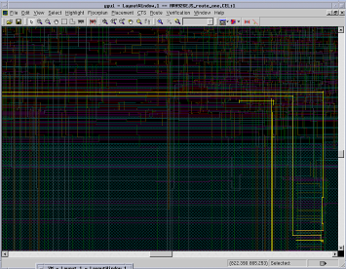
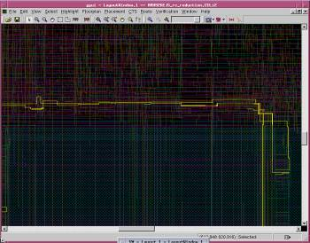
Crosstalk-Reduction at Work
Nets are spaced and can switch to different layers to reduce crosstalk without adding cells
Notes:
IDESA - IC Design Skills for Advanced DSM Technologies
48
IDESA - IC Design Skills for Advanced DSM Technologies
48
Here, an example of interconnect spacing is presented. Increasing spacing between wires and/or moving nets to higher or lower layers has reduced crosstalk.

