Slide 1
Cadence SoC Encounter – with AMS c35
Dr Basel Halak

Slide 2
Digital Design Flow
Design Specification
Architecture design
Verification
Logic Synthesis
Verification
no
yes
Floorplanning,
Placement & Routing
no
yes
Verification
Finished design

Slide 3
Design Stage
Design
Create specifications and a verification plan, High Level modelling and RTL Coding
Synthesis
Reading HDL , Mapping into generic cells, Mapping into logic cells, Optimise design to meet constraints
PnR
Floorplaning, Placement of cells, Clock Tree Synthesis, Routing, Design finishing(e.g. adding core fillers)
Signoff
DRC, IR-Drop , EM , Static Timing Analysis, Power Analysis and Transistor Level Simulations

Slide 4
Digital IC Design Flow: Place&Route
Logic Synthesis
(Synthesis tool)
Cell Library
(Physical description)
Gate-level Netlist (Verilog / VHDL)
Design Constraints
Physical Design
(Physical design tool)
Layout

Slide 5
SOC Encounter Lab Instructions
For this lab you will need:
Tool setup file (this is provided)
A synthesised Verilog net list of the design (this is obtained from the synthesis stage)
Your timing constraints file “design.sdc” (this is obtained from the synthesis stage)
Configuration file (design.conf) this is provided

Slide 6
Design Directory Management
Inside your design directory create a sub-directory called pnr
Copy the design files into pnr
digit
syn
src
pnr

Slide 7
Introduction
The place and Route software within the Cadence software is called “velocity”
To be able to run this software you need to first set up your directory for the required AMS c35 design files
To setup your environment source the file soc_setup (attached with this tutorial) from your working directory

Slide 8
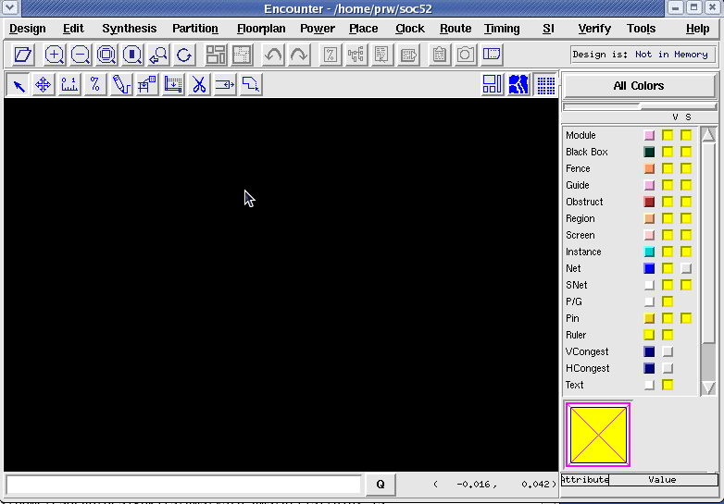
Running encounter
Simply type “velocity” at a command prompt and the basic encounter GUI with appear:

Slide 9
Stages of the lab
Design Setup
Floor Planning
Power Planning
Place
Clock Tree Synthesis
Timing Optimization Post-CTS
Route
Adding Filler
Write Out
Power Routing
Timing Optimization Pre-CTS
Timing Optimization Post-Rout
Design Verification

Slide 10
P&R Process
Design Setup
Floor Planning
Power Planning
Place
Clock Tree Synthesis
Timing Optimization Post-CTS
Route
Adding Filler
Write Out
Power Routing
Timing Optimization Pre-CTS
Timing Optimization Post-Rout
Design Verification

Slide 11
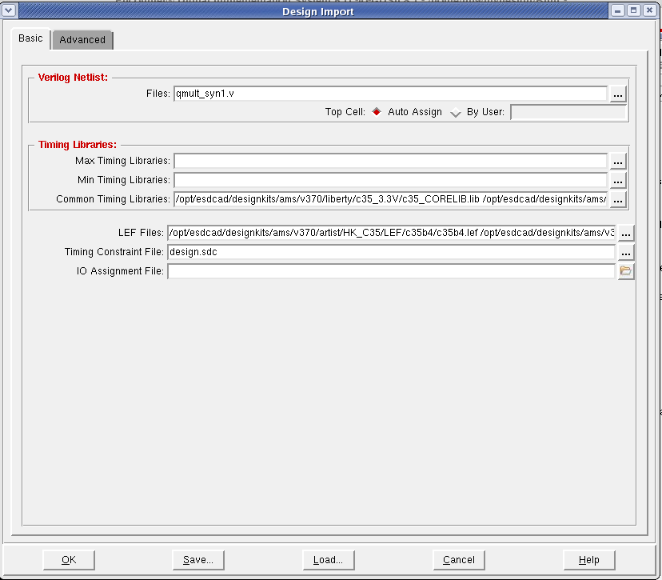
Import the Design
Choose Design – import Design to open the form
Load up the configuration file (design.conf).
Notes:
The LEF files contain physical information about the standard cell library and the metal layers.
This information includes capacitances, resistances, area, and the physical location of pins for each
cell. The LIB files contain timing information about each cell; they are similar to the DB files used
by Design Compiler.
Normally, if this was a full chip design, we would also have to specify the I/O pad information now by the IO Assignment File, but for now we will not use I/O pads. Your Design Import pop-up window should look like this now

Slide 12
Import the Design
Change the name of the verilo net list to match your own).
Then click ok, this will setup your libraries and read in all the relevant cell definitions and calculate the initial floor plan
Notes:
The LEF files contain physical information about the standard cell library and the metal layers.
This information includes capacitances, resistances, area, and the physical location of pins for each
cell. The LIB files contain timing information about each cell; they are similar to the DB files used
by Design Compiler.
Normally, if this was a full chip design, we would also have to specify the I/O pad information now by the IO Assignment File, but for now we will not use I/O pads. Your Design Import pop-up window should look like this now

Slide 13
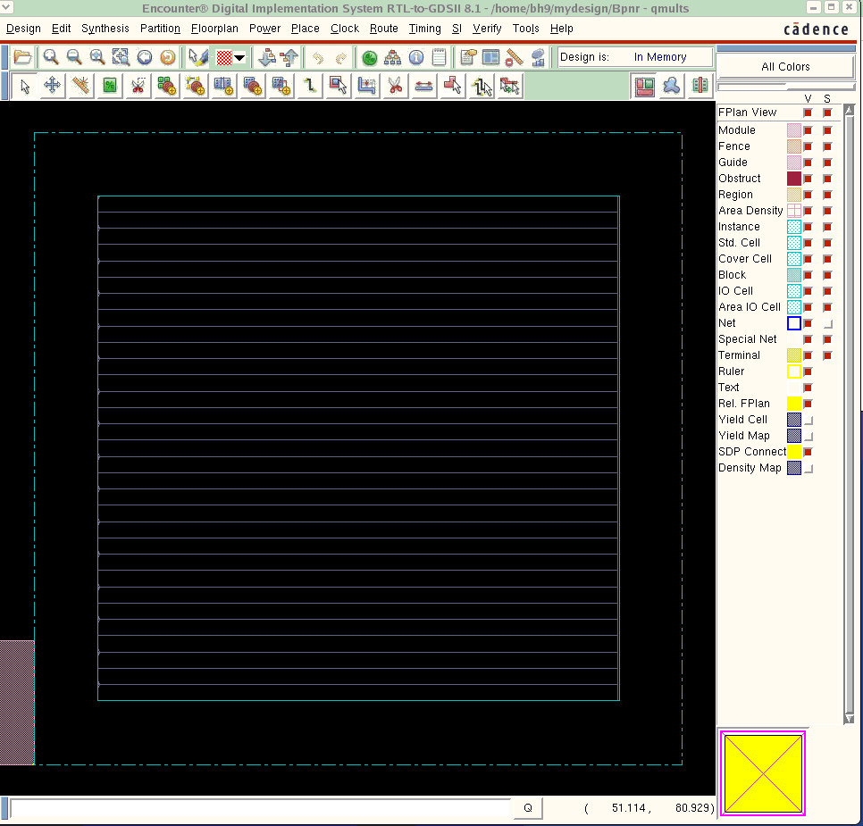
Design Prepped
Note the design is ready for placement…

Slide 14
P&R Process
Design Setup
Floor Planning
Power Planning
Place
Clock Tree Synthesis
Timing Optimization Post-CTS
Route
Adding Filler
Write Out
Power Routing
Timing Optimization Pre-CTS
Timing Optimization Post-Rout
Design Verification

Slide 15
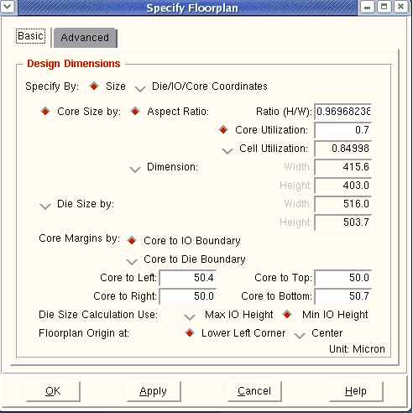
Floorplanning
Can specify details of the floor plan
Floorplan -> Specify Floorplan
The CORE is the part of the design containing the cells, and the periphery is for all the IO and power rings
Select the core size as follows(notice the core dimensions)
Set the core utilization to 0.7 to allow room for routing
Notes:
This form is use to specify the size of the design , you can specify the cell size or the core size
Floorplanning a chip or block is an important task of physical design in which the location, size, and shape of soft modules, and the placement of hard macros are decided. Depending on the design style or purpose, floorplanning can also include row creation, I/O pad or pin placement, bump assignment (flip chip), bus planning, power planning, and more. For example, floorplanning is very important when preparing the design for timing closure and detailed routing. Floorplanning, in conjunction with placement and trial routing, can be an iterative design process.
Size: Specifies that the design dimensions are specified by size. If you select this option, specify the details in Core Size or Die Size fields.
Die/IO/ CORE COORDINATE: Specifies that the design dimensions are specified by die, I/O, or core coordinates. Specify the Die/IO/Core lower left (ll) and upper right (ur) coordinates in the fields that are displayed if you select this option.
CORE SIZE BY
Specifies the core size dimension definition.
Aspect Ratio defines the chip's core dimensions as the ratio of the height divided by the width. If a value of 1.0 is used, a square chip is defined. A value of 2.0 will define a rectangular chip with height dimension that is twice the width dimension.
Choose one of the following ways of determining core and module sizes:
Core Utilization determines the core and module sizes by total standard cells and macros density.
Cell Utilization determines the core and module sizes by standard cell density.
For more information on total density versus standard cell density calculation, see Calculating Density in the Encounter User Guide.
Die Size by width and Hight
Width and Height specifies the core's width and height values, in micrometers.
Specifies the design's die size, in micrometers.
CORE MARGIN DIMENTIONS
Specifies the core margin dimension definition. Choose one of the following:
Core to IO Boundary uses the spacing, in micrometers, between the core edge and the I/O box, which is the margin between the outside edge of the core box and the inside edge of the I/O box. The margin values and the height of the I/O pad instances determines the die size. You can specify the margins on all four sides: Core to Left, Core to Bottom, Core to Right, and Core to Top.
Core to Die Boundary uses the spacing, in micrometers, between the core edge and the die edge, which is the margin between the outside edge of the core box and the inside edge of the die (head) box. This sets the die size once the core size is calculated. You can specify the margins on all four sides: Core to Left, Core to Bottom, Core to Right, and Core to Top.
Specifies the die size and I/O box calculation when using Core Margins by. The height of the I/O pad instance determines the final die size calculation. Choose one of the following:
Max I/O Height uses the tallest height I/O pad instance dimension to calculate the die size.
Min I/O Height uses the shortest I/O pad instance dimension to calculate the die size.
Specifies the floorplan's origin. Choose one of the following:
Lower Left Corner when loading a design that has its origin at the lower left. All files saved or output will reference the origin selection.
Center when loading a design that has its origin at the center of the core.

Slide 16
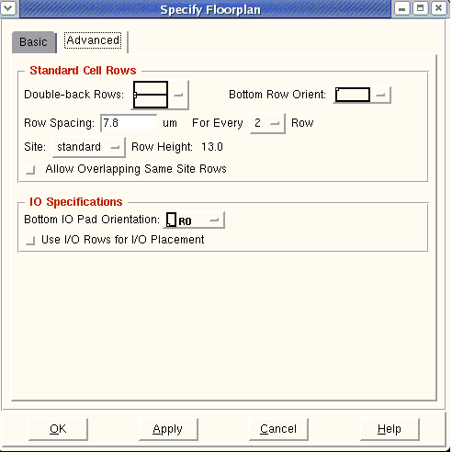
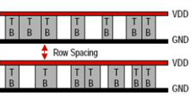
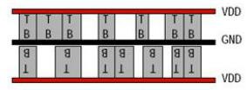
Floorplanning
Set the advanced option as shown here
Note that row spacing is set here to 7.8 to facilitate routing
Non Abutted Rows
Abutted and Flipped Rows
Notes:
Specify Floorplan - Advanced Fields and Options
Row Direction
Specifies whether the rows are horizontal or vertical.
Note: Support for vertical rows is a beta feature. Usage and support of this beta feature are subject to prior agreement with Cadence. Contact your Cadence representative if you have any questions.
Double-back Rows
Allows the selection of standard cell row pair orientations. The orientation selections for the row pair are bottom-to-bottom or top-to-bottom. The default is bottom-to-bottom orientation.
Bottom Row Orient
(Bottom/Left Row Orient, if vertical row support is enabled)
Specifies the orientation of the bottom/left row in the core area. The default is an R0 orientation, or you can choose the MX orientation (mirrored through the x axis) for horizontal rows or MY orientation for vertical rows.
Note: Support for vertical rows is a beta feature. Usage and support of this beta feature are subject to prior agreement with Cadence. Contact your Cadence representative if you have any questions.
Row Spacing for Every # rows
Specifies the standard row spacing, in micrometers. This must be a positive value. By default, this value is zero. In the For Every Row pull-down menu, specify 1 for every row, or 2 for every other row.
Site Name
Specifies a core row site. The tech site names listed in the pull-down menu come from the LEF Files field of the Design Import form.
Row height
Specifies the standard cell row height, in micrometers. During design import, the standard cell row height is automatically determined.
Allow overlapping same site rows
If selected, specifies that same-site rows can overlap with one another. If deselected, specifies that same-site rows cannot overlap with one another.
Single height rows must not overlap. Only double- or multiple-height rows can overlap. The overlap must be in sections that are multiple of single height--any other overlap section size will result in the rows being ignored.
Bottom IO Pad Orientation
Specifies an orientation of R0 (default), R90, R180, and R270.
If the bottom I/O pad orientation is changed, the other three sides will also change. The west side is rotated 90 degrees counterclockwise from the bottom I/O pad orientation; the north side is rotated 180 degrees counterclockwise from the bottom I/O pad orientation; and the east side is rotated 270 degrees counterclockwise from the bottom I/O pad orientation.
The default orientation of the bottom I/O pad instance is R0; however, during design import, the software approximates the I/O pad orientation.
Use I/O Rows for I/O Placement
Enables I/O row based pad placement.

Slide 17
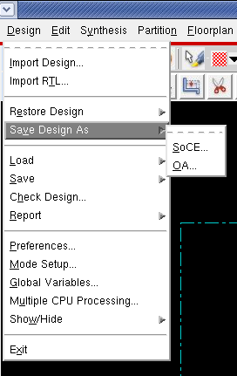
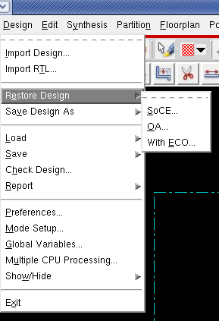
Save the Design
To Save the design:
To restore the design:
Design >Save Design As> SoCE
Design >Save Design As> SoCE
Notes:
It is good idea to save a copy after each stage j

Slide 18
P&R Process
Design Setup
Floor Planning
Power Planning
Place
Clock Tree Synthesis
Timing Optimization Post-CTS
Route
Adding Filler
Write Out
Power Routing
Timing Optimization Pre-CTS
Timing Optimization Post-Rout
Design Verification

Slide 19
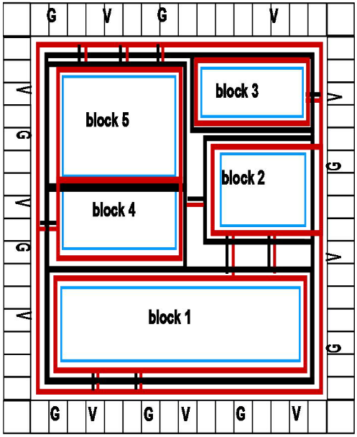
Power Planning
During Power Planning:
You define the global wire and grounds nets and create the power structures that corresponds to the global nets

Slide 20
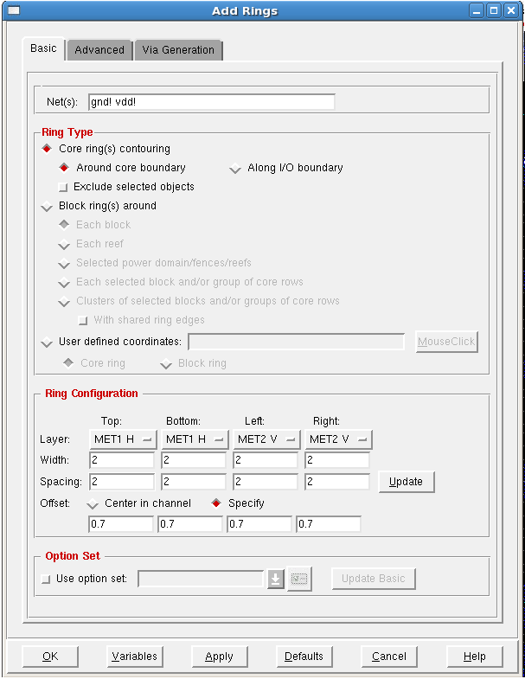
Power and Ground Rings
You can automatically add power and ground rings around the design using Power >Power Planning > Add Rings
Specify the names of the power and ground connections
From here you can change the layer and dimensions of power and grounds rings
Click ok, this will add a ring for power and ground around the design
Notes:
If the dimention of the ring is too small it will create problem with the verifications
Add Rings - Basic Fields and Options
Net(s)
The net names for power rings to be created.
Ring Type
Specifies the type of ring to be created. You can specify only one type at a time. For example, if you need both core rings and block rings, create core rings first, then select this form again to create block rings.
Select one of the following options:
Core Ring(s) contouring
Creates core rings that follow either the contour of the core boundary or contour around the I/O boundary. Select one of the following options:
Around core boundary
Creates core rings that contour around blocks or rows in the core area of the design, including cores that are rectilinear. This is the default.
Use the options in the Ring Configuration panel to either center the ring in the channel between the core boundary and the I/O area, or offset each side of the ring by a specific distance from the core boundary.
Along I/O boundary
Creates core rings that contour the I/O area.
Use the options in the Ring Configuration panel to either center the ring in the channel between the core boundary and the I/O area, or offset each side of the ring by a specific distance from the I/O boundary.
Exclude selected objects
If selected, creates a ring that contours the core boundary while contouring around the selected objects so that they are outside of the ring. If deselected, all objects in the core area are enclosed within the core ring. This is the default.
Block ring(s) around
Creates block rings that follow the contour of the specified objects. Choose one of the following options:
Each Block
Creates a separate ring around each block in the design. Rings are created as shown in the following illustration.
Each Reef
Creates a separate ring around each reef in the design. Reefs are used in flipchip designs.
Selected power domain/fences/reefs
Creates a separate ring around each power domain selected in the design display area, around the fence that surrounds a soft block, or around a reef of bumps. If both a power domain and a fence are selected, the power domain takes precedence. For example, if you select PD1, PD2, and PD3, rings are created as shown in the following illustration.
Each selected block and/or group of core rows
Creates a separate ring around each block and each group of core rows that is selected in the design display area. For example, if you select Block A, Block B, and Block C, block rings are created as shown in the following illustration.
Cluster of selected blocks and/or groups of core rows
Treats all the blocks and groups of core rows selected in the design display area as a single cluster and creates a ring around the cluster. For example, if you select Block A, Block B, and Block C, a ring is created as shown in the following illustration.
With shared ring edges
Treats all the blocks and groups of core rows selected in the design display area as a single cluster and creates rings with shared ring edges around the cluster. To enable this option, you must first select Cluster of selected blocks/groups of core rows. For example, if you select Block A, Block B, and Block C, block rings with shared edges are created as shown in the following illustration.
User defined coordinates
Creates a ring that has the same number of corners as the number of x and y coordinates that you specify. You must specify the coordinates in a linear sequence. For example, you cannot specify the coordinates in a sequence such as bottom left, top right, bottom right, top left. For more information, see Creating a Ring with User Defined Coordinates.
Mouse Click
Click this button, then move the cursor to the design display area. Click the points to define the corners of the ring. A temporary image shows the location of the ring wires that will be created. When you press the Esc key, the User Specified Coordinates text entry field is automatically populated with the coordinates of the area you selected.
Core ring
The ring has the shape RING. This is the default.
Block ring
The ring has the shape BLOCKRING.
Ring Configuration
The configuration of the rings to be created. Specify options to meet the requirements of your design.
Layer
Use the pull-down menus to select the layer to use for each side of the ring(s) being created.
Width
Use the text entry fields to specify the width, in microns, of the ring segments for each side ring(s).
Spacing
Use the text entry fields to specify the edge-to-edge spacing, in microns, between rings for each side of the ring.
Update
Click this button to automatically update the values in the Spacing fields. If spacing values in the Spacing fields are less than the values from the LEF file for a particular width, the values in the Spacing fields are increased to prevent minimum spacing violations.
Offset
Controls how core rings are offset from the core area. Select one of the following options:
Center in channel
Specifies that the core ring is centered in the channel between the I/O area and the core area. This option is not available for block rings.
Specify
Select this option, then use the text entry boxes to specify the distance, in microns, between the edge of the inner ring and the boundary of the referenced object (blocks, rows, power domains, I/O area or core area) for each side of the ring. If you specify a negative number, the ring is created inside of, rather than surrounding, the referenced object.
Note: For core rings, you can choose between this option and the Center in channel option. For block rings, you must specify offset values.
Option File
Use option file
Instructs the power analysis software to use an option file.
Note: When you click this option, the Via Generation tab becomes inactive.
Update Basic
Updates data on the Basic tab with the contents of the option file you have specified.
Load Editor
Opens the Edit Power Planning Option form.

Slide 21
P&R Process
Design Setup
Floor Planning
Power Planning
Place
Clock Tree Synthesis
Timing Optimization Post-CTS
Route
Adding Filler
Write Out
Power Routing
Timing Optimization Pre-CTS
Timing Optimization Post-Rout
Design Verification

Slide 22
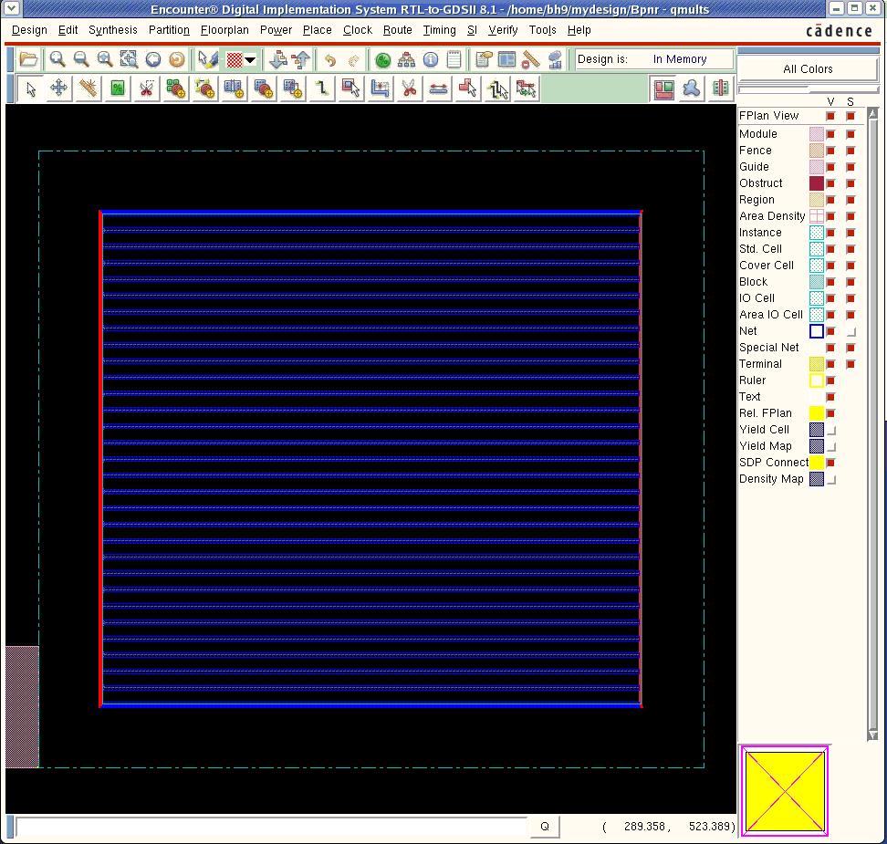
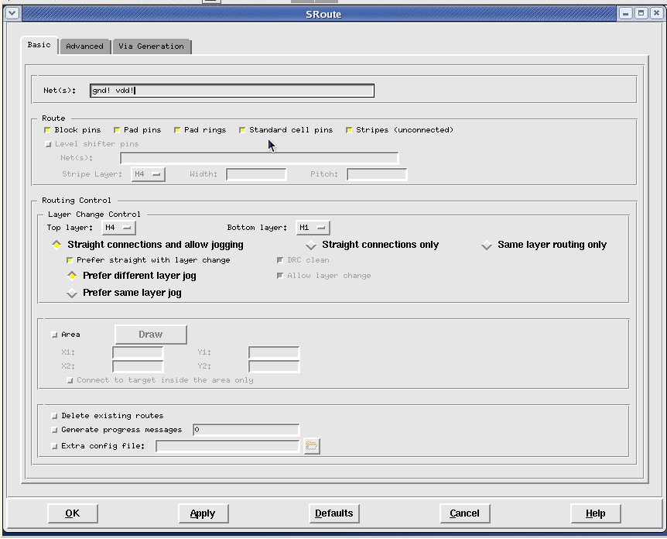
Connect Power and Ground to Core
To connect to the core you need to complete a route -> special route:
Notes:
SRoute - Basic Fields and Options
Nets
The nets that must be connected in the core rows, or on the blocks, pads, or stripes. Both ground and power are specified by default.
Route
The types of routing that the Sroute tool can perform. Sroute performs all routing types by default. Select or deselect any of the following options:
Block pins
Connects the power and ground pins of the blocks to rings and stripes.
Pad pins
Connects the power and ground pins of the power pads into the core power ring.
Note: The physical port must be identified with the CLASS CORE statement in the LEF file so that SRoute can recognize the proper pad pins to be routed to the core.
Pad rings
Creates pad rings. If you do not specify any layers, a pad ring is created on each layer that contains pad pins.
Standard cell pins
Connects the power and ground pins of the standard cells along the core rows. The end connections are based on the options you set using the Advanced tab of this form. By default, the end connections are at the first ring or stripe outside the row.
Stripes (unconnected)
Extends unconnected stripes to allow a connection to a target.
Top Layer
The top-most metal layers that the tool can use when routing power structures. Power structures on higher layers are not connected.
Bottom Layer
The top-most metal layers that the tool can use when routing power structures. Power structures on lower layers are not connected.
Allow Jogging
Specifies that jogs are allowed during routing to avoid DRC violations.
If both this option and Allow Layer Change are selected, the software creates straight connections between targets, and changes layers instead of jogging to avoid DRC violations. If you do not specify this option, the route uses both layer changes and jogging to avoid DRC violations.
If this option is selected and Allow Layer Change is deleted, then, if the route must jog to avoid a DRC violation, the jog occurs on the same layer whenever possible. This can result in routing in the non-preferred direction.
If this option is deselected and Allow Layer Change is selected, only straight connections are made between targets and that jogs are not allowed during routing. Routing can change to another layer to avoid DRC violations.
If both this option and Allow Layer Change are deselected, only straight connections to targets on the same layer are allowed.
Allow Layer Change
Allows connections to targets on different layers. See Allow Jogging for more information.
Area
If selected, you can either enter coordinates in the X1, X2, Y1, and Y2 fields, or click the Draw button to interactively select an area in the design display window. Metal fill is created only in the specified area. If deselected, the tool performs routing for the entire design area. This is the default.
Note: Selecting the Area option always preserves existing connections. If you select this option, the Delete Existing Routes option is disabled.
Connect to Target Inside the Area Only
If selected, connections from all sources within the specified area can connect only to targets that are also inside that area. If deselected, the tool makes connections from all sources within the specified area to targets both inside and outside the specified area.
Delete Existing Routes
If selected, removes existing connections when you click Apply or OK. If deselected, existing connections are left untouched each time you use the SRoute form.
Note: This option is disabled if you select the Area option.
Generate progress messages
If selected, allows you to see all messages displayed while power routing takes place. Specify an integer value in the associated text entry field to set the interval at which progress messages are generated. If you specify 1, SRoute generates every progress message; if you specify 2, SRoute generates every other progress message, and so on. If deselected or if you specify a value of 0, routing messages do not display in the Encounter console. This is the default.
Extra Config File
(Optional) The name of an extra configuration file that contains additional commands to provide more control over the placement of metal fill in the design. For more information about configuration variables, see sroute in the Encounter Text Command Reference.
You should only add the extra configuration file if you are familiar with its use.

Slide 23
P&R Process
Design Setup
Floor Planning
Power Planning
Place
Clock Tree Synthesis
Timing Optimization Post-CTS
Route
Adding Filler
Write Out
Power Routing
Timing Optimization Pre-CTS
Timing Optimization Post-Rout
Design Verification

Slide 24
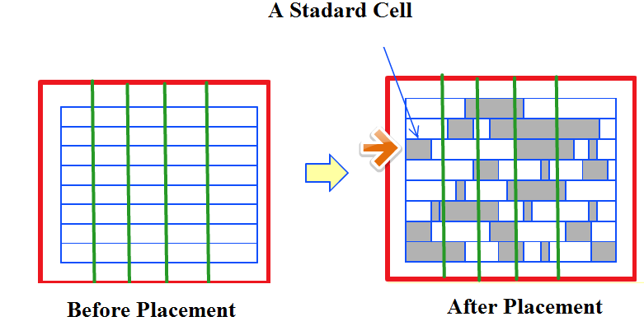
Placement
Placement is the process of placing the standard cells and blocks into the floor planned design

Slide 25
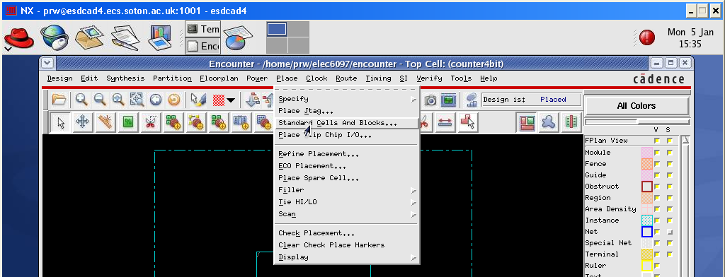
Placement
This is simply to show the quickest place and route approach (Place >> Standard Cells )
Notes:
Specify spare cell helps you specify some reduandant cell within your layout, so later on if you dicovred you need to implement additional logic, yu do not need to do the whole layout but you can place it this in the reserved place for te pace cell
Specify JTAG is in order to identify the JTAG to the tools, JTAG CELL create a test structure around your design

Slide 26
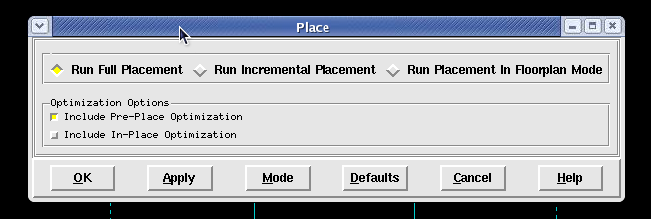
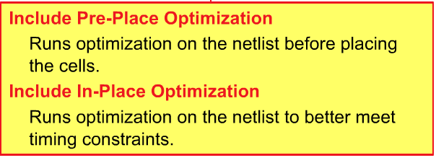
Placement
Choose the full placement – on a simple design it won’t take very long at all to complete
Notes:
Use the Place form to place standard cells in the design based on the global settings for placement, RC extraction, timing analysis, and trial routing. The placement commands consider the modules that were placed (guided) during floorplanning, and take into account the design's hierarchy and connectivity.
Choose Place - Standard Cells.
Place Fields and Options
Run Full Placement
Runs placement in timing-driven mode, based on the global settings for placement, RC extraction, timing analysis, and trial routing.
Default: On
Run Incremental Placement
Reruns placement in timing-driven mode while honoring current placement.
Default: Off
Run Placement in Floorplan Mode
Runs a quick placement to gauge the feasibility of the netlist, but might not place components in legal locations. This mode assumes non-timing-driven placement.
Default: Off
Note: In this mode the Include In-Place Optimization option is disabled.
Optimization Options
Include Pre-Place Optimization
Simplifies the netlist, for example, by deleting buffer trees, before running placement.
Default: On
Include In-Place Optimization
Runs netlist optimization between placement iterations in order to improve instance placement of timing-critical paths.
Default: Off
Number of Threads
Displays the number of threads to use for multiple-CPU processing.
Note: This is a non-editable field. To edit this field, select Set Multiple CPU.
Set Multiple CPU
Opens the Multiple CPU Processing form. For more information, see "Multiple CPU Processing".

Slide 27
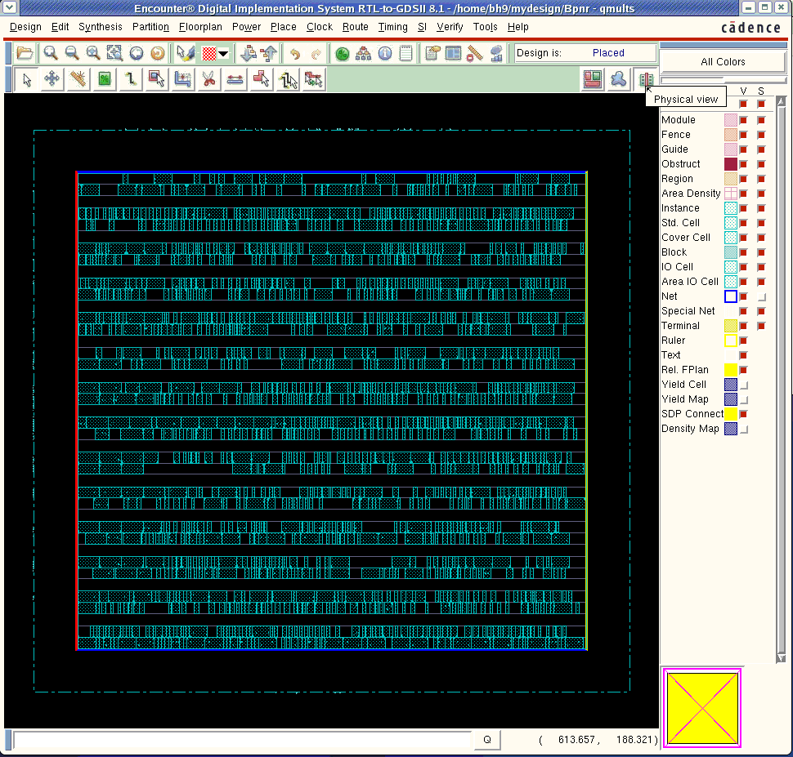
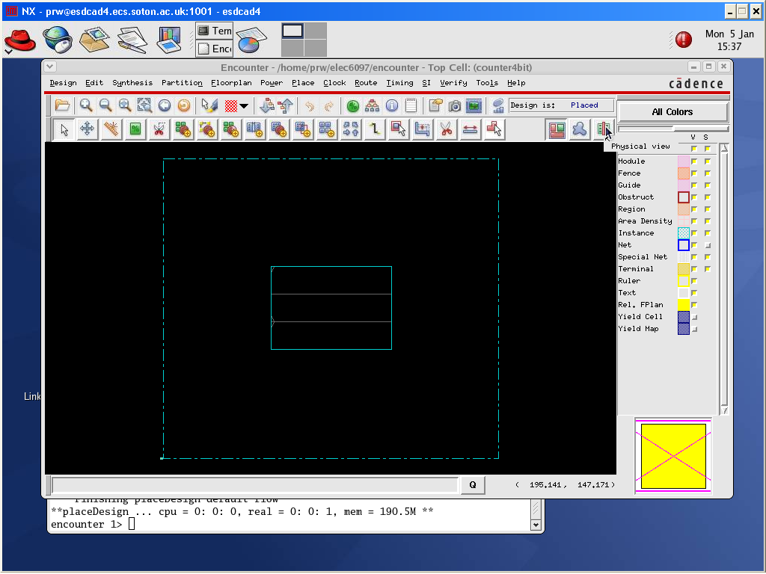
Placement
Then select the physical view option to see the placed cells

Slide 28
P&R Process
Design Setup
Floor Planning
Power Planning
Place
Clock Tree Synthesis
Timing Optimization Post-CTS
Route
Adding Filler
Write Out
Power Routing
Timing Optimization Pre-CTS
Timing Optimization Post-Rout
Design Verification

Slide 29
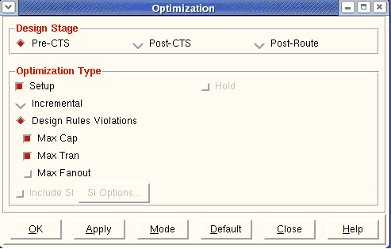
Timing Optimization
Select : Timing > Optimize
In the dialog box select Pre-CTS
Select the type of Optimization
Click ok
Note that you need to perform Timing Optimization at different design stages
Notes:
Optimize
Use the Optimization form to make the following improvements to your design:
Reduce path delays
Improve transition times
Correct capacitance violations
Choose Timing - Optimize.
Timing - Optimization Fields and Options
Design Stage
Pre-CTS
Performs timing optimization on placed design before the clock tree is built. By default, repairs DRVs and setup violations for all path groups. If the worst negative slack found during the first optimization pass does not occur on a register-to-register path, the software performs an additional optimization for the register-to-register critical paths.
Default: Selected
Post-CTS
Performs timing optimization after the clock tree is built. By default, repairs DRVs and setup violations for all path groups. If the worst negative slack found during the first optimization pass does not occur on a register-to-register path, the software performs an additional optimization for the register-to-register critical paths. In this mode, if you are running Useful Skew and you have already detail routed the clock, the Encounter software performs ECO routing using the NanoRoute router.
Default: Deselected
Post-Route
Performs timing optimization on routed designs. By default, repairs DRVs and setup violations for all path groups. If the worst negative slack found during the first optimization pass does not occur on a register-to-register path, the software performs an additional optimization for the register-to-register critical paths. In this mode, the software performs ECO routing using the NanoRoute router.
Default: Deselected
Optimization Type
Setup
Corrects setup time violations.
Default: Selected in all modes.
Hold
Corrects hold time violations.
Default: Deselected. Available in Post-CTS and Post-Route modes.
incremental
Performs incremental optimization on all path groups.
Default: Deselected
Design Rules Violations
Specifies the type of design rule violations to correct.
Default: Selected. Unavailable if Incremental is selected, or if Pre-CTS mode and Low effort (on the Mode Setup - Optimization form) are selected.
Max Cap
Corrects maximum capacitance violations in the design based on the threshold specified in the SDC constraints file or in the timing libraries.
Default: Selected. Available only if Design Rule Violations is selected.
Max Tran
Corrects maximum transition violations in the design based on the threshold specified in the SDC constraints file or in the timing libraries.
Default: Selected. Available only if Design Rule Violations is selected.
Max Fanout
Corrects maximum fanout-load violations.
In the library, each cell output pin might have a maxfanout constraint defined, and each input pin might have a fanout_load defined. The Encounter software checks maxfanout against the total fanout_load that the output pin drives in the netlist. A violation exists if the total fanout load exceeds the maxfanout. You can override these limits by specifying new limits in the SDC file.
If maxfanout or fanout_load are not defined in the library, the Encounter software does not perform maximum fanout repair.
Default: Deselected. Available only if Design Rule Violations is selected.
Include SI
Corrects signal integrity violations for designs routed in signal integrity prevention mode.
Default: Deselected. This option is available in Post-Route mode only.
SI Options
Opens the Fix Crosstalk form, enabling you to select options for repairing noise-on-delay and glitch noise violations. This option is available only in Post-Route mode, and only if you select Include SI.

Slide 30
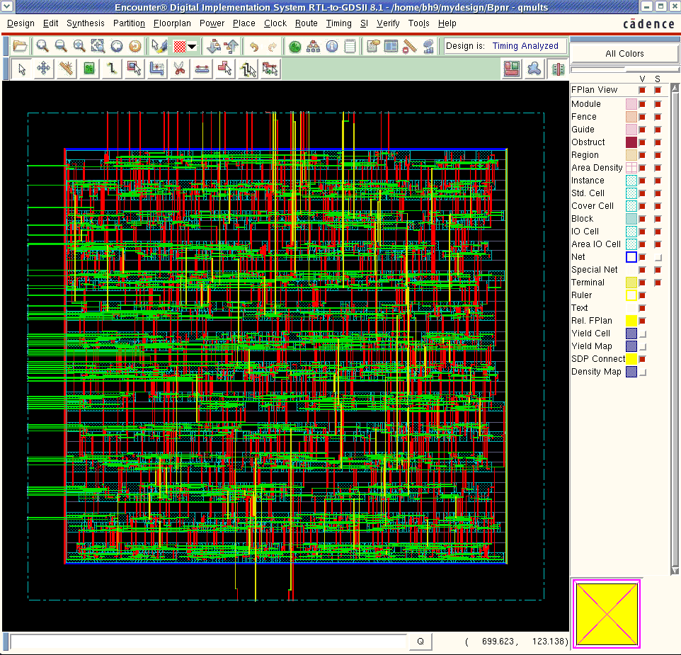
Timing Optimization Pre-CTS: Trial Rout

Slide 31
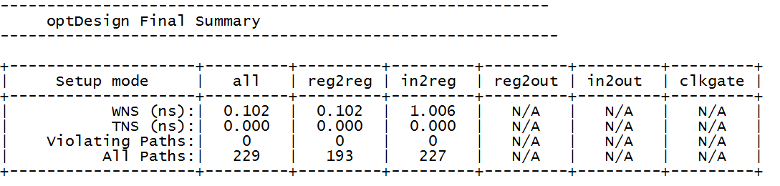
Timing Optimization
You will get a summary of the optimization,
Figure 1 show is an extract for that report that shows
that setup timing constraints are met
Figure 1

Slide 32
P&R Process
Design Setup
Floor Planning
Power Planning
Place
Clock Tree Synthesis
Timing Optimization Post-CTS
Route
Adding Filler
Write Out
Power Routing
Timing Optimization Pre-CTS
Timing Optimization Post-Rout
Design Verification

Slide 33
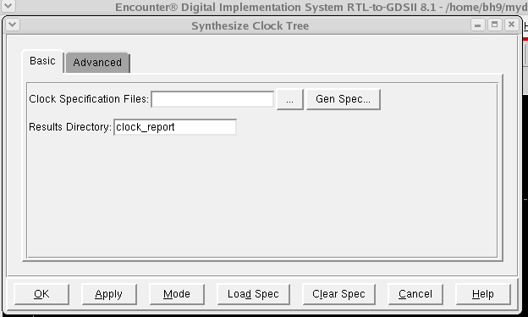
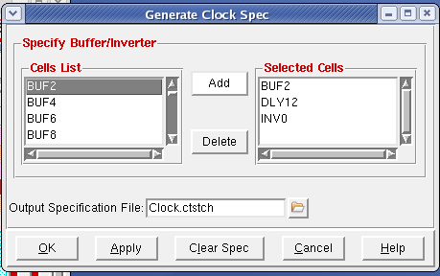
Clock Tree Synthesis
Select Clock > Design Clock
Click on Gen Spec button to create a clock specification file
Choose from the Cells List the name of the cell you want to use during timing optimization
Click ok in Generate Clock Spec form to generate a file called Clock.ctstch that contains that clock specification
Click ok in Synthesize Clock Tree form to synthesize the clock
You can clear these specs from the clear spec Tab
Notes:
The clock tree specification file defines the clocks in the design that you want to synthesize. If a design contains several clocks, you can specify any of these clocks in the clock tree specification file, and those clocks will be synthesized during a single CTS run. You can also synthesize an individual clock tree separatelusing its own clock tree specification file.
Timing constraints must be loaded into the Encounter session before using this form.
Choose Clock - Design Clock, and click the Gen Spec... button.
Fields and Options
Cells List
Specifies the list of buffer and inverter cells to use during automatic, gated clock tree synthesis.
Selected Cells
Lists the available buffer and inverter cells that you can choose to use.
To add a cell to the Cells List window, highlight the cell name in the Selected Cells window, and click the Add button.
To delete a cell from the Cells List window, hightlight the cell name in the Cells List window and click the Delete button.
Output Specification File
Specifies the name of the clock tree specification file to be created.
Default: Clock.ctstch

Slide 34
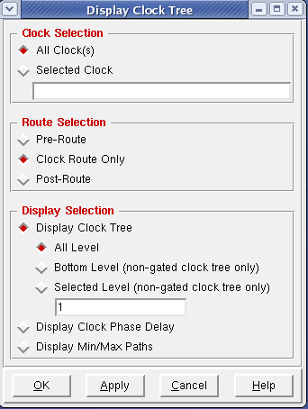
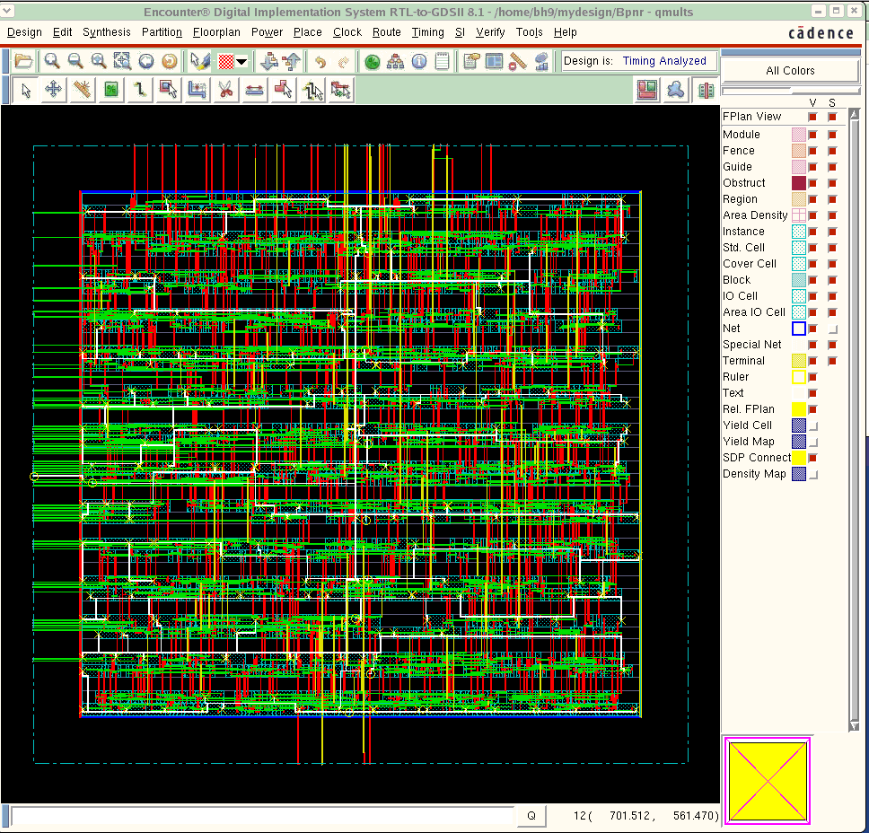
Clock Tree Synthesis
To see the clock tree select Clock > Display > Display Clock Tree
In the dialog box select the options as shown in figure one and click ok
You should see the clock tree in a white colour as in figure 2
Figure 1
Figure 2

Slide 35
P&R Process
Design Setup
Floor Planning
Power Planning
Place
Clock Tree Synthesis
Timing Optimization Post-CTS
Route
Adding Filler
Write Out
Power Routing
Timing Optimization Pre-CTS
Timing Optimization Post-Rout
Design Verification

Slide 36
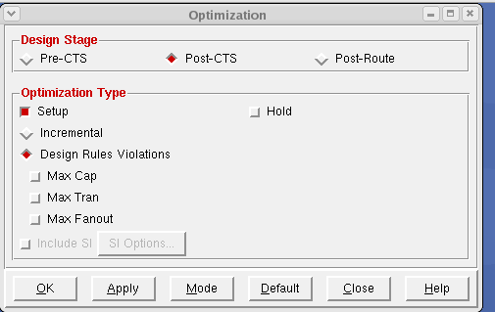
Timing Optimization
Select : Timing > Optimize
In the dialog box select Post-CTS
Select the type of Optimization
Click ok
Notes:
Optimize
Use the Optimization form to make the following improvements to your design:
Reduce path delays
Improve transition times
Correct capacitance violations
Choose Timing - Optimize.
Timing - Optimization Fields and Options
Design Stage
Pre-CTS
Performs timing optimization on placed design before the clock tree is built. By default, repairs DRVs and setup violations for all path groups. If the worst negative slack found during the first optimization pass does not occur on a register-to-register path, the software performs an additional optimization for the register-to-register critical paths.
Default: Selected
Post-CTS
Performs timing optimization after the clock tree is built. By default, repairs DRVs and setup violations for all path groups. If the worst negative slack found during the first optimization pass does not occur on a register-to-register path, the software performs an additional optimization for the register-to-register critical paths. In this mode, if you are running Useful Skew and you have already detail routed the clock, the Encounter software performs ECO routing using the NanoRoute router.
Default: Deselected
Post-Route
Performs timing optimization on routed designs. By default, repairs DRVs and setup violations for all path groups. If the worst negative slack found during the first optimization pass does not occur on a register-to-register path, the software performs an additional optimization for the register-to-register critical paths. In this mode, the software performs ECO routing using the NanoRoute router.
Default: Deselected
Optimization Type
Setup
Corrects setup time violations.
Default: Selected in all modes.
Hold
Corrects hold time violations.
Default: Deselected. Available in Post-CTS and Post-Route modes.
incremental
Performs incremental optimization on all path groups.
Default: Deselected
Design Rules Violations
Specifies the type of design rule violations to correct.
Default: Selected. Unavailable if Incremental is selected, or if Pre-CTS mode and Low effort (on the Mode Setup - Optimization form) are selected.
Max Cap
Corrects maximum capacitance violations in the design based on the threshold specified in the SDC constraints file or in the timing libraries.
Default: Selected. Available only if Design Rule Violations is selected.
Max Tran
Corrects maximum transition violations in the design based on the threshold specified in the SDC constraints file or in the timing libraries.
Default: Selected. Available only if Design Rule Violations is selected.
Max Fanout
Corrects maximum fanout-load violations.
In the library, each cell output pin might have a maxfanout constraint defined, and each input pin might have a fanout_load defined. The Encounter software checks maxfanout against the total fanout_load that the output pin drives in the netlist. A violation exists if the total fanout load exceeds the maxfanout. You can override these limits by specifying new limits in the SDC file.
If maxfanout or fanout_load are not defined in the library, the Encounter software does not perform maximum fanout repair.
Default: Deselected. Available only if Design Rule Violations is selected.
Include SI
Corrects signal integrity violations for designs routed in signal integrity prevention mode.
Default: Deselected. This option is available in Post-Route mode only.
SI Options
Opens the Fix Crosstalk form, enabling you to select options for repairing noise-on-delay and glitch noise violations. This option is available only in Post-Route mode, and only if you select Include SI.

Slide 37
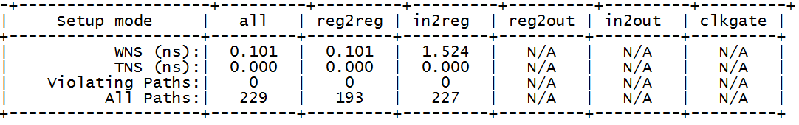
Timing Optimization
You will get a summary of the optimization,
Figure 1 show is an extract for that report that shows
that setup timing constraints are met
Figure 1

Slide 38
P&R Process
Design Setup
Floor Planning
Power Planning
Place
Clock Tree Synthesis
Timing Optimization Post-CTS
Route
Adding Filler
Write Out
Power Routing
Timing Optimization Pre-CTS
Timing Optimization Post-Rout
Design Verification

Slide 39
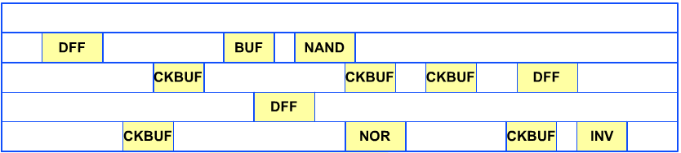
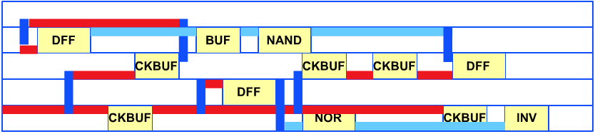
Routing
Routing is the step where the placed cells are connected with metal lines in a similar fashion to the Verilog netlist
Before Routing
After Routing

Slide 40
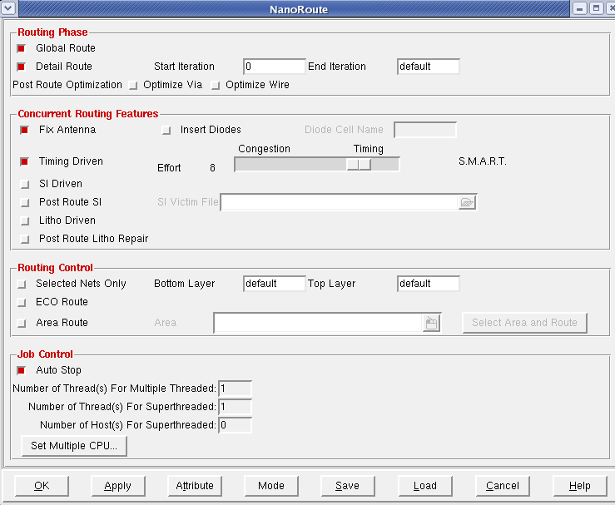
Routing
After the cells have been powered up, then final routing can take place
Route > NanoRoute > Route
You select Timing driven so that the router will try and meet your timing constraints
After it finishes you should see 0 violations and 0 fails in the shell window
Notes:
NanoRoute
Use the NanoRoute form to specify the most commonly used NanoRoute run-time options, and to run global and detailed routing. The NanoRoute form also provides access to the following additional forms:
NanoRoute/Attributes
Mode Setup - NanoRoute on page 319
Multiple CPU Processing
Choose Route - NanoRoute - Route.
NanoRoute Fields and Options
Global Route
Plans the global interconnect and detailed routing for the design using the NanoRoute router, and produces a congestion map.
During global routing, the router breaks the design into rectangles called global routing cells (gcells). It connects the regular nets defined in the NETS section of the DEF file by assigning them to gcells. The goals of global routing are to distribute and minimize congestion and to minimize the number of gcells that have more nets assigned than routing resources available.
Detail Route
Uses the NanoRoute router to perform detailed routing on the entire design, on an area of the design specified, or on selected nets.
During detailed routing, the router follows the global routing plan and lays down actual wires that connect the pins to their corresponding nets. The primary goal of detailed routing is to complete the interconnect without creating shorts or spacing violations.
Note: If you have not already run detailed routing on the entire design, you cannot run detailed routing on a specified area. For more information, see "Area Route".
Start Iteration
Specifies the first pass in a detailed routing step. Together with End Iteration, divides detailed routing into intermediate steps.
End Iteration
Specifies the last pass in a detailed routing step or the beginning of postroute optimization. Together with Start Iteration, divides detailed routing into intermediate steps.
Note: Setting End Iteration to a value higher than 20 generally does not improve results.
Post Route Optimization
Replaces single-cut vias with multiple-cut vias or fat single-cut vias after postroute optimization.
Optimize Via
Optimizes vias after routing.
Exercise caution with the use of this option, as the router might create violations during postroute via optimization. It runs a search and repair step after optimization if violations occur.
Optimize Wire
Optimizes wires after routing.
Concurrent Routing Features
Fix Antenna
Repairs process antenna violations during postroute optimization. NanoRoute repairs process antenna violations if it can do so without creating design rule violations. The router might need to make several passes before repairing all antenna violations. By default, this option is selected.
Insert Diodes
Inserts and places antenna diode cells during postroute optimization if there are available placement locations for the cells. By default, NanoRoute repairs antenna violations by changing layers (also called antenna stapling or layer hopping), but it can also repair antenna violations by inserting diodes as close as possible to input gates to discharge current. By default, this option is not selected.
Diode Cell Name
Routes antenna diode cells with the specified name during postroute optimization. The antenna diode cells must have the same LEF SITE definition as the standard cells. If you select Insert Diodes and do not enter a cell name, NanoRoute searches the LEF file and inserts the first MACRO with CLASS CORE ANTENNACELL it finds with the appropriate SITE definition.
Timing Driven
Minimizes timing violations by analyzing the timing slack for each path, the drive strengths of each cell in the library, and the maximum capacitance and maximum transition limits. During timing-driven routing, NanoRoute routes multi-pin nets to the most critical sink first, performs wire optimization by reducing resistance and coupling, and continually adjusts detouring. By default, this option is not selected.
Effort
Specifies how aggressively the router works to meet timing constraints. A higher value increases the effort toward meeting timing constraints and decreases the effort toward relieving congestion.
Range: 0 - 10
Default: Dynamic default setting
S.M.A.R.T.
Abbreviation for Signal integrity, Manufacturing Awareness, Routability, and Timing.
During SMART routing, the router runs both timing-driven and signal integrity-driven routing concurrently. It uses the Encounter software's extraction, delay calculation, and timing engines during detailed routing to make intelligent trade-offs between routability, timing, and crosstalk minimization.
SI Driven
Prevents or reduces crosstalk. Works in conjunction with timing-driven routing. By default, this option is not selected.
When Timing Driven is selected, uses SMART routing to identify victim nets and minimize crosstalk by wire spacing, layer hopping, net ordering, and minimizing the use of long parallel wires.
When Timing Driven is not selected, uses an older signal integrity engine to identify victim nets and minimize crosstalk by preventing or reducing the use of long parallel wires.
Post Route SI
After routing and signal integrity analysis, uses information from a file that contains a list of victim nets to change the routing topology, including layer assignments, spacing, and location, to prevent coupling to other nets. Specify the file with Use SI Victim File. Postroute signal integrity repair requires both global and detailed routing. By default, this option is not selected.
Note: This option applies to nets with the SI Post Route Fix attribute set to True.
SI Victim File
Specifies a file from a crosstalk analysis tool, such as the CeltICTM crosstalk analyzer for cell-based designs, that contains a list of nets with crosstalk problems.
Litho Driven
Avoids lithography problems during routing by avoiding certain routing patterns that might lead to the creation of lithography hotspots.
Default: Off
Routing Control
Selected Nets Only
Specifies whether NanoRoute routes all nets at once or routes selected nets only. To route critical nets as short as possible, select the critical nets and select this option. By default, this option is not selected.
When this option is selected, NanoRoute does the following:
Removes incomplete nets unless they are marked + FIXED or have a -skip_routing net attribute.
Routes the remaining selected nets.
Bottom Layer
Specifies the lowest layer the router uses for global and detailed routing.
If the design has pins below the layer specified by this parameter, and if the tracks for the in-between layers are aligned to allow stacked vias to be dropped directly on top of the pins, the router uses stacked vias. However, if the tracks are not aligned, the router adds a short piece of wire before dropping a via to go to the next layer.
Default: 1
Note: To set a soft limit, use the Bottom Layer attribute.
Top Layer
Specifies the highest layer NanoRoute uses for global and detailed routing. This option sets a hard limit, that is, NanoRoute does not route nets above the specified layer. The default value is the number of the highest routing layer specified in the LEF LAYER (Routing) statement. For example, setting the value to 4 means no wires will be routed on any layer above metal4: The global and detailed routers will use metal1, metal2, metal3, and metal4.
Note: To set a soft limit, use the Top Layer attribute.
ECO Route
Specifies engineering change order (ECO) mode. During ECO mode, NanoRoute completes partial routes with added logic, while maintaining the existing wire segments as much as possible.
Note: Select ECO Route only if you are running both global and detailed routing.
Area Route
Repairs violations in a local area after global and detailed routing. If you move any cells after routing, you must rerun global and detailed routing before running Area Route. By default, this option is not selected.
Note: If you select Area Route and the design is not already routed, Area Route will route the entire design and issue a warning in the log file.
Area
Specifies the area to route.
Select Area and Route
Lets you select the routing area when you click and drag the mouse in the design display area of the Encounter main window.
Job Control
Auto Stop
Controls whether NanoRoute continues routing if there are many violations. In highly congested designs, NanoRoute stops if the number of violations is too high. If you deselect this option, NanoRoute continues routing until there is no improvement. By default, this option is selected.
Number of Thread(s) For Multiple Threaded
Displays the maximum number of threads for multi-threaded routing. This is a view-only field.
Number of Thread(s) For Superthreaded
Displays the maximum number of threads for Superthreading. This is a view-only field.
Number of Host(s) for Superthreaded
Displays the maximum number of hosts for Superthreading. This is a view-only field.
Set Multiple CPU ...
Opens the Multiple CPU Processing form. Use this form to configure multi-threading and Superthreading. For information, see "Multiple CPU Processing".
Attribute
Opens the NanoRoute/Attributes form. For information, see "NanoRoute/Attributes".
Mode
Opens the NanoRoute page of the Mode Setup form. For information, see "Mode Setup - NanoRoute" on page 319.
Save
Lets you save the router's option settings, so you can load them later. Opens the Save As form. For information, see "Design Menu".
Load
Loads a previously saved file with NanoRoute option settings. Opens the Open form. For information, see "Design Menu".

Slide 41
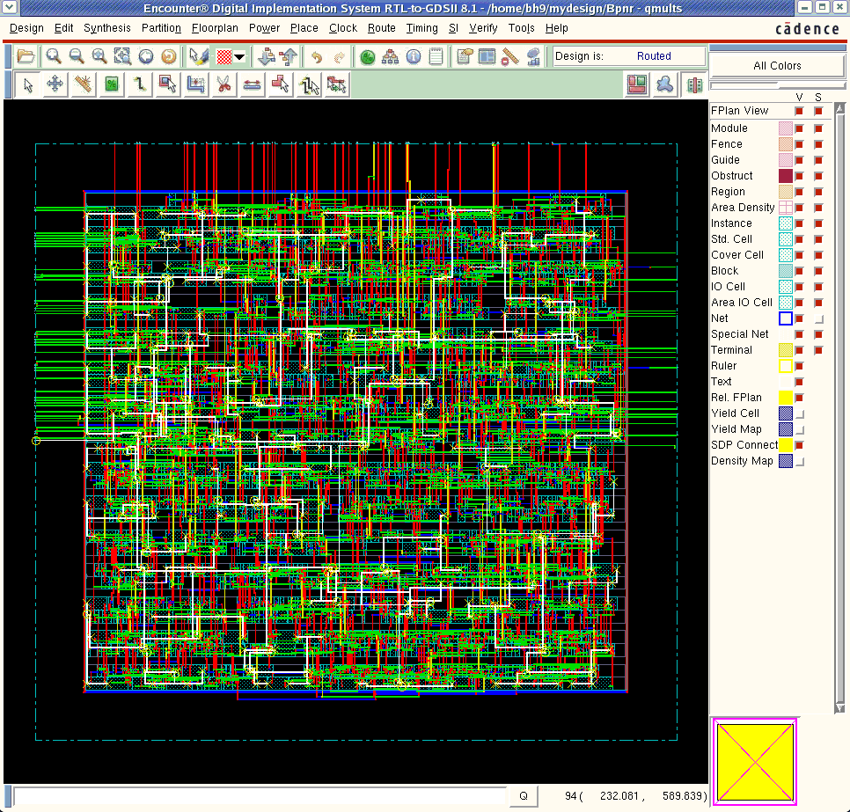
Design View after Routing

Slide 42
P&R Process
Design Setup
Floor Planning
Power Planning
Place
Clock Tree Synthesis
Timing Optimization Post-CTS
Route
Adding Filler
Write Out
Power Routing
Timing Optimization Pre-CTS
Timing Optimization Post-Rout
Design Verification

Slide 43
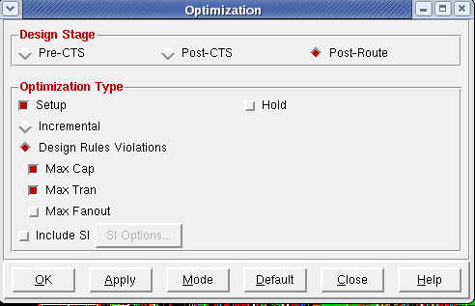
Timing Optimization
Select : Timing > Optimize
In the dialog box select Post-Rout
Select the type of Optimization
Click ok
Notes:
Optimize
Use the Optimization form to make the following improvements to your design:
Reduce path delays
Improve transition times
Correct capacitance violations
Choose Timing - Optimize.
Timing - Optimization Fields and Options
Design Stage
Pre-CTS
Performs timing optimization on placed design before the clock tree is built. By default, repairs DRVs and setup violations for all path groups. If the worst negative slack found during the first optimization pass does not occur on a register-to-register path, the software performs an additional optimization for the register-to-register critical paths.
Default: Selected
Post-CTS
Performs timing optimization after the clock tree is built. By default, repairs DRVs and setup violations for all path groups. If the worst negative slack found during the first optimization pass does not occur on a register-to-register path, the software performs an additional optimization for the register-to-register critical paths. In this mode, if you are running Useful Skew and you have already detail routed the clock, the Encounter software performs ECO routing using the NanoRoute router.
Default: Deselected
Post-Route
Performs timing optimization on routed designs. By default, repairs DRVs and setup violations for all path groups. If the worst negative slack found during the first optimization pass does not occur on a register-to-register path, the software performs an additional optimization for the register-to-register critical paths. In this mode, the software performs ECO routing using the NanoRoute router.
Default: Deselected
Optimization Type
Setup
Corrects setup time violations.
Default: Selected in all modes.
Hold
Corrects hold time violations.
Default: Deselected. Available in Post-CTS and Post-Route modes.
incremental
Performs incremental optimization on all path groups.
Default: Deselected
Design Rules Violations
Specifies the type of design rule violations to correct.
Default: Selected. Unavailable if Incremental is selected, or if Pre-CTS mode and Low effort (on the Mode Setup - Optimization form) are selected.
Max Cap
Corrects maximum capacitance violations in the design based on the threshold specified in the SDC constraints file or in the timing libraries.
Default: Selected. Available only if Design Rule Violations is selected.
Max Tran
Corrects maximum transition violations in the design based on the threshold specified in the SDC constraints file or in the timing libraries.
Default: Selected. Available only if Design Rule Violations is selected.
Max Fanout
Corrects maximum fanout-load violations.
In the library, each cell output pin might have a maxfanout constraint defined, and each input pin might have a fanout_load defined. The Encounter software checks maxfanout against the total fanout_load that the output pin drives in the netlist. A violation exists if the total fanout load exceeds the maxfanout. You can override these limits by specifying new limits in the SDC file.
If maxfanout or fanout_load are not defined in the library, the Encounter software does not perform maximum fanout repair.
Default: Deselected. Available only if Design Rule Violations is selected.
Include SI
Corrects signal integrity violations for designs routed in signal integrity prevention mode.
Default: Deselected. This option is available in Post-Route mode only.
SI Options
Opens the Fix Crosstalk form, enabling you to select options for repairing noise-on-delay and glitch noise violations. This option is available only in Post-Route mode, and only if you select Include SI.

Slide 44
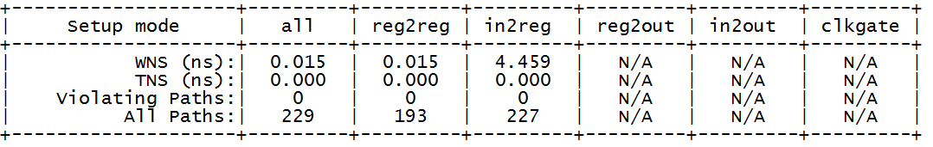
Timing Optimization
You will get a summary of the optimization,
Figure 1 show is an extract for that report that shows
that setup timing constraints are met
Figure 1

Slide 45
P&R Process
Design Setup
Floor Planning
Power Planning
Place
Clock Tree Synthesis
Timing Optimization Post-CTS
Route
Adding Filler
Write Out
Power Routing
Timing Optimization Pre-CTS
Timing Optimization Post-Rout
Design Verification

Slide 46
Filler Cells
You can see gaps between the cells and these need to be filled using filler cells.
These cells are simply standard power and ground router cells to connect the VDD, GND and nwells together
Place >> Physical Cells >> Add Filler
VDD
Well contacts to VDD/VSS by defaults
VSS
Notes:
Filler cells are used to establish the continuity of the N- well and the implant layers
on the standard cell rows, This is one of the Fab constraints, for ease in the generation of the masks.
The software uses filler cells to fill the gaps between standard cell instances. Filler cells also provide decoupling capacitance to complete the power connections in the standard cell rows and extend N-well and P-well regions. The reason to add them as the last placement step is that you cannot run in-place optimization after they are added. After routing, the software checks for DRC violations created by the added filler cells.
To add filler cells, use the Add Filler form or the addFiller command.
Provide a list of filler cells so that at least one filler cell can be used to fill the space without causing DRC violations.
Add Filler recognizes whether a filler cell has implant layer geometries and attempts to add fillers that honor the implant layers' width and spacing rules. By judicious selection of filler cells, the software can correct implant layers' minimum spacing errors by putting in same voltage threshold implant layer fillers in spaces between two same implant layer cells. Add Filler also avoids creating implant layer minimum width errors by abutting fillers of same implant layer as the adjacent cells, thus extending the implant layer width.
Add Filler expects to be provided with cells of all types of implant layers to be able to completely fill the design's core area with fillers. For example, if only a low-voltage implant layer filler is provided, and the abutting logical cell has a high-voltage implant layer, then Add Filler places the provided low-voltage implant filler only if its width satisfies the minimum width rule for that implant layer.
Adding Fillers to MSV Designs
In cases where there are different voltages in the same design, also known as a multi-voltage (MSV) design, you might need to specify the power domain in which the fillers are to be inserted using the -powerDomain parameter of the addFiller command. If this parameter is not specified for MSV designs, the command only inserts default power domain fillers. Any region that does not belong to a specific power domain is assigned to the default power domain.
Deleting Filler Cells
To remove added filler cells, use the Delete Instances form or the deleteFiller command. If you specify an area, the deleteFiller command deletes only filler cells that are completely contained within the area; it does not delete filler cells that cross the area boundary.

Slide 47
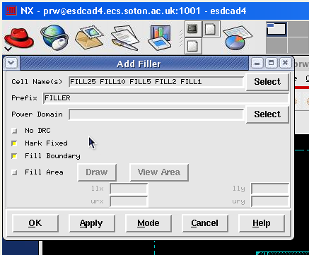
Filler Cells
Select the filler cells from the list as shown
…
Notes:
The order of adding filler cells is important, start from the large to the small

Slide 48
Filler Cells
Example: There is a gap in here

Slide 49
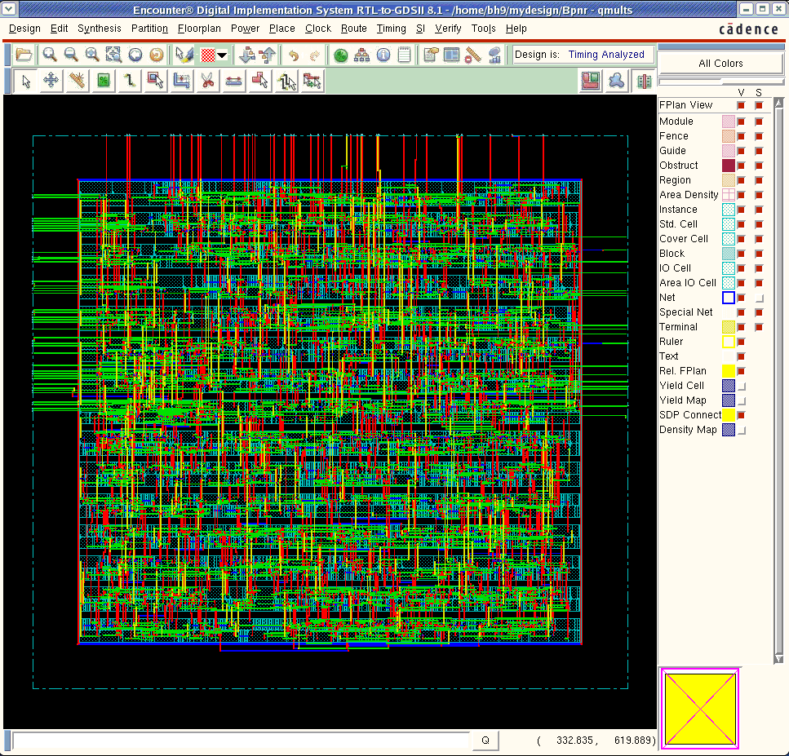
Filler Cells
After adding filler cells, all gaps will be filled
Notes:
Add Filler
Use the Add Filler form to insert filler cell instances between the gaps of standard cell instances. If the design is routed, the software does DRC checks of the filler cells added to the wires in the design. It does not check adjacent cells. This process ensures that adding filler cells is fast enough to be used many times in the design flow.
To resolve adjacent cell DRC violations created by the insertion of filler cells, run Verify Geometry to mark these violations. Then, use Add Filler with No DRC turned off to add more filler cells to replace filler cells that cause violations.
Note: This command resolves only filler-related violations--it cannot resolve net-based violations. To repair net-based violations, reroute the net with violations.
Add Filler recognizes up to five implant layers and attempts to honor implant layer width and spacing rules within each implant layer. If it does not find the correct filler cell to add to an implant layer, it tries to add "no-implant" filler cells. If it cannot add the "no-implant" cells, it inserts a filler cell that is large enough that it does not violate the minimum width rule of the relevant implant layer.
Choose Place - Physical Cells - Add Filler.
Add Filler Fields and Options
Cell Name(s)
Specifies the cell name(s) of the filler cell instance.
Click Select to open a browser to highlight a cell, or cells, from the Selectable Cells List. Clicking Add includes the cell name(s) to the Cells List and Cell Name(s) field. Highlighting a cell or cells in the Cells List and clicking Delete removes the cell name(s) from both areas.
Prefix
Specifies the prefix for the added filler cell instances.
Default: FILLER
Power Domain
Specifies the power domain in which the fillers are to be inserted. If this parameter is not specified, and a list of filler cells is specified with Cell Name(s), the software tries to add fillers to all power domains.
Click Select to open a browser to highlight a cell, or cells, from the Selectable Power Domain List. Clicking Add includes the cell name(s) in the Cells List and Cell Name(s) field. Highlighting a cell or cells in the Cells List and clicking Delete removes the cell name(s) from both areas.
No DRC
Disables postroute DRC violation checking against existing net routing. By default, if filler cells are added after routing, the software checks for DRC violations between regular nets and the filler cells.
Default: Off
Mark Fixed
Marks added fillers as FIXED.
Default: On
Fill Area
Specifies an area to fill. Specify values for the lower left (llx) and upper right (urx) boundaries in the x-direction, and the lower left (lly) and upper right (ury) boundaries in the y-direction.
Use Draw to click and drag a window around the area in the design display area. This will automatically update the values for the boundaries.
Note: If the area is not defined properly, no filler cells are added.

Slide 50
P&R Process
Design Setup
Floor Planning
Power Planning
Place
Clock Tree Synthesis
Timing Optimization Post-CTS
Route
Adding Filler
Write Out
Power Routing
Timing Optimization Pre-CTS
Timing Optimization Post-Rout
Design Verification

Slide 51
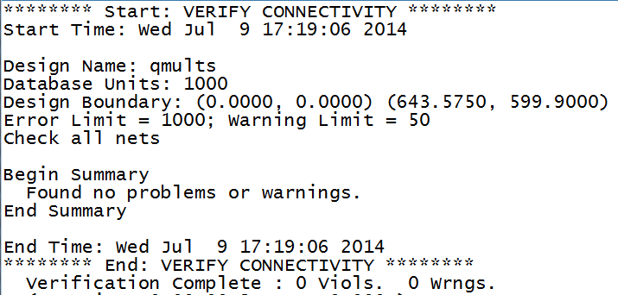
Verification of the Design
Choose Verify – Verify Connectivity to open the form and leave the default settings
  This form allows to detect conditions such as opens, unconnected wires, unconnected pins, loops, partial routing, and unrouted nets.
  You will get a summary of this verification in the shell window (you should have no violations or fails)

Slide 52
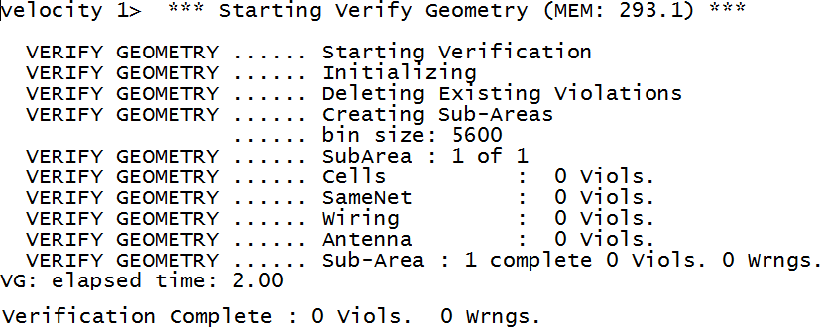
Verification of the Design
Choose Verify – Verify Geometry to open the form and leave the default settings
  This form allows to check the physical layout of the design for DRC violations.
  You will get a summary of this verification in the shell window (you should have no violations or fails)

Slide 53
P&R Process
Design Setup
Floor Planning
Power Planning
Place
Clock Tree Synthesis
Timing Optimization Post-CTS
Route
Adding Filler
Write Out
Power Routing
Timing Optimization Pre-CTS
Timing Optimization Post-Rout
Design Verification

Slide 54
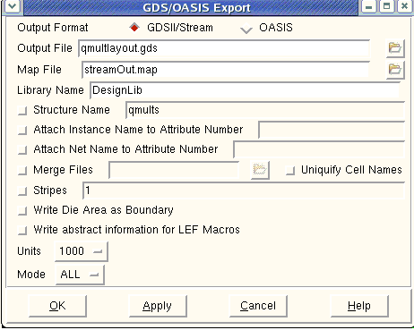
Export out GDS
We can export the GDSII by selecting Design -> Save and choose the GDSII option

Slide 55
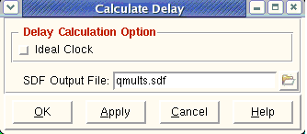
Export Structural Verilog and SDF files
For Verilog: select Design > Save > Netlist
To Export SDF file:
Extract RC delay: select Timing > Extract RC to extract RC timings of interconnects
Generate SDF file: select Timing > Calculate Delay and click ok

Slide 56
Discussion points
What are the main advantages of automated place and route as opposed to manual layout
Assuming you have a hard IP core, at which stage of the place and route flow you should integrate it.
What can you do of the routing fails?
What should you do if you have timing violations after placement?
What will you do if the design is too large to be handled by the place and route tool?
What is the difference between the post synthesis Verilog netlist and the netlist you obtain after place and route?

