Slide 1
Digital Simulation using Xcelium
Shengyu Duan and Terrence Mak
Updated for Xcelium by Iain McNally

Slide 2
Digital Simulations Lab Instructions
For this lab you will need:
A post-layout Verilog net list of the design - obtained from place and route lab (wrap_qmults_final.v)
A Standard Delay Format file of the design - again, from place and route (wrap_qmults_func_max.sdf)
A Verilog testbench - the same as in synthesis lab (wrap_qmults_stim.sv)

Slide 3
Design Directory Management
Inside your design directory create a sub-directory called extracted
Copy the design files into extracted
cp place_and_route/wrap_qmults_final.v extracted/wrap_qmults.v
cp place_and_route/wrap_qmults_func_max.sdf extracted/
cp behavioural/wrap_qmults_stim.sv extracted/
ams_demo
behavioural
gate_level
constraints
synthesis
place_and_route
extracted

Slide 4
Introduction
The simulator we are going to use in this lab is Cadence Xcelium (xmverilog)
Before we run the simulation, there are some modifications you need to make …

Slide 5
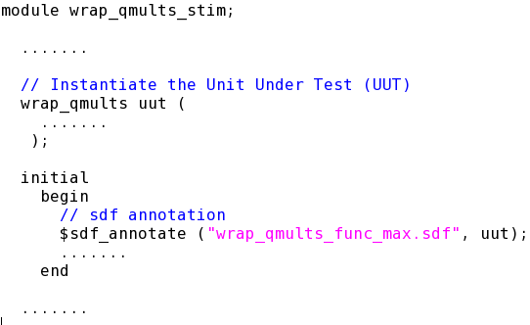
SDF Annotation
In order to simulate your design with correct delays, you need to annotate the .sdf file, in the testbench:
Make sure you annotate the .sdf for the right instance

Slide 6
Timescale
xmverilog expects all modules to have timescales specified (whether or not any delays are used in the module).
For the wrap_qmults.v Verilog file, we must set a default timescale using following xmverilog option:
+xmtimescale+<timeunit>/<timeprecision>

Slide 7
Run Simulation
Now you can simulate your design by following command:
xmverilog +naccess+r +xmtimescale+1ns/10ps -f /opt/cad/designkits/ams/v410/verilog/c35b4/verilogin.inc wrap_qmults_stim.sv wrap_qmults_final.v
The circuit under test is a multiplier. Thus the functionality can be easily verified by observing the waves.
Notes:
The clock tree specification file defines the clocks in the design that you want to synthesize. If a design contains several clocks, you can specify any of these clocks in the clock tree specification file, and those clocks will be synthesized during a single CTS run. You can also synthesize an individual clock tree separatelusing its own clock tree specification file.
Timing constraints must be loaded into the Encounter session before using this form.
Choose Clock - Design Clock, and click the Gen Spec... button.
Fields and Options
Cells List
Specifies the list of buffer and inverter cells to use during automatic, gated clock tree synthesis.
Selected Cells
Lists the available buffer and inverter cells that you can choose to use.
To add a cell to the Cells List window, highlight the cell name in the Selected Cells window, and click the Add button.
To delete a cell from the Cells List window, hightlight the cell name in the Cells List window and click the Delete button.
Output Specification File
Specifies the name of the clock tree specification file to be created.
Default: Clock.ctstch

