Slide 1
Principles CMOS Cell Design and Characterization
Dr Basel Halak

Slide 2
Learning Outcomes
At the end of this lecture you should be able to:
Describe the principles of field effect transistors
Describe the principles of CMOS technology
Measure and optimise the performance of CMOS combinational gates
Measure setup and hold times of CMOS sequential elements

Slide 3
Learning Outcomes
At the end of this lecture you should be able to:
Describe the principles of field effect transistors
Describe the principles of CMOS technology
Measure and optimise the performance of CMOS combinational gates
Measure setup and hold times of CMOS sequential elements

Slide 4
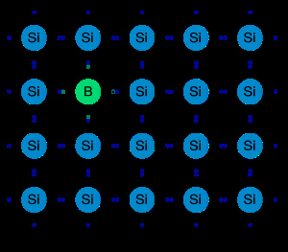
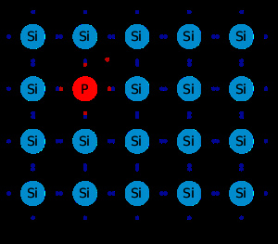
Semiconductor Conductivity Principle
p-type Semiconductor
(e.g. boron or aluminium))
n-type Semiconductor
(e.g. phosphorus)
Notes:
In electronics, a transistor is a semiconductor device commonly used to amplify or switch electronic signals and is the fundamental building block of modern electronic devices, and is used in radio, telephone, computer and other electronic systems. The transistor is considered by many to be the greatest invention of the twentieth-century, or as one of the greatest. It is the key active component in practically all modern electronics [1-2].
In this web-page we will focus on the understanding of several types of electronic devices , such as P- junctions, MOSFETs (metal–oxide–semiconductor field-effect transistors), HEMTs (High Electron Mobility Transistors), after first defining some fundamental processes that take place in doped P- and N-semiconductors. For further information on baseline principles of metal-semiconductor interfaces you could check work done by Dharma [3].
1.2 P- and N-doped semiconductors-How are they formed?
A P-type semiconductor is obtained by carrying out a process of doping, that is adding a certain type of atoms to the semiconductor in order to increase the number of free charge carriers (in this case positive). When the doping material is added, it takes away (accepts) weakly-bound outer electrons from the semiconductor atoms. This type of doping agent is also known as acceptor material and the semiconductor atoms that have lost an electron are known as holes ; the purpose of p-type doping is to create an abundance of holes.
Similarly, an N-type semiconductor is obtained by carrying out a process of doping, that is, by adding an impurity of valence-five elements to a valence-four semiconductor in order to increase the number of free charge carriers (in this case negative).When the doping material is added, it gives away (donates) weakly-bound outer electrons to the semiconductor atoms. This type of doping agent is also known as donor material since it gives away some of its electrons. The purpose of n-type doping is to produce an abundance of mobile or "carrier" electrons in the material.

Slide 5
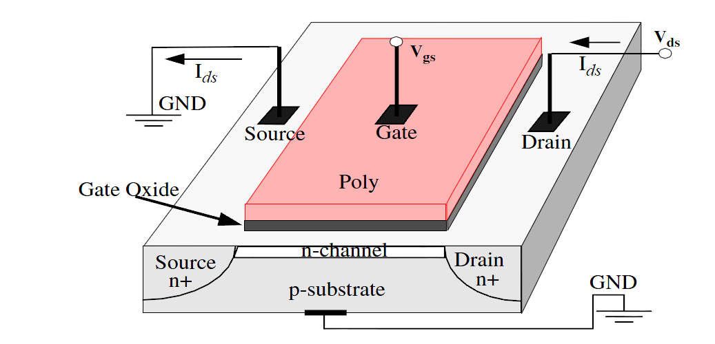
Operation Principles of MOSFET Transistor
MOSFETs (metal–oxide–semiconductor field-effect transistors)
n-type MOS: Majority carriers are electrons.
p-type MOS: Majority carriers are holes.
n-type MOS

Slide 6
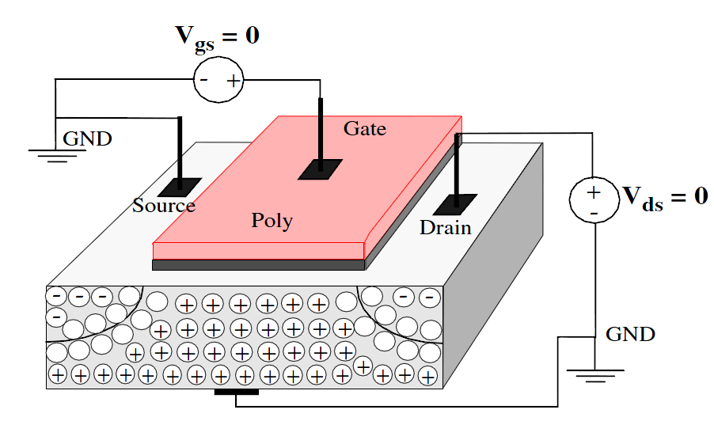
Operation Principles of MOSFET Transistor

Slide 7
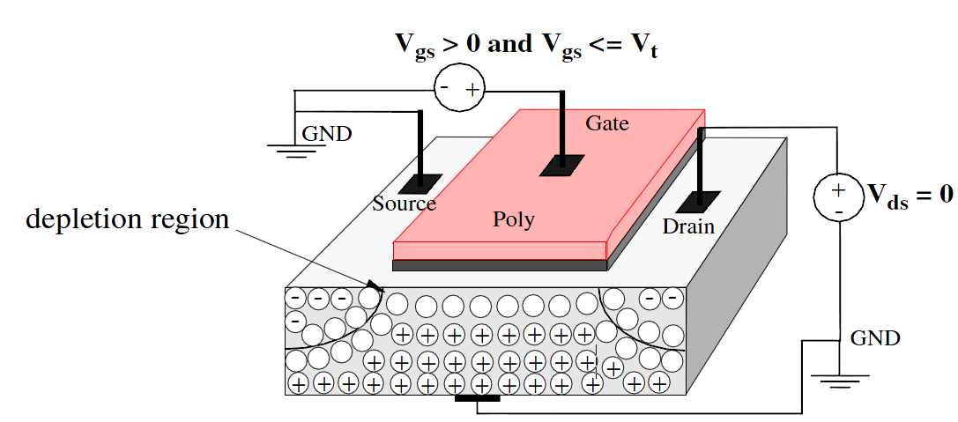
Operation Principles of MOSFET Transistor
Notes:
normal operation, a positive voltage applied between source and drain
(Vds).
No current flows between source and drain (Ids = 0) with Vgs = 0 because of
back to back pn junctions.
For n-MOS, with Vgs > Vtn, electric fi eld attracts electrons creating channel.
Channel is p-type silicon which is inverted to n-type by the electrons
attracted by the electric fi eld.

Slide 8
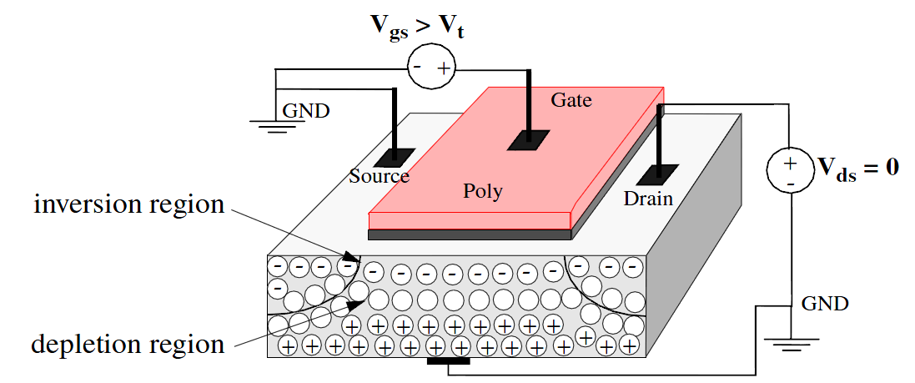
Operation Principles of MOSFET Transistor
Notes:
Threshold Voltage
Vt is also an important parameter. What effects its value?
Most are related to the material properties. In other words, Vt is largely determined
at the time of fabrication, rather than by circuit conditions, like Ids.
For example, material parameters that effect Vt include:
The gate conductor material (poly vs. metal).
The gate insulation material (SiO2).
The thickness of the gate material.
The channel doping concentration.
However, Vt is also dependent on
Vsb (the voltage between source and substrate), which is normally 0 in digital
devices.
Temperature: changes by -2mV/degree C for low substrate doping levels

Slide 9
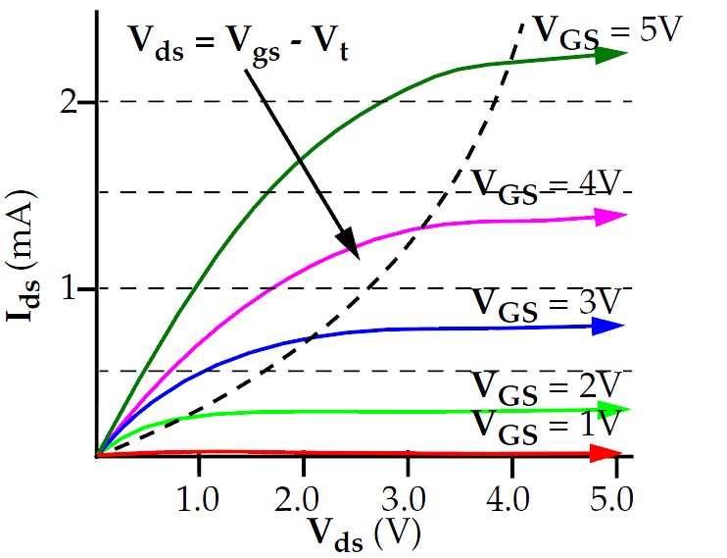
Operation Principles of MOSFET Transistor

Slide 10
Learning Outcomes
At the end of this lecture you should be able to:
Describe the principles of field effect transistors
Describe the principles of CMOS technology
Measure and optimise the performance of CMOS combinational gates
Measure setup and hold times of CMOS sequential elements

Slide 11
What is Static CMOS?
Complementary metal–oxide–semiconductor (a.k.a. static CMOS)
 | Pull-up OFF | Pull-up ON
Pull-down OFF | Z (float) | 1
Pull-down ON | 0 | X (crowbar)

Slide 12
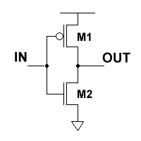
Conduction Complement
Complementary CMOS gates always produce 0 or 1
CMOS Inverter

Slide 13
NMOS Transistors in Series/Parallel Connection
    Transistors can be thought as a switch controlled by its gate signal
    NMOS switch closes when switch control input is high

Slide 14
PMOS Transistors in Series/Parallel Connection

Slide 15
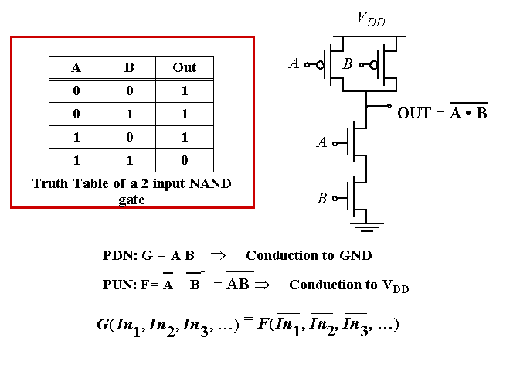
Example Gate: NAND

Slide 16
CMOS Properties
Full rail-to-rail swing; high noise margins
Logic levels not dependent upon the relative device sizes;
Always a path to Vdd or Gnd in steady state; low output impedance
Extremely high input resistance; nearly zero steady-state input current
No direct path steady state between power and ground; no leakage power dissipation (this is not true in modern technologies).
Propagation delay function of load capacitance and resistance of transistors

Slide 17
Learning Outcomes
At the end of this lecture you should be able to:
Describe the principles of field effect transistors
Describe the principles of CMOS technology
Measure and optimise the performance of CMOS combinational gates
Measure setup and hold times of CMOS sequential elements

Slide 18
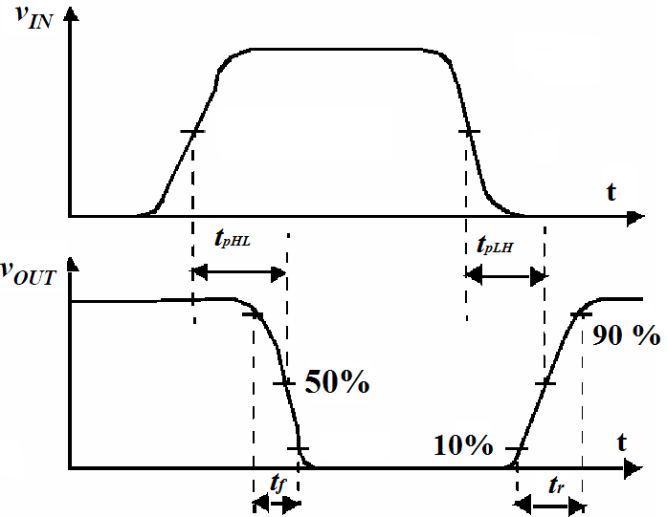
Propagation Delay Calculations
When an input signal of a logic gate is changed, there is a propagation delay before the output of the logic gate changes. This is due to capacitive loading at the output.
The propagation delay is measured between the 50% transition points of the input and output signals.

Slide 19
Propagation Delay Calculations
When an input signal of a logic gate is changed, there is a propagation delay before the output of the logic gate changes. This is due to capacitive loading at the output.
The propagation delay is measured between the 50% transition points of the input and output signals.
V
DD
V
DD
R
p
V
out
V
out
C
L
C
L
R
n
V
in
5
0
V
in
5
V
DD
(a) Low-to-high
(b) High-to-low
t
pHL
= 0.69(R
n
.C
L
)
t
pLH
= 0.69(R
p
.C
L
)
t_{p} = (t_{pHL} +t_{pLH})/2

Slide 20
Logic Gate Output Capacitance
The output capacitance of a logic gate is
comprised of several components:
Intrinsic capacitances: mainly pn-junction and gate-drain capacitance (both NMOS and PMOS transistors).
Extrinsic capacitances:
capacitance of connecting wires
input capacitances of the fan-out gates

Slide 21
Fan-in and Fan-out
M
N
Fan-out N
Fan-in M

Slide 22
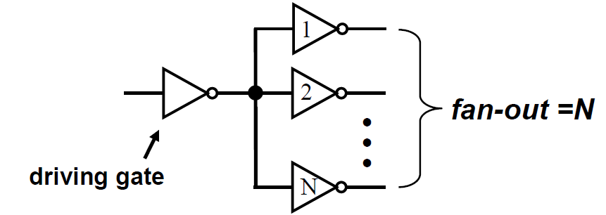
FanOut
The fan-out is the number of identical logic gates that are connected to the output of the driving gate
The input capacitances of the driven gates sum, and must be charged through the equivalent resistance of the driver
Fan-out leads to increased capacitive load on the driving gate, and therefore longer propagation delay
Notes:
(it is assumed the driving gate have the same size as the driven gates).

Slide 23
t_{p} as a Function of Fan-Out
All gates have the same drive current.
t_{p}NOR2
t_{p}NAND2
t_{p}INV
t_{p} (psec)
Slope is a function of “driving strength”
eff. fan-out
Notes:
slope is a function of the driving strength

Slide 24
Fan-In Considerations
A
B
C
D
A
C_{L}
Distributed RC model
(Elmore delay)
t_{pHL} = 0.69 R_{eqn}(C₁+2C₂+3C₃+4C_{L})
Propagation delay deteriorates rapidly as a function of fan-in – quadratically in the worst case.
B
C₃
C
C₂
D
C₁
Notes:
While output capacitance makes full swing transition (from VDD to 0), internal nodes only transition from VDD-VTn to GND
C1, C2, C3 on the order of 0.85 fF for W/L of 0.5/0.25 NMOS and 0.375/0.25 PMOS
CL of 3.2 fF with no output load (all diffusion capacitance – intrinsic capacitance of the gate itself).
To give a 80.3 psec tpHL (simulated as 86 psec)

Slide 25
t_{p} as a Function of Fan-In
quadratic
t_{p} (psec)
t_{pHL}
t_{p}
t_{pLH}
linear
fan-in
Propagation delay of CMOS NAND gate as a function of fan-in.
Gates with a fan-in greater than 4 should be avoided.
Notes:
Fixed fan-out (NMOS 0.5 micrcon, PMOS 1.5 micron)
tpLH increases linearly due to the linearly increasing value of the diffusion capacitance
tpHL increase quadratically due to the simultaneous incrase in pull-down resistance and internal capacitance

Slide 26
t_{p} as a Function of Fan-In and Fan-Out
Fan-in: quadratic due to increasing resistance and capacitance
Fan-out: each additional fan-out gate adds two gate capacitances to C_{L}
t_{p} = a₁FI + a₂FI² + a₃FO
Notes:
a1 term is for parallel chain, a2 term is for serial chain, a3 is fan-out

Slide 27
Delay as a function of V_{DD}

Slide 28
How to Minimise Propagation Delay
Reduce the the output capacitance
Minimize the area of drain pn junctions.
Lay out devices to minimize interconnect capacitance.
Avoid large fan-out.
2. Decrease the equivalent resistance of the transistors
Decrease L
Increase W (but this increases pn junction area and hence the output capacitance
3. Increase VDD
Better performance but more power consumption

Slide 29
How to Minimise Propagation Delay
Use alternative logic structures for complex functions
Example:
F = ABCDEFGH
Notes:
Reduced fan-in -> deeper logic depth
Reduction in fan-in offsets, by far, the extra delay incurred by the NOR gate (second configuration).
Only simulation will tell which of the last two configurations is faster, lower power

Slide 30
How to Minimise Propagation Delay
Isolate fan-in from fan-out using buffer insertion
C_{L}
C_{L}
Notes:
Reduce CL on large fan-in gates, especially for large CL, and size the inverters progressively to handle the CL more effectively

Slide 31
Learning Outcomes
At the end of this lecture you should be able to:
Describe the principles of field effect transistors
Describe the principles of CMOS technology
Measure and optimise the performance of CMOS combinational gates
Measure setup and hold times of CMOS sequential elements

Slide 32
Combinational vs. Sequential Logic
Combinational
Sequential
Output =
(
)
Output =
(
)
f
In, Previous In
f
In

Slide 33
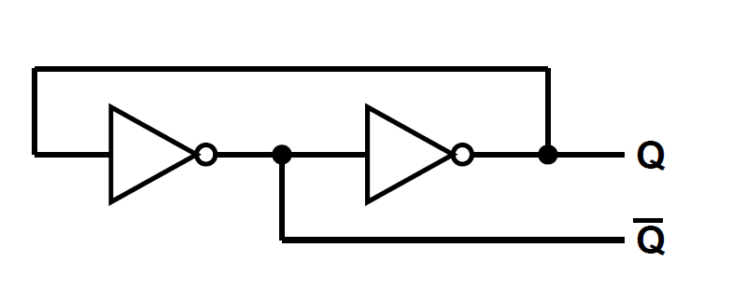
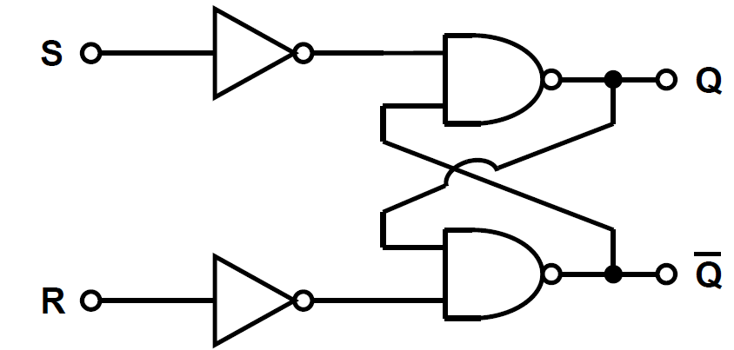
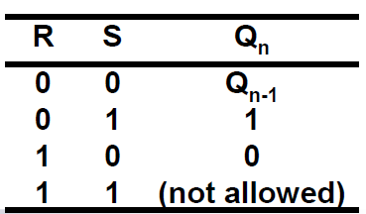
Latches
One of the basic building blocks for sequential circuits is the latches: 2 stable operating states stores 1 bit.
A simple latch can be constructed using two inverters (figure 1).
S-R latch are commonly used (figures 2 and 3)
Figure 1: A simple Latch
Figure 2: S-R Latch Structure
Figure 2: S-R Latch Truth Table

Slide 34
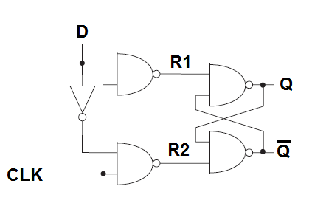
Operation of D Latch

Slide 35
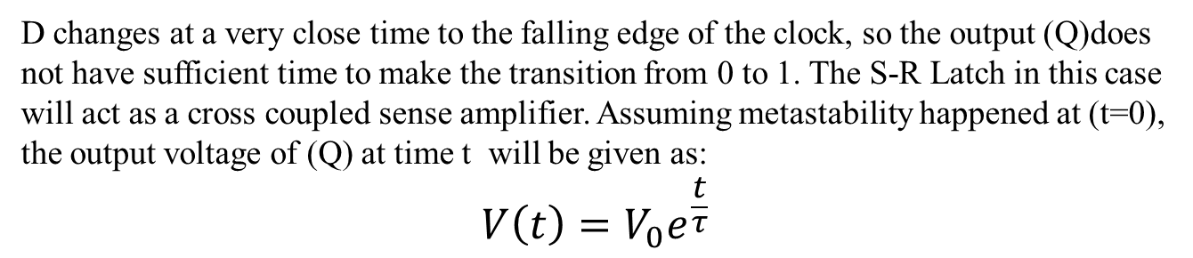
What happens if data change too closely to the Clock’s edge
Example of a Synchronization Failure
D changes at a very close time to the falling edge of the clock, so the output (Q)does not have sufficient time to make the transition from 0 to 1. The S-R Latch in this case will act as a cross coupled sense amplifier. Assuming metastability happened at (t=0), the output voltage of (Q) at time t will be given as:
$$V\left(t\right)=V_{0}e^{\frac{t}{τ}}$$
Notes:
Vo is the output voltage when the metastability happened
Tqw is a time constants detirmined by the capacitance and conductance and the gain of the transistors hence, it is technology dependent
Twa is also affected bt process variations, low supply voltage, extremely low of high tempreture

Slide 36
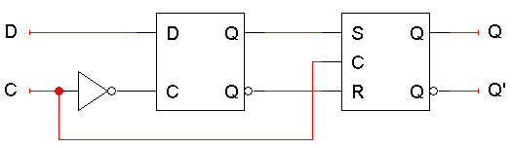
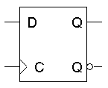
Edge Triggering: Positive Edge D Flip Flop
  The flip-flop output Q changes only after the positive edge of C.
  The change is based on the flip-flop input values that were present right at the positive edge of the clock signal. The D flip-flop’s behavior is similar to that of a D latch except for the positive edge-triggered nature, which is not explicit in this table
D Flip Flop

Slide 37
Flip-Flop Based Synchronous Design
Q becomes D after clock edge
Timing Constraint: The data applied to the D flip-flop should be stable for at least T_{setup} and should stay stable for at least T_{hold}
Setup time (T_{setup}):is the minimum amount of time the data should be stable before the application of the clock signal
Hold time(T_{hold}):is the minimum amount of time the data should be stable after the application of the clock signal
CLK
t
t
su
t
hold
D
Q
D
DATA
CLK
STABLE
t
t
c
2
q
Q
DATA
STABLE
t
Notes:
Data can not change no later than this point before the clock edge.
Hold time:
Data can not change during this time after the clock edge.
t_clock-Q
Delay on output (Q) changing from positive clock edge
I should mentioned here that we can

Slide 38
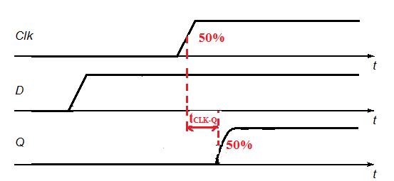
D Flip Flop Propagation Delay
To measure the for the propagation delay, the inputs must transition at least one setup time before the rising edge of the clock and the delay is measured from the 50% point of the CLK edge to the 50% point of the Q output.

Slide 39
How to measure setup time
To obtain the set-up time of the register using simulations , we progressively skew the input with respect to the clock edge until the circuit fails.

Slide 40
How to measure hold time
To obtain the hold time can be simulated. The D input edge is once again skewed relative to the clock signal till the circuit stop functioning. This will also lead to a rise in the propagation delay.

