Slide 1
A Breakneck Introduction to the Industrial Revolution
Most stuff comes out of mines.. But they tend to flood…. We need to invent the handpump…
We’ve potentially solved the problem of what to use Arts Graduates for….
https://www.youtube.com/watch?v=UmZYQ5I0CDU

Slide 2
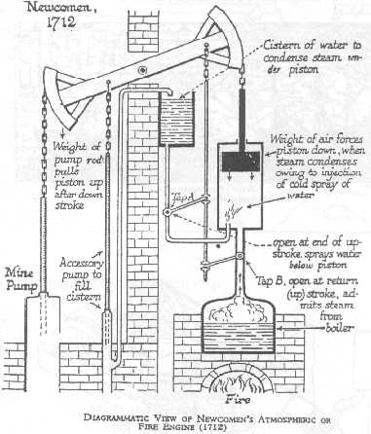
Except it turns out that arts graduates need to eat and are therefore expensive… so we invent the steam engine
P
V
The boiler generates super heated air…. That we release into the space below the piston…

Slide 3
Except it turns out that arts graduates need to eat and are therefore expensive… so we invent the steam engine
P
V
The hot air expands (basically at constant T so P ~ 1/V) and pushes the piston up…

Slide 4
Except it turns out that arts graduates need to eat and are therefore expensive… so we invent the steam engine
P
V
We inject cold water into the piston, cooling the air and dropping the pressure…

Slide 5
Except it turns out that arts graduates need to eat and are therefore expensive… so we invent the steam engine
P
V
Now the piston falls under its own weight (gravity does the work)…

Slide 6
Except it turns out that arts graduates need to eat and are therefore expensive… so we invent the steam engine
P
work
V
We’ve done work by moving the top beam which is attached to the pump…
We have done one cycle and are ready to go again…

Slide 7
Except it turns out that arts graduates need to eat and are therefore expensive… so we invent the steam engine
P
work
V
Clever rods automatically open the valve to let steam in and start the next cycle….
The arts graduate problem remains…

Slide 8
https://www.youtube.com/watch?v=fsXpaPSVasQ

Slide 9
https://www.youtube.com/watch?v=9mhYnQGZJuM

Slide 10
Take away messages
People made engines that do work using energy flowing from a hot source to a cold sink…
Engineers can make some nifty gadgets with sticks… they used a variety of designs and materials and they wondered what the best material and design was… Carnot idealized the engines and showed these questions are not the deep point…
No Arts Graduate were made to work in the making of this slide show…

