Slide 1
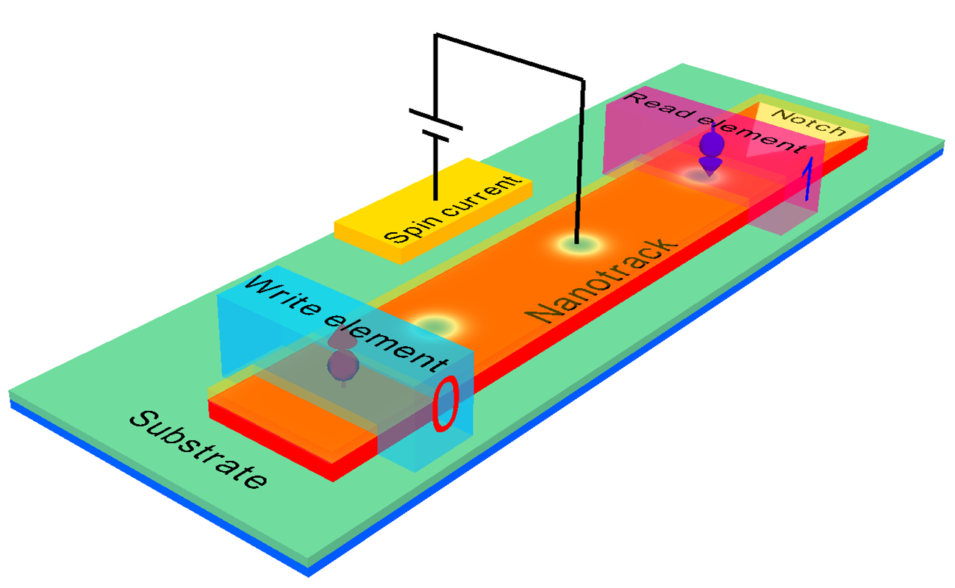
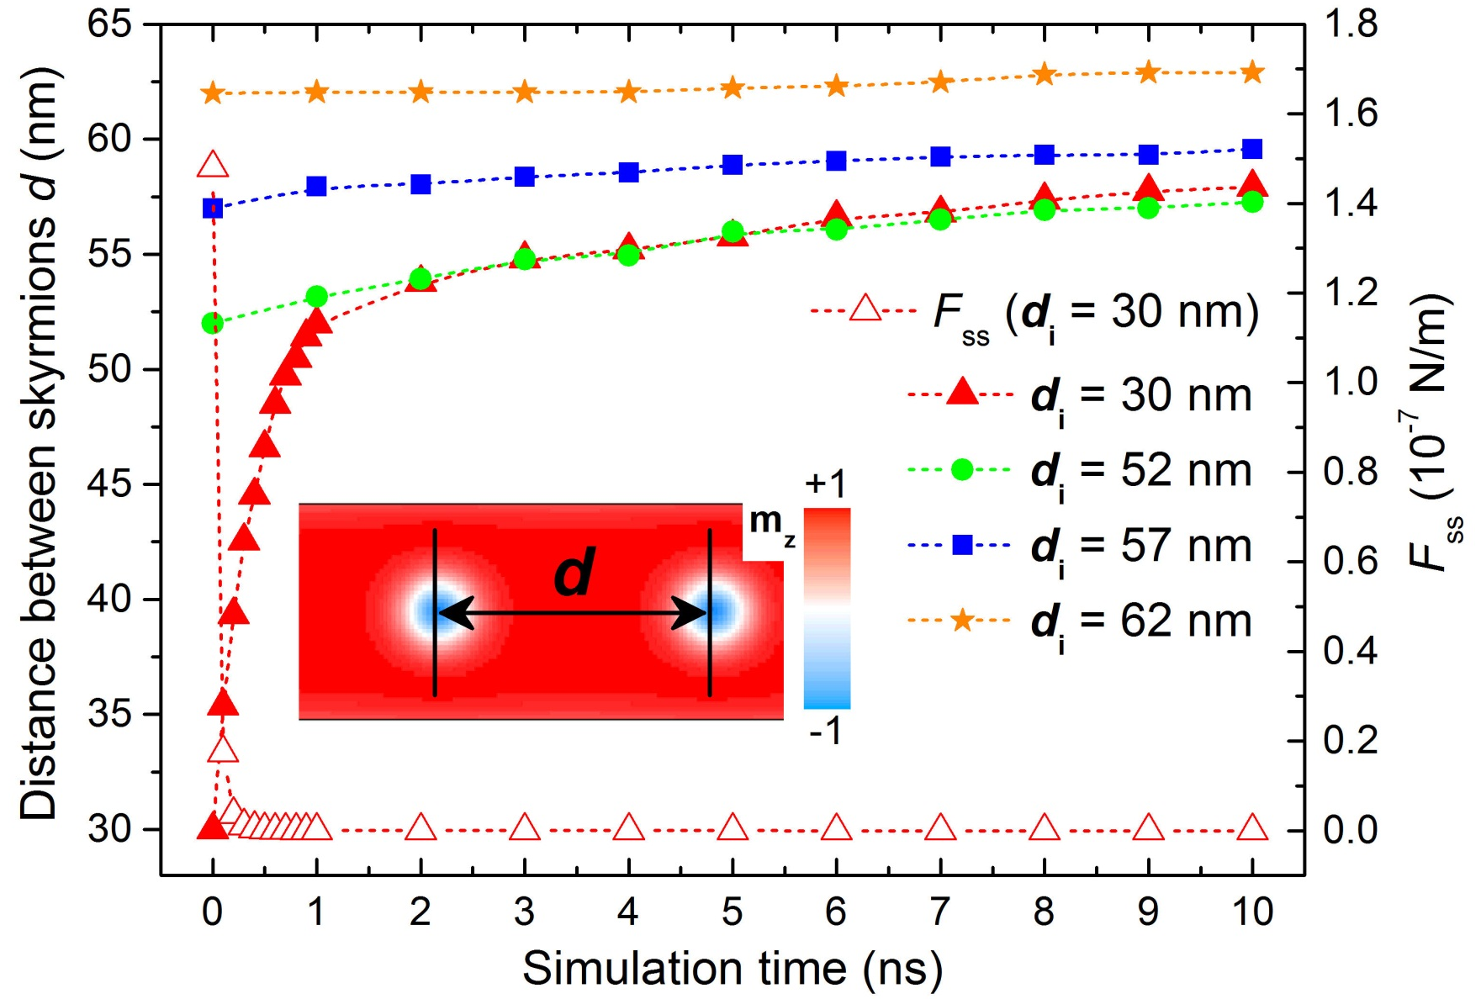
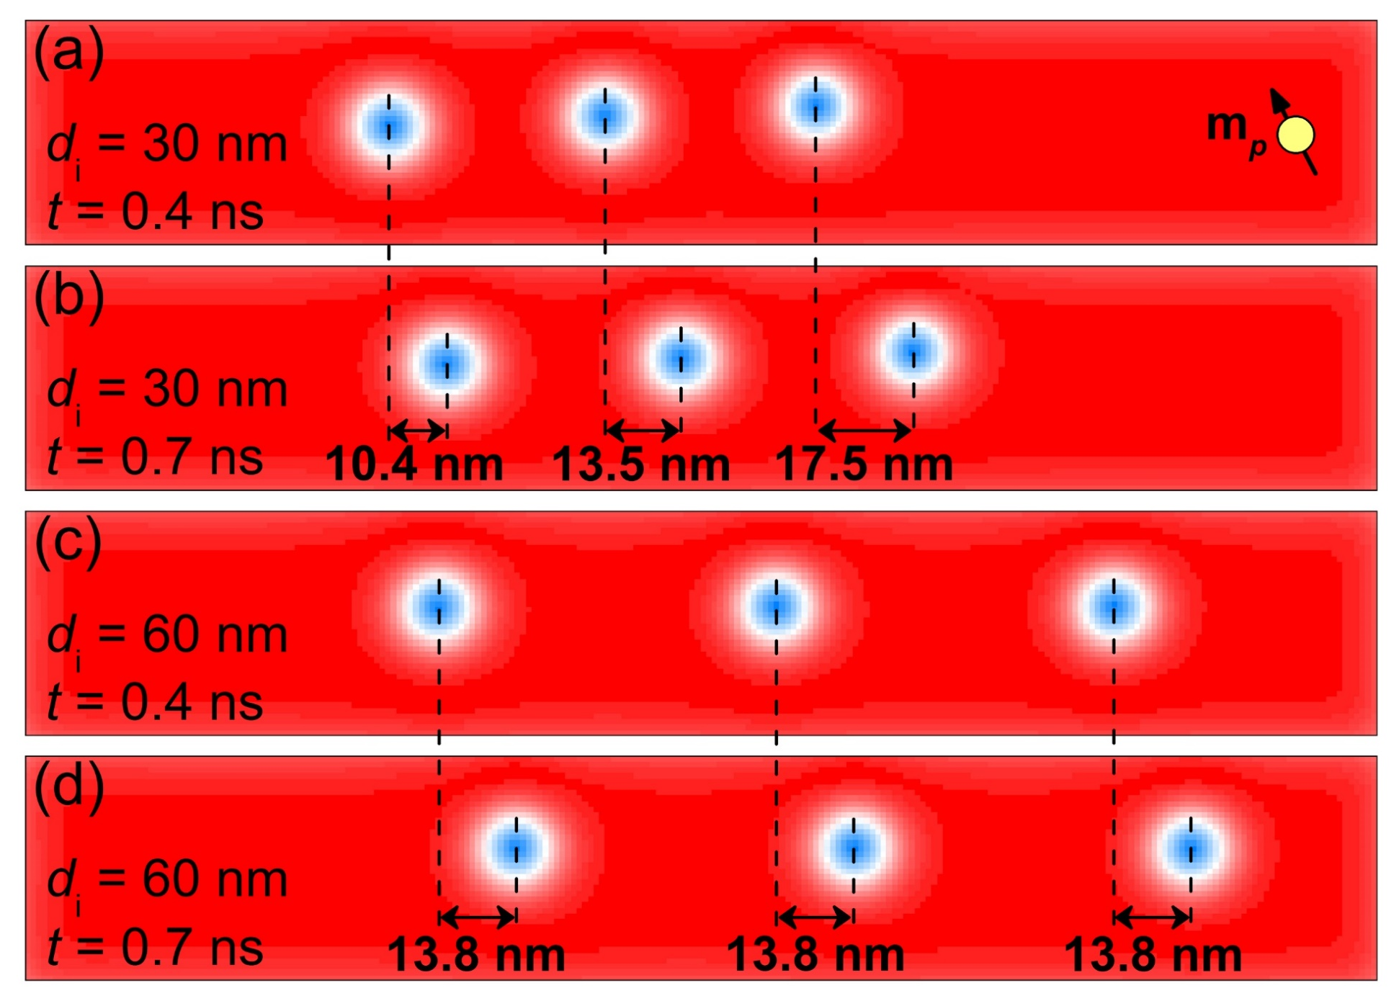
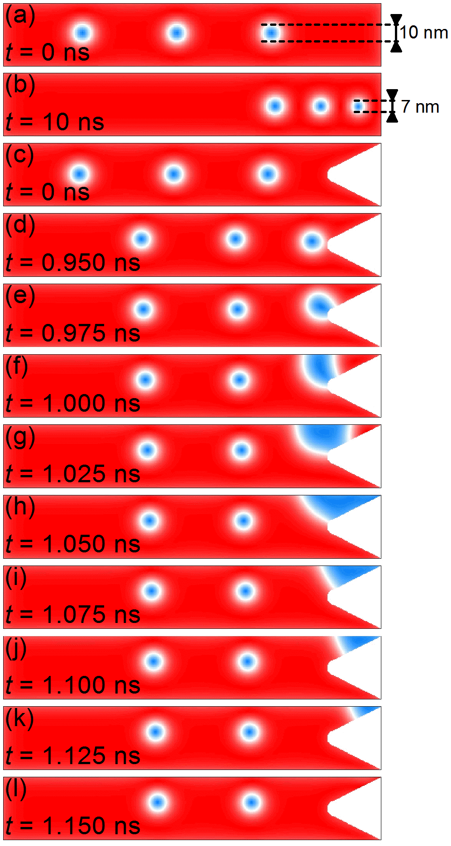
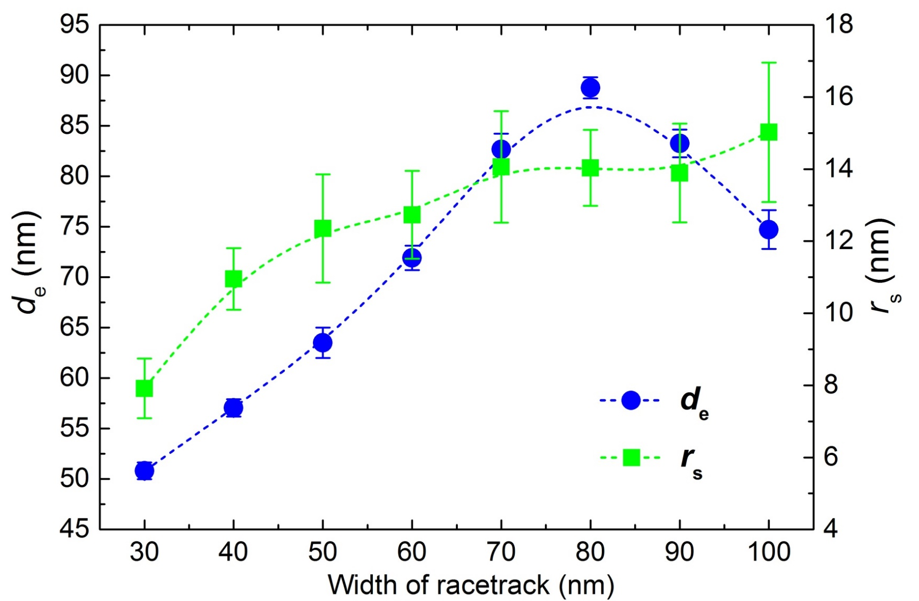
Skyrmion-skyrmion and skyrmion-edge repulsions in
skyrmion-based racetrack memory
Xichao Zhang¹, G. P. Zhao^{1, 2, *}, Hans Fangohr³, J. Ping Liu^{2, 4}, W. X. Xia², J. Xia¹, F. J. Morvan¹
Download Me
1. College of Physics and Electronic Engineering, Sichuan Normal University, Chengdu 610068, China
2. Key Laboratory of Magnetic Materials and Devices, Ningbo Institute of Material Technology & Engineering, Chinese Academy of Sciences, Ningbo 315201, China
3. Engineering and the Environment, University of Southampton, Southampton SO17 1BJ, United Kingdom
4. Department of Physics, University of Texas at Arlington, Arlington, Texas 76019, USA
Skyrmion-based racetrack memory
Skyrmion-based racetrack memory storage device moves the skyrmions along the racetrack in one direction only. The reading element can be positioned at one end of the racetrack. The skyrmions are annihilated upon moving them across the reading element but their corresponding information is read into one or more memory devices (e.g., built-in CMOS circuits).
We study the reliable and practicable spacing between consecutive skyrmionic bits on the racetrack that are driven by vertically injected spin-polarized currents, and demonstrate the ability to adjust that spacing. Skyrmionic bits are found to squeeze together at the end of the racetrack. We therefore propose a technological solution to address this problem and demonstrate that the end of the racetrack can be designed with notch-tip to ensure that the skyrmionic bits moving beyond the reading element can easily exit from the racetrack at low current density (~ 10¹⁰ A/m²).
The micromagnetic simulations are performed using the software package OOMMF including the extension module of the Dzyaloshinskii-Moriya interaction (DMI). The motion of skyrmionic bits is simulated in 0.4-nm-thick cobalt racetracks with width of 30 ~ 100 nm and length of 200 ~ 800 nm. The parameters are adopted from Ref. [Nature Nanotechnology 8, 839–844 (2013)].
Figure 1. Schematic of typical vertical-current-driven horizontal skyrmion-based racetrack memory.
Spacing between consecutive skyrmionic bits
Motion of skyrmionic bit chain
As the initial spacing d_{i} is small, the skyrmions separation distance d increases rapidly due to the repulsion between the skyrmions. At the same time, the size of skyrmion r_{s} increases.
For d_{i} > L_{D} (4πA/|D|), d keeps a nearly constant due to the exponentially decaying interaction between skyrmions, which means that L_{D} would be an ideal initial spacing for writing consecutive skyrmion bits.
For d_{i} = 30 nm, the spacing increases to d_{e} due to the skyrmion-skyrmion repulsion, leading to the different velocities. From t = 0.4 ns to t = 0.7 ns, the right skyrmionic bit moves 17.5 nm (v = 58 m/s) while the left skyrmionic bit only moves 10.4 nm (v = 35 m/s).
For d_{i} = 60 nm, as shown in Fig. 5 c-d, within the same time frame, both skyrmionic bits move 13.8 nm with a steady velocity of 46 m/s.
Figure 2. Distance d and repulsive force F_{ss} between two skyrmions on the racetrack as functions of the simulation time.
Figure 5. Vertical-current-driven motion of a skyrmionic bit chain with initial spacing of 30 nm on the 40-nm-wide racetrack at (a) t = 0.4 ns, (b) t = 0.7 ns, and motion of a chain with initial spacing of 60 nm at (c) t = 0.4 ns, (d) t = 0.7 ns.
d_{i}: the initial spacing between the two skyrmions
F_{ss}: the repulsive force between two skyrmions
Spacing versus applied field, anisotropy and racetrack width
Elimination of skyrmionic bits
Figure 3. Effect of different (a) applied fields and (b) perpendicular magnetic anisotropies (PMA) on the equilibrium spacing de between consecutive skyrmions and equilibrium skyrmion size r_{s} on 40-nm-wide racetrack.
Applied field perpendicular to the plane and opposite to the direction of the magnetization in the core of skyrmions (i.e. positive values) can marginally reduce the relaxed skyrmion size r_{s} as well as the equilibrium skyrmion distance d_{e.}
d_{e} and relaxed r_{s} decrease approximately linearly with increasing PMA.
Figure 6. Vertical-current-driven motion of a skyrmionic bit chain
at the end of the racetrack
For the racetrack without any notch (Fig. 6 a-b), the skyrmionic bit chain gets clogged at the end of the racetrack and the size of skyrmions will reduce, which is caused by the repulsions between skyrmions and edges as well as the repulsions between skyrmions and skyrmions. Figure 6 d-l show the process of the annihilation of a skyrmion within 0.2 ns, where the skyrmionic bit is firstly attracted by the tilts of magnetization around the notch-tip, then evolves to a domain wall pair when touching the notch edge and is eventually cleared away by the currents. In this process (j = ~10¹⁰ A/m²), the skyrmionic bit chain is not compressed at the end of the racetrack, in which all skyrmions move together coherently.
d_{e} rapidly goes up from ~ 50 nm to ~ 90 nm with the width increasing from 30 nm to 80 nm, then decreases to 75 nm when the width continually increases to 100 nm.
When the width of the racetrack is smaller than a certain threshold (~ 20 nm in our simulation), the skyrmionic bits are not stable on the racetrack, which may quickly evolve to domain walls.
Conclusion
Figure 4. Skyrmion size r_{s} and equilibrium spacing between consecutive bits de as a function of racetrack width.
The reliable and practicable spacing between consecutive skyrmionic bits on skyrmion-based racetrack memory has been studied, which is important for the writing process, reading process and storage density. We have tested that the reliable and practicable spacing can be adjusted in a limited range by tuning the perpendicular anisotropy and/or applying an external magnetic field perpendicular to the racetrack plane. We conclude that the notch-tip is a practical way to assist skyrmionic bits moving beyond the reading element to exit from the racetrack easily. Our results are relevant to the fundamental understanding of magnetic skyrmions, and more practically, to the application of magnetic skyrmions in memory technology.
How to cite this work
Zhang, X. C. et al. Skyrmion-skyrmion and skyrmion-edge repulsions in skyrmion-based racetrack memory. Sci. Rep. 5, 7643; DOI:10.1038/srep07643 (2015).
*Correspondence E-mail: zhaogp@uestc.edu.cn
G. P. Zhao thanks the support by NSFC (Grant No. 11074179 and No. 10747007), the Construction Plan for Scientific Research Innovation Teams of Universities in Sichuan (No. 12TD008), and SSRIP of SICNU.

